Slide 1

19 Style
Peter H. Chen

Slide 2
19 Style
https://www.tutorialspoint.com/jasper_reports/index.htm
This chapter discusses the Style.
Design Phase
(Create JRXML File)
Execute Phase
[Fill Jasper Template with Data to Generate Jasper Print File (xxx.jrprint)]
Compile Phase
(Compile JRXML to Jasper Template)
Export Phase
[Export the Report to Any Specified Format]

Slide 3
19 Style
https://www.tutorialspoint.com/jasper_reports/index.htm
JasperReports has a feature <style> which helps to control text properties in a report template.
This element is a collection of style settings declared at the report level.
Properties like foreground color, background color, whether the font is bold, italic, or normal, the font size, a border for the font, and many other attributes are controlled by <style> element.
Styles can extend other styles, and add to, or override properties of the parent style as well.

Slide 4
19 Style
https://www.tutorialspoint.com/jasper_reports/index.htm
Style Properties (1)
A <style> element has many attributes. Some of the most commonly used are listed in the table given below:
S. NO | Attribute and Description
1 | name Is mandatory. It must be unique because it references the corresponding report style throughout the report.
2 | isDefault Indicates whether this style is the document's default style.
3 | style Is a reference to the parent style.
4 | mode Specifies the element's transparency. Possible values are Opaqueand Transparent.

Slide 5
19 Style
https://www.tutorialspoint.com/jasper_reports/index.htm
Style Properties (2)
A <style> element has many attributes. Some of the most commonly used are listed in the table given below:
S. NO | Attribute and Description
5 | forecolor Is the foreground color of object.
6 | backcolor Is the background color of object.
7 | fill Determines the fill pattern used to fill the object. At the moment, the single value allowed is Solid.
8 | radius Specifies the radius of the rectangle's corner arc.

Slide 6
19 Style
https://www.tutorialspoint.com/jasper_reports/index.htm
Style Properties (3)
A <style> element has many attributes. Some of the most commonly used are listed in the table given below:
S. NO | Attribute and Description
9 | scaleImage Specifies scale for the images only. Possible values: Clip, FillFrame, RetainShape, RealHeight, and RealSize.
10 | hAlign Specifies the horizontal alignment. Possible values: Left, Center, Right, and Justified.
11 | vAlign Specifies the vertical alignment. Possible values: Top, Middle, and Bottom.
12 | rotation Specifies the element's rotation. Possible values: None, Left, Right,and UpsideDown.

Slide 7
19 Style
https://www.tutorialspoint.com/jasper_reports/index.htm
Style Properties (4)
A <style> element has many attributes. Some of the most commonly used are listed in the table given below:
S. NO | Attribute and Description
13 | lineSpacing Specifies the line spacing between lines of text. Possible values:Single, 1_1_2, Double.
14 | markup Specifies the markup style for styled texts.
15 | fontName Specifies the font name.
16 | fontSize Specifies the font size.

Slide 8
19 Style
https://www.tutorialspoint.com/jasper_reports/index.htm
Style Properties (5)
A <style> element has many attributes. Some of the most commonly used are listed in the table given below:
S. NO | Attribute and Description
17 | isBold Indicates if the font style is bold.
18 | isItalic Indicates if the font style is italic.
19 | isUnderline Indicates if the font style is underline.
20 | isStrikeThrough Indicates if the font style is strikethrough.
21 | pdfFontName Specifies the related PDF font name.

Slide 9
19 Style
https://www.tutorialspoint.com/jasper_reports/index.htm
Style Properties (5)
A <style> element has many attributes. Some of the most commonly used are listed in the table given below:
S. NO | Attribute and Description
22 | pdfEncoding Specifies the character encoding for the PDF output format.
23 | isPdfEmbedded Indicates if the PDF font is embedded.
24 | pattern Specifies the format pattern for formatted texts.
25 | isBlankWhenNull Indicates if an empty string (whitespace) should be shown if the expression evaluates to null.

Slide 10
19 Style
https://www.tutorialspoint.com/jasper_reports/index.htm
Conditional Styles
In some situations, a style should be applied only when certain condition is met (for example, to alternate adjacent row colors in a report detail section). This can be achieved using conditional styles.
A conditional style has two elements −
a Boolean condition expression
a style
The style is used only if the condition evaluates to true.
Applying Styles to Report Elements
Any type of report element can reference a report style definition using the style attribute.
Hence, all the style properties declared by the style definition that are applicable to the current element will be inherited.
To override the inherited values, style properties specified at the report element level can be used.

Slide 11
19 Style
https://www.tutorialspoint.com/jasper_reports/index.htm
Style Templates (1)
We can make a set of reports with a common look by defining the style at a common place. This common style template can then be referenced by the report templates. A style template is an XML file that contains one or more style definitions. Style template files used by convention the *.jrtx extension, but this is not mandatory.
A style template contains following elements −
<jasperTemplate> − This is the root element of a style template file.
<template> − This element is used to include references to other template files. The contents of this element are interpreted as the location of the referred template file.
<style> − This element is identical to the element with the same name from report design templates (JRXML files), with the exception that a style in a style template cannot contain conditional styles. This limitation is caused by the fact that conditional styles involve report expressions, and expressions can only be interpreted in the context of a single report definition.

Slide 12
19 Style
https://www.tutorialspoint.com/jasper_reports/index.htm
Style Templates (2)
References to style templates are included in JRXML reports as <template> elements.
The style templates are loaded at report fill time, and style name references are resolved once all the templates have been loaded.
When loading style templates and resolving style names to styles, a tree/graph of style templates is created, the top of the tree being the set of styles defined in the report.
On this tree, style name references are resolved to the last style that matches the name in a depth-first traversal.

Slide 13
19.1 jasper_report_template.jrxml

Slide 14
19.1 jasper_report_template.jrxml
https://www.tutorialspoint.com/jasper_reports/index.htm
Style Example:
Let’s try the conditional styles and style templates.
Add the <style> element alternateStyle to our existing report template (Chapter 05 Report Designs).
Based on the condition, font color changes to blue for even count.
We also included a style template "styles.jrtx".

Slide 15
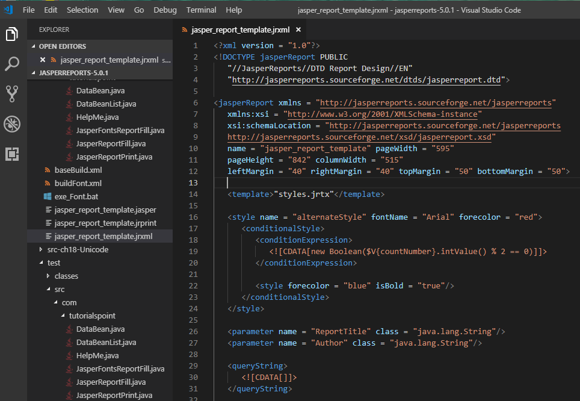
18.1 jasper_report_template.jrxml
https://www.tutorialspoint.com/jasper_reports/index.htm
Style Example:
The revised report template (jasper_report_template.jrxml) is as follows. Save it to C:\tools\jasperreports-5.0.1\test directory

Slide 16
19.2 styles.jrtx

Slide 17
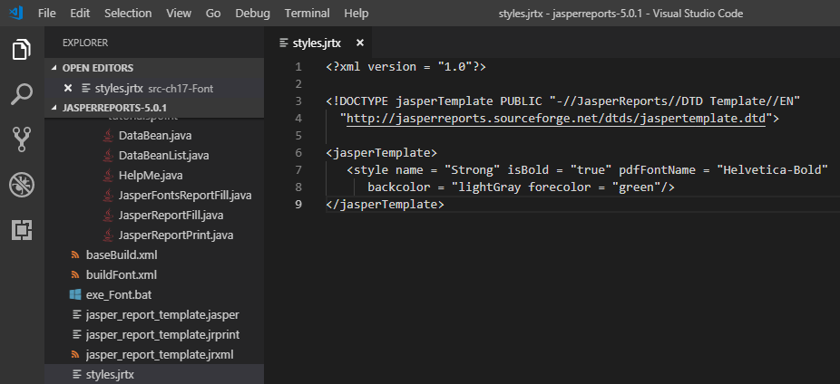
19.2 styles.jrtx
https://www.tutorialspoint.com/jasper_reports/index.htm
The contents of style template styles.jrtx are as follows. Save it to C:\tools\jasperreports-5.0.1\test directory.

Slide 18
19.3 JasperReportFill.java

Slide 19
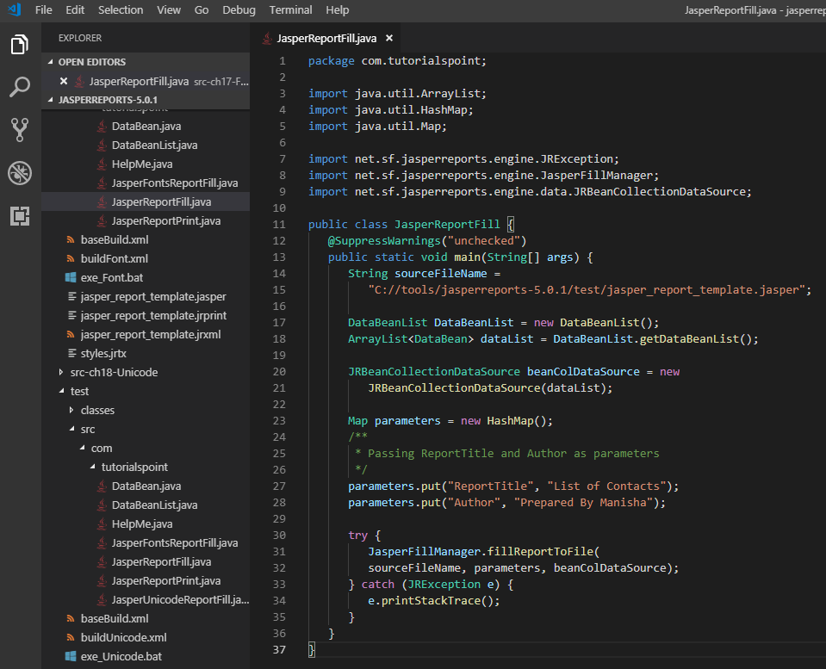
19.3 JasperReportFill.java
https://www.tutorialspoint.com/jasper_reports/index.htm
The JasperReportFill.java for report filling remain unchanged and put directory C:\tools\jasperreports-5.0.1\test\src\com\tutorialspoint as below:

Slide 20
19.4 POJO DataBean.java

Slide 21
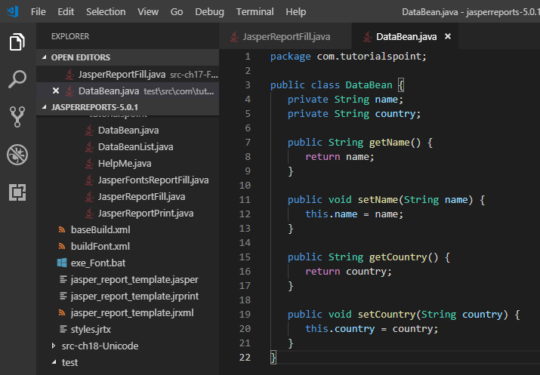
19.4 POJO DataBean.java
https://www.tutorialspoint.com/jasper_reports/index.htm
The POJO DataBean.java foremain unchanged and put directory C:\tools\jasperreports-5.0.1\test\src\com\tutorialspoint as below:

Slide 22
19.5 DataBeanList.java

Slide 23
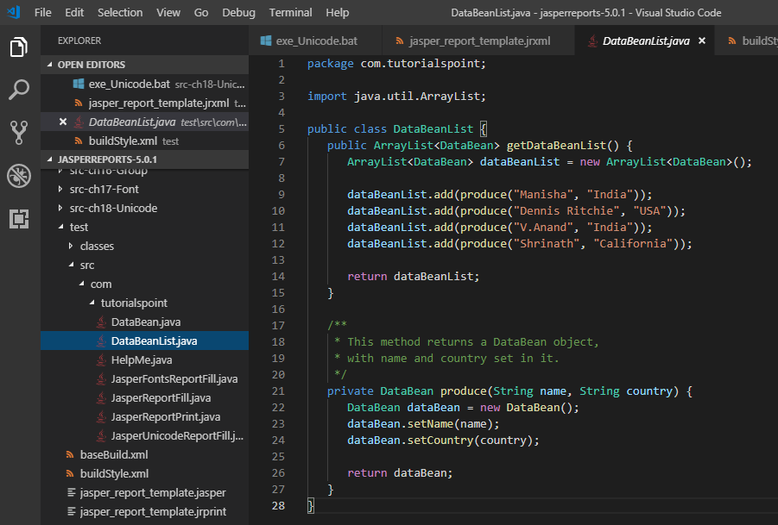
19.5 DataBeanList.java
https://www.tutorialspoint.com/jasper_reports/index.htm
The DataBeanList.java remain unchanged and put directory C:\tools\jasperreports-5.0.1\test\src\com\tutorialspoint as below:

Slide 24
19.6 buildStyle.xml

Slide 25
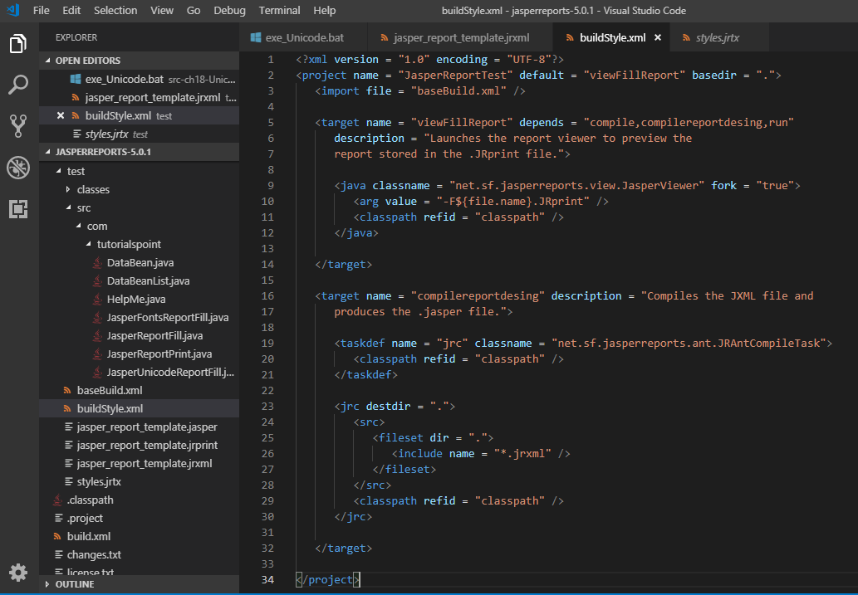
19.6 buildStyle.xml
https://www.tutorialspoint.com/jasper_reports/index.htm
Write buildStyle.xml under C:\tools\jasperreports-5.0.1\test as below:

Slide 26
19.7 exe_Style.bat

Slide 27
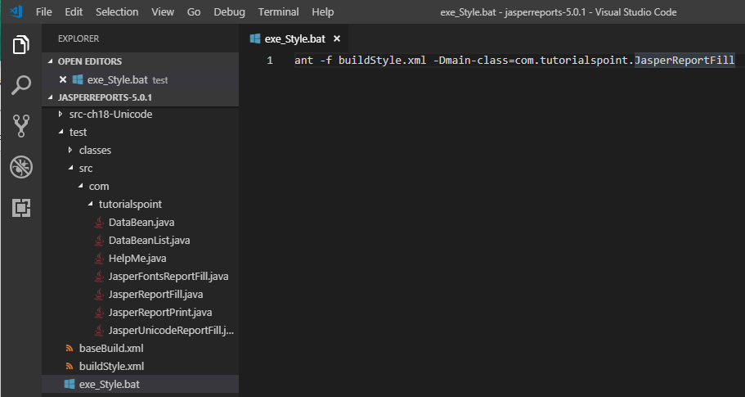
19.7 exe_Style.ba6
https://www.tutorialspoint.com/jasper_reports/index.htm
Write exe_Style.bat under C:\tools\jasperreports-5.0.1\test as below:

Slide 28
19.8 Run exe_Style.bat

Slide 29
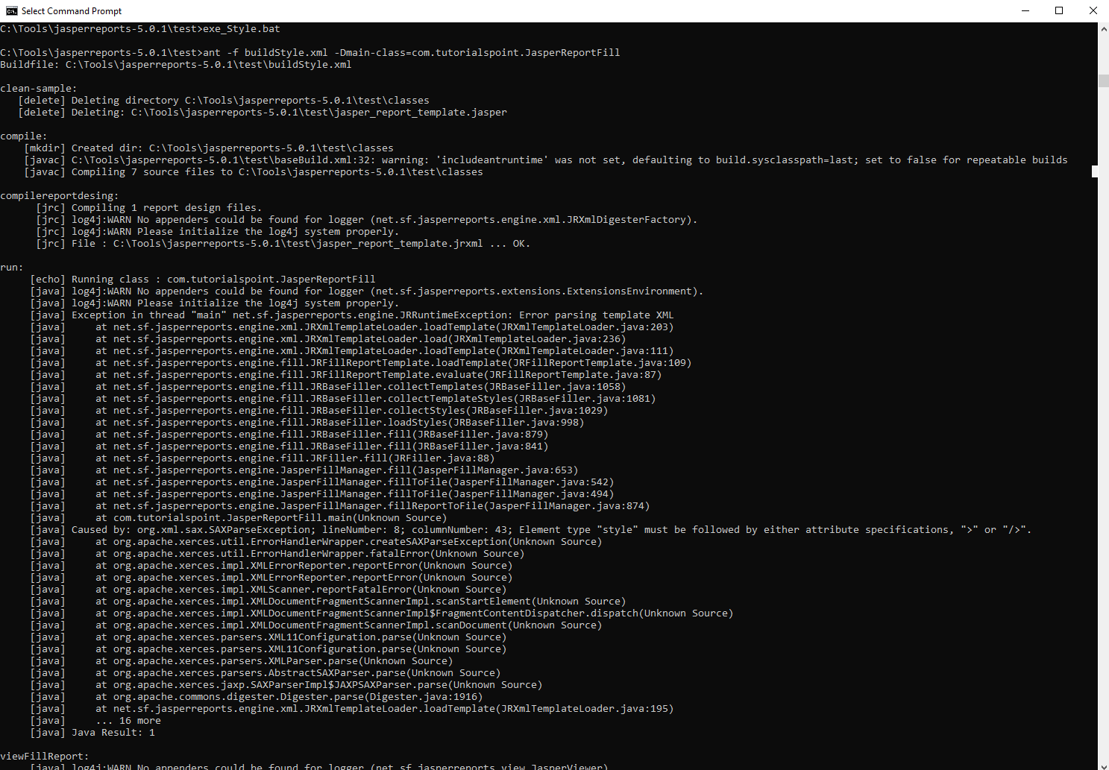
19.8 Run exe_Style.ba6
https://www.tutorialspoint.com/jasper_reports/index.htm
Run exe_Style.bat under C:\tools\jasperreports-5.0.1\test as below:
Note: JasperReport is not able to recognize the style and alternative Style.

Slide 30
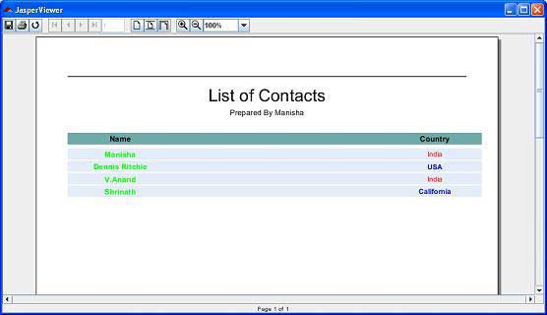
19.8 Run exe_Style.ba6
https://www.tutorialspoint.com/jasper_reports/index.htm
The correct result is as follow (Copy from tutporialspoint.com)

Slide 31
End of Chapter

