Slide 1

20 Scriptlet
Peter H. Chen

Slide 2
20 Scriptlet
https://www.tutorialspoint.com/jasper_reports/index.htm
This chapter discusses the Style.
Design Phase
(Create JRXML File)
Execute Phase
[Fill Jasper Template with Data to Generate Jasper Print File (xxx.jrprint)]
Compile Phase
(Compile JRXML to Jasper Template)
Export Phase
[Export the Report to Any Specified Format]

Slide 3
20 Scriptlet
https://www.tutorialspoint.com/jasper_reports/index.htm
We have seen in our previous chapters, data displayed on the report is usually fetched from report parameters and report fields.
This data can be processed using the report variables and their expressions.
There are situations when a complex functionality cannot be achieved easily using report expressions or variables.
Examples of this may be complex String manipulations, building of Maps, or Lists of objects in memory or manipulations of dates using 3rd party Java APIs.
For such situations, JasperReports provides us with a simple and powerful means of doing this with Scriptlets.
Scriptlets are sequences of Java code that are executed every time a report event occurs.
Values of report variables can be affected through scriptlets.

Slide 4
20 Scriptlet
https://www.tutorialspoint.com/jasper_reports/index.htm
Scriptlet Declaration
We can declare a scriptlet in two ways −
Using <scriptlet> element. This element has name attribute and class attribute. The class attribute should specify the name of the class, which extends JRAbstractScriptlet class. The class must be available in the classpath at report filling time and must have an empty constructor, so that the engine can instantiate it on the fly.
Using the attribute scriptletClass of the element <jasperReport>, in the report template (JRXML). By setting this attribute with fully qualified name of scriptlet (including the entire package name), we indicate that we want to use a scriptlet. The scriptlet instance, created with this attribute, acts like the first scriptlet in the list of scriptlets and has the predefined name REPORT.

Slide 5
20 Scriptlet
https://www.tutorialspoint.com/jasper_reports/index.htm
Scriptlet class
A scriptlet is a java class, which must extend either of the following classes −
net.sf.jasperreports.engine.JRAbstractScriptlet − This class contains a number of abstract methods that must be overridden in every implementation. These methods are called automatically by JasperReports at the appropriate moment. Developer must implement all the abstract methods.
net.sf.jasperreports.engine.JRDefaultScriptlet − This class contains default empty implementations of every method in JRAbstractScriptlet. A developer is only required to implement those methods he/she needs for his/her project.

Slide 6
20 Scriptlet
https://www.tutorialspoint.com/jasper_reports/index.htm
Scriptlet class (1)
The following table lists the methods in the above class.
These methods will be called by the report engine at the appropriate time, during report filling phase.
S. NO | Method and Description
1 | public void beforeReportInit() Called before report initialization.
2 | public void afterReportInit() Called after report initialization.
3 | public void beforePageInit() Called before each page is initialized.
4 | public void afterPageInit() Called after each page is initialized.

Slide 7
20 Scriptlet
https://www.tutorialspoint.com/jasper_reports/index.htm
Scriptlet class (2)
S. NO | Method and Description
5 | public void beforeColumnInit() Called before each column is initialized.
6 | public void afterColumnInit() Called after each column is initialized.
7 | public void beforeGroupInit(String groupName) Called before the group specified in the parameter is initialized.
8 | public void afterGroupInit(String groupName) Called after the group specified in the parameter is initialized.

Slide 8
20 Scriptlet
https://www.tutorialspoint.com/jasper_reports/index.htm
Scriptlet class (3)
S. NO | Method and Description
9 | public void beforeDetailEval() Called before each record in the detail section of the report is evaluated.
10 | public void afterDetailEval() Called after each record in the detail section of the report is evaluated.
Any number of scriptlets can be specified per report. If no scriptlet is specified for a report, the engine still creates a single JRDefaultScriptlet instance and registers it with the built-in REPORT_SCRIPTLET parameter.
We can add any additional methods that we need to our scriptlets.
Reports can call these methods by using the built-in parameter REPORT_SCRIPTLET.

Slide 9
20 Scriptlet
https://www.tutorialspoint.com/jasper_reports/index.htm
Global Scriptlets
We can associate scriptlets in another way to reports, which is by declaring the scriptlets globally.
This makes the scriptlets apply to all reports being filled in the given JasperReports deployment.
This is made easy by the fact that scriptlets can be added to JasperReports as extensions. The scriptlet extension point is represented by the net.sf.jasperreports.engine.scriptlets.ScriptletFactory interface.
JasperReports will load all scriptlet factories available through extensions at runtime. Then, it will ask each one of them for the list of scriptlets instances that they want to apply to the current report that is being run.
When asking for the list of scriptlet instances, the engine gives some context information that the factory could use in order to decide, which scriptlets actually apply to the current report.

Slide 10
20 Scriptlet
https://www.tutorialspoint.com/jasper_reports/index.htm
Report Governors (1)
Governors are just an extension of global scriptlets that enable us to tackle a problem of report engine entering infinite loop at runtime, while generating reports. Invalid report templates cannot be detected at design time, because most of the time, the conditions for entering the infinite loops depend on the actual data that is fed into the engine at runtime.
Report Governors help in deciding whether a certain report has entered an infinite loop and they can stop it. This prevents resource exhaustion for the machine that runs the report.

Slide 11
20 Scriptlet
https://www.tutorialspoint.com/jasper_reports/index.htm
Report Governors (2)
JasperReports has two simple report governors that would stop a report execution based on a specified maximum number of pages or a specified timeout interval.
They are −
net.sf.jasperreports.governors.MaxPagesGovernor − This is a global scriptlet that is looking for two configuration properties to decide if it applies or not to the report currently being run. The configuration properties are −
net.sf.jasperreports.governor.max.pages.enabled=[true|false]
net.sf.jasperreports.governor.max.pages=[integer]
net.sf.jasperreports.governors.TimeoutGovernor− This is also a global scriptlet that is looking for the following two configuration properties to decide if it applies or not.
The configuration properties are −
net.sf.jasperreports.governor.timeout.enabled=[true|false]
net.sf.jasperreports.governor.timeout=[milliseconds]

Slide 12
20 Scriptlet
https://www.tutorialspoint.com/jasper_reports/index.htm
Report Governors (3)
The properties for both governors can be set globally, in the jasperreports.properties file, or at report level, as custom report properties.
This is useful because different reports can have different estimated size or timeout limits and also because you might want turn on the governors for all reports, while turning it off for some, or vice-versa.

Slide 13
20.1 MyScript.java

Slide 14
20.1 MyScript.java
https://www.tutorialspoint.com/jasper_reports/index.htm
Details of the above scriptlet class are as follows −
In the afterReportInit method, we set a value to the variable "someVar" this.setVariableValue ("someVar", new String("This variable value was modified by the scriptlet.")).
At the end of the class, an extra method called 'hello' has been defined. This is an example of a method that can be added to the Scriptlet that actually returns a value, rather than setting a Variable

Slide 15
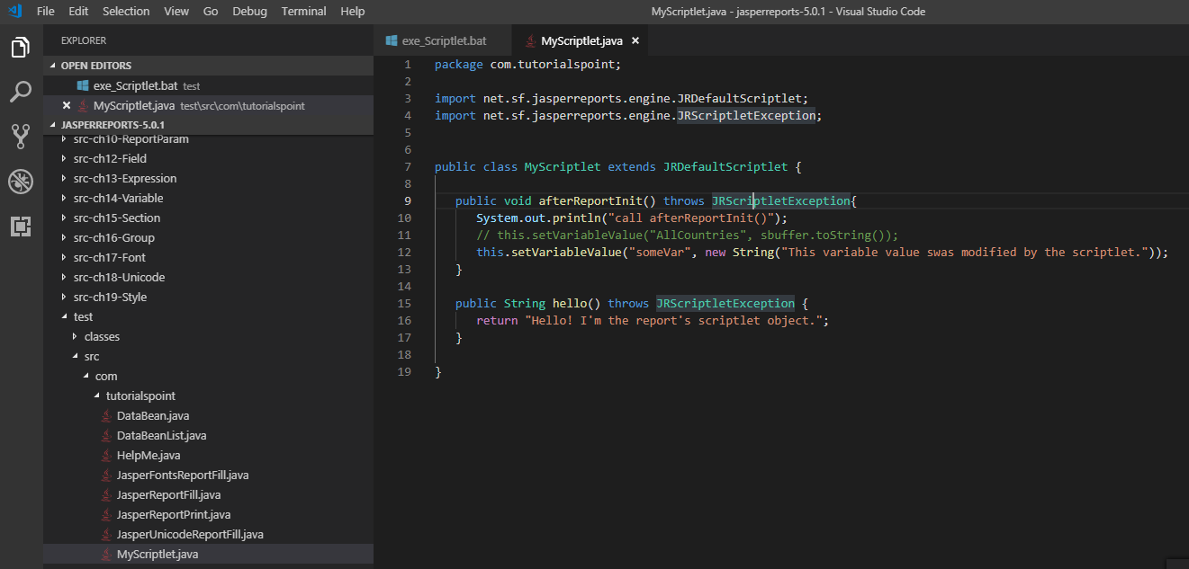
20.1 MyScript.java
https://www.tutorialspoint.com/jasper_reports/index.htm
Write a scriptlet class (MyScriptlet). The contents of file C:\tools\jasperreports-5.0.1\test\src\com\tutorialspoint\MyScriptlet.java are as follows

Slide 16
20.2 jasper_report_template.jrxml

Slide 17
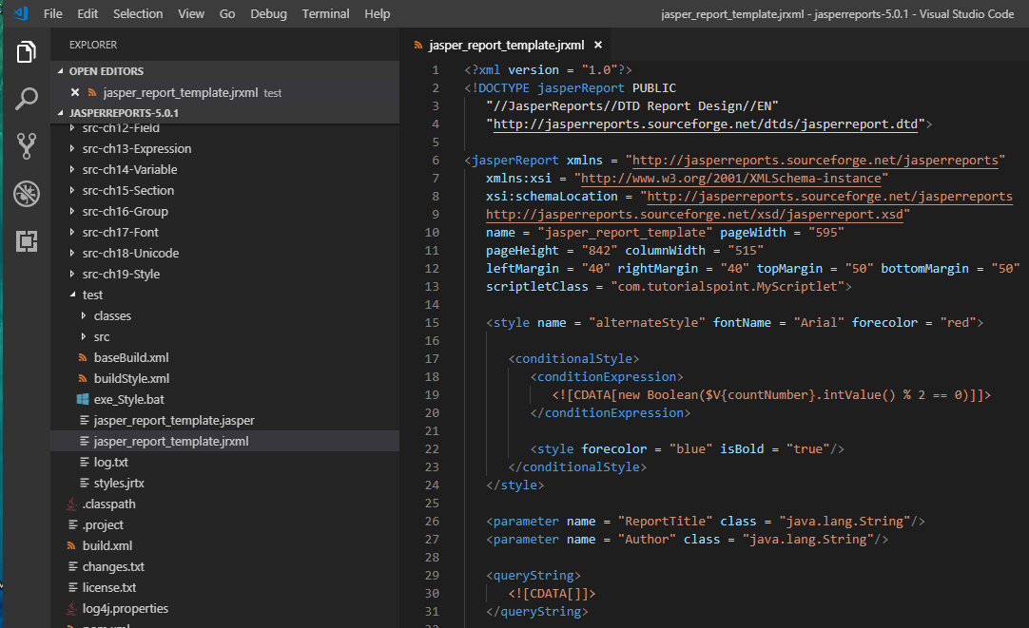
20.1 jasper_report_template.jrxml
https://www.tutorialspoint.com/jasper_reports/index.htm
We add the scriptlet class reference in our existing report template (Chapter 05 Report Designs).
The revised report template (jasper_report_template.jrxml) are as follows. Save it to C:\tools\jasperreports-5.0.1\test directory

Slide 18
20.1 jasper_report_template.jrmxl
https://www.tutorialspoint.com/jasper_reports/index.htm
The details of the revised report template is given below −
We have referenced the MyScriptlet class in the attribute scriptletClassof <jasperReport> element.
Scriptlets can only access, but not modify the report fields and parameters. However, scriptlets can modify report variable values. This can be accomplished by calling the setVariableValue() method. This method is defined in JRAbstractScriptlet class, which is always the parent class of any scriptlet. Here, we have defined a variable someVar, which will be modified by the MyScriptlet to have the value This value was modified by the scriptlet.
The above report template has a method call in the Summary band that illustrates how to write new methods (in scriptlets) and use them in the report template. ($P{REPORT_SCRIPTLET}.hello())

Slide 19
20.3 JasperReportFill.java

Slide 20
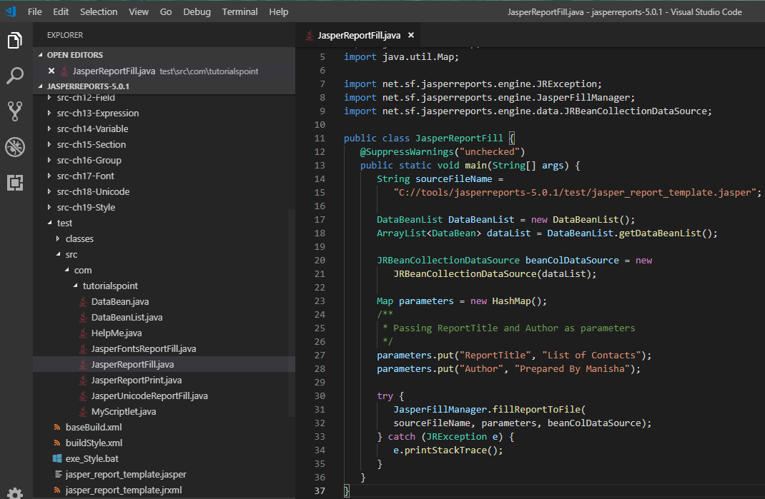
20.3 JasperReportFill.java
https://www.tutorialspoint.com/jasper_reports/index.htm
The java codes for report filling remain unchanged. The contents of the file C:\tools\jasperreports-5.0.1\test\src\com\tutorialspoint\JasperReportFill.java are as given below

Slide 21
20.4 POJO DataBean.java

Slide 22
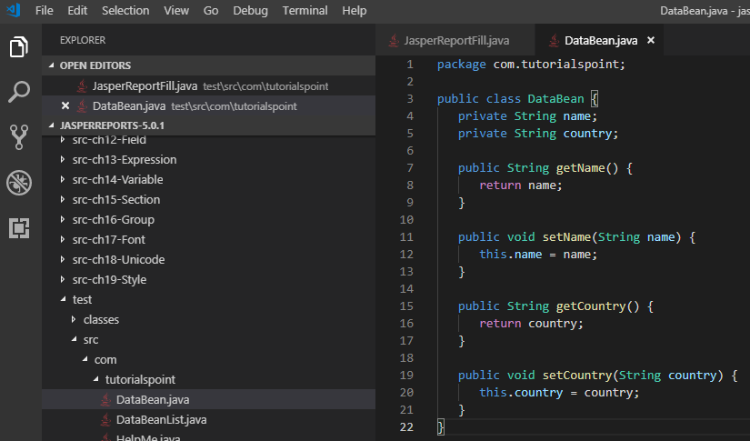
20.4 POJO DataBean.java
https://www.tutorialspoint.com/jasper_reports/index.htm
The contents of the POJO file C:\tools\jasperreports-5.0.1\test\src\com\tutorialspoint\DataBean.java are as given below

Slide 23
20.5 DataBeanList.java

Slide 24
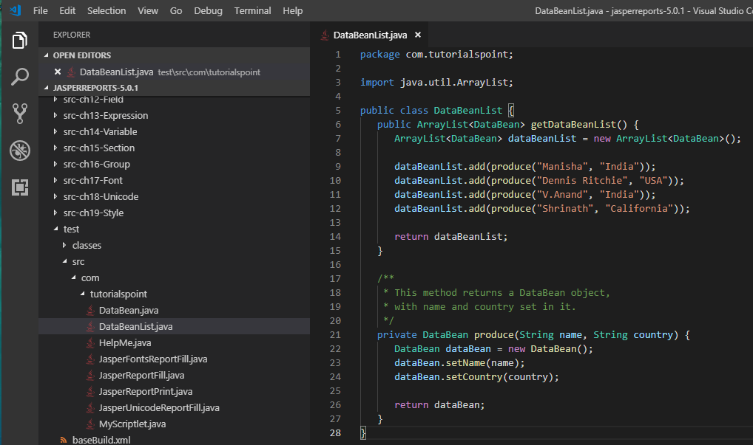
20.5 DataBeanList.java
https://www.tutorialspoint.com/jasper_reports/index.htm
The contents of the file C:\tools\jasperreports-5.0.1\test\src\com\tutorialspoint\DataBeanList.java are as given below

Slide 25
20.6 DataBeanList.java

Slide 26
20.6 DataBeanList.java
https://www.tutorialspoint.com/jasper_reports/index.htm
The contents of the file C:\tools\jasperreports-5.0.1\test\src\com\tutorialspoint\DataBeanList.java are as given below

Slide 27
20.7 buildScriptlet.xml

Slide 28
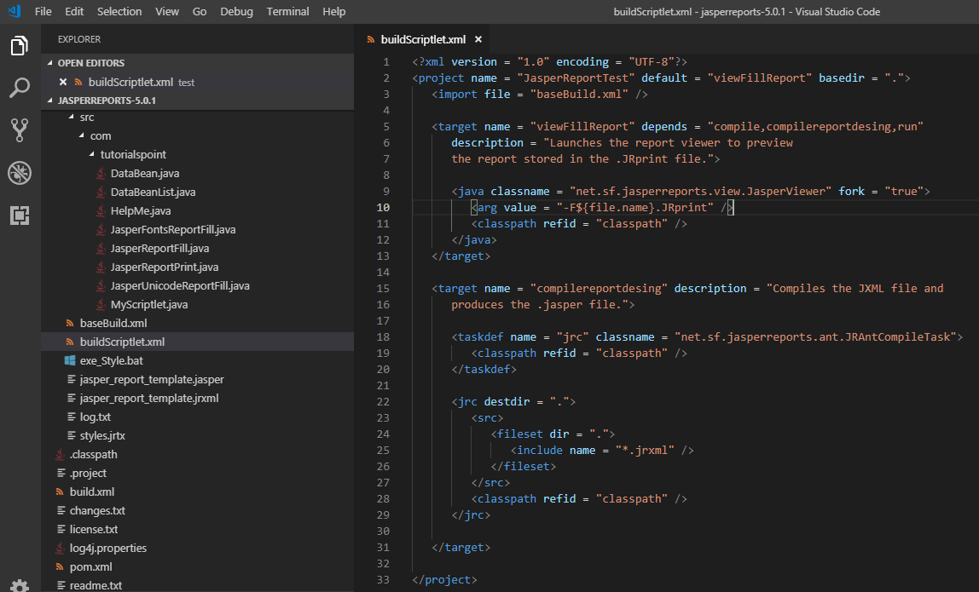
20.7 buildScriptlet.xml
https://www.tutorialspoint.com/jasper_reports/index.htm
Write buildScriptlet.xml (saved under directory C:\tools\jasperreports-5.0.1\test) are as given below.
The import file - baseBuild.xml is picked up from the chapter 03 Environment Setup and should be placed in the same directory as the buildScriptlet.xml

Slide 29
20.8 exe_Scriptlet.bat

Slide 30
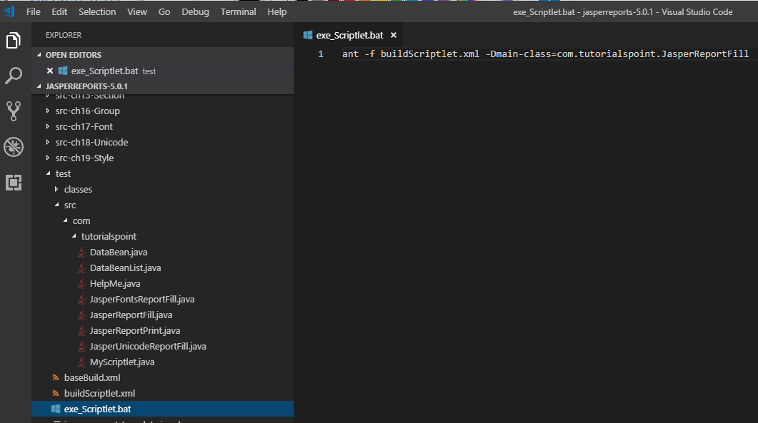
20.8 exe_Scriptlet.bat
https://www.tutorialspoint.com/jasper_reports/index.htm
Write exe_Scriptlet.bat
ant -f buildScriptlet.xml -Dmain-class=com.tutorialspoint.JasperReportFill

Slide 31
20.9 Run exe_Scriptlet.bat

Slide 32
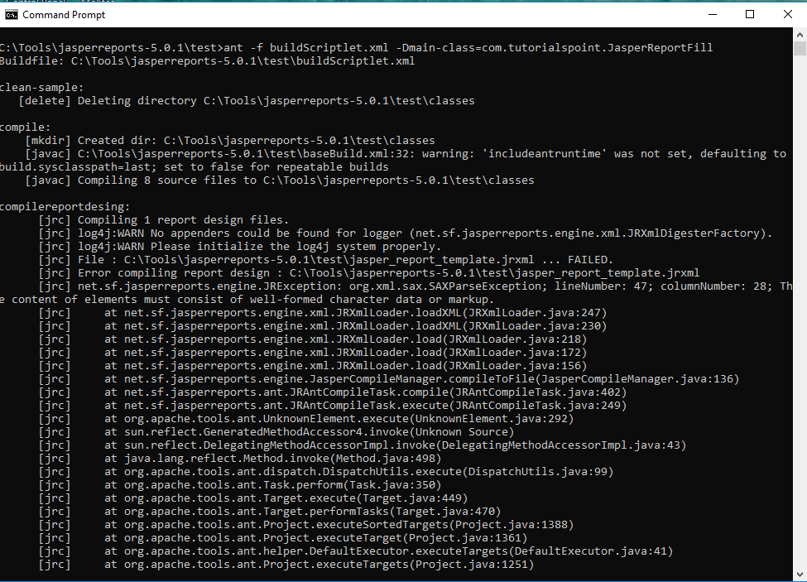
20.9 Run exe_Scriptlet.bat
https://www.tutorialspoint.com/jasper_reports/index.htm
> exe_Scriptlet.bat
There are error message. Need to know how to debug the jrxml.

Slide 33
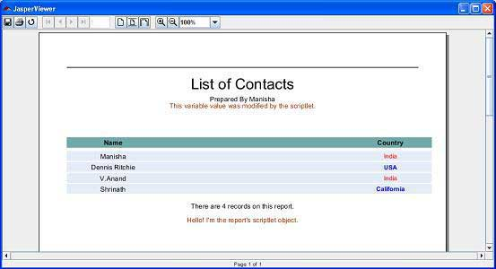
20.9 Run exe_Scriptlet.bat
https://www.tutorialspoint.com/jasper_reports/index.htm
Result of exe_ScriptLet.bat

Slide 34
End of Chapter

