Slide 1

21 Subreport
Peter H. Chen

Slide 2
21 Subreport
https://www.tutorialspoint.com/jasper_reports/index.htm
This chapter discusses the Style.
Design Phase
(Create JRXML File)
Execute Phase
[Fill Jasper Template with Data to Generate Jasper Print File (xxx.jrprint)]
Compile Phase
(Compile JRXML to Jasper Template)
Export Phase
[Export the Report to Any Specified Format]

Slide 3
21 Subreport
https://www.tutorialspoint.com/jasper_reports/index.htm
Subreports are one of the nice features of the JasperReports.
This feature allows incorporating a report within another report, that is, one report can be a subreport of another.
Subreports help us keep report designs simple, as we can create many simple reports and encapsulate them into a master report.
Subreports are compiled and filled just like normal reports.
Any report template can be used as a subreport when incorporated into another report template, without anything changed inside (of the report template).
Subreports are like normal report templates. They are in fact net.sf.jasperreports.engine.JasperReport objects, which are obtained after compiling a net.sf.jasperreports.engine.design.JasperDesign object.

Slide 4
21 Subreport
https://www.tutorialspoint.com/jasper_reports/index.htm
<subreport> Element
A <subreport> element is used when introducing subreports into master reports. Here is the list of sub-elements in the <subreport> JRXML element.
<reportElement>
<parametersMapExpression> − This is used to pass a map containing report parameters to the subreport. The map is usually obtained from a parameter in the master report, or by using the built-in REPORTS_PARAMETERS_MAP parameter to pass the parent report's parameters to the subreport. This expression should always return a java.util.Map object in which the keys are the parameter names.
<subreportParameter> − This element is used to pass parameters to the subreport. It has an attribute name, which is mandatory.
<connectionExpression > − This is used to pass a java.sql.Connectionto the subreport. It is used only when the subreport template needs a database connection during report filling phase.

Slide 5
21 Subreport
https://www.tutorialspoint.com/jasper_reports/index.htm
<dataSourceExpression> − This is used to pass a datasource to the subreport. This datasource is usually obtained from a parameter in the master report or by using the built-in REPORT_DATA_SOURCE parameter to pass the parent report's datasource to the subreport.
The elements (connectionExpression and dataSourceExpression) cannot be present at the same time in a <subreport> element declaration. This is because we cannot supply both a data source and a connection to the subreport. We must decide on one of them and stick to it.

Slide 6
21 Subreport
https://www.tutorialspoint.com/jasper_reports/index.htm
<returnValue> − This is used to assign the value of one of the subreport's variables to one of the master report's variables. This sub element has attributes as follows −
subreportVariable − This attribute specifies the name of the subreport variable whose value is to be returned.
toVariable − This attribute specifies the name of the parent report variable whose value is to be copied/incremented with the value from the subreport.
calculation − This attribute can take values : Nothing, Count, DistinctCount, Sum, Average, Lowest, Highest, StandardDeviation, Variance. Default value for attribute calculation is "Nothing".
incrementerFactoryClass − This attribute specifies the factory class for creating the incrementer instance.

Slide 7
21 Subreport
https://www.tutorialspoint.com/jasper_reports/index.htm
<subreportExpression> − This indicates where to find the compiled report template for the subreport. This element has a class attribute. The class attribute can take any of these values:java.lang.String, java.io.File, java.net.URL, java.io.InputStream, net.sf.jasperreports.engine.JasperReport. Default value is java.lang.String.
isUsingCache − This is an attribute of the <subreport> element. This is a Boolean, when set to true, the reporting engine will try to recognize previously loaded subreport template objects, using their specified source. This caching functionality is available only for subreport elements that have expressions returning java.lang.String objects as the subreport template source, representing file names, URLs, or classpath resources.

Slide 8
21.1 address_report_template.jrxml

Slide 9
21.1 address_report_template.jrxml
https://www.tutorialspoint.com/jasper_reports/index.htm
Write subreports using JRDataSource.
First, write two new report templates, one being subreport and the other Master report.
The contents of the subreport (address_report_template.jrxml) template is as given below.

Slide 10
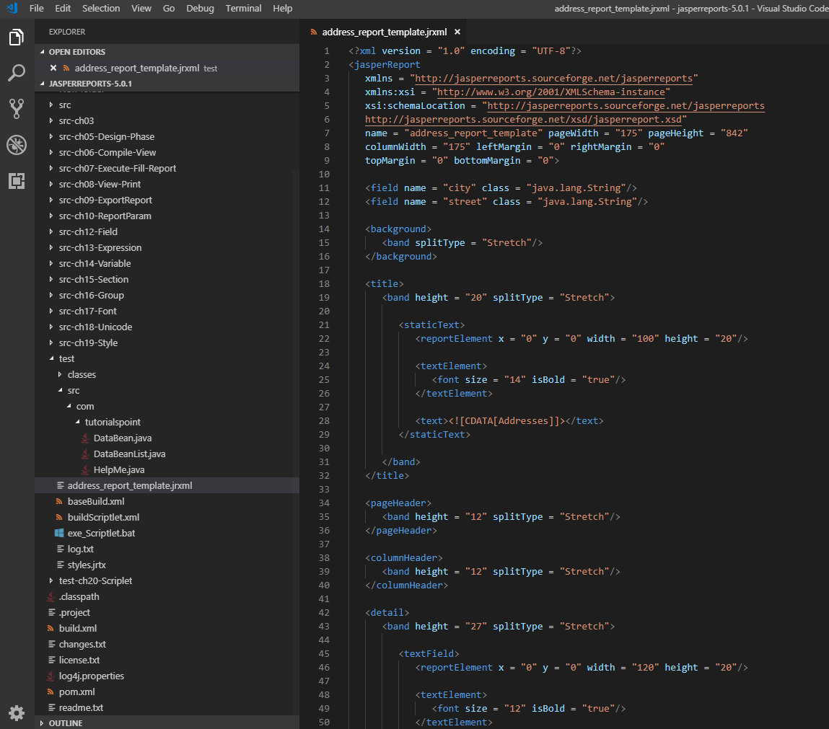
21.1 address_report_template.jrxml
https://www.tutorialspoint.com/jasper_reports/index.htm
Write subreport (address_report_template.jrxml) template is as given below.
Save it to C:\tools\jasperreports-5.0.1\test directory.

Slide 11
21.2 POJO SubReportBean.java

Slide 12
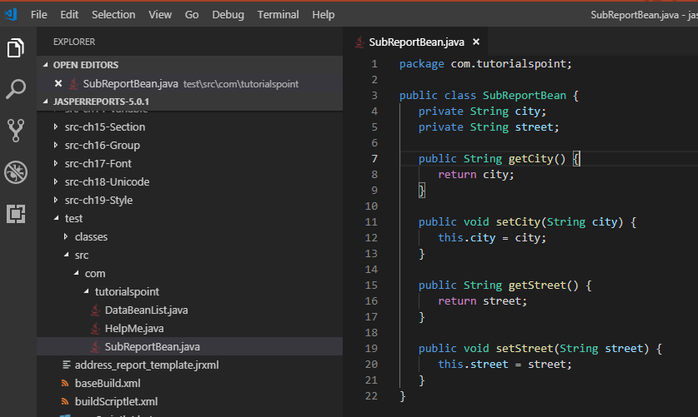
21.2 POJO SubReportBean.java
https://www.tutorialspoint.com/jasper_reports/index.htm
Write a corresponding POJO file SubReportBean.java as shown below.
Save it to directory C:\tools\jasperreports-5.0.1\test\src\com\tutorialspoint
Here, we have declared two fields 'city' and 'street' and respective getter and setter methods are defined.

Slide 13
21.3 DataBean.java

Slide 14
21.3 DataBean.java
https://www.tutorialspoint.com/jasper_reports/index.htm
Write DataBean.java file.
We will add a new field subReportBeanList, which is a java.util.List.
This field will hold the list of SubReportBean objects.

Slide 15
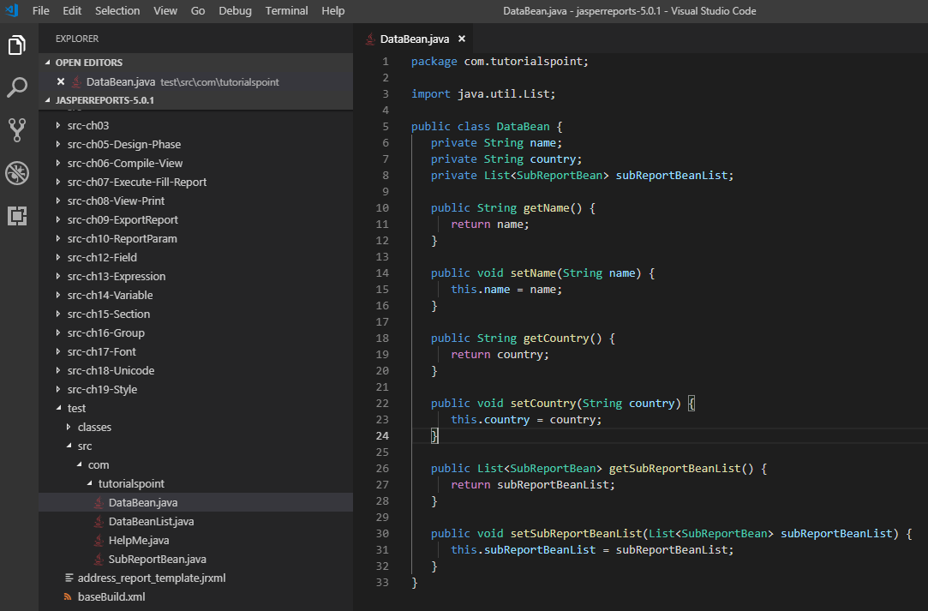
21.3 DataBean.java
https://www.tutorialspoint.com/jasper_reports/index.htm
The contents of the file DataBean.java are as below.
Save it to directory C:\tools\jasperreports-5.0.1\test\src\com\tutorialspoint.

Slide 16
21.4 DataBeanList.java

Slide 17
21.4 DataBeanList.java
https://www.tutorialspoint.com/jasper_reports/index.htm
Write DataBeanList.java to C:\tools\jasperreports-5.0.1\test\src\com\tutorialspoint\DataBeanList.java.
The contents of this file are as follow:

Slide 18
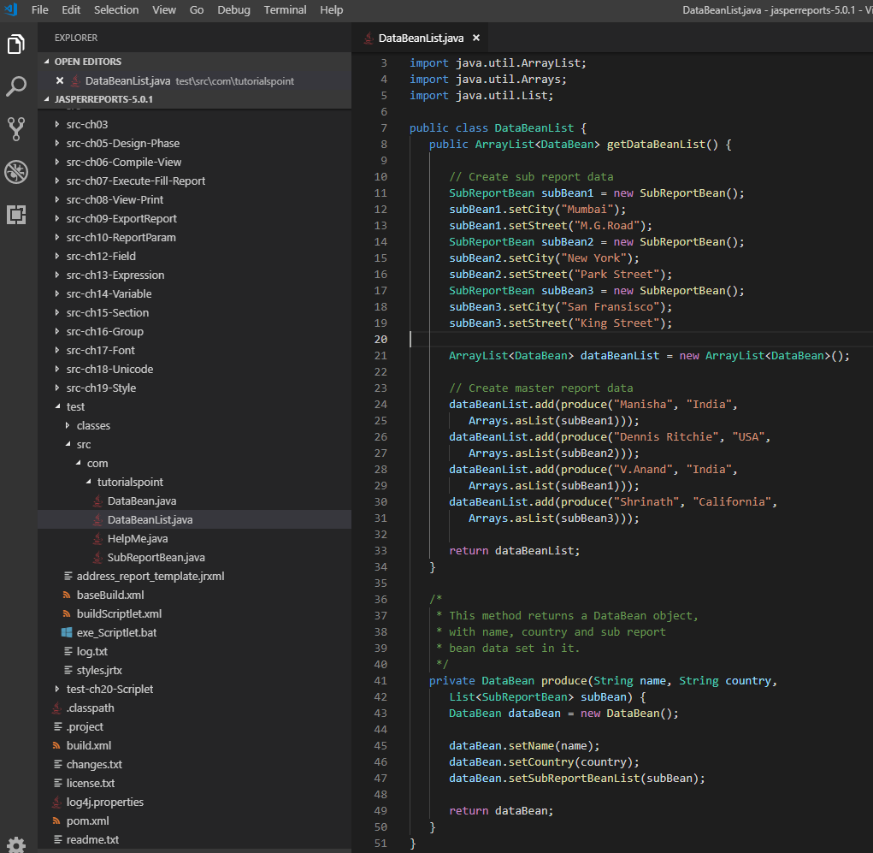
21.4 DataBeanList.java
https://www.tutorialspoint.com/jasper_reports/index.htm
The contents of the file DataBeanList.java are as below.
In the method produce() in the above file, we are setting the list of SubReportBean.

Slide 19
21.5 jasper_report_template.jrxml

Slide 20
21.5 jasper_report_template.jrxml
https://www.tutorialspoint.com/jasper_reports/index.htm
Write a new master report template (jasper_report_template.jrxml).
Save this file to directory C:\tools\jasperreports-5.0.1\test.
This master report composes two subvreports inside.

Slide 21
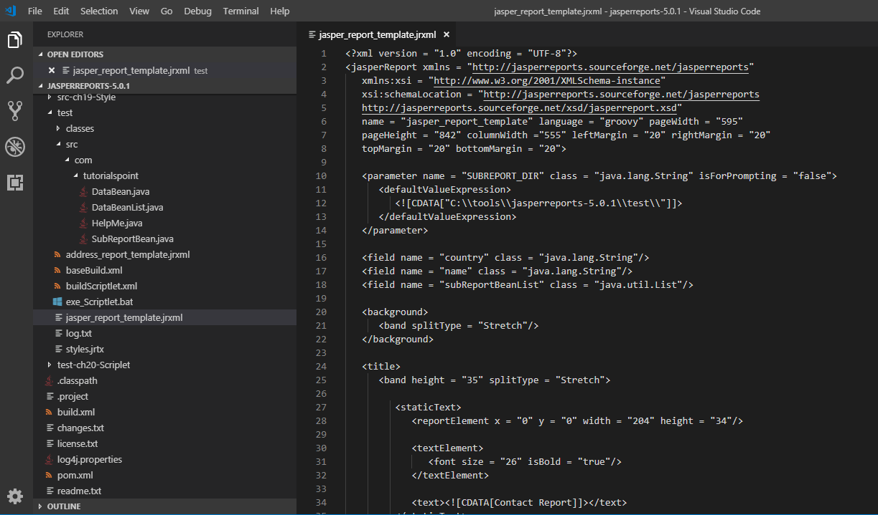
21.5 jasper_report_template.jrxml
https://www.tutorialspoint.com/jasper_reports/index.htm
The master report template (jasper_report_template.jrxml) is as follow.

Slide 22
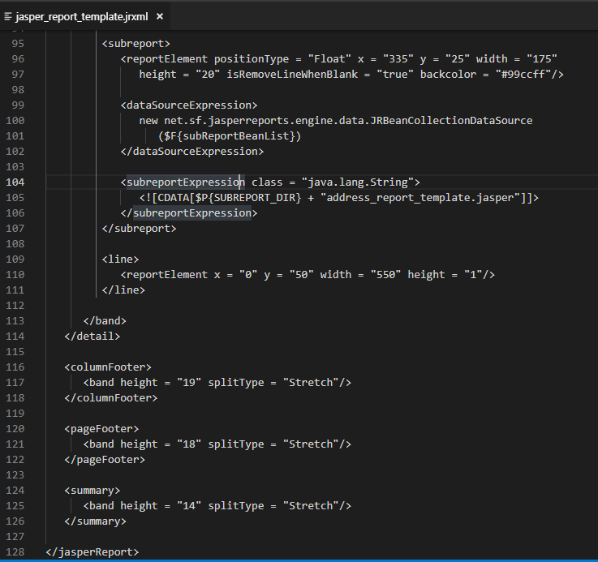
21.5 jasper_report_template.jrxml
https://www.tutorialspoint.com/jasper_reports/index.htm
In this template, we have defined a new parameter "SUBREPORT_DIR," which defines the path of the subreport.
We have defined a field subReportBeanList of type java.util.List, which corresponds to property in the file DataBean.
The element <subreport> has sub-element <dataSourceExpression>.
We have put the list subReportBeanList in an instance of JRBeanCollectionDataSource. In the sub-element <subreportExpression/>, we have given the subreport name (AddressReport.jasper).

Slide 23
21.6 CreateReport.java

Slide 24
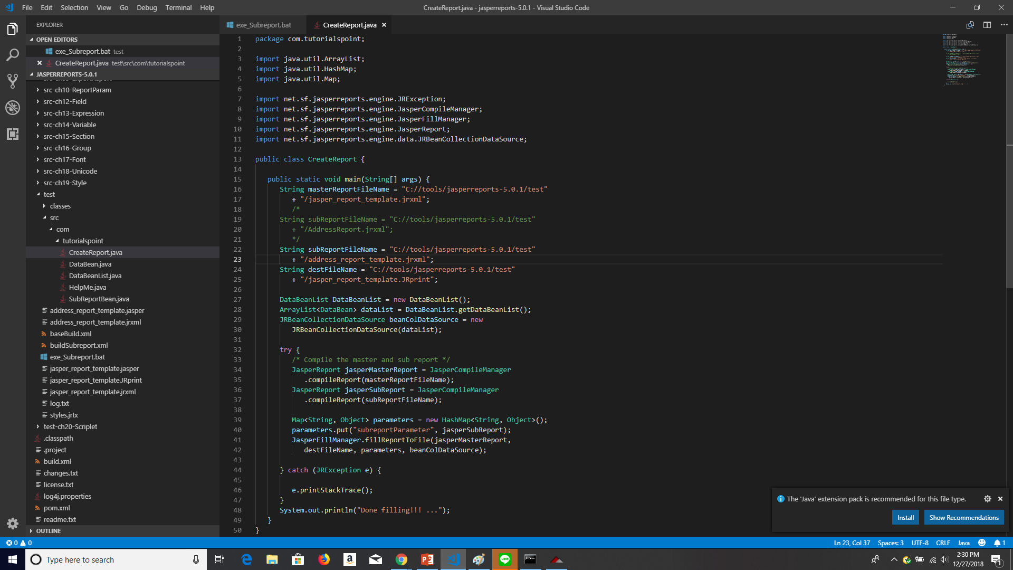
21.6 CreateReport.java
https://www.tutorialspoint.com/jasper_reports/index.htm
Write a new class CreateReport for all java (*.java) to report templates (master and subreport *.jsxml) and pass to the (*.jasper)
Save as C:\tools\jasperreports-5.0.1\test\src\com\tutorialspoint\CreateReport.java are as given below

Slide 25
21.7 buildSubreport.xml

Slide 26
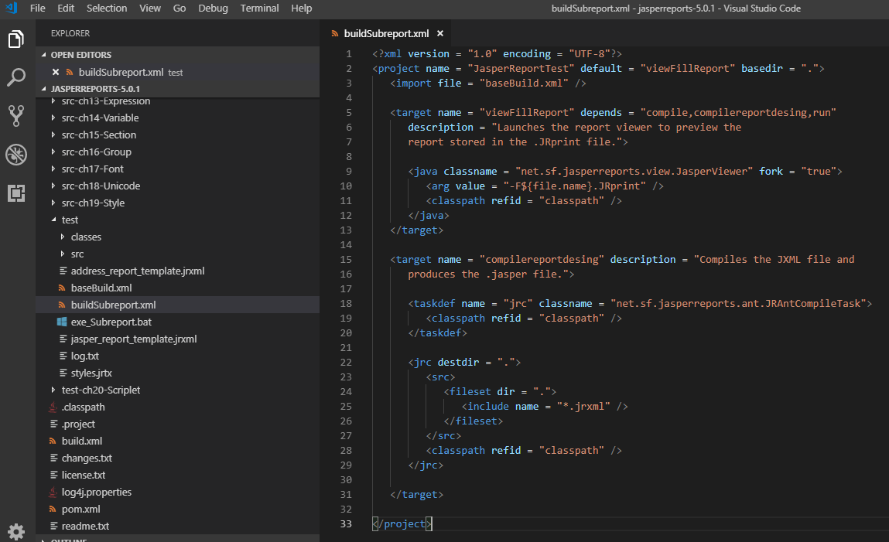
21.7 buildSubreport.xml
https://www.tutorialspoint.com/jasper_reports/index.htm
Write buildSubreport.xml (saved under directory C:\tools\jasperreports-5.0.1\test) are as given below.
The import file - baseBuild.xml is picked up from the chapter 03 Environment Setup and should be placed in the same directory as the buildSubreport.xml.

Slide 27
21.8 exe_Subreport.bat

Slide 28
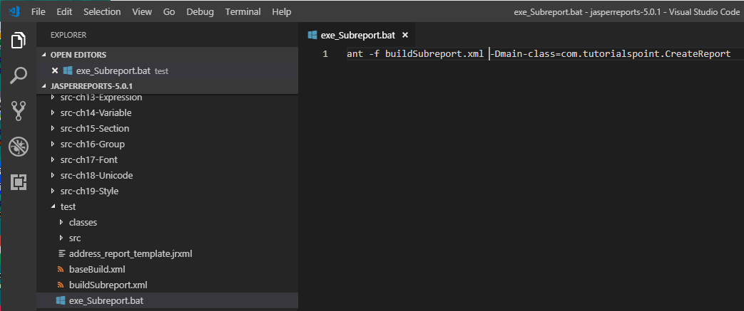
21.8 exe_Subreport.bat
https://www.tutorialspoint.com/jasper_reports/index.htm
Write exe_Subreport.bat with following:
ant -f buildSubreport.xml -Dmain-class=com.tutorialspoint.CreateReport

Slide 29
21.9 Run exe_Subreport.bat

Slide 30
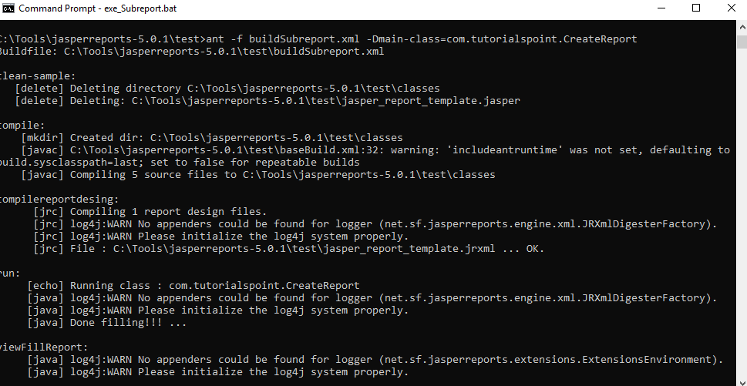
21.9 Run exe_Subreport.bat
https://www.tutorialspoint.com/jasper_reports/index.htm
Run exe_Subreport.bat

Slide 31
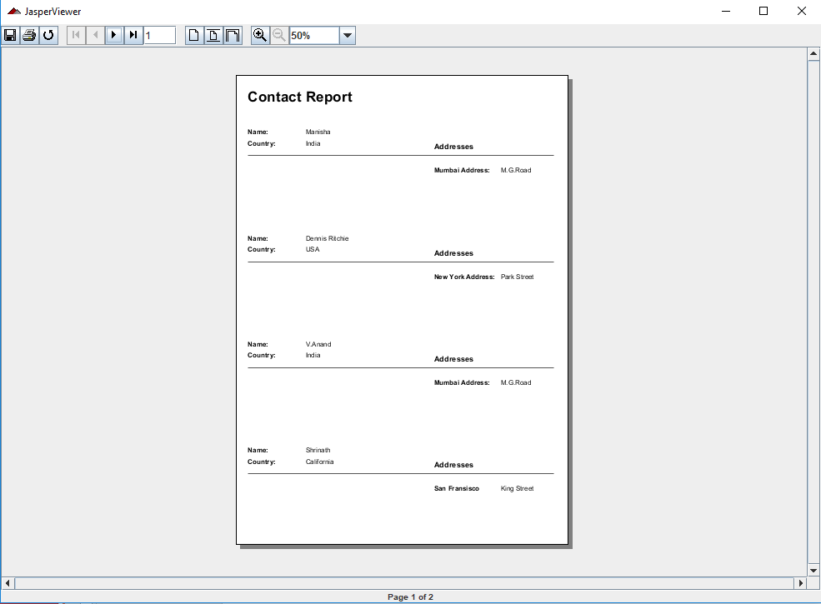
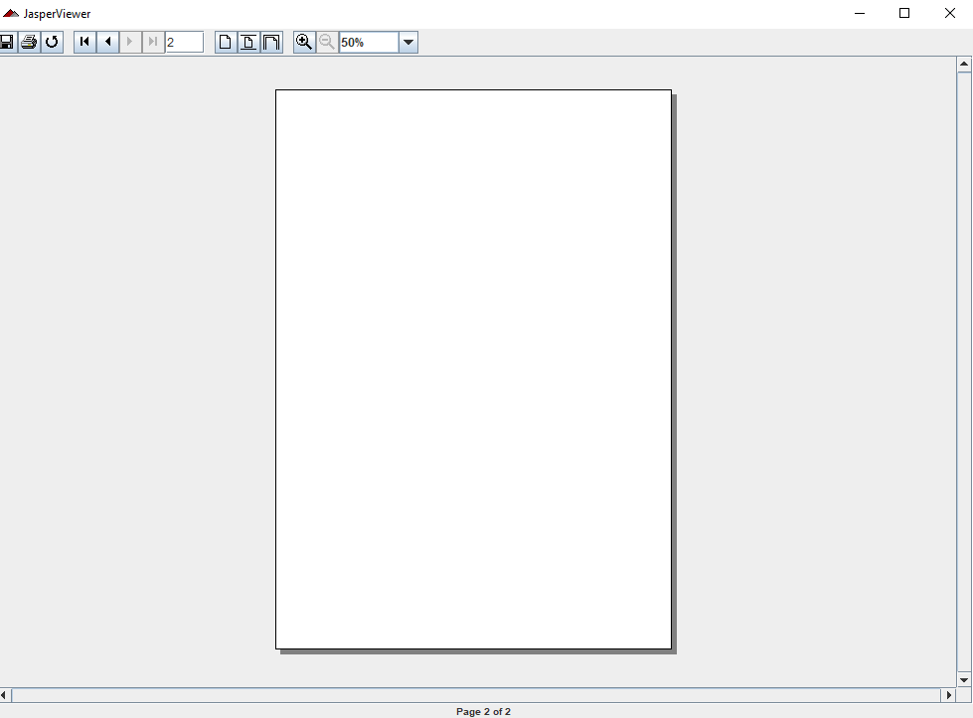
21.9 Run exe_Subreport.bat
https://www.tutorialspoint.com/jasper_reports/index.htm
Compose 4 peoples in two pages. The second page is empty.

Slide 32
End of Chapter

