Slide 1

22 Chart
Peter H. Chen

Slide 2
22 Chart
https://www.tutorialspoint.com/jasper_reports/index.htm
This chapter discusses the Style.
Design Phase
(Create JRXML File)
Execute Phase
[Fill Jasper Template with Data to Generate Jasper Print File (xxx.jrprint)]
Compile Phase
(Compile JRXML to Jasper Template)
Export Phase
[Export the Report to Any Specified Format]

Slide 3
22 Chart
https://www.tutorialspoint.com/jasper_reports/index.htm
Earlier people had to rely on scriptlets to gather the chart data and render the chart using an image element in the report template.
JasperReports makes it simple now, as it has a built-in support for charts using the new chart component.
Using a new chart component, user needs to apply only the visual settings and define expressions that will help build the chart dataset.
JasperReports uses JFreeChart as the underlying charting library.
When configuring a new chart component, following three components are involved −
The overall chart component.
The chart dataset (which groups chart data-related settings).
The chart plot (which groups visual settings related to the way the chart items are rendered).
JasperReports currently supports the following types of charts: Pie, Pie 3D, Bar, Bar 3D, XY Bar, Stacked Bar, Stacked Bar 3D, Line, XY Line, Area, XY Area, Stacked Area, Scatter, Bubble, Time Series, High-Low-Open-Close, Candlestick, Multiple Axis, Meter, Thermometer, and Gantt.

Slide 4
22 Chart
https://www.tutorialspoint.com/jasper_reports/index.htm
Chart Properties
Charts are normal report elements, so they share some of their properties with all the other report elements. There is a JRXML element called <chart>, used to create all type of charts. This element groups special chart-specific settings that apply to all types of charts.

Slide 5
22 Chart
https://www.tutorialspoint.com/jasper_reports/index.htm
Chart Sub-Elements (1)
The sub-elements of <chart> element are −
<reportElement> − These are displayable objects like static texts, text fields, images, lines, and rectangles that you put in your report template sections.
<Box> − This element is used to surround charts by a border that's customizable on each side.
<chartTitle> − This element is used to place the title of the chart. The position attribute decides the title position of the chart in the report. This element has attributes - Position (Values could be Top, Bottom, Left, Right. Deafult value is Top), color. <chartTitle> has fontand titleExpression as subelements.
<chartSubtitle> − This element is used to place the subtitle of the chart. This element has attribute - color. <chartSubtitle> has fontand subtitleExpression as subelements.

Slide 6
22 Chart
https://www.tutorialspoint.com/jasper_reports/index.htm
Chart Sub-Elements (2)
<chartLegend> − The element can control the font-related properties as well as the text color and the background color of the chart legend using this element. This element has attributes - textColor and backgroundColor.
<anchorNameExpression> − This element creates the target for the anchor.
<hyperlinkReferenceExpression> − This element contains a report expression indicating the name of the external resource (usually a URL).
<hyperlinkAnchorExpression> − Hyperlink points to an anchor in an external resource.
<hyperlinkPageExpression> − Hyperlink points to a page in the current report.
<hyperlinkTooltipExpression> − This element controls the ToolTip of hyperlink. The type of the expression should be java.lang.String.
<hyperlinkParameter> − This element when present generates a final hyperlink depending on the parameter values.

Slide 7
22 Chart
https://www.tutorialspoint.com/jasper_reports/index.htm
Chart attributes (1)
Attributes in the <chart> element available for all chart types are −
isShowLegend − This attribute is used to determine, if a chart legend will be displayed on the report. Values could be true, or false. Default value is true.
evaluationTime − Determines when the chart's expression will be evaluated. Values could be Now, Report, Page, Column, Group, Band. Default value is Now.
evaluationGroup − This attribute determines the name of the group to be used to evaluate the chart's expressions. The value for this attribute must match the name of the group, we would like to use as the chart's evaluation group.
hyperlinkType − This attribute can hold any text value. Default value is None. This means, neither the text fields nor the images represent hyperlinks, even if the special hyperlink expressions are present.
hyperlinkTarget − This attribute helps to customize the behavior of the specified link when it is clicked in the viewer. Values could be Self, or Blank. Default value is Self.

Slide 8
22 Chart
https://www.tutorialspoint.com/jasper_reports/index.htm
Chart attributes (2)
bookmarkLevel − This attribute when set to a positive integer, generates bookmarks in the reports exported to PDF. Default value is 0.
customizerClass − This is the name of a class (optional) that can be used to customize the chart. The value for this element must be a String containing the name of a customizer class.

Slide 9
22 Chart
https://www.tutorialspoint.com/jasper_reports/index.htm
Chart customization
As mentioned above, JasperReports uses JFreeChart as the underlying charting library.
JFreeChart contains features that are directly not supported by JasperReports. We can take advantage of these features by supplying a customizer class via the customizerClass attribute in <chart> element.
A customizer class is nothing, but an implementation of the net.sf.jasperreports.engine.JRChartCustomizer interface.
The easiest way to implement this interface is by extending the net.sf.jasperreports.engine.JRAbstractChartCustomizer class and thus having access to parameters, fields, and variables for more flexible chart customization based on report data.

Slide 10
22 Chart
https://www.tutorialspoint.com/jasper_reports/index.htm
Chart Datasets
One of the common properties across all chart types is <dataset> element.
Chart datasets help mapping report data and retrieving chart data at runtime.
Each chart type contains different sub-elements to define chart's expressions.
These expressions define the data used to generate the chart.
All of these sub-elements contain a <dataset> element that defines when the chart's expressions are evaluated and reset.
Several types of chart datasets are available in JasperReports because each type of chart works with certain datasets: Pie, Category, XY, Time Series, Time Period, XYZ, and High-Low.
Each of these dataset types implements net.sf.jasperreports.engine.JRChartDataset interface that define chart datasets.
All chart datasets initialize and increment in the same way; however, they differ only in the type of data or data series they map.

Slide 11
22 Chart
https://www.tutorialspoint.com/jasper_reports/index.htm
Dataset Properties (1)
Table given below summarizes the attributes of the element <dataset>
Attribute | Description | Values
resetType | This attribute determines when the value of the chart expression is to be reset. | None, Report, Page, Column, Group. Default value is Report.
resetGroup | This attribute determines the name of the group at which the chart expression value is reset. | The value for this attribute must match the name of any group declared in the JRXML report template.

Slide 12
22 Chart
https://www.tutorialspoint.com/jasper_reports/index.htm
Dataset Properties (2)
Table given below summarizes the attributes of the element <dataset>
Attribute | Description | Values
incrementType | This attribute determines when to recalculate the value of the chart expression. | None, Report, Page, Column, Group. Default value is "None".
incrementGroup | This attribute determines the name of the group at which the chart expression is recalculated. | The value for this attribute must match the name of a group declared in the JRXML report template.

Slide 13
22 Chart
https://www.tutorialspoint.com/jasper_reports/index.htm
Dataset Properties (3)
The following table summarizes the sub-elements of the element <dataset>
Sub element | Description
<incrementWhenExpression> | The way a chart dataset is incremented can be customized by filtering out unwanted data through the use of this sub element.
<datasetRun> | This contains information required to instantiate a report subdataset.

Slide 14
22 Chart
https://www.tutorialspoint.com/jasper_reports/index.htm
Dataset Types
Specific dataset types are explained below −
Pie Dataset
A pie dataset is characterized by the following expressions:
<keyExpression> − represents the categories that will make up the slices in the pie chart. This expression can return any java.lang.Comparable object.
<valueExpression> − produces the values that correspond to each category/key in the dataset. Values are always java.lang.Number objects.
<labelExpression> − if this expression is missing, the chart will display default labels for each slice in the pie chart. Use this expression, which returns java.lang.String values, to customize the item labels for the pie chart.
<sectionHyperlink> − sets hyperlinks associated with the pie sections.

Slide 15
22 Chart
https://www.tutorialspoint.com/jasper_reports/index.htm
Category Dataset
A category dataset is characterized by the <categorySeries> element, which contains:
<seriesExpression> − indicates the name of the series. This expression can return any java.lang.Comparable object.
<categoryExpression> − returns the name of the category for each value inside the series specified by the series expression. Categories are java.lang.Comparable objects.
<valueExpression> − produces the values that correspond to each category in the dataset. Values are always java.lang.Number objects.
<labelExpression> − if this expression is missing, the chart will display default labels for each item in the chart. Use this expression, which returns java.lang.String values, to customize the item labels for the chart.
<itemHyperlink> − sets hyperlinks associated with chart items.

Slide 16
22 Chart
https://www.tutorialspoint.com/jasper_reports/index.htm
XYZ Dataset
An XYZ dataset is characterized by the <xyzSeries> element, which contains:0
<seriesExpression> − indicates the name of the series. This expression can return any java.lang.Comparable object.
<xValueExpression> − returns the java.lang.Number value representing the X value from the (x, y, z) item that will be added to the current data series.
<yValueExpression> − returns the java.lang.Number value representing the Y value from the (x, y, z) item that will be added to the current data series.
<zValueExpression> − returns the java.lang.Number value representing the Z value from the (x, y, z) item that will be added to the current data series.
<labelExpression> − if this expression is missing, the chart will display default labels for each item in the chart. Use this expression, which returns java.lang.String values, to customize the item labels for the chart.
<itemHyperlink> − sets hyperlinks associated with the chart items.

Slide 17
22 Chart
https://www.tutorialspoint.com/jasper_reports/index.htm
Time Series Dataset (1)
A time series dataset is characterized by the timePeriod attribute, and the <timeSeries> element.
The timePeriod attribute specifies the type of the data series inside the dataset.
Time series can contain numeric values associated with days, months, years, or other predefined time periods.
Possible values are: Year, Quarter, Month, Week, Day - this is the default value, Hour, Minute, Second, Millisecond.

Slide 18
22 Chart
https://www.tutorialspoint.com/jasper_reports/index.htm
Time Series Dataset (2)
The <timeSeries> element contains:
<seriesExpression> − indicates the name of the series. This expression can return any java.lang.Comparable object.
<timePeriodExpression> − returns a java.util.Date value from which the engine will extract the corresponding time period depending on the value set for the timePeriod attribute mentioned above.
<valueExpression> − returns the java.lang.Number value to associate with the corresponding time period value when incrementing the current series of the dataset.
<labelExpression> − if this expression is missing, the chart will display default labels for each item in the chart. Use this expression, which returns java.lang.String values, to customize the item labels for the chart.
<itemHyperlink> − sets hyperlinks associated with the chart items.

Slide 19
22 Chart
https://www.tutorialspoint.com/jasper_reports/index.htm
Time Period Dataset
A time period dataset is characterized by the <timePeriodSeries> element, which contains:
<seriesExpression> − indicates the name of the series. This expression can return any java.lang.Comparable object.
<startDateExpression> − specifies the beginning of the date interval with which the numeric value will be associated when it is added to the time period series.
<endDateExpression> − specifies the end of the date interval with which the numeric value will be associated when it is added to the time period series.
<valueExpression> − returns the java.lang.Number value to associate with the current date interval specified by the start date and end date expressions.
<labelExpression> − if this expression is missing, the chart will display default labels for each item in the chart. Use this expression, which returns java.lang.String values, to customize the item labels for the chart.
<itemHyperlink> − sets hyperlinks associated with the chart items.

Slide 20
22 Chart
https://www.tutorialspoint.com/jasper_reports/index.htm
High Low Dataset (1)
A high low dataset is characterized by the following expressions −
<seriesExpression> − currently, only one series is supported inside a High-Low or Candlestick chart. However, this single series must be identified by a java.lang.Comparable value returned by this expression, and it must also be used as the series name in the chart's legend.
<dateExpression> − returns the date to which the current (high, low, open, close, volume) item refers.
<highExpression> − returns a java.lang.Number value, which will be part of the data item added to the series when the dataset gets incremented.
<lowExpression> − returns a java.lang.Number value, which will be part of the data item added to the series when the dataset gets incremented.
<openExpression> − returns a java.lang.Number value, which will be part of the data item added to the series when the dataset gets incremented.

Slide 21
22 Chart
https://www.tutorialspoint.com/jasper_reports/index.htm
High Low Dataset (2)
<closeExpression> − returns a java.lang.Number value, which will be part of the data item added to the series when the dataset gets incremented.
<volumeExpression> − a numeric expression that returns the volume value to use for the current data item. It is used only for Candlestick charts.
<itemHyperlink> − sets hyperlinks associated with the chart items.

Slide 22
22 Chart
https://www.tutorialspoint.com/jasper_reports/index.htm
Value Dataset
This is a special chart dataset implementation that contains a single value and is used for rendering Meter and Thermometer charts.
The value is collected using the <valueExpression> expression.

Slide 23
22 Chart
https://www.tutorialspoint.com/jasper_reports/index.htm
Chart Plots
Another common JRXML element through all chart types is the <plot> element.
This allows us to define several of chart's characteristics like orientation and background color.
Plots differ, based on the type of chart.

Slide 24
22 Chart
https://www.tutorialspoint.com/jasper_reports/index.htm
Plot Attribute (1)
The table given below summarizes the attributes of <plot> element.
Attribute | Description | Values
backcolor | This attribute defines the chart's background color. | Any six digit hexadecimal value is a valid value for this attribute. The hexadecimal value must be preceded by a #.
orientation | This attribute defines the chart's orientation. | Horizontal,Vertical Default value is "Vertical"

Slide 25
22 Chart
https://www.tutorialspoint.com/jasper_reports/index.htm
Plot Attribute (2)
Attribute | Description | Values
backgroundAlpha | This attribute defines the transparency of the chart's background color. | The valid values for this attribute include any decimal number between 0 and 1, inclusive. The higher the number, the less transparent the background will be. Default value is "1."
foregroundAlpha | This attribute defines the transparency of the chart's foreground colors. | The valid values for this attribute include any decimal number between 0 and 1, inclusive. The higher the number, the less transparent the background will be. Default value is "1."

Slide 26
22 Chart
https://www.tutorialspoint.com/jasper_reports/index.htm
Plot Attribute (3)
Attribute | Description | Values
labelRotation | This attribute allows rotation of text labels on x-axis to rotate clockwise or anti-clockwise. This attribute applies only to charts for which the x axis is not numeric or does not display dates. | Default value is "0.0."
The <plot> element has a subelement <seriesColor> which attributes are: seriesOrder and color. This element customizes colors for series, and their position within in the color sequence.

Slide 27
22 Chart
https://www.tutorialspoint.com/jasper_reports/index.htm
Specific Settings for Chart Plots (1)
piePlot − It has no specific settings
pie3DPlot − Contains the depthFactor attribute, a numeric value ranging from 0 to 1 that represents the depth of the pie as a percentage of the height of the plot area.
barPlot − One can show or hide tick labels, tick marks or item labels, and provides settings for both axis.
bar3DPlot − Provides the same settings as the barPlot, and generates a 3D effect using the xOffset and yOffset attributes.
linePlot − One can show or hide lines connecting item points, can show or hide shapes associated with item points, and provides settings for both axis.
scatterPlot − Similar to the linePlot, it can show or hide lines connecting item points, can show or hide shapes associated with item points, and provides settings for both axis.
areaPlot − Provides settings for both axis.

Slide 28
22 Chart
https://www.tutorialspoint.com/jasper_reports/index.htm
Specific Settings for Chart Plots (2)
bubblePlot − One can set the bubble dimensions by setting the scaleType attribute, and provides settings for both axis.
timeSeriesPlot − One can show or hide lines connecting item points, can show or hide shapes associated with item points, and provides settings for both axis.
highLowPlot − One can show or hide open ticks, can show or hide close ticks, and provides settings for both axis.
candlestickPlot − One can show or hide the volume, and provides settings for both axis.
meterPlot − Contains specific settings for the dial shape, scale angle, measurement units, tick interval, dial color, needle color, tick color, value display font, color and format pattern, data range, and meter intervals.
thermometerPlot − Contains specific settings for the value location, mercury color, show/hide value lines, value display font, color and format pattern, data range, low range, medium range, and high range.
multiAxisChart − Contains specific settings for axis included in the plot.

Slide 29
22 Chart
https://www.tutorialspoint.com/jasper_reports/index.htm
Types of Charts (1)
JasperReports offers built-in support for several chart types. They are listed as below −
pieChart − A combination of a Pie dataset and a Pie plot.
pie3DChart − Groups a Pie dataset and a Pie 3D plot.
barChart − A basic combination of a Category dataset and a Bar plot.
bar3DChart − Wraps a Category dataset and a Bar 3D plot.
xyBarChart − Supports Time Period datasets, Time Series datasets, and XY datasets, and uses a Bar plot to render the axis and the items.
stackedBarChart − Uses data from a Category dataset and renders its content using a Bar plot.
stackedBar3DChart − Uses data from a Category dataset and renders its content using a Bar 3D plot.
lineChart − Groups a Category dataset and a Line plot.
xyLineChart − Groups an XY dataset and a Line plot.

Slide 30
22 Chart
https://www.tutorialspoint.com/jasper_reports/index.htm
Types of Charts (2)
areaChart − Items from a Category dataset are rendered using an Area plot.
stackedAreaChart − Items from a Category dataset are rendered using an Area plot.
xyAreaChart − Uses data from an XY dataset and renders it through an Area plot.
scatterChart − Wraps an XY dataset with a Scatter plot.
bubbleChart − Combines an XYZ dataset with a Bubble plot.
timeSeriesChart − Groups a Time Series dataset and a Time Series plot.
highLowChart − A combination of a High-Low dataset and a High-Low plot.
candlestickChart − Uses data from a High-Low dataset but with a special Candlestick plot.
meterChart − Displays a single value from a Value dataset on a dial, using rendering options from a Meter plot.

Slide 31
22 Chart
https://www.tutorialspoint.com/jasper_reports/index.htm
Types of Charts (3)
thermometerChart − Displays the single value in a Value dataset using rendering options from a Thermometer plot.
multiAxisChart − Contains multiple range axes, all sharing a common domain axis.

Slide 32
22.1 jasper_report_template.jrxml

Slide 33
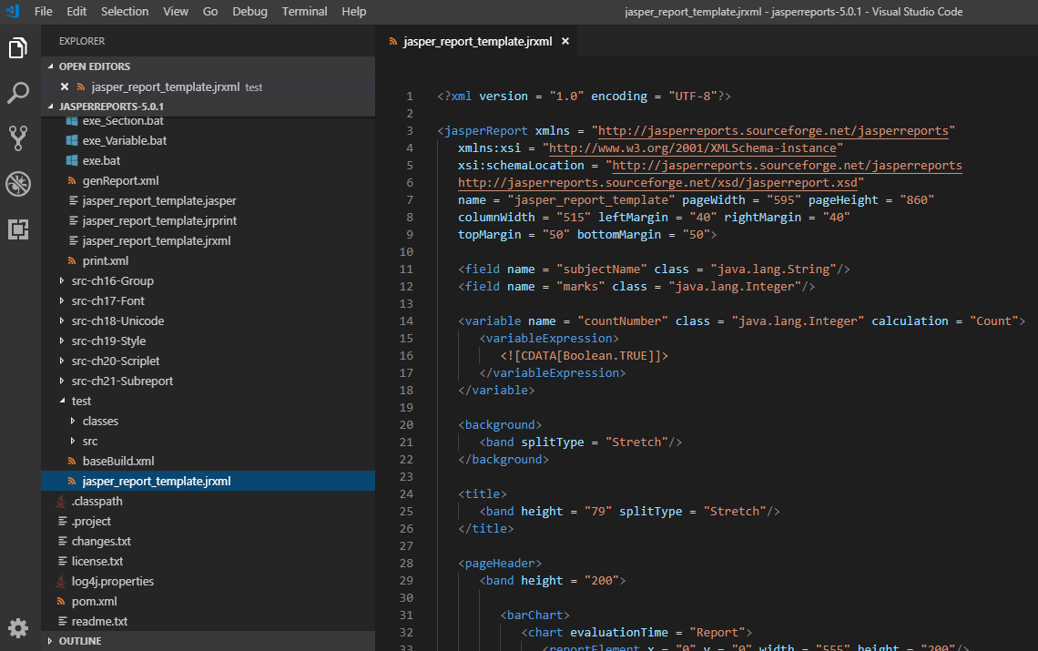
22.1 jasper_report_template.jrxml
https://www.tutorialspoint.com/jasper_reports/index.htm
Write jasper_report_template.jrxml to display each subhject.
Add the <barChart> element to the <pageHeader> section and <pieChart> to <summary> section.
Save jasper_report_template.jrxml to the directory C:\tools\jasperreports-5.0.1\test. The contents of the file are as given below

Slide 34
22.1 jasper_report_template.jrxml
https://www.tutorialspoint.com/jasper_reports/index.htm
The details of the above file are as given below (1):
The JRXML element used to create a bar chart is </barChart> in the <pageHeader>. It contains a </chart> sub-element, which contains a <reportElement> sub-element defining the chart's dimensions and position.
The <dataset> element in a bar chart must be enclosed between <categoryDataset> and </categoryDataset> JRXML elements.
<categoryDataset> must contain a <categorySeries> element. This element defines what data element the bars will represent (subject names, in this example).
<categoryDataset> must also contain an element, which defines how the data will be separated into categories for comparison. Here, data is separated by subject names.
The <valueExpression> element defines that what expression is used to determine the value of each bar in the chart. Here, we are using "marks".

Slide 35
22.1 jasper_report_template.jrxml
https://www.tutorialspoint.com/jasper_reports/index.htm
The details of the above file are as given below (2):
For the pie chart, we have used the element <pieChart> under the <summary> section. It contains a </chart> sub-element.
The sub-element contains a report expression indicating what to use as a key in the chart. Here, we have used subjectName.
The sub-element contains an expression used to calculate the value for the key. Here, we have used marks.

Slide 36
22.2 JasperReportFill.java

Slide 37
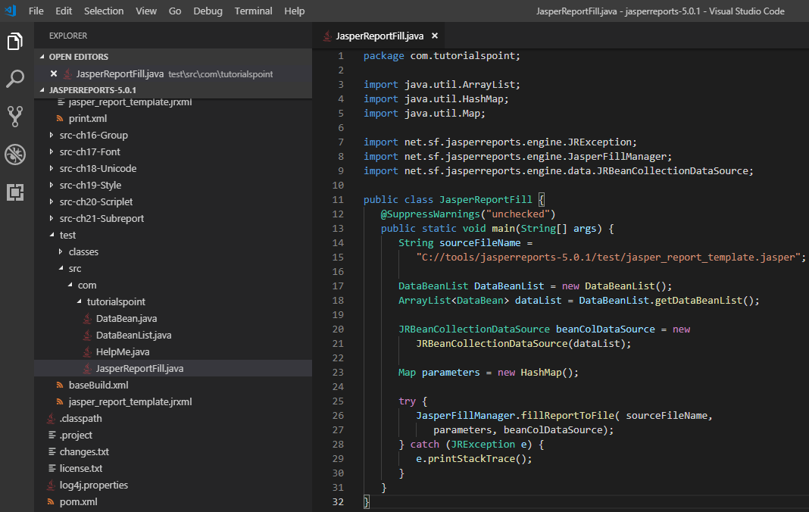
22.2 JasperReportFill.java
https://www.tutorialspoint.com/jasper_reports/index.htm
The JasperReportFill.java for report filling remains unchanged.
Put it to C:\tools\jasperreports-5.0.1\test\src\com\tutorialspoint directory.

Slide 38
22.3 POJO DataBean.java

Slide 39
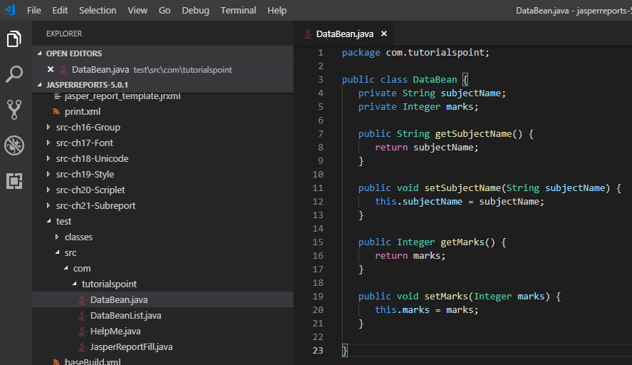
22.3 POJO DataBean.java
https://www.tutorialspoint.com/jasper_reports/index.htm
We will display the marks for each subject. POJO DataBean.java needs change.
C:\tools\jasperreports-5.0.1\test\src\com\tutorialspoint\DataBean.java as below.

Slide 40
22.4 DataBeanList.java

Slide 41
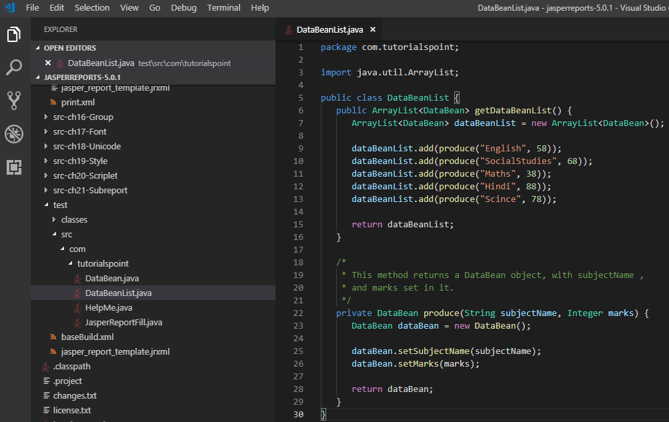
22.4 DataBeanList.java
https://www.tutorialspoint.com/jasper_reports/index.htm
Write C:\tools\jasperreports-5.0.1\test\src\com\tutorialspoint\DataBeanList.java as below.

Slide 42
22.5 buildChart.xml

Slide 43
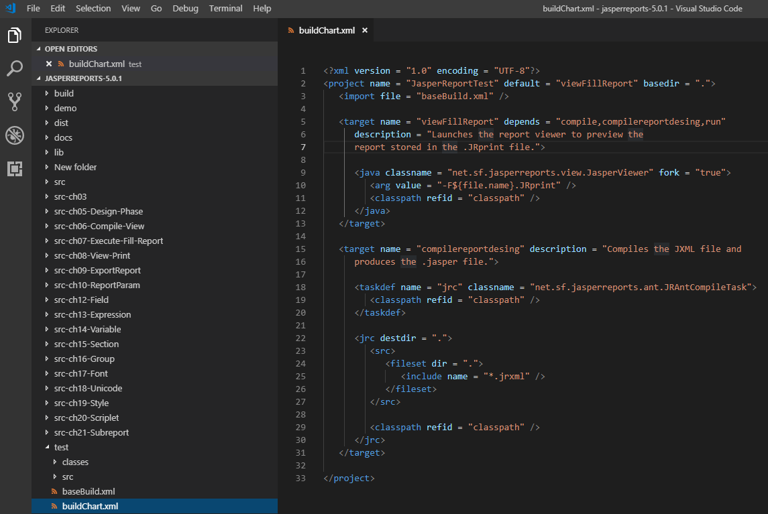
22.5 buildChart.xml
https://www.tutorialspoint.com/jasper_reports/index.htm
Write buildChart.xml as below.
The import file - baseBuild.xml is picked up from the chapter 03 Environment Setup and should be placed in the same directory as the buildChart.xml.

Slide 44
22.6 exe_Chart.bat

Slide 45
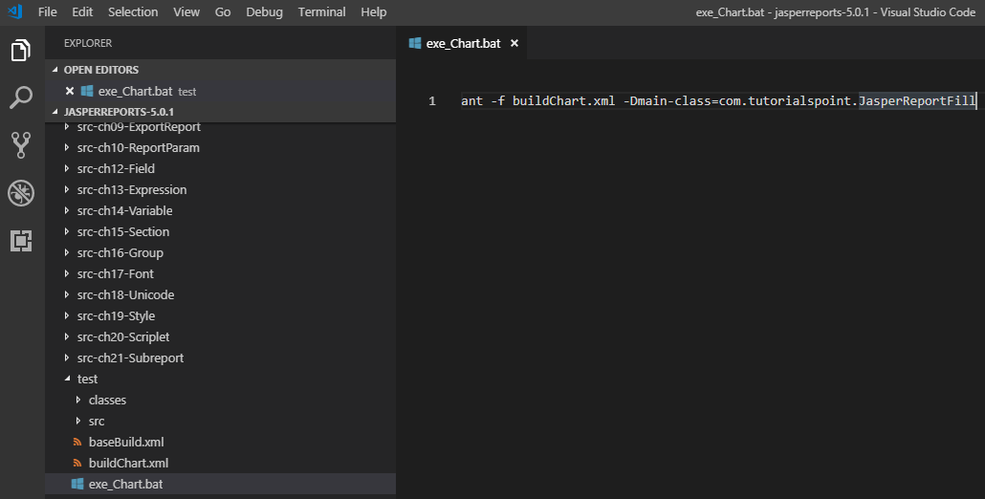
22.6 exe_Chart.bat
https://www.tutorialspoint.com/jasper_reports/index.htm
Write exe_Chart.bat
ant -f buildChart.xml -Dmain-class=com.tutorialspoint.JasperReportFill

Slide 46
22.7 Run exe_Chart.bat

Slide 47
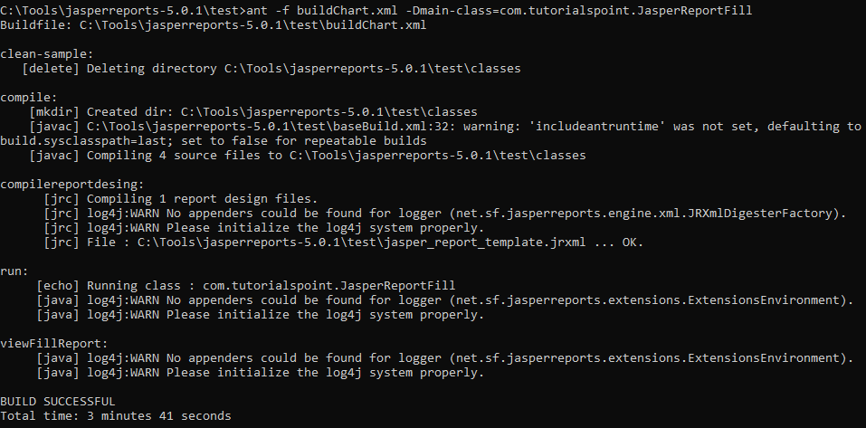
22.7 Run exe_Chart.bat
https://www.tutorialspoint.com/jasper_reports/index.htm
Run exe_Chart.bat.

Slide 48
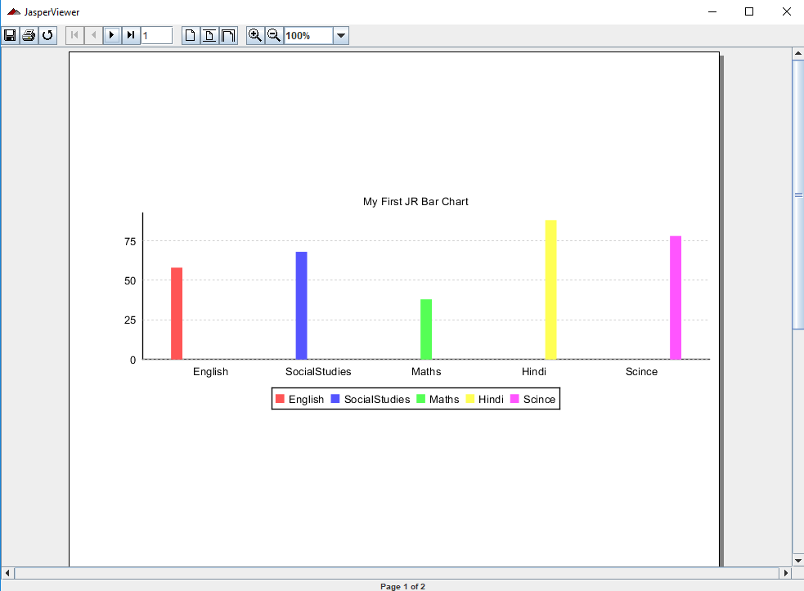
22.7 Run exe_Chart.bat
https://www.tutorialspoint.com/jasper_reports/index.htm
Display Bar Chart: The bar chart displays in the pageheader and the pie chart displays in the summary sections.

Slide 49
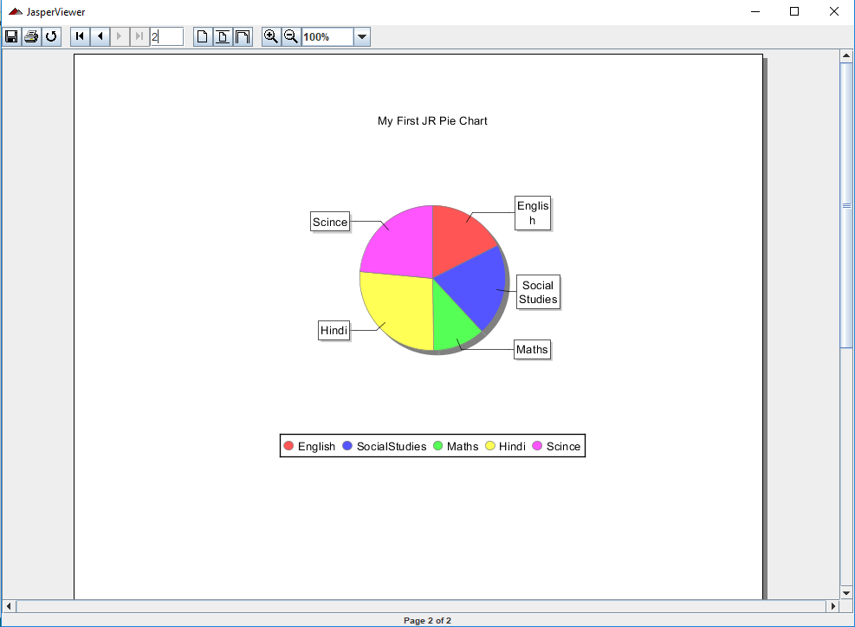
22.7 Run exe_Chart.bat
https://www.tutorialspoint.com/jasper_reports/index.htm
Display Pie Chart.

Slide 50
End of Chapter

