Slide 1

4 Handle Report
Peter H. Chen

Slide 2
4 Handle Report
http://jasperreports.sourceforge.net/JasperReports-Ultimate-Guide-3.pdf
The output of the report-filling process is a pixel-perfect document made of multiple pages, each containing a series of absolutely positioned and sized visual elements.
The document is an instance of the net.sf.jasperreports.engine.JasperPrint class, and it is the responsibility of the parent application to make use of it once generated by JasperReports.
JasperPrint objects can be serialized for storage or transfer over the network, viewed using a built-in viewer component, or printed or exported to more popular document formats like PDF, HTML, RTF, XLS, ODT, CSV, or XML.

Slide 3
4 Handle Report
http://jasperreports.sourceforge.net/JasperReports-Ultimate-Guide-3.pdf
LOADING AND SAVING GENERATED REPORTS (1)
Once a net.sf.jasperreports.engine.JasperPrint object has been created as a result of the report-filling process, you can serialize it and store it on disk, normally in a *.jrprint file.
We could say that this is the proprietary format in which JasperReports stores its generated documents.
You can easily save and load JasperPrint objects to and from *.jrprint files or other byte streams using the net.sf.jasperreports.engine.util.JRSaver and net.sf.jasperreports.engine.util.JRLoader utility classes that the library offers.
The JRLoader has various methods for loading serialized objects from files, URLs, input streams, or classpath resources.
Its loadObjectFromLocation (String) method is the most flexible because it has a built-in fall back mechanism that tries to understand if the supplied java.lang.String location is a URL, file name, or classpath resource; only after all these fail will it raise an error.

Slide 4
4 Handle Report
http://jasperreports.sourceforge.net/JasperReports-Ultimate-Guide-3.pdf
LOADING AND SAVING GENERATED REPORTS (2)
Sometimes it is more convenient to store generated documents in a text-based format like XML instead of serialized JasperPrint objects.
This can be achieved by exporting those documents to XML using the net.sf.jasperreports.engine.export.JRXmlExporter implementation.
The recommended file extension for these is *.jrpxml.
The documents can be parsed back into in-memory JasperPrint objects using the net.sf.jasperreports.engine.xml.JRPrintXmlLoader utility class.
Exporting to XML is explained in detail in the “XML Exporter” section.

Slide 5
4 Handle Report
http://jasperreports.sourceforge.net/JasperReports-Ultimate-Guide-3.pdf
VIEWING REPORTS (1)
JasperReports provides a built-in viewer for viewing the generated reports in its proprietary format or in the proprietary XML format produced by the internal XML exporter.
It is a Swing-based component.
Other Java applications can easily integrate this component without having to export the documents into more popular formats in order to be viewed or printed.
The net.sf.jasperreports.view.JRViewer class represents this visual component.
It can be customized to respond to a particular application’s needs by subclassing it.
For example, you could add or remove buttons from the existing toolbar.
This is illustrated in the supplied /demo/samples/webapp sample, where the JRViewerPlus class adds a new button to the existing toolbar of this report viewer component.

Slide 6
4 Handle Report
http://jasperreports.sourceforge.net/JasperReports-Ultimate-Guide-3.pdf
VIEWING REPORTS (2)
More details about how to extend the viewer component are provided in the “Customizing Viewers”.
JasperReports also comes with a simple Swing application that uses the visual component for viewing the reports.
This application helps view reports stored on disk in the JasperReports *.jrprint proprietary format or in the JRPXML format produced by the default XML exporter.
This simple Java Swing application is implemented in the net.sf.jasperreports.view.JasperViewer class.
It is used in almost all the provided samples for viewing the generated reports.
To view a sample report if you have the Ant build tool installed on your system, go to the desired sample directory and launch the following from the command line: > ant view or [> ant xml; > ant viewXml]
You should see the window shown in Figure 4-1.

Slide 7
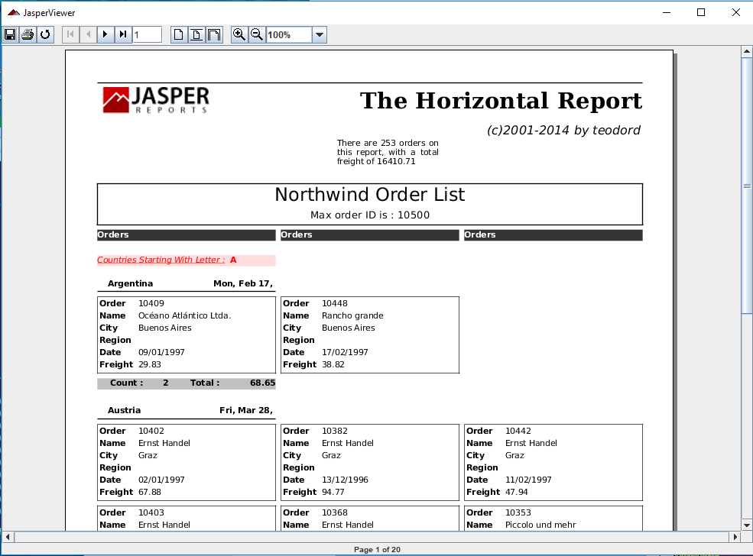
4 Handle Report
http://jasperreports.sourceforge.net/JasperReports-Ultimate-Guide-3.pdf
VIEWING REPORTS (3)
You should see the window shown in Figure 4-1.
Figure 4-1. Report viewer

Slide 8
4 Handle Report
http://jasperreports.sourceforge.net/JasperReports-Ultimate-Guide-3.pdf
VIEWING REPORTS (4)
Note:
The viewer application implemented in the net.sf.jasperreports.view.JasperViewer class should be considered a demo application that shows how the net.sf.jasperreports.view.JRViewer component can be used in Swing applications to display reports.
If you use it directly in your application by calling the public and static viewReport() methods it exposes, when you close the report viewer frame, the application will unexpectedly terminate. This is because the JasperViewer class makes a call to System.exit(0). A workaround is to subclass it and remove the java.awt.event.WindowListener it has registered by default.

Slide 9
4 Handle Report
http://jasperreports.sourceforge.net/JasperReports-Ultimate-Guide-3.pdf
PRINTING REPORTS (1)
The main objective of the JasperReports library is to create ready-to-print documents.
Most reports that are generated by applications end up (or are supposed to end up) on paper.
The printing functionality built into JasperReports at this time reflects the evolution of printing capabilities within the Java platform.
JDK 1.2 introduced a new API called the Java 2 Printing API to allow Java applications to render all Java 2D graphics on any platform even though the host and printer capabilities are over matched by Java 2D.
This requirement meant that the Printing API in some situations would have had to rasterize Java 2D graphics on the host computer.
The SDK 1.2 Printing API primarily supplies the “imaging” portion of the print subsystem and allows applications to format pages and draw their contents; however, printer discovery is not supported by the SDK 1.2 Printing API.

Slide 10
4 Handle Report
http://jasperreports.sourceforge.net/JasperReports-Ultimate-Guide-3.pdf
PRINTING REPORTS (2)
An application can obtain information about the current printer and print to it by using the Printing API.
The printing dialog supplied by the Printing API also allows a user to change the current printer, but the application cannot do this automatically.
Starting with JDK 1.4, a new Java print API called the Java Print Service API was introduced to allow applications to print on all Java platforms (including platforms requiring a small footprint, such as a J2ME profile) and still support the existing Java 2 Printing API.
The Java Print Service API includes an extensible print attribute set based on the standard attributes specified in the Internet Printing Protocol (IPP) 1.1 from the Internet Engineering Task Force (IETF).
With these attributes, client and server applications can discover and select printers that have the capabilities specified by the attributes.
You can print the documents generated by the JasperReports library using the net.sf.jasperreports.engine.JasperPrintManager class, which is a facade class that relies on the former Java 2 Printing API.

Slide 11
4 Handle Report
http://jasperreports.sourceforge.net/JasperReports-Ultimate-Guide-3.pdf
PRINTING REPORTS (3)
Of course, documents can also be printed after they are exported to other formats such as HTML or PDF.
However, here we will explain how to use the specialized manager class mentioned to print documents that are stored or transferred in the JasperReports proprietary format (net.sf.jasperreports.engine.JasperPrint objects).
Among the various methods that the net.sf.jasperreports.engine.JasperPrintManager class exposes, some allow printing a whole document, a single page, or a page range, with and without displaying the print dialog.
Here is how you can print an entire document without displaying the standard print dialog: JasperPrintManager.printReport(myReport, false);
Here is how to print all the pages from 5 to 11 of your document, after having displayed the standard print dialog: JasperPrintManager.printPages(myReport, 4, 10, true);

Slide 12
4 Handle Report
http://jasperreports.sourceforge.net/JasperReports-Ultimate-Guide-3.pdf
PRINTING REPORTS (4)
Making use of the much more flexible Java Print Service API introduced with JDK 1.4 requires a special exporter implementation.
This implementation uses this new API to allow applications to print JasperReports documents to printing services searched for using attributes such as the network printer name and/or page size.
This is the net.sf.jasperreports.engine.export.JRPrintServiceExporter class. More details about using it can be found in the “Java Print Service Exporter”.
An exporter implementation is well suited for sending documents to the printer through the Java Print Service API, because in some ways printing is similar to document exporting; both printing and exporting store generated reports in some other format (paper).

Slide 13
4 Handle Report
http://jasperreports.sourceforge.net/JasperReports-Ultimate-Guide-3.pdf
EXPORTING REPORTS (1)
In some application environments, it is useful to transform the JasperReports–generated documents from the proprietary format into other, more popular formats like PDF, HTML, RTF, or XLS.
This way, users can view those reports without having to install special viewers on their systems, which is especially important in the case of documents sent over a network.
There is a facade class in JasperReports for this type of functionality: net.sf.jasperreports.engine.JasperExportManager; it can be used to obtain PDF, HTML, or XML content for the documents produced by the report-filling process.
Exporting means taking a net.sf.jasperreports.engine.JasperPrint object, which represents a JasperReports document, and transforming it into a different format.
The main reason to export reports into other formats is to allow more people to view those reports.
HTML reports can be viewed by anybody these days, since at least one browser is available on any system.

Slide 14
4 Handle Report
http://jasperreports.sourceforge.net/JasperReports-Ultimate-Guide-3.pdf
EXPORTING REPORTS (2)
Viewing JasperReports documents in their proprietary form would require the installation of special software on the target platform (at least a Java applet, if not more).
With time, more and more output formats will be supported by the JasperReports library.
For the moment, the various exporter implementations shipped with the library produce only PDF, HTML, RTF, XLS, ODT, CSV, and XML output.
These implementations are found in the net.sf.jasperreports.engine.export package.
The JasperExportManager class offers easy access for only the PDF, HTML, and XML implementations, as these have historically been the most common formats or required the least export configuration.

Slide 15
4 Handle Report
http://jasperreports.sourceforge.net/JasperReports-Ultimate-Guide-3.pdf
EXPORTING REPORTS (3)
Here’s how you can export your report to HTML format using the facade export manager class:
JasperExportManager.exportReportToHtmlFile(myReport);
To avoid excessive utility methods, this class was originally written such that the default settings only offer easy access to the most common export formats.
When new exporters were added to the library, the export manager class was not extended, and users were encouraged to use the exporter classes directly.
Only by doing that could they fully customize the behavior of that particular exporter using specific exporter parameters.
The chapter “Report Exporters” explains in detail how to use each exporter implementation currently shipped with the JasperReports library.
Note To export reports into other formats not supported by JasperReports, you must implement a special interface called net.sf.jasperreports.engine.JRExporter or extend the corresponding net.sf.jasperreports.engine.JRAbstractExporter class.

Slide 16
End of Chapter

