Slide 1

5 Large File Support
Peter H. Chen

Slide 2
5 Large File Support
http://jasperreports.sourceforge.net/JasperReports-Ultimate-Guide-3.pdf
Large File Support (1)
When filling report templates with data, the engine takes a JasperReport object along with the supplied parameters and data source and generates an in-memory JasperPrint object.
If very large datasets are used for report filling, the size of the resulting JasperPrint object could also be very large and might cause the JVM to run out of memory.
To increase the memory available for the Java application, first use the -Xmx option when launching the JVM, since the default value for this parameter is fairly small.
However, if you do this with large datasets (for example, containing tens of thousands or more records and resulting in documents that have thousands or more pages), the JVM may run out of memory.
Recent versions of JasperReports offer a simple solution to the problem by introducing the report virtualizer.

Slide 3
5 Large File Support
http://jasperreports.sourceforge.net/JasperReports-Ultimate-Guide-3.pdf
Large File Support (2)
The virtualizer is a simple interface (net.sf.jasperreports.engine.JRVirtualizer) that enables the reporting engine to optimize memory consumption during report filling by removing parts of the JasperPrint object from memory and storing them on disk or in other temporary locations.
If a report virtualizer is used during filling, the engine keeps only a limited number of pages from the generated JasperPrint object at a time and serializes all the other pages to a temporary storage location, usually the file system.
Using a report virtualizer is very simple.
You supply an instance of the net.sf.jasperreports.engine.JRVirtualizer interface as the value for the builtin REPORT_VIRTUALIZER parameter when filling the report.
In virtualized form, a generated JasperPrint document still behaves normally and can be subject to exporting, printing, or viewing processes, and the impact on memory consumption is minimal even when dealing with very large documents.

Slide 4
5 Large File Support
http://jasperreports.sourceforge.net/JasperReports-Ultimate-Guide-3.pdf
Large File Support (3)
When produced using a virtualizer (which itself performs partial document serialization into temporary files), once completed, a JasperPrint document can itself be serialized normally without any loss of information.
During the serialization of a virtualized JasperPrint object, the program puts back together all the pieces and a single serialized file is produced.
However, because this single file is probably very large, simple deserialization would not make sense (in fact, it wouldn’t be possible, as the JVM would run out of memory, which is the reason for using virtualization in the first place).
So in order to reload into memory a virtualized document that was serialized to a permanent storage facility, a report virtualizer is needed.
This would be set using a local thread variable by calling the following:
JRVirtualizationHelper.setThreadVirtualizer(JRVirtualizer virtualizer)
For details about how report virtualization can be used for generating large reports, check the supplied /demo/samples/virtualizer sample.

Slide 5
5 Large File Support
http://jasperreports.sourceforge.net/JasperReports-Ultimate-Guide-3.pdf
FILE VIRTUALIZER (1)
The library ships with a ready-to-use implementation of this interface called net.sf.jasperreports.engine.fill.JRFileVirtualizer, which stores document pages on disk during the filling process to free up memory.
Once a JasperPrint object is produced using a report virtualizer, it can be exported to other formats or viewed directly using the library’s built-in viewer component, even though this document is not fully loaded at any one time. The virtualizer ensures that pages are deserialized and loaded from their temporary storage location as needed during exporting or display.
A single JRFileVirtualizer instance can be shared across multiple report-filling processes so that the number of document pages kept in-memory at any one time will be limited by the virtualizer maxSize property, regardless of the number of reports that are generated simultaneously.
Because it works with temporary files on disk, the file virtualizer has a built-in mechanism to remove those files after they are no longer needed (that is, after the generated document or the virtualizer itself have been disposed of by the JVM).

Slide 6
5 Large File Support
http://jasperreports.sourceforge.net/JasperReports-Ultimate-Guide-3.pdf
FILE VIRTUALIZER (2)
Because it works with temporary files on disk, the file virtualizer has a built-in mechanism to remove those files after they are no longer needed (that is, after the generated document or the virtualizer itself have been disposed of by the JVM).
The cleanup() method exposed by this virtualizer implementation can be also called manually so that the temporary files are removed from disk right away instead of after the finalization of the entities involved.
To ensure that no virtualization files are left over on disk by the application that uses the file virtualizer, all these temporary files are registered with the JVM so that they are deleted automatically when the JVM exits normally.

Slide 7
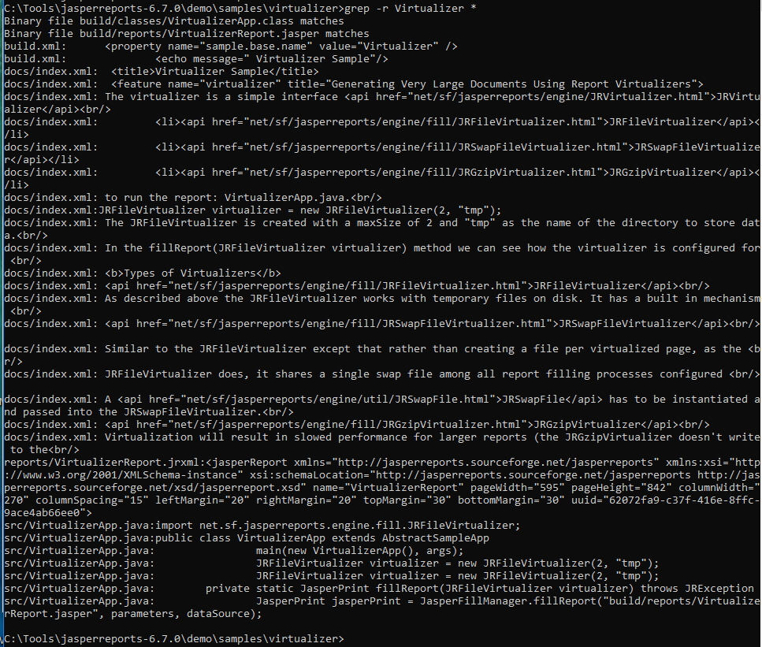
5 Large File Support
http://jasperreports.sourceforge.net/JasperReports-Ultimate-Guide-3.pdf
FILE VIRTUALIZER (3)
But using File.deleteOnExit() will accumulate JVM process memory on some virtual machine implementations (see http://bugs.sun.com/bugdatabase/view_bug.do?bug_id=4513817); you should avoid using this feature in long-running applications by turning it off using the net.sf.jasperreports.virtualizer.files.delete.on.exit configuration property.

Slide 8
End of Chapter

