Slide 1

6 API Overview
Peter H. Chen

Slide 2
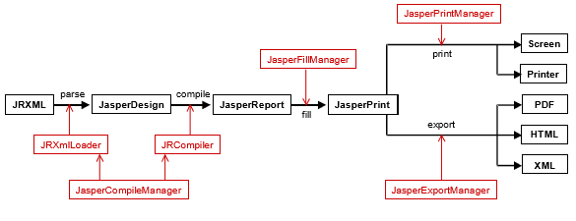
6 API Overview
http://jasperreports.sourceforge.net/JasperReports-Ultimate-Guide-3.pdf
API Overview (1)
Usually you will work only with a few JasperReports library classes and won’t have to get to know the entire API.
This section addresses the classes and interfaces that are significant when using the library, and shows you how to use them in applications that require reporting functionality (see Figure 6-1).
*.jasper
*.jrprint
Figure 6-1. JasperReports API overview

Slide 3
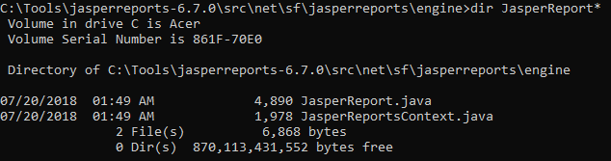
6 API Overview
http://jasperreports.sourceforge.net/JasperReports-Ultimate-Guide-3.pdf
NET.SF.JASPERREPORTS.ENGINE.DESIGN.JasperDesign
Instances of this class are the raw material that the JasperReports library uses to generate reports. Such instances are usually obtained by parsing the JRXML report template files using the library’s internal XML-parsing utility classes.
But they can also be independently generated by the application that uses JasperReports through API calls if working with JRXML files is not an option.
Third-party GUI design tools use the JasperReports API to create these report template objects. Among the supplied samples that come with the project source files, there is one inside /demo/samples/noxmldesign that you can check to see how to dynamically create a JasperDesign object without editing a JRXML report design file.
All instances of the JasperDesign class are subject to compilation before being used for filling and report generation. This is why they are considered the raw material for the library.

Slide 4
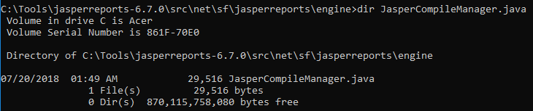
6 API Overview
http://jasperreports.sourceforge.net/JasperReports-Ultimate-Guide-3.pdf
NET.SF.JASPERREPORTS.ENGINE.JasperCompileManager
This is the class that exposes all the library’s report compilation functionality. It has various methods that allow the users to compile JRXML report templates found in files on disk or that come from input streams.
It also lets you compile in-memory report templates by directly passing a net.sf.jasperreports.engine.design.JasperDesign object and receiving the corresponding net.sf.jasperreports.engine.JasperReport object.
Other utility methods include report template verification and JRXML report template generation for in-memory constructed net.sf.jasperreports.engine.design.JasperDesign class instances.
These instances are especially useful in GUI tools that simplify report design work.

Slide 5
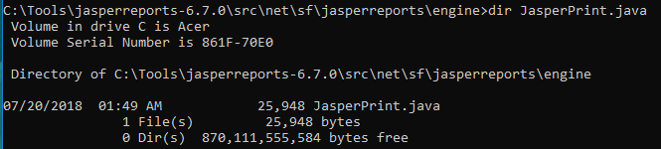
6 API Overview
http://jasperreports.sourceforge.net/JasperReports-Ultimate-Guide-3.pdf
NET.SF.JASPERREPORTS.ENGINE.JasperPrint
After a compiled report template is filled with data, the resulting document comes in the form of a net.sf.jasperreports.engine.JasperPrint instance. Such an object can be viewed directly using the built-in JasperReports report viewer, or can be serialized for disk storage and later use or sending over the network. The instances of this class are the output of the report-filling process of the JasperReports library, and represent its proprietary format for storing full-featured, pageoriented documents. You can transform them into other more popular formats (such as PDF, HTML, RTF, XLS, ODT, CSV, or XML) by using the library’s export functionality.

Slide 6
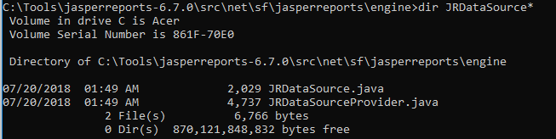
6 API Overview
http://jasperreports.sourceforge.net/JasperReports-Ultimate-Guide-3.pdf
NET.SF.JASPERREPORTS.ENGINE.JRDataSource
JasperReports is very flexible as to the source of the report data. It lets people use any kind of data source they want, as long as they can provide an appropriate implementation of this interface.
Normally, every time a report is filled, an instance of this interface is supplied or created behind the scenes by the reporting engine.
NET.SF.JASPERREPORTS.ENGINE.JRResultSetDataSource
This is a default implementation of the net.sf.jasperreports.engine.JRDataSource interface. Since most reports are generated using data from a relational database, JasperReports includes by default this implementation that wraps a java.sql.ResultSet object.
This class can be instantiated intentionally to wrap already loaded result sets before passing them to the report-filling routines, but it is also used by the reporting engine to wrap the data retrieved from the database after having executed the report query (if present) through JDBC.

Slide 7
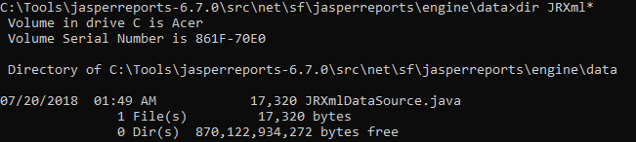
6 API Overview
http://jasperreports.sourceforge.net/JasperReports-Ultimate-Guide-3.pdf
NET.SF.JASPERREPORTS.ENGINE.DATA.JRXmlDataSource
If application data resides inside XML files, and you need this data to generate reports, the built-in XPath-based implementations of the JRDataSource interface are useful.
With the help of an XPath query, the XML data can take a tabular form and be fed into the report-filling process to generate documents. The /demo/samples/xmldatasource sample in the distribution package shows how this special data source implementation can be used with XML data.

Slide 8
6 API Overview
http://jasperreports.sourceforge.net/JasperReports-Ultimate-Guide-3.pdf
NET.SF.JASPERREPORTS.ENGINE.JREmptyDataSource
The simplest implementation of the net.sf.jasperreports.engine.JRDataSource interface, this class can be used in reports that do not display data from the supplied data source, but rather from parameters, and when only the number of virtual rows in the data source is important.
Many of the provided samples found in the /demo/samples directory of the project’s distribution (such as fonts, images, shapes, and unicode) use an instance of this class when filling reports to simulate a data source with one record in it, but with all the fields in this single record being null.

Slide 9
6 API Overview
http://jasperreports.sourceforge.net/JasperReports-Ultimate-Guide-3.pdf
NET.SF.JASPERREPORTS.ENGINE.JASPERFILLMANAGER
This class is the facade to the report-filling functionality of the JasperReports library. It exposes a variety of methods that receive a report template in the form of an object, file, or input stream, and also produces a document in various output forms (object, file, or output stream).
Along with the report template, the report-filling engine must also receive data from the data source, as well as the values for the report parameters, to generate the documents. Parameter values are always supplied in a java.util.Map object, in which the keys are the report parameter names.
The data source can be supplied in two different forms, depending on the situation.
Normally, it is supplied as a net.sf.jasperreports.engine.JRDataSource object, as just mentioned.
However, since most reports are filled with data from relational databases, JasperReports has a built-in default behavior that lets people specify an SQL query in the report template itself. This SQL query is executed to retrieve the data for filling the report at runtime.
In such cases, the only thing JasperReports needs is a java.sql.Connection object, instead of the usual data source object. It needs this connection object to connect to the relational database management system through JDBC and execute the report query.
It automatically creates a net.sf.jasperreports.engine.JRResultSetDataSource behind the scenes to wrap the java.sql.ResultSet object returned after the execution of the query and passes it to the normal report-filling process.

Slide 10
6 API Overview
http://jasperreports.sourceforge.net/JasperReports-Ultimate-Guide-3.pdf
NET.SF.JASPERREPORTS.ENGINE.JRAbstractScriptlet
Scriptlets are a very powerful feature of the JasperReports library. They allow users to write custom code to be executed by the reporting engine during the report-filling process. This user code can manipulate report data and gets executed at well-defined moments such as page, column, or group breaks.
NET.SF.JASPERREPORTS.ENGINE.JRDeafultScriptlet
This is a convenient subclass of the net.sf.jasperreports.engine.JRAbstractScriptlet class. You will usually subclass this when working with scriptlets so that they don’t have to implement all the abstract methods declared in the abstract class.

Slide 11
6 API Overview
http://jasperreports.sourceforge.net/JasperReports-Ultimate-Guide-3.pdf
NET.SF.JASPERREPORTS.ENGINE.JasperPrintManager
After having filled a report, you have the option of viewing it, exporting it to a different format, or (most commonly) printing it.
In JasperReports, you can print reports using this manager class, which is a facade to the printing functionality exposed by the library. This class contains various methods that can send entire documents or portions of them to the printer. It also allows you to choose whether to display the print dialog. You can display the content of a page from a JasperReports document by generating a java.awt.Image object for it using this manager class.
NET.SF.JASPERREPORTS.ENGINE.JasperExportManager
As already mentioned, JasperReports can transform generated documents from its proprietary format into more popular documents formats such as PDF, HTML, or XML. Over time, this part of the JasperReports functionality has been extended to support other formats, including RTF, XSL, and CSV. This manager class has various methods that can process data that comes from different sources and goes to different destinations (files, input and output streams, etc.).
NET.SF.JASPERREPORTS.ENGINE.JasperRunManager
Sometimes it is useful to produce documents only in a popular format such as PDF or HTML, without having to store on disk the serialized, intermediate net.sf.jasperreports.engine.JasperPrint object produced by the report-filling process.
This can be achieved using this manager class, which immediately exports the document produced by the report-filling process into the desired output format. The use of this manager class is shown and can be tested in the supplied /demo/samples/webapp sample, where PDF and HTML content is produced on the fly.

Slide 12
6 API Overview
http://jasperreports.sourceforge.net/JasperReports-Ultimate-Guide-3.pdf
NET.SF.JASPERREPORTS.VIEW.JRViewer
This class is different from the rest of the classes listed previously in that it is more like a pluggable visual component than a utility class. It can be used in Swing-based applications to view the reports generated by the JasperReports library.
This visual component is not meant to satisfy everybody. It was included like a demo component to show how the core printing functionality can be used to display the reports in Swing-based applications.
The preferred way to adapt this component to a particular application is by subclassing it. The “Customizing Viewers” section on page 276 gives more details abo
NET.SF.JASPERREPORTS.VIEW.JasperViewer
This class also serves a didactic purpose. It uses the net.sf.jasperreports.view.JRViewer component to display reports. It represents a simple Java Swing application that can load and display reports. It is used in almost all of the supplied samples to display the generated documents.
NET.SF.JASPERREPORTS.VIEW.JasperDesignViewer
Usually, an application that uses the JasperReports library for reporting purposes will never use this class. This class can be used at design time to preview the report templates. It was included in the main library as a development tool in order to make up for the missing visual designer. This class is also used in all the samples to preview the report designs, either in raw JRXML form or the compiled form.

Slide 13
6 API Overview
http://jasperreports.sourceforge.net/JasperReports-Ultimate-Guide-3.pdf
NET.SF.JASPERREPORTS.ENGINE.UTIL.JRLoader
Many JasperReports processes, like report compilation, report filling, and exporting, often work with serialized objects. Sometimes it is useful to manually load those serialized objects before submitting them to the desired JasperReport process. The net.sf.jasperreports.engine.util.JRLoader class is a utility class that helps load serialized objects found in various locations such as files, URLs, and input streams. The most interesting method exposed by this class is loadObjectFromLocation(String). When calling this method to load an object from the supplied location, the program first tries to interpret the location as a valid URL. If this fails, then the program assumes that the supplied location is the name of a file on disk and tries to read from it. If no file is found at that location, it will try to locate a resource through the classpath that would correspond to the location. Only after this third try fails is an exception thrown.
NET.SF.JASPERREPORTS.ENGINE.UTIL.JRSaver
This utility class can be used when serializable objects must be saved on disk or sent over the network through an output stream.
NET.SF.JASPERREPORTS.ENGINE.XML.JRXmlLoader
Parsing a JRXML file into a JasperDesign object can be done using one of the methods published by this class. Applications might need to do this in cases where report templates kept in their source form (JRXML) must be modified at runtime based on some user input and then compiled on the fly for filling with data.
NET.SF.JASPERREPORTS.ENGINE.XML.JRPrintXmlLoader
Generated documents can be stored in XML format if they are exported using the net.sf.jasperreports.engine.export.JRXmlExporter. After they’re exported, you can parse them back into net.sf.jasperreports.engine.JasperPrint objects by using this JRPrintXmlLoader.

Slide 14
End of Chapter

