Slide 1

1 Data Structure
Peter H. Chen

Slide 2
1 Data Structure
https://www.tutorialspoint.com/java/java_data_structures.htm/
The data structures provided by the Java utility package are very powerful and perform a wide range of functions.
These data structures consist of the following interface and classes −
Enumeration
BitSet
Vector
Stack
Dictionary
Hashtable
Properties
All these classes are now legacy and Java-2 has introduced a new framework called Collections Framework, which is discussed in the next chapter.

Slide 3
1.1 Enumeration

Slide 4
1.1 Enumeration
https://www.tutorialspoint.com/java/java_data_structures.htm/
The Enumeration interface isn't itself a data structure, but it is very important within the context of other data structures.
The Enumeration interface defines a means to retrieve successive elements from a data structure.
For example, Enumeration defines a method called nextElement that is used to get the next element in a data structure that contains multiple elements.
The Enumeration interface defines the methods by which you can enumerate (obtain one at a time) the elements in a collection of objects.
This legacy interface has been superceded by Iterator.
Although not deprecated, Enumeration is considered obsolete for new code. However, it is used by several methods defined by the legacy classes such as Vector and Properties, is used by several other API classes, and is currently in widespread use in application code.
The methods declared by Enumeration are summarized in the following table

Slide 5
1.1 Enumeration
https://www.tutorialspoint.com/java/java_data_structures.htm/
To have more detail about this interface, check The Enumeration.
No. | Method & Description
1 | boolean hasMoreElements( ) When implemented, it must return true while there are still more elements to extract, and false when all the elements have been enumerated.
2 | Object nextElement( ) This returns the next object in the enumeration as a generic Object reference.

Slide 6
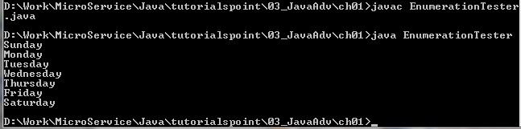
1.1 Enumeration
https://www.tutorialspoint.com/java/java_data_structures.htm/
Example
Following is an example showing usage of Enumeration.
import java.util.Vector;
import java.util.Enumeration;
public class EnumerationTester {
public static void main(String args[]) {
Enumeration <String> days;
Vector <String> dayNames = new Vector<String>();
dayNames.add("Sunday");
dayNames.add("Monday");
dayNames.add("Tuesday");
dayNames.add("Wednesday");
dayNames.add("Thursday");
dayNames.add("Friday");
dayNames.add("Saturday");
days = dayNames.elements();
while (days.hasMoreElements()) {
System.out.println(days.nextElement());
}
}
}

Slide 7
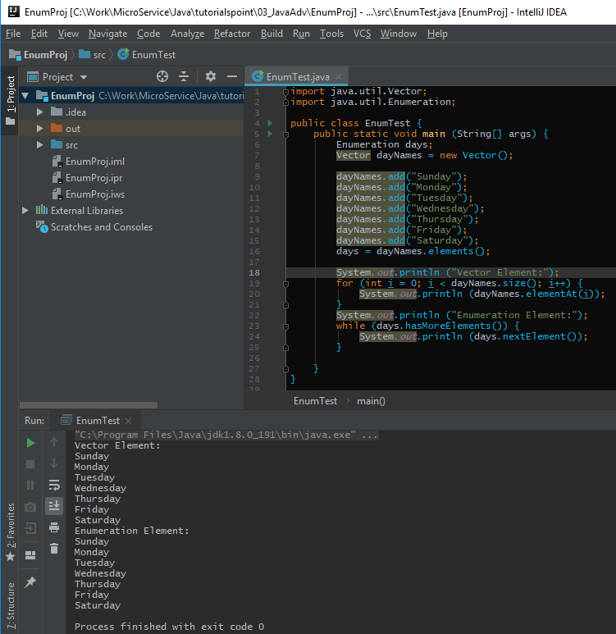
1.1 Enumeration
https://www.tutorialspoint.com/java/java_data_structures.htm/
Example
Following is an example showing usage of Vector and Enumeration.

Slide 8
1.2 BitSet

Slide 9
1.2 BitSet
https://www.tutorialspoint.com/java/java_data_structures.htm/
The BitSet class implements a group of bits or flags that can be set and cleared individually.
This class is very useful in cases where you need to keep up with a set of Boolean values; you just assign a bit to each value and set or clear it as appropriate.
The BitSet class creates a special type of array that holds bit values. The BitSet array can increase in size as needed. This makes it similar to a vector of bits. This is a legacy class but it has been completely re-engineered in Java 2, version 1.5.
The BitSet defines the following two constructors.

Slide 10
1.2 BitSet
https://www.tutorialspoint.com/java/java_data_structures.htm/
For more details about this class, check The BitSet.
No. | Constructor & Description
1 | BitSet( ) This constructor creates a default object.
2 | BitSet(int size) This constructor allows you to specify its initial size, i.e., the number of bits that it can hold. All bits are initialized to zero.

Slide 11
1.2 BitSet
https://www.tutorialspoint.com/java/java_data_structures.htm/
The BitSet interface
No. | Method & Description
1 | void and(BitSet bitSet) ANDs the contents of the invoking BitSet object with those specified by bitSet. The result is placed into the invoking object.
2 | void andNot(BitSet bitSet) For each 1 bit in bitSet, the corresponding bit in the invoking BitSet is cleared.
3 | int cardinality( ) Returns the number of set bits in the invoking object.
4 | void clear( ) Zeros all bits.
5 | void clear(int index) Zeros the bit specified by index.

Slide 12
1.2 BitSet
https://www.tutorialspoint.com/java/java_data_structures.htm/
The BitSet interface
No. | Method & Description
6 | void clear(int startIndex, int endIndex) Zeros the bits from startIndex to endIndex.
7 | Object clone( ) Duplicates the invoking BitSet object.
8 | boolean equals(Object bitSet) Returns true if the invoking bit set is equivalent to the one passed in bitSet. Otherwise, the method returns false.
9 | void flip(int index) Reverses the bit specified by the index.
10 | void flip(int startIndex, int endIndex) Reverses the bits from startIndex to endIndex.

Slide 13
1.2 BitSet
https://www.tutorialspoint.com/java/java_data_structures.htm/
The BitSet interface
No. | Method & Description
11 | boolean get(int index) Returns the current state of the bit at the specified index.
12 | BitSet get(int startIndex, int endIndex) Returns a BitSet that consists of the bits from startIndex to endIndex. The invoking object is not changed.
13 | int hashCode( ) Returns the hash code for the invoking object.
14 | boolean intersects(BitSet bitSet) Returns true if at least one pair of corresponding bits within the invoking object and bitSet are 1.
15 | boolean isEmpty( ) Returns true if all bits in the invoking object are zero.

Slide 14
1.2 BitSet
https://www.tutorialspoint.com/java/java_data_structures.htm/
The BitSet interface
No. | Method & Description
16 | int length( ) Returns the number of bits required to hold the contents of the invoking BitSet. This value is determined by the location of the last 1 bit.
17 | int nextClearBit(int startIndex) Returns the index of the next cleared bit, (that is, the next zero bit), starting from the index specified by startIndex.
18 | int nextSetBit(int startIndex) Returns the index of the next set bit (that is, the next 1 bit), starting from the index specified by startIndex. If no bit is set, -1 is returned.
19 | void or(BitSet bitSet) ORs the contents of the invoking BitSet object with that specified by bitSet. The result is placed into the invoking object.

Slide 15
1.2 BitSet
https://www.tutorialspoint.com/java/java_data_structures.htm/
The BitSet interface
No. | Method & Description
20 | void set(int index) Sets the bit specified by index.
21 | void set(int index, boolean v) Sets the bit specified by index to the value passed in v. True sets the bit, false clears the bit.
22 | void set(int startIndex, int endIndex) Sets the bits from startIndex to endIndex.
23 | void set(int startIndex, int endIndex, boolean v) Sets the bits from startIndex to endIndex, to the value passed in v. true sets the bits, false clears the bits.
24 | int size( ) Returns the number of bits in the invoking BitSet object.

Slide 16
1.2 BitSet
https://www.tutorialspoint.com/java/java_data_structures.htm/
The BitSet interface
No. | Method & Description
25 | String toString( ) Returns the string equivalent of the invoking BitSet object.
26 | void xor(BitSet bitSet) XORs the contents of the invoking BitSet object with that specified by bitSet. The result is placed into the invoking object.

Slide 17
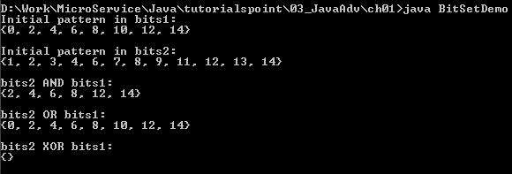
1.2 BitSet
https://www.tutorialspoint.com/java/java_data_structures.htm/
Example:
import java.util.BitSet;
public class BitSetDemo {
public static void main(String args[]) {
BitSet bits1 = new BitSet(16);
BitSet bits2 = new BitSet(16);
// set some bits
for(int i = 0; i < 16; i++) {
if((i % 2) == 0) bits1.set(i); // bit 0, 2, …,15 to 1
if((i % 5) != 0) bits2.set(i); // bit 1-4, 6-9, 11-15 to 1
}
System.out.println("Initial pattern in bits1: ");
System.out.println(bits1);
System.out.println("\nInitial pattern in bits2: ");
System.out.println(bits2);
// AND bits
bits2.and(bits1);
System.out.println("\nbits2 AND bits1: ");
System.out.println(bits2);
// OR bits
bits2.or(bits1);
System.out.println("\nbits2 OR bits1: ");
System.out.println(bits2);
// XOR bits
bits2.xor(bits1);
System.out.println("\nbits2 XOR bits1: ");
System.out.println(bits2);
}
}

Slide 18
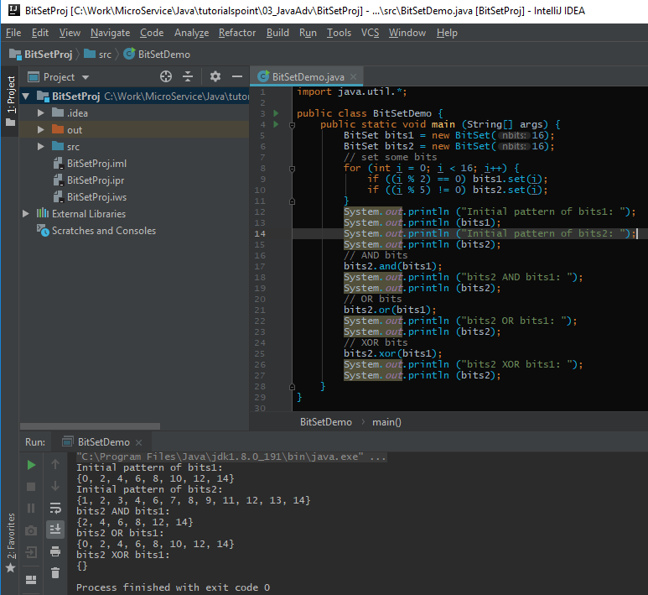
1.2 BitSet
https://www.tutorialspoint.com/java/java_data_structures.htm/
Example BitSet:

Slide 19
1.3 Vector

Slide 20
1.3 Vector
https://www.tutorialspoint.com/java/java_data_structures.htm/
The Vector class is similar to a traditional Java array, except that it can grow as necessary to accommodate new elements.
Like an array, elements of a Vector object can be accessed via an index into the vector.
The nice thing about using the Vector class is that you don't have to worry about setting it to a specific size upon creation; it shrinks and grows automatically when necessary.
For more details about this class, check The Vector.
Vector implements a dynamic array. It is similar to ArrayList, but with two differences −
Vector is synchronized.
Vector contains many legacy methods that are not part of the collections framework.
Vector proves to be very useful if you don't know the size of the array in advance or you just need one that can change sizes over the lifetime of a program.

Slide 21
1.3 Vector
https://www.tutorialspoint.com/java/java_data_structures.htm/
Constructors of Vector class.
No. | Constructor & Description
1 | Vector( ) This constructor creates a default vector, which has an initial size of 10.
2 | Vector(int size) This constructor accepts an argument that equals to the required size, and creates a vector whose initial capacity is specified by size.
3 | Vector(int size, int incr) This constructor creates a vector whose initial capacity is specified by size and whose increment is specified by incr. The increment specifies the number of elements to allocate each time that a vector is resized upward.
4 | Vector(Collection c) This constructor creates a vector that contains the elements of collection c.

Slide 22
1.3 Vector
https://www.tutorialspoint.com/java/java_data_structures.htm/
Vector Method:
No. | Method & Description
1 | void add(int index, Object element) Inserts the specified element at the specified position in this Vector.
2 | boolean add(Object o) Appends the specified element to the end of this Vector.
3 | boolean addAll(Collection c) Appends all of the elements in the specified Collection to the end of this Vector, in the order that they are returned by the specified Collection's Iterator.
4 | boolean addAll(int index, Collection c) Inserts all of the elements in in the specified Collection into this Vector at the specified position.

Slide 23
1.3 Vector
https://www.tutorialspoint.com/java/java_data_structures.htm/
Vector Method:
No. | Method & Description
5 | void addElement(Object obj) Adds the specified component to the end of this vector, increasing its size by one.
6 | int capacity() Returns the current capacity of this vector.
7 | void clear() Removes all of the elements from this vector.
8 | Object clone() Returns a clone of this vector.
9 | boolean contains(Object elem) Tests if the specified object is a component in this vector.

Slide 24
1.3 Vector
https://www.tutorialspoint.com/java/java_data_structures.htm/
Vector Method:
No. | Method & Description
10 | boolean containsAll(Collection c) Returns true if this vector contains all of the elements in the specified Collection.
11 | void copyInto(Object[] anArray) Copies the components of this vector into the specified array.
12 | Object elementAt(int index) Returns the component at the specified index.
13 | Enumeration elements() Returns an enumeration of the components of this vector.
14 | void ensureCapacity(int minCapacity) Increases the capacity of this vector, if necessary, to ensure that it can hold at least the number of components specified by the minimum capacity argument.

Slide 25
1.3 Vector
https://www.tutorialspoint.com/java/java_data_structures.htm/
Vector Method:
No. | Method & Description
15 | boolean equals(Object o) Compares the specified Object with this vector for equality.
16 | Object firstElement() Returns the first component (the item at index 0) of this vector.
17 | Object get(int index) Returns the element at the specified position in this vector.
18 | int hashCode() Returns the hash code value for this vector.
19 | int indexOf(Object elem) Searches for the first occurence of the given argument, testing for equality using the equals method.

Slide 26
1.3 Vector
https://www.tutorialspoint.com/java/java_data_structures.htm/
Vector Method:
No. | Method & Description
20 | int indexOf(Object elem, int index) Searches for the first occurence of the given argument, beginning the search at index, and testing for equality using the equals method.
21 | void insertElementAt(Object obj, int index) Inserts the specified object as a component in this vector at the specified index.
22 | boolean isEmpty() Tests if this vector has no components.
23 | Object lastElement() Returns the last component of the vector.
24 | int lastIndexOf(Object elem) Returns the index of the last occurrence of the specified object in this vector.

Slide 27
1.3 Vector
https://www.tutorialspoint.com/java/java_data_structures.htm/
Vector Method:
No. | Method & Description
25 | int lastIndexOf(Object elem, int index) Searches backwards for the specified object, starting from the specified index, and returns an index to it.
26 | Object remove(int index) Removes the element at the specified position in this vector.
27 | boolean remove(Object o) Removes the first occurrence of the specified element in this vector, If the vector does not contain the element, it is unchanged.
28 | boolean removeAll(Collection c) Removes from this vector all of its elements that are contained in the specified Collection.

Slide 28
1.3 Vector
https://www.tutorialspoint.com/java/java_data_structures.htm/
Vector Method:
No. | Method & Description
29 | void removeAllElements() Removes all components from this vector and sets its size to zero.
30 | boolean removeElement(Object obj) Removes the first (lowest-indexed) occurrence of the argument from this vector.
31 | void removeElementAt(int index) removeElementAt(int index).
32 | protected void removeRange(int fromIndex, int toIndex) Removes from this List all of the elements whose index is between fromIndex, inclusive and toIndex, exclusive.
33 | boolean retainAll(Collection c) Retains only the elements in this vector that are contained in the specified Collection.

Slide 29
1.3 Vector
https://www.tutorialspoint.com/java/java_data_structures.htm/
Vector Method:
No. | Method & Description
34 | Object set(int index, Object element) Replaces the element at the specified position in this vector with the specified element.
35 | void setElementAt(Object obj, int index) Sets the component at the specified index of this vector to be the specified object.
36 | void setSize(int newSize) Sets the size of this vector.
37 | int size() Returns the number of components in this vector.

Slide 30
1.3 Vector
https://www.tutorialspoint.com/java/java_data_structures.htm/
Vector Method:
No. | Method & Description
38 | List subList(int fromIndex, int toIndex) Returns a view of the portion of this List between fromIndex, inclusive, and toIndex, exclusive.
39 | Object[] toArray() Returns an array containing all of the elements in this vector in the correct order.
40 | Object[] toArray(Object[] a) Returns an array containing all of the elements in this vector in the correct order; the runtime type of the returned array is that of the specified array.
41 | String toString() Returns a string representation of this vector, containing the String representation of each element.

Slide 31
1.3 Vector
https://www.tutorialspoint.com/java/java_data_structures.htm/
Vector Method:
No. | Method & Description
42 | void trimToSize() Trims the capacity of this vector to be the vector's current size.

Slide 32
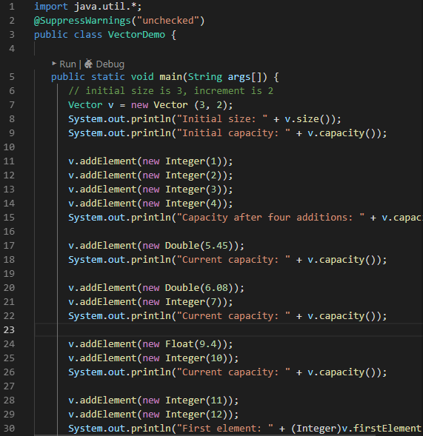
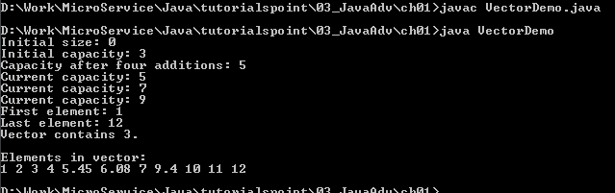
1.3 Vector
https://www.tutorialspoint.com/java/java_data_structures.htm/
Code:

Slide 33
1.4 Stack

Slide 34
1.4 Stack
https://www.tutorialspoint.com/java/java_data_structures.htm/
The Stack class implements a last-in-first-out (LIFO) stack of elements.
You can think of a stack literally as a vertical stack of objects; when you add a new element, it gets stacked on top of the others.
When you pull an element off the stack, it comes off the top. In other words, the last element you added to the stack is the first one to come back off.
For more details about this class, check The Stack.
Stack is a subclass of Vector that implements a standard last-in, first-out stack.
Stack only defines the default constructor, which creates an empty stack. Stack includes all the methods defined by Vector, and adds several of its own.
Stack( )

Slide 35
1.4 Stack
https://www.tutorialspoint.com/java/java_data_structures.htm/
Stack Method:
No. | Method & Description
1 | boolean empty() Tests if this stack is empty. Returns true if the stack is empty, and returns false if the stack contains elements.
2 | Object peek( ) Returns the element on the top of the stack, but does not remove it.
3 | Object pop( ) Returns the element on the top of the stack, removing it in the process.
4 | Object push(Object element) Pushes the element onto the stack. Element is also returned.
5 | int search(Object element) Searches for element in the stack. If found, its offset from the top of the stack is returned. Otherwise, .1 is returned.

Slide 36
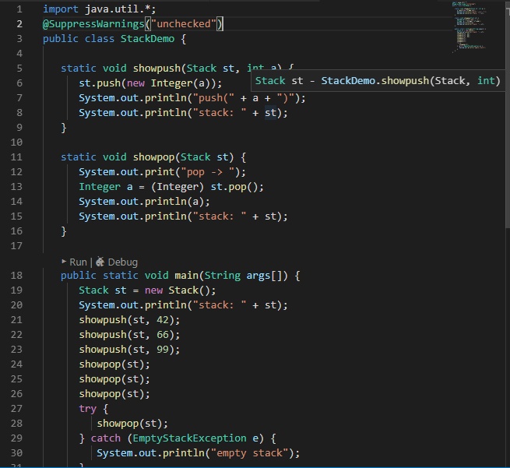
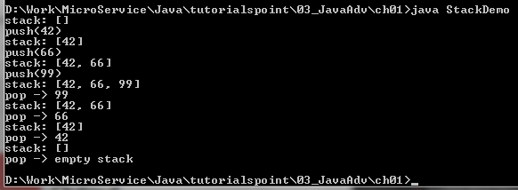
1.4 Stack
https://www.tutorialspoint.com/java/java_data_structures.htm/
Code:

Slide 37
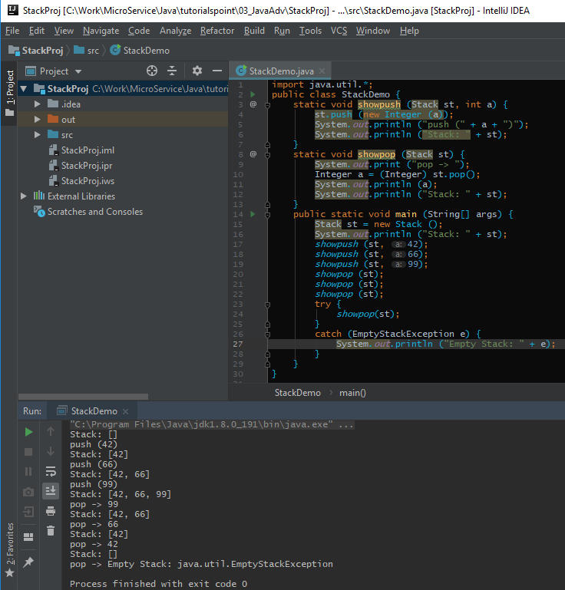
1.4 Stack
https://www.tutorialspoint.com/java/java_data_structures.htm/
Code:

Slide 38
1.5 Dictionary

Slide 39
1.5 Dictionary
https://www.tutorialspoint.com/java/java_data_structures.htm/
The Dictionary class is an abstract class that defines a data structure for mapping keys to values.
This is useful in cases where you want to be able to access data via a particular key rather than an integer index.
Since the Dictionary class is abstract, it provides only the framework for a key-mapped data structure rather than a specific implementation.
For more details about this class, check The Dictionary.
Dictionary is an abstract class that represents a key/value storage repository and operates much like Map.
Given a key and value, you can store the value in a Dictionary object. Once the value is stored, you can retrieve it by using its key.
Dictionary is obsolete. Use Map instead.
Thus, like a map, a dictionary can be thought of as a list of key/value pairs.

Slide 40
1.5 Dictionary
https://www.tutorialspoint.com/java/java_data_structures.htm/
The abstract methods defined by Dictionary are listed below
No. | Method & Description
1 | Enumeration elements( ) Returns an enumeration of the values contained in the dictionary.
2 | Object get(Object key) Returns the object that contains the value associated with the key. If the key is not in the dictionary, a null object is returned.
3 | boolean isEmpty( ) Returns true if the dictionary is empty, and returns false if it contains at least one key.
4 | Enumeration keys( ) Returns an enumeration of the keys contained in the dictionary.

Slide 41
1.5 Dictionary
https://www.tutorialspoint.com/java/java_data_structures.htm/
The abstract methods defined by Dictionary are listed below
No. | Method & Description
5 | Object put(Object key, Object value) Inserts a key and its value into the dictionary. Returns null if the key is not already in the dictionary; returns the previous value associated with the key if the key is already in the dictionary.
6 | Object remove(Object key) Removes the key and its value. Returns the value associated with the key. If the key is not in the dictionary, a null is returned.
7 | int size( ) Returns the number of entries in the dictionary.

Slide 42
1.5 Dictionary
https://www.tutorialspoint.com/java/java_data_structures.htm/
You need to implement the map interface for dictionary.
The Map interface maps unique keys to values. A key is an object that you use to retrieve a value at a later date.
Given a key and a value, you can store the value in a Map object. After the value is stored, you can retrieve it by using its key.
Several methods throw a NoSuchElementException when no items exist in the invoking map.
A ClassCastException is thrown when an object is incompatible with the elements in a map.
A NullPointerException is thrown if an attempt is made to use a null object and null is not allowed in the map.
An UnsupportedOperationException is thrown when an attempt is made to change an unmodifiable map.

Slide 43
1.5 Dictionary
https://www.tutorialspoint.com/java/java_data_structures.htm/
Dictionary Map Interface:
No. | Method & Description
1 | void clear( ) Removes all key/value pairs from the invoking map.
2 | boolean containsKey(Object k) Returns true if the invoking map contains k as a key. Otherwise, returns false.
3 | boolean containsValue(Object v) Returns true if the map contains v as a value. Otherwise, returns false.
4 | Set entrySet( ) Returns a Set that contains the entries in the map. The set contains objects of type Map.Entry. This method provides a set-view of the invoking map.
5 | boolean equals(Object obj) Returns true if obj is a Map and contains the same entries. Otherwise, returns false.

Slide 44
1.5 Dictionary
https://www.tutorialspoint.com/java/java_data_structures.htm/
Dictionary Map Interface:
No. | Method & Description
6 | Object get(Object k) Returns the value associated with the key k.
7 | int hashCode( ) Returns the hash code for the invoking map.
8 | boolean isEmpty( ) Returns true if the invoking map is empty. Otherwise, returns false.
9 | Set keySet( ) Returns a Set that contains the keys in the invoking map. This method provides a set-view of the keys in the invoking map.

Slide 45
1.5 Dictionary
https://www.tutorialspoint.com/java/java_data_structures.htm/
Dictionary Map Interface:
No. | Method & Description
10 | Object put(Object k, Object v) Puts an entry in the invoking map, overwriting any previous value associated with the key. The key and value are k and v, respectively. Returns null if the key did not already exist. Otherwise, the previous value linked to the key is returned.
11 | void putAll(Map m) Puts all the entries from m into this map.
12 | Object remove(Object k) Removes the entry whose key equals k.

Slide 46
1.5 Dictionary
https://www.tutorialspoint.com/java/java_data_structures.htm/
Dictionary Map Interface:
No. | Method & Description
13 | int size( ) Returns the number of key/value pairs in the map.
14 | Collection values( ) Returns a collection containing the values in the map. This method provides a collection-view of the values in the map.

Slide 47
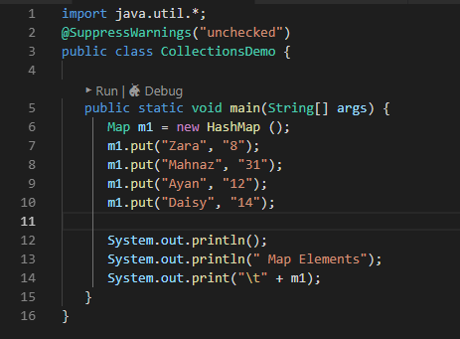
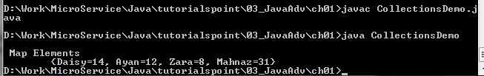
1.5 Dictionary
https://www.tutorialspoint.com/java/java_data_structures.htm/
Dictionary Example:

Slide 48
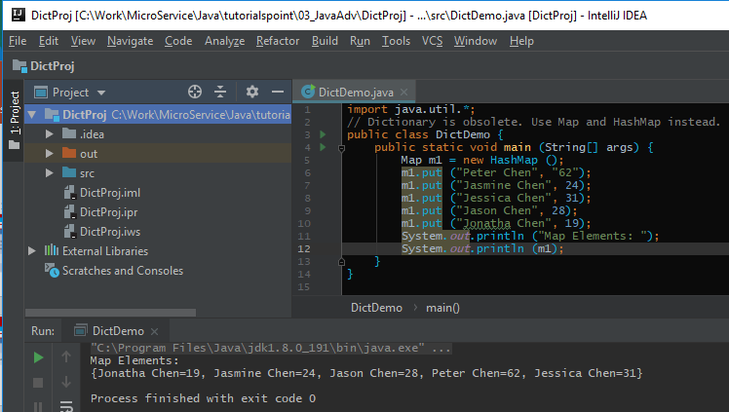
1.5 Dictionary
https://www.tutorialspoint.com/java/java_data_structures.htm/
Map and HashMap Example:

Slide 49
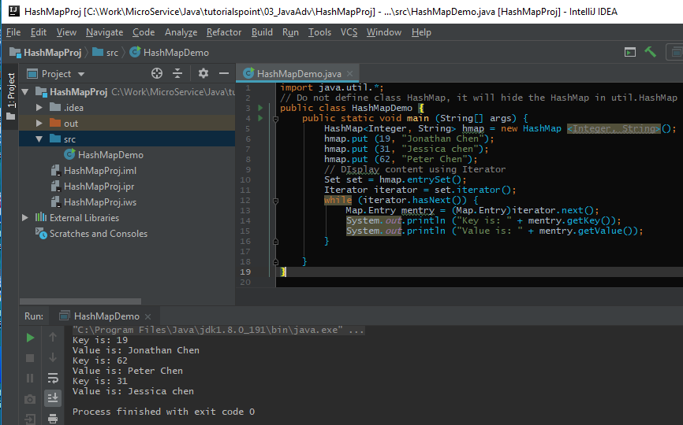
1.5 Dictionary
https://www.tutorialspoint.com/java/java_data_structures.htm/
HashMap <key, value> Example:

Slide 50
1.6 Hashtable

Slide 51
1.6 Hashtable
https://www.tutorialspoint.com/java/java_data_structures.htm/
The Hashtable class provides a means of organizing data based on some user-defined key structure.
For example, in an address list hash table you could store and sort data based on a key such as ZIP code rather than on a person's name.
The specific meaning of keys with regard to hash tables is totally dependent on the usage of the hash table and the data it contains.
For more detail about this class, check The Hashtable.
Hashtable was part of the original java.util and is a concrete implementation of a Dictionary.
However, Java 2 re-engineered Hashtable so that it also implements the Map interface. Thus, Hashtable is now integrated into the collections framework. It is similar to HashMap, but is synchronized.
Like HashMap, Hashtable stores key/value pairs in a hash table. When using a Hashtable, you specify an object that is used as a key, and the value that you want linked to that key. The key is then hashed, and the resulting hash code is used as the index at which the value is stored within the table.

Slide 52
1.6 Hashtable
https://www.tutorialspoint.com/java/java_data_structures.htm/
Hashtable constructor.
No | Constructor & Description
1 | Hashtable( ) This is the default constructor of the hash table it instantiates the Hashtable class.
2 | Hashtable(int size) This constructor accepts an integer parameter and creates a hash table that has an initial size specified by integer value size.
3 | Hashtable(int size, float fillRatio) This creates a hash table that has an initial size specified by size and a fill ratio specified by fillRatio. This ratio must be between 0.0 and 1.0, and it determines how full the hash table can be before it is resized upward.
4 | Hashtable(Map < ? extends K, ? extends V > t) This constructs a Hashtable with the given mappings.

Slide 53
1.6 Hashtable
https://www.tutorialspoint.com/java/java_data_structures.htm/
Hashtable methods.
No | Method & Description
1 | void clear( ) Resets and empties the hash table.
2 | Object clone( ) Returns a duplicate of the invoking object.
3 | boolean contains(Object value) Returns true if some value equal to the value exists within the hash table. Returns false if the value isn't found.
4 | boolean containsKey(Object key) Returns true if some key equal to the key exists within the hash table. Returns false if the key isn't found.

Slide 54
1.6 Hashtable
https://www.tutorialspoint.com/java/java_data_structures.htm/
Hashtable methods.
No | Method & Description
5 | boolean containsValue(Object value) Returns true if some value equal to the value exists within the hash table. Returns false if the value isn't found.
6 | Enumeration elements( ) Returns an enumeration of the values contained in the hash table.
7 | Object get(Object key) Returns the object that contains the value associated with the key. If the key is not in the hash table, a null object is returned.
8 | boolean isEmpty( ) Returns true if the hash table is empty; returns false if it contains at least one key.

Slide 55
1.6 Hashtable
https://www.tutorialspoint.com/java/java_data_structures.htm/
Hashtable methods.
No | Method & Description
10 | Object put(Object key, Object value) Inserts a key and a value into the hash table. Returns null if the key isn't already in the hash table; returns the previous value associated with the key if the key is already in the hash table.
11 | void rehash( ) Increases the size of the hash table and rehashes all of its keys.
12 | Object remove(Object key) Removes the key and its value. Returns the value associated with the key. If the key is not in the hash table, a null object is returned.
13 | int size( ) Returns the number of entries in the hash table.

Slide 56
1.6 Hashtable
https://www.tutorialspoint.com/java/java_data_structures.htm/
Hashtable methods.
No | Method & Description
14 | String toString( ) Returns the string equivalent of a hash table.

Slide 57
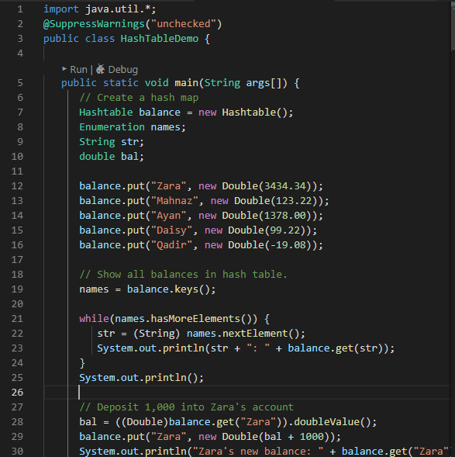
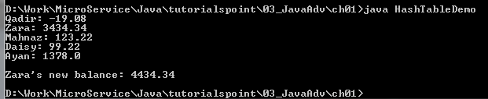
1.6 Hashtable
https://www.tutorialspoint.com/java/java_data_structures.htm/
Example:

Slide 58
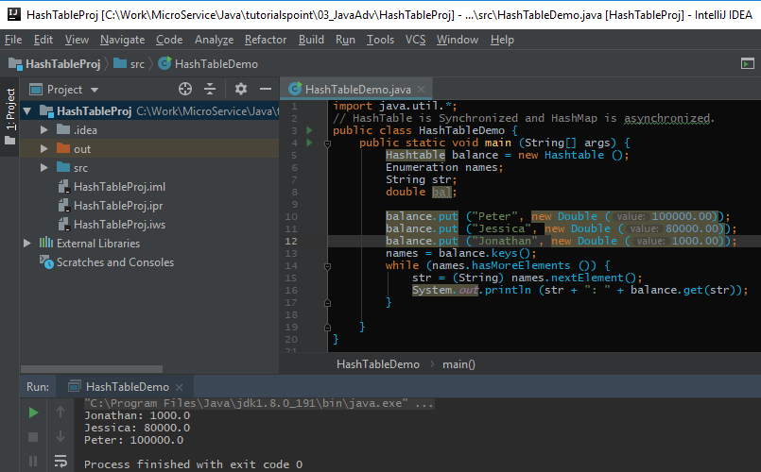
1.6 Hashtable
https://www.tutorialspoint.com/java/java_data_structures.htm/
Example:

Slide 59
1.6 Property

Slide 60
1.6 Hashtable
https://www.tutorialspoint.com/java/java_data_structures.htm/
Properties is a subclass of Hashtable. It is used to maintain lists of values in which the key is a String and the value is also a String.
The Properties class is used by many other Java classes. For example, it is the type of object returned by System.getProperties( ) when obtaining environmental values.
For more detail about this class, check The Properties.
Properties is a subclass of Hashtable. It is used to maintain lists of values in which the key is a String and the value is also a String.
The Properties class is used by many other Java classes. For example, it is the type of object returned by System.getProperties( ) when obtaining environmental values.
Properties define the following instance variable. This variable holds a default property list associated with a Properties object.
Properties defaults;.

Slide 61
1.6 Hashtable
https://www.tutorialspoint.com/java/java_data_structures.htm/
Properties constructor:
No. | Constructor & Description
1 | Properties( ) This constructor creates a Properties object that has no default values.
2 | Properties(Properties propDefault) Creates an object that uses propDefault for its default values. In both cases, the property list is empty.

Slide 62
1.6 Hashtable
https://www.tutorialspoint.com/java/java_data_structures.htm/
Property methods:
No. | Method & Description
1 | String getProperty(String key) Returns the value associated with the key. A null object is returned if the key is neither in the list nor in the default property list.
2 | String getProperty(String key, String defaultProperty) Returns the value associated with the key; defaultProperty is returned if the key is neither in the list nor in the default property list.
3 | void list(PrintStream streamOut) Sends the property list to the output stream linked to streamOut.
4 | void list(PrintWriter streamOut) Sends the property list to the output stream linked to streamOut.

Slide 63
1.6 Hashtable
https://www.tutorialspoint.com/java/java_data_structures.htm/
Property methods:
No. | Method & Description
5 | void load(InputStream streamIn) throws IOException Inputs a property list from the input stream linked to streamIn.
6 | Enumeration propertyNames( ) Returns an enumeration of the keys. This includes those keys found in the default property list, too.
7 | Object setProperty(String key, String value) Associates value with the key. Returns the previous value associated with the key, or returns null if no such association exists.
8 | void store(OutputStream streamOut, String description) After writing the string specified by description, the property list is written to the output stream linked to streamOut.

Slide 64
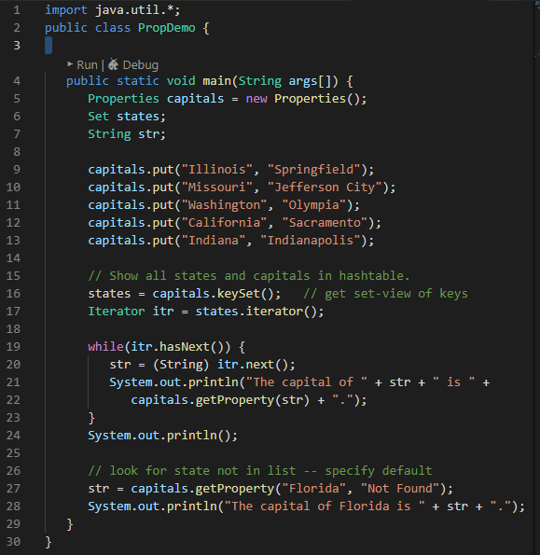
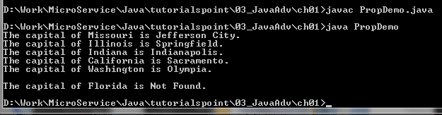
1.6 Hashtable
https://www.tutorialspoint.com/java/java_data_structures.htm/
Code:

Slide 65
End of Chapter

