Slide 1

2 Collection
Peter H. Chen

Slide 2
2 Collection
https://www.tutorialspoint.com/java/java_collections.htm
Prior to Java 2, Java provided classes, such as, Dictionary, Vector, Stack, and Properties to store and manipulate groups of objects.
Although these classes were quite useful, they lacked a central, unifying theme.
Thus, the way that you used Vector was different from the way that you used Properties.
The collections framework was designed to meet several goals, such as −
The framework had to be high-performance. The implementations for the fundamental collections (dynamic arrays, linked lists, trees, and hashtables) were to be highly efficient.
The framework had to allow different types of collections to work in a similar manner and with a high degree of interoperability.
The framework had to extend and/or adapt a collection easily.
Towards this end, the entire collections framework is designed around a set of standard interfaces.
Several standard implementations, such as, LinkedList, HashSet, and TreeSet, of these interfaces are provided that you may use as-is and you may also implement your own collection, if you choose.

Slide 3
2 Collection
https://www.tutorialspoint.com/java/java_collections.htm
A collections framework is a unified architecture for representing and manipulating collections.
All collections frameworks contain the following −
Interfaces − These are abstract data types that represent collections. Interfaces allow collections to be manipulated independently of the details of their representation. In object-oriented languages, interfaces generally form a hierarchy.
Implementations, i.e., Classes − These are the concrete implementations of the collection interfaces. In essence, they are reusable data structures.
Algorithms − These are the methods that perform useful computations, such as searching and sorting, on objects that implement collection interfaces. The algorithms are said to be polymorphic: that is, the same method can be used on many different implementations of the appropriate collection interface.
In addition to collections, the framework defines several map interfaces and classes.
Maps store key/value pairs.
Although maps are not collections in the proper use of the term, but they are fully integrated with collections.

Slide 4
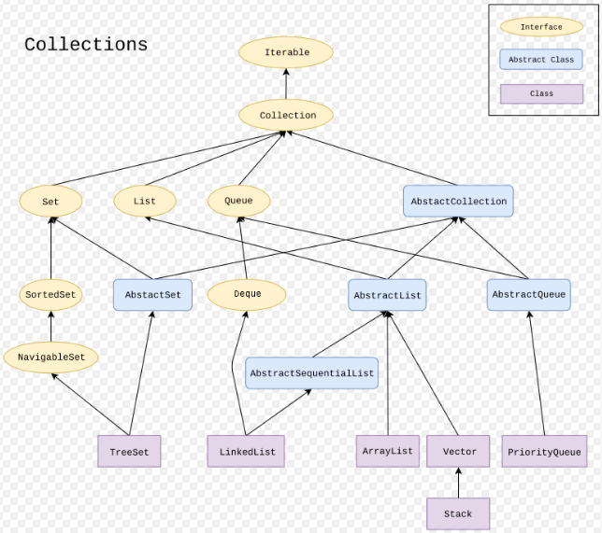
2 Collection
https://www.tutorialspoint.com/java/java_collections.htm
Java 8 Collection:

Slide 5
2.1 Collection Interface

Slide 6
2 Collection
https://www.tutorialspoint.com/java/java_collections.htm
A collections framework is a unified architecture for representing and manipulating collections.
All collections frameworks contain the following −
Interfaces − These are abstract data types that represent collections. Interfaces allow collections to be manipulated independently of the details of their representation. In object-oriented languages, interfaces generally form a hierarchy.
Implementations, i.e., Classes − These are the concrete implementations of the collection interfaces. In essence, they are reusable data structures.
Algorithms − These are the methods that perform useful computations, such as searching and sorting, on objects that implement collection interfaces. The algorithms are said to be polymorphic: that is, the same method can be used on many different implementations of the appropriate collection interface.
In addition to collections, the framework defines several map interfaces and classes.
Maps store key/value pairs.
Although maps are not collections in the proper use of the term, but they are fully integrated with collections.

Slide 7
2.1 Collection Interface
https://www.tutorialspoint.com/java/java_collections.htm
The collections framework defines several interfaces as follow:
No. | Interface & Description
1 | The Collection InterfaceThis enables you to work with groups of objects; it is at the top of the collections hierarchy.
2 | The List InterfaceThis extends Collection and an instance of List stores an ordered collection of elements.
3 | The SetThis extends Collection to handle sets, which must contain unique elements.
4 | The SortedSetThis extends Set to handle sorted sets.
5 | The MapThis maps unique keys to values.
6 | The Map.EntryThis describes an element (a key/value pair) in a map. This is an inner class of Map.

Slide 8
2.1 Collection Interface
https://www.tutorialspoint.com/java/java_collections.htm
The collections framework defines several interfaces as follow:
No. | Interface & Description
7 | The SortedMapThis extends Map so that the keys are maintained in an ascending order.
8 | The EnumerationThis is legacy interface defines the methods by which you can enumerate (obtain one at a time) the elements in a collection of objects. This legacy interface has been superceded by Iterator.

Slide 9
2.2 Collection Classes

Slide 10
2.2 Collection Classes
https://www.tutorialspoint.com/java/java_collections.htm
Java provides a set of standard collection classes that implement Collection interfaces.
Some of the classes provide full implementations that can be used as-is and others are abstract class, providing skeletal implementations that are used as starting points for creating concrete collections.

Slide 11
2.2 Collection Classes
https://www.tutorialspoint.com/java/java_collections.htm
The standard collection classes are summarized in the following table.
No. | Class & Description
1 | AbstractCollection Implements most of the Collection interface.
2 | AbstractList Extends AbstractCollection and implements most of the List interface.
3 | AbstractSequentialList Extends AbstractList for use by a collection that uses sequential rather than random access of its elements.
4 | LinkedListImplements a linked list by extending AbstractSequentialList.
5 | ArrayListImplements a dynamic array by extending AbstractList.
6 | AbstractSet Extends AbstractCollection and implements most of the Set interface.

Slide 12
2.2 Collection Classes
https://www.tutorialspoint.com/java/java_collections.htm
The standard collection classes are summarized in the following table.
No. | Class & Description
7 | HashSetExtends AbstractSet for use with a hash table.
8 | LinkedHashSetExtends HashSet to allow insertion-order iterations.
9 | TreeSetImplements a set stored in a tree. Extends AbstractSet.
10 | AbstractMap Implements most of the Map interface.
11 | HashMapExtends AbstractMap to use a hash table.
12 | TreeMapExtends AbstractMap to use a tree.
13 | WeakHashMapExtends AbstractMap to use a hash table with weak keys.

Slide 13
2.2 Collection Classes
https://www.tutorialspoint.com/java/java_collections.htm
The standard collection classes are summarized in the following table.
No. | Class & Description
14 | LinkedHashMapExtends HashMap to allow insertion-order iterations.
15 | IdentityHashMapExtends AbstractMap and uses reference equality when comparing documents.

Slide 14
2.2 Collection Classes
https://www.tutorialspoint.com/java/java_collections.htm
The AbstractCollection, AbstractSet, AbstractList, AbstractSequentialList, and AbstractMap classes provide skeletal implementations of the core collection interfaces, to minimize the effort required to implement them.
The following legacy classes defined by java.util have been discussed in the previous chapter:
No. | Class & Description
1 | Vector This implements a dynamic array. It is similar to ArrayList, but with some differences.
2 | Stack Stack is a subclass of Vector that implements a standard last-in, first-out stack.
3 | Dictionary Dictionary is an abstract class that represents a key/value storage repository and operates much like Map.
4 | Hashtable Hashtable was part of the original java.util and is a concrete implementation of a Dictionary.
5 | PropertiesProperties is a subclass of Hashtable. It is used to maintain lists of values in which the key is a String and the value is also a String.
6 | BitSetA BitSet class creates a special type of array that holds bit values. This array can increase in size as needed.

Slide 15
2.3 LinkedList Example

Slide 16
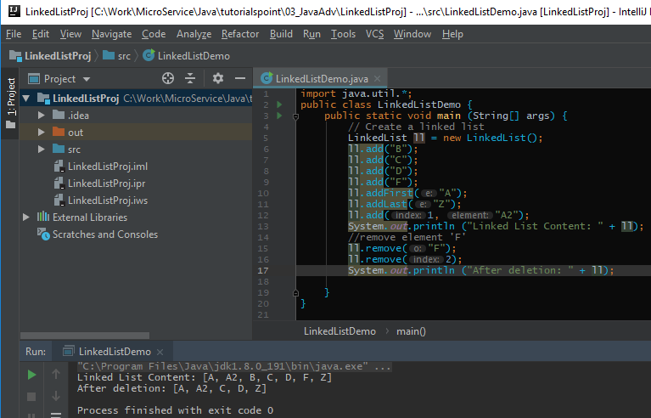
2.3 LinkedList Example
https://www.tutorialspoint.com/java/java_collections.htm
LinkedList Example:

Slide 17
End of Chapter

