Slide 1

21 Exception
Peter H. Chen

Slide 2
21 Exception
https://www.tutorialspoint.com/java/index.htm
An exception (or exceptional event) is a problem that arises during the execution of a program.
When an Exception occurs the normal flow of the program is disrupted and the program/Application terminates abnormally, which is not recommended, therefore, these exceptions are to be handled.
An exception can occur for many different reasons. Following are some scenarios where an exception occurs.
A user has entered an invalid data.
A file that needs to be opened cannot be found.
A network connection has been lost in the middle of communications or the JVM has run out of memory.
Some of these exceptions are caused by user error, others by programmer error, and others by physical resources that have failed in some manner.

Slide 3
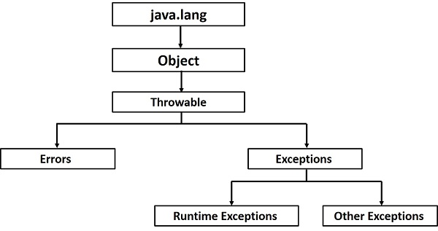
21 Exception
https://www.tutorialspoint.com/java/index.htm
Based on these, we have three categories of Exceptions. You need to understand them to know how exception handling works in Java.
Checked exceptions − A checked exception is an exception that is checked (notified) by the compiler at compilation-time, these are also called as compile time exceptions. These exceptions cannot simply be ignored, the programmer should take care of (handle) these exceptions.
For example, if you use FileReader class in your program to read data from a file, if the file specified in its constructor doesn't exist, then a FileNotFoundException occurs, and the compiler prompts the programmer to handle the exception.

Slide 4
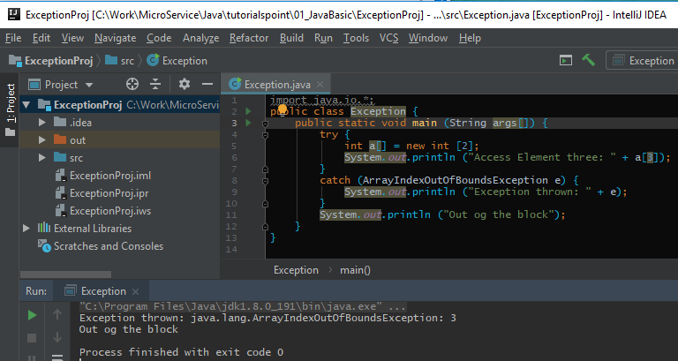
21 Exception
https://www.tutorialspoint.com/java/index.htm
Array out of Bound example:

Slide 5
20.1 Byte Stream
Peter H. Chen

Slide 6
20.1 Byte Stream
https://www.tutorialspoint.com/java/index.htm
Byte Streams (1)
Java byte streams are used to perform input and output of 8-bit bytes.
Though there are many classes related to byte streams but the most frequently used classes are, FileInputStream and FileOutputStream.

Slide 7
20.1 Byte Stream
https://www.tutorialspoint.com/java/index.htm
Byte Streams (1)
Java byte streams are used to perform input and output of 8-bit bytes.
Though there are many classes related to byte streams but the most frequently used classes are, FileInputStream and FileOutputStream.

Slide 8
End of Chapter

