Slide 1

22 Inner Class
Peter H. Chen

Slide 2
22 Inner Class
https://www.tutorialspoint.com/java/index.htm
In this chapter, we will discuss inner classes of Java.
Nested Classes
In Java, just like methods, variables of a class too can have another class as its member. Writing a class within another is allowed in Java.
The class written within is called the nested class, and the class that holds the inner class is called the outer class.
Syntax
Following is the syntax to write a nested class. Here, the class Outer_Demo is the outer class and the class Inner_Demo is the nested class.
class Outer_Demo {
class Inner_Demo {
}
}

Slide 3
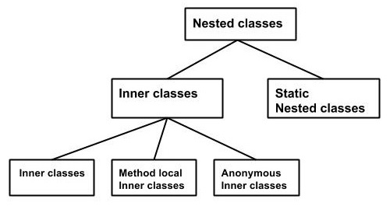
22 Inner Class
https://www.tutorialspoint.com/java/index.htm
Nested classes are divided into two types −
Non-static nested classes − These are the non-static members of a class.
Static nested classes − These are the static members of a class.

Slide 4
22 Inner Class
https://www.tutorialspoint.com/java/index.htm
Inner Classes (Non-static Nested Classes)
Inner classes are a security mechanism in Java. We know a class cannot be associated with the access modifier private, but if we have the class as a member of other class, then the inner class can be made private. And this is also used to access the private members of a class.
Inner classes are of three types depending on how and where you define them. They are −
Inner Class
Method-local Inner Class
Anonymous Inner Class
Inner Class
Creating an inner class is quite simple. You just need to write a class within a class. Unlike a class, an inner class can be private and once you declare an inner class private, it cannot be accessed from an object outside the class.

Slide 5
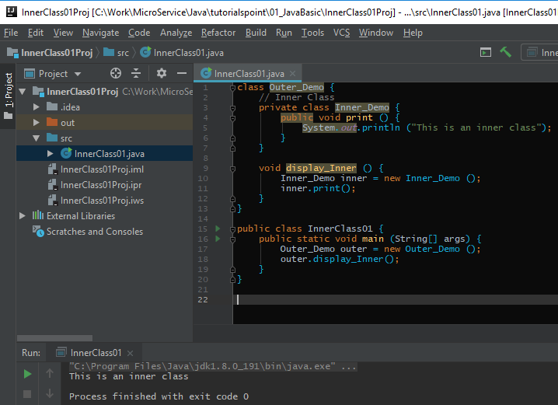
22 Inner Class
https://www.tutorialspoint.com/java/index.htm
Following is the program to create an inner class and access it.
In the given example, we make the inner class private and access the class through a method.

Slide 6
End of Chapter

