Slide 1

15 String
Peter H. Chen

Slide 2
15 String
https://www.tutorialspoint.com/java/index.htm
Strings, which are widely used in Java programming, are a sequence of characters. In Java programming language, strings are treated as objects.
The Java platform provides the String class to create and manipulate string.
Creating Strings
The most direct way to create a string is to write:
String greeting = "Hello world!“;

Slide 3
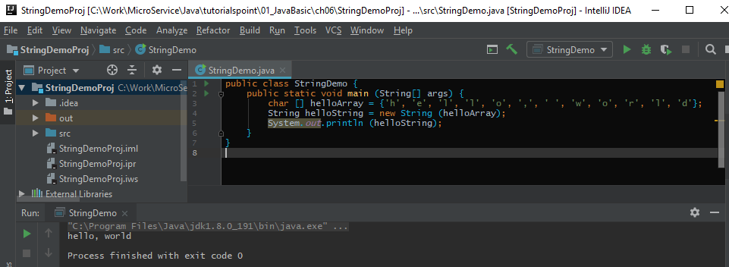
15 String
https://www.tutorialspoint.com/java/index.htm
Example:

Slide 4
End of Chapter

