Slide 1

24 Multi-Thread
Peter H. Chen

Slide 2
24 Multi-Thread
https://www.tutorialspoint.com/java/java_data_structures.htm/
Class A:
// Create thread by two ways: // One by extends the Thread. // Another one by implementing interface Runnable class A {}

Slide 3
24 Multi-Thread
https://www.tutorialspoint.com/java/java_data_structures.htm/
Class Hi:
//class Hi { //class Hi extends Thread { class Hi extends A implements Runnable { // public void show () { public void run () { for (int i =1; i <=5; i++){ System.out.println ("Hi"); try { Thread.sleep (500); // sleep 0.5 sec } catch (Exception e) {} } } }

Slide 4
24 Multi-Thread
https://www.tutorialspoint.com/java/java_data_structures.htm/
Class Hello:
//class Hello { //class Hello extends Thread { class Hello implements Runnable { //public void show () { public void run () { for (int i =1; i <=5; i++) { System.out.println("Hello"); try { Thread.sleep (500); // sleep 0.5 sec } catch (Exception e) {} } } }

Slide 5
24 Multi-Thread
https://www.tutorialspoint.com/java/java_data_structures.htm/
Class ThreadDemo:
public class ThreadDemo { public static void main (String[] args) { //System.out.println ("Good"); // How to link the thread with run? Runnable obj1 = new Hi (); Runnable obj2 = new Hello (); Thread t1 = new Thread(obj1); Thread t2 = new Thread(obj2); t1.start (); try { Thread.sleep (50); // sleep 0.05 sec } catch (Exception e) {} t2.start (); } }

Slide 6
24 Multi-Thread
https://www.tutorialspoint.com/java/java_data_structures.htm/
Class ThreadDemo:
public class ThreadDemo { public static void main (String[] args) { //System.out.println ("Good"); // How to link the thread with run? Runnable obj1 = new Hi (); Runnable obj2 = new Hello (); Thread t1 = new Thread(obj1); Thread t2 = new Thread(obj2); t1.start (); try { Thread.sleep (50); // sleep 0.05 sec } catch (Exception e) {} t2.start (); } }

Slide 7
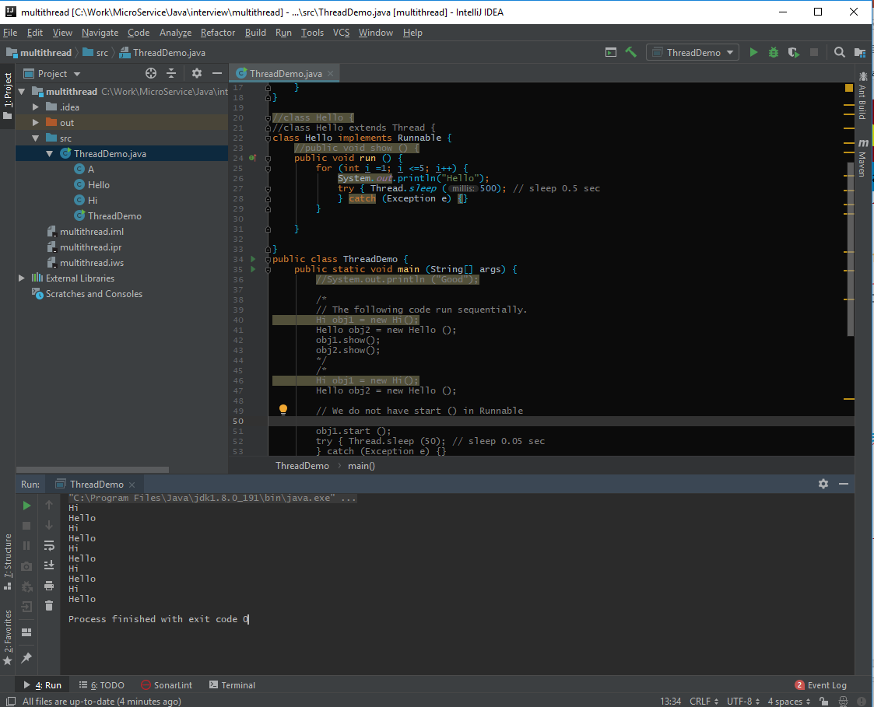
24 Multi-Thread
https://www.tutorialspoint.com/java/java_data_structures.htm/
Run Multi-Thread:

Slide 8
End of Chapter

