Slide 1

17 Date
Peter H. Chen

Slide 2
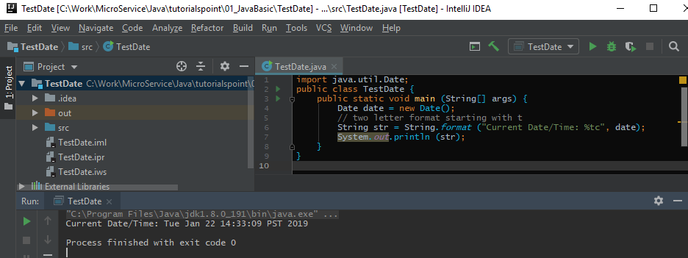
17 Date
https://www.tutorialspoint.com/java/index.htm
Date Formatting Using printf
Date and time formatting can be done very easily using printf method. You use a two-letter format, starting with t and ending in one of the letters of the table as shown in the following code.

Slide 3
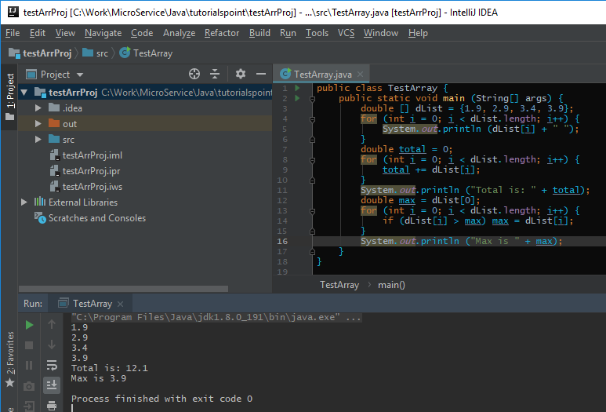
16 Array
https://www.tutorialspoint.com/java/index.htm
Array Example:

Slide 4
End of Chapter

