Slide 1

18 Regular Expression
Peter H. Chen

Slide 2
18 Regular Rexpression
https://www.tutorialspoint.com/java/index.htm
Java provides the java.util.regex package for pattern matching with regular expressions. Java regular expressions are very similar to the Perl programming language and very easy to learn.
A regular expression is a special sequence of characters that helps you match or find other strings or sets of strings, using a specialized syntax held in a pattern. They can be used to search, edit, or manipulate text and data.
The java.util.regex package primarily consists of the following three classes −
Pattern Class − A Pattern object is a compiled representation of a regular expression. The Pattern class provides no public constructors. To create a pattern, you must first invoke one of its public static compile() methods, which will then return a Pattern object. These methods accept a regular expression as the first argument.
Matcher Class − A Matcher object is the engine that interprets the pattern and performs match operations against an input string. Like the Pattern class, Matcher defines no public constructors. You obtain a Matcher object by invoking the matcher() method on a Pattern object.
PatternSyntaxException − A PatternSyntaxException object is an unchecked exception that indicates a syntax error in a regular expression pattern.

Slide 3
18 Regular Rexpression
https://www.tutorialspoint.com/java/index.htm
Capturing Groups
Capturing groups are a way to treat multiple characters as a single unit. They are created by placing the characters to be grouped inside a set of parentheses. For example, the regular expression (dog) creates a single group containing the letters "d", "o", and "g".
Capturing groups are numbered by counting their opening parentheses from the left to the right.
In the expression ((A)(B(C))), for example, there are four such groups −
((A)(B(C)))
(A)
(B(C))
(C)
To find out how many groups are present in the expression, call the groupCount method on a matcher object.
The groupCount method returns an int showing the number of capturing groups present in the matcher's pattern.
There is also a special group, group 0, which always represents the entire expression. This group is not included in the total reported by groupCount.

Slide 4
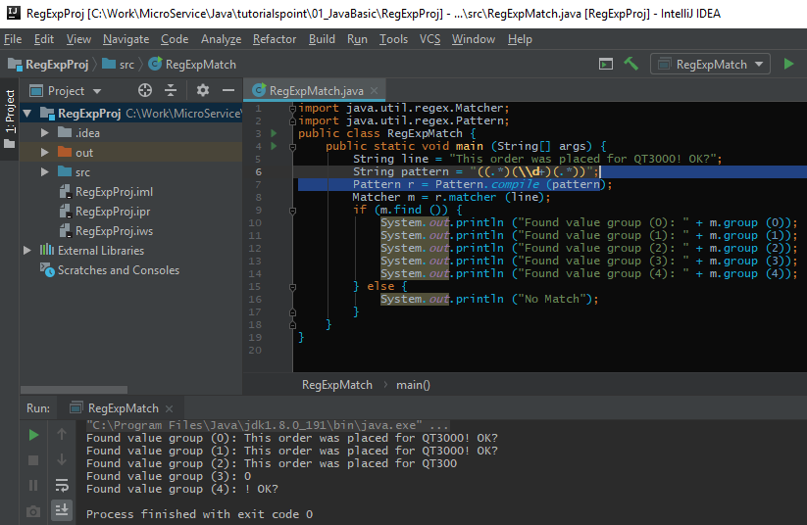
18 Regular Rexpression
https://www.tutorialspoint.com/java/index.htm
Find Grouping:

Slide 5
End of Chapter

