Slide 1
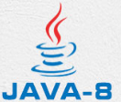
16 Array
Peter H. Chen

Slide 2
16 Array
https://www.tutorialspoint.com/java/index.htm
Java provides a data structure, the array, which stores a fixed-size sequential collection of elements of the same type. An array is used to store a collection of data, but it is often more useful to think of an array as a collection of variables of the same type.
Instead of declaring individual variables, such as number0, number1, ..., and number99, you declare one array variable such as numbers and use numbers[0], numbers[1], and ..., numbers[99] to represent individual variables.
This tutorial introduces how to declare array variables, create arrays, and process arrays using indexed variables.
Declaring Array Variables
To use an array in a program, you must declare a variable to reference the array, and you must specify the type of array the variable can reference. Here is the syntax for declaring an array variable

Slide 3
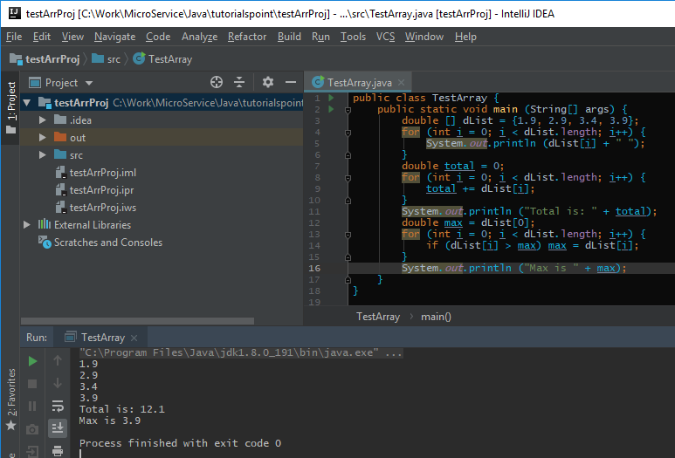
16 Array
https://www.tutorialspoint.com/java/index.htm
Array Example:

Slide 4
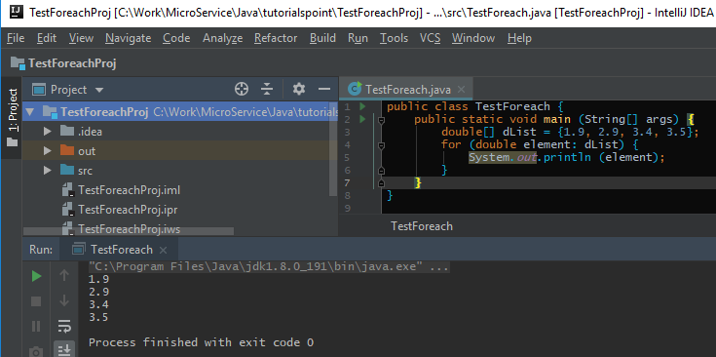
16 Array
https://www.tutorialspoint.com/java/index.htm
foreach Example:

Slide 5
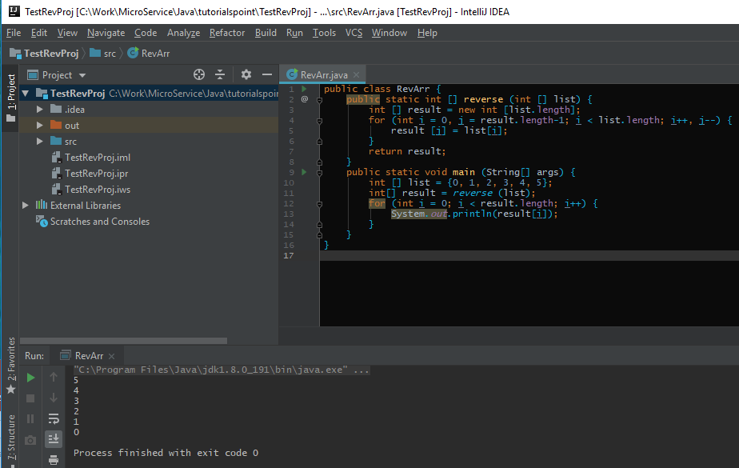
16 Array
https://www.tutorialspoint.com/java/index.htm
Reverse Example:

Slide 6
16 Array
https://www.tutorialspoint.com/java/index.htm
foreach Example:

Slide 7
End of Chapter

