Slide 1
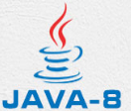
19 Method
Peter H. Chen

Slide 2
19 Method
https://www.tutorialspoint.com/java/index.htm
A Java method is a collection of statements that are grouped together to perform an operation. When you call the System.out.println() method, for example, the system actually executes several statements in order to display a message on the console.
Now you will learn how to create your own methods with or without return values, invoke a method with or without parameters, and apply method abstraction in the program design.

Slide 3
19 Method
https://www.tutorialspoint.com/java/index.htm
Creating Method
Considering the following example to explain the syntax of a method −
Syntax
public static int methodName(int a, int b) {
// body
}
Here,
public static − modifier
int − return type
methodName − name of the method
a, b − formal parameters
int a, int b − list of parameters

Slide 4
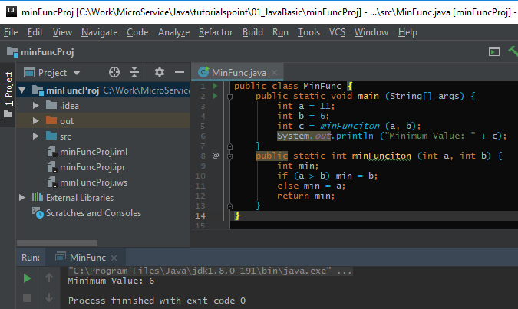
19 Method
https://www.tutorialspoint.com/java/index.htm
Example:

Slide 5
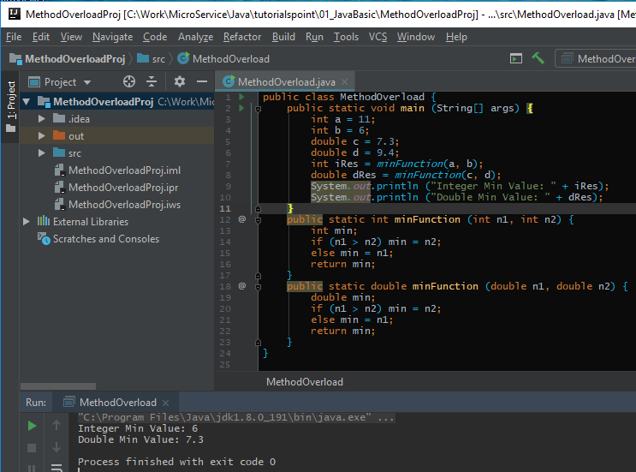
19 Method
https://www.tutorialspoint.com/java/index.htm
Example: Method Overloading

Slide 6
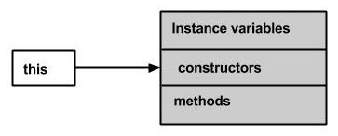
19 Method
https://www.tutorialspoint.com/java/index.htm
this (1)
this is a keyword in Java which is used as a reference to the object of the current class, with in an instance method or a constructor. Using this you can refer the members of a class such as constructors, variables and methods.
Note − The keyword this is used only within instance methods or constructors
In general, the keyword this is used to −
Differentiate the instance variables from local variables if they have same names, within a constructor or a method.
class Student { int age;
Student(int age) { this.age = age;
}
}

Slide 7
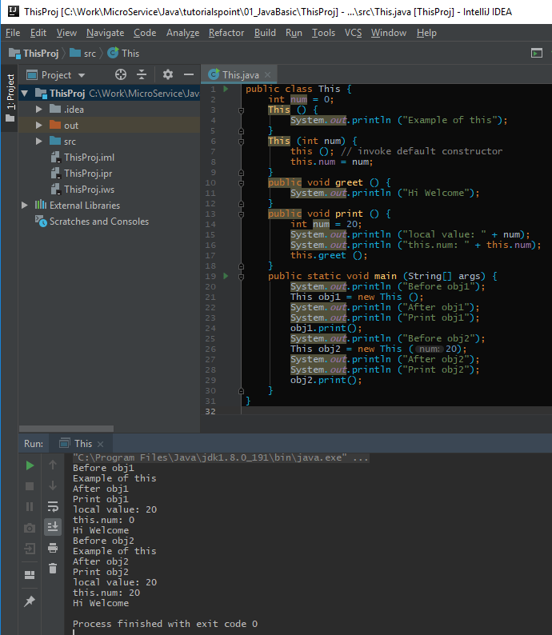
19 Method
https://www.tutorialspoint.com/java/index.htm
This (3)
Example

Slide 8
19 Method
https://www.tutorialspoint.com/java/index.htm
This (2)
Call one type of constructor (parametrized constructor or default) from other in a class. It is known as explicit constructor invocation.
class Student {
int age;
Student() {
this(20);
}
Student(int age) {
this.age = age;
}
}

Slide 9
End of Chapter

