Slide 1

25 Inter-Thread Communication
Peter H. Chen

Slide 2
25 Inter-Thread Communication
https://www.tutorialspoint.com/java/java_data_structures.htm/
Class Q
// Iter-communication between the Threads // Telusko: Java Multithreading class Q { int num; public void put (int num) { System.out.println ("Put: " + num); this.num = num; } public int get () { System.out.println ("Get: " + num); return num; } }

Slide 3
25 Inter-Thread Communication
https://www.tutorialspoint.com/java/java_data_structures.htm/
Class Producer
class Producer implements Runnable { Q q; public Producer(Q q) { this.q = q; // Producer run needs the Thread. Thread t = new Thread (this, "Producer"); t.start(); } public void run () { int i = 0; while (true) { q.put (i++); try { Thread.sleep (1000); } catch (Exception e) {} } } }

Slide 4
25 Inter-Thread Communication
https://www.tutorialspoint.com/java/java_data_structures.htm/
Class Consumer
class Consumer implements Runnable { Q q; public Consumer(Q q) { this.q = q; Thread t = new Thread (this, "Consumer"); t.start(); } public void run () { while (true) { q.get(); try { Thread.sleep (1000); } catch (Exception e) {} } } }

Slide 5
25 Inter-Thread Communication
https://www.tutorialspoint.com/java/java_data_structures.htm/
Class InterThread
public class InterThread { public static void main (String[] args) { Q q = new Q(); new Producer (q); new Consumer (q); } }

Slide 6
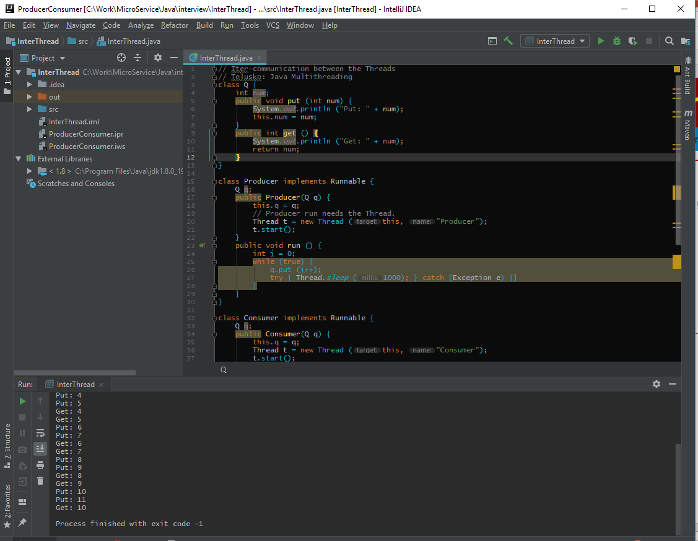
25 Inter-Thread Communication
https://www.tutorialspoint.com/java/java_data_structures.htm/
Run InterThread, you see two consecutive “Put” which are not synchronized.

Slide 7
25.1 Add Wait() and Notify()
Peter H. Chen

Slide 8
25.1 Add Wait and Notify
https://www.tutorialspoint.com/java/java_data_structures.htm/
Class Q (1): boolean valueSet = false
// Iter-communication between the Threads // Telusko: Java Multithreading class Q { int num; boolean valueSet = false;

Slide 9
25.1 Add Wait and Notify
https://www.tutorialspoint.com/java/java_data_structures.htm/
Class Q (2): Synchronized put () // Need synchronized keyword for both wait() and notify public synchronized void put (int num) { // when the value is set, always wait. // wait for consumer to consumer the value. while (valueSet) { // When you are in wait state,
//someone will notifiy you some time. try { wait(); } catch (Exception e) {} } // It valueSet is not set,
// we are going to set the data, System.out.println ("Put: " + num); this.num = num; // the the flag to true after write and notifu others. valueSet = true; notify(); // This notify notify consumer }

Slide 10
25.1 Add Wait and Notify
https://www.tutorialspoint.com/java/java_data_structures.htm/
Class Producer
class Producer implements Runnable { Q q; public Producer(Q q) { this.q = q; // Producer run needs the Thread. Thread t = new Thread (this, "Producer"); t.start(); } public void run () { int i = 0; while (true) { q.put (i++); try { Thread.sleep (1000); } catch (Exception e) {} } } }

Slide 11
25.1 Add Wait and Notify
https://www.tutorialspoint.com/java/java_data_structures.htm/
Class Q (3): Synchronized get public synchronized void get () { // If everything is not set, just wait. while (!valueSet) { try { wait(); } catch (Exception e) {} }// otherwsie, we will print the message System.out.println ("Get: " + num); // Set the flag to false after read and notify others. valueSet = false; notify(); // This notify notify producer } }

Slide 12
25.1 Add Wait and Notify
https://www.tutorialspoint.com/java/java_data_structures.htm/
Class Consumer
class Consumer implements Runnable { Q q; public Consumer(Q q) { this.q = q; Thread t = new Thread (this, "Consumer"); t.start(); } public void run () { while (true) { q.get(); try { Thread.sleep (1000); } catch (Exception e) {} } } }

Slide 13
25.1 Add Wait and Notify
https://www.tutorialspoint.com/java/java_data_structures.htm/
Class InterThread
public class InterThread { public static void main (String[] args) { Q q = new Q(); new Producer (q); new Consumer (q); } }

Slide 14
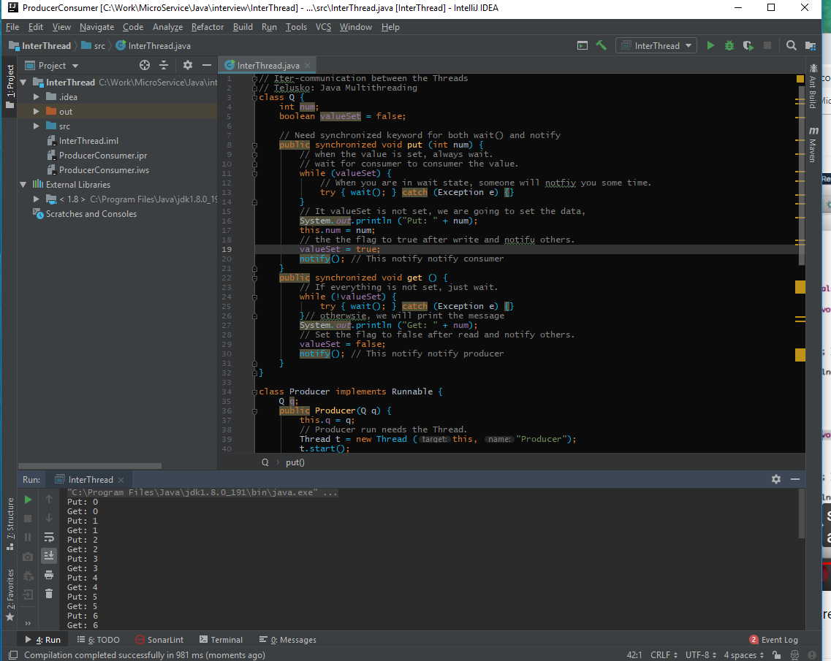
25.1 Add Wait and Notify
https://www.tutorialspoint.com/java/java_data_structures.htm/
Run InterThread, you see two consecutive “Put” which are not synchronized.

Slide 15
End of Chapter

