Slide 1

20 File
Peter H. Chen

Slide 2

20 File
https://www.tutorialspoint.com/java/index.htm
The java.io package contains nearly every class you might ever need to perform input and output (I/O) in Java. All these streams represent an input source and an output destination. The stream in the java.io package supports many data such as primitives, object, localized characters, etc.
Stream
A stream can be defined as a sequence of data. There are two kinds of Streams −
InPutStream − The InputStream is used to read data from a source.
OutPutStream − The OutputStream is used for writing data to a destination.
Java provides strong but flexible support for I/O related to files and networks but this tutorial covers very basic functionality related to streams and I/O.
We will see the most commonly used examples one by one.

Slide 3
20.1 Byte Stream
Peter H. Chen

Slide 4
20.1 Byte Stream
https://www.tutorialspoint.com/java/index.htm
Byte Streams (1)
Java byte streams are used to perform input and output of 8-bit bytes.
Though there are many classes related to byte streams but the most frequently used classes are, FileInputStream and FileOutputStream.

Slide 5
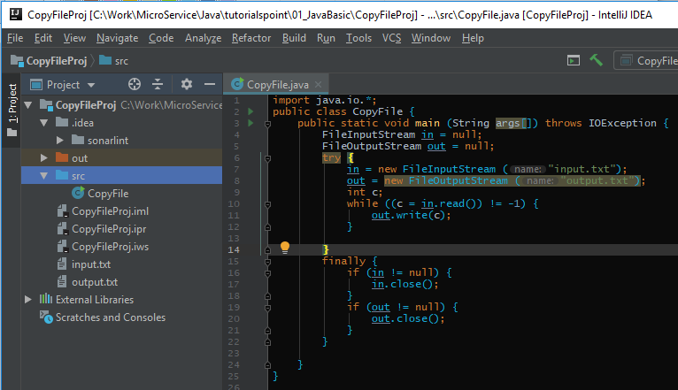
20.1 Byte Stream
https://www.tutorialspoint.com/java/index.htm
Byte Streams (2)
Following is an example which makes use of these two classes to copy an input file into an output file.

Slide 6
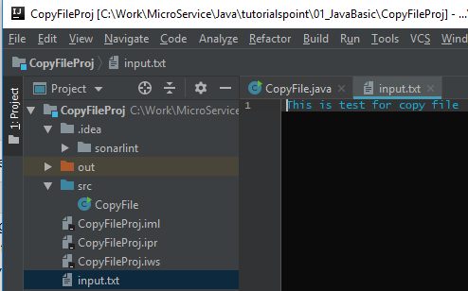
20.1 Byte Stream
https://www.tutorialspoint.com/java/index.htm
Byte Streams (3)
Put the “input.txt” to the project folder.

Slide 7
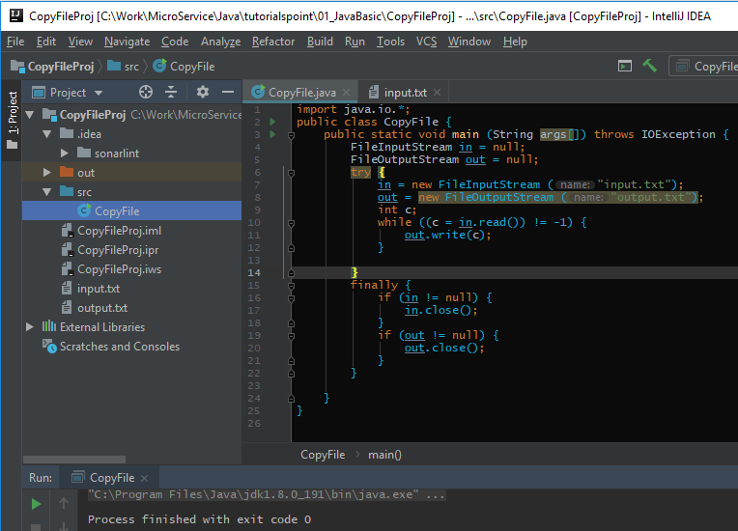
20.1 Byte Stream
https://www.tutorialspoint.com/java/index.htm
Byte Streams (4)
> run

Slide 8
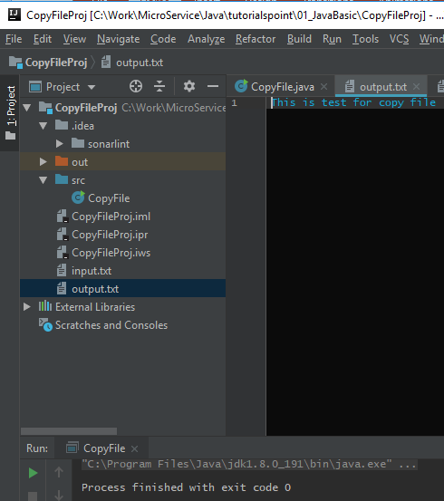
20.1 Byte Stream
https://www.tutorialspoint.com/java/index.htm
Byte Streams (5)
Check the “output.txt” to the project folder.

Slide 9
20.2 Character Stream
Peter H. Chen

Slide 10
20.2 Character Stream
https://www.tutorialspoint.com/java/index.htm
Character Streams (1)
Java Byte streams are used to perform input and output of 8-bit bytes, whereas Java Character streams are used to perform input and output for 16-bit unicode.
Though there are many classes related to character streams but the most frequently used classes are, FileReader and FileWriter.
Though internally FileReader uses FileInputStream and FileWriter uses FileOutputStream but here the major difference is that FileReader reads two bytes at a time and FileWriter writes two bytes at a time.

Slide 11
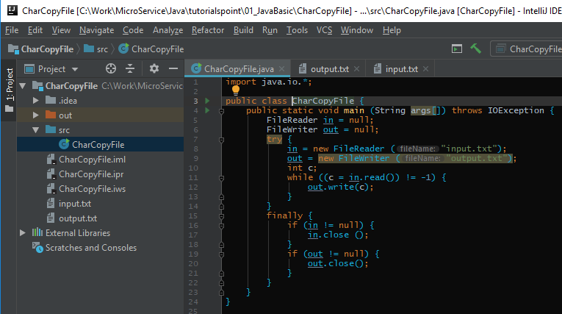
20.2 Character Stream
https://www.tutorialspoint.com/java/index.htm
Character Streams (2)
We can re-write the above example, which makes the use of these two classes to copy an input file (having unicode characters) into an output file

Slide 12
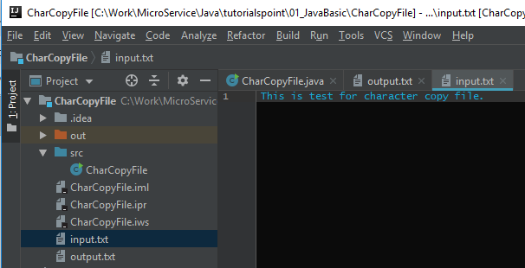
20.2 Character Stream
https://www.tutorialspoint.com/java/index.htm
Character Streams (3)
Put “input.txt” under project folder.

Slide 13
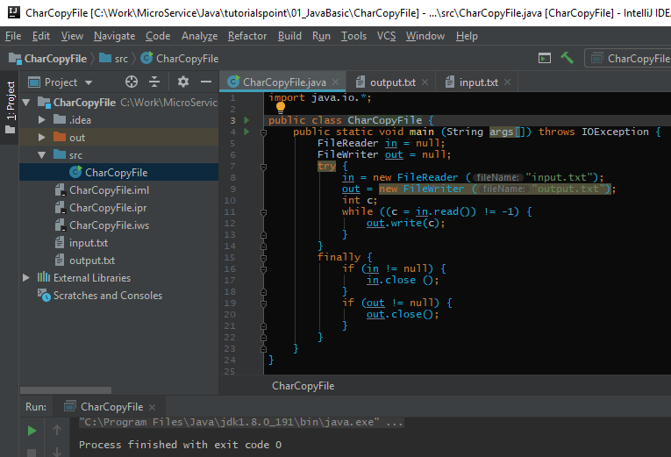
20.2 Character Stream
https://www.tutorialspoint.com/java/index.htm
Character Streams (4)
> run

Slide 14
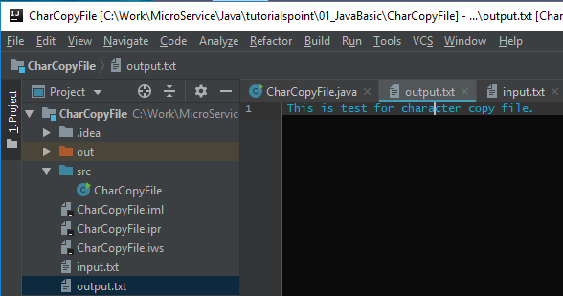
20.2 Character Stream
https://www.tutorialspoint.com/java/index.htm
Character Streams (5)
Check “output.txt”

Slide 15
20.3 Standard Stream
Peter H. Chen

Slide 16
20.3 Standard Stream
https://www.tutorialspoint.com/java/index.htm
Standard Streams (1)
All the programming languages provide support for standard I/O where the user's program can take input from a keyboard and then produce an output on the computer screen. If you are aware of C or C++ programming languages, then you must be aware of three standard devices STDIN, STDOUT and STDERR. Similarly, Java provides the following three standard streams −
Standard Input − This is used to feed the data to user's program and usually a keyboard is used as standard input stream and represented as System.in.
Standard Output − This is used to output the data produced by the user's program and usually a computer screen is used for standard output stream and represented as System.out.
Standard Error − This is used to output the error data produced by the user's program and usually a computer screen is used for standard error stream and represented as System.err.

Slide 17
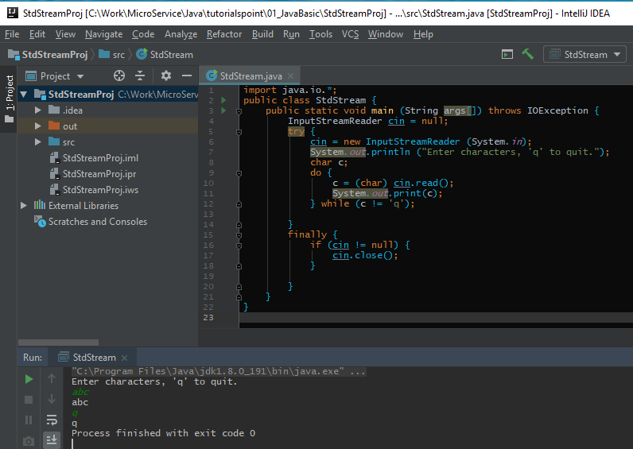
20.3 Standard Stream
https://www.tutorialspoint.com/java/index.htm
Standard Streams (2)
Following is a simple program, which creates InputStreamReader to read standard input stream until the user types a "q" −

Slide 18
20.4 Read/Write File
Peter H. Chen

Slide 19
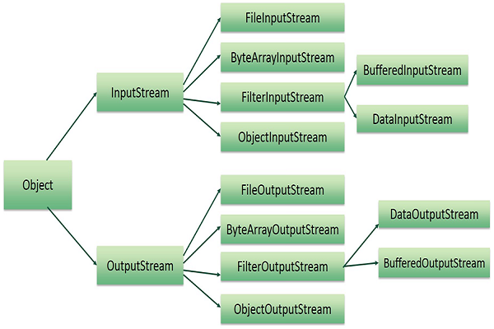
20.4 Read/Write File
https://www.tutorialspoint.com/java/index.htm
As described earlier, a stream can be defined as a sequence of data.
The InputStream is used to read data from a source and the OutputStream is used for writing data to a destination.
Here is a hierarchy of classes to deal with Input and Output streams.

Slide 20
20.4 Read/Write File
https://www.tutorialspoint.com/java/index.htm
The two important streams are FileInputStream and FileOutputStream.

Slide 21
20.5 Directory
Peter H. Chen

Slide 22
20.5 Directory
https://www.tutorialspoint.com/java/index.htm
Directories in Java (1)
A directory is a File which can contain a list of other files and directories. You use File object to create directories, to list down files available in a directory. For complete detail, check a list of all the methods which you can call on File object and what are related to directories.
Creating Directories
There are two useful File utility methods, which can be used to create directories −
The mkdir( ) method creates a directory, returning true on success and false on failure. Failure indicates that the path specified in the File object already exists, or that the directory cannot be created because the entire path does not exist yet.
The mkdirs() method creates both a directory and all the parents of the directory.

Slide 23
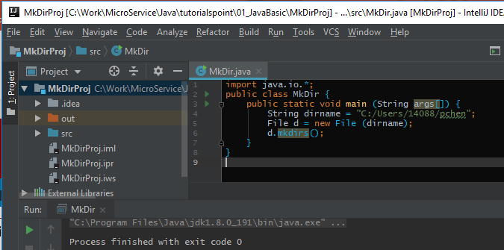
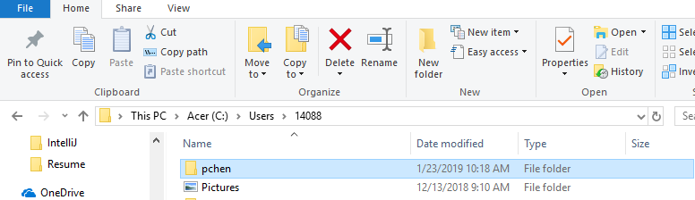
20.5 Directory
https://www.tutorialspoint.com/java/index.htm
Directories in Java (2)
Following example creates “C:/Users/10488/pchen" directory

Slide 24
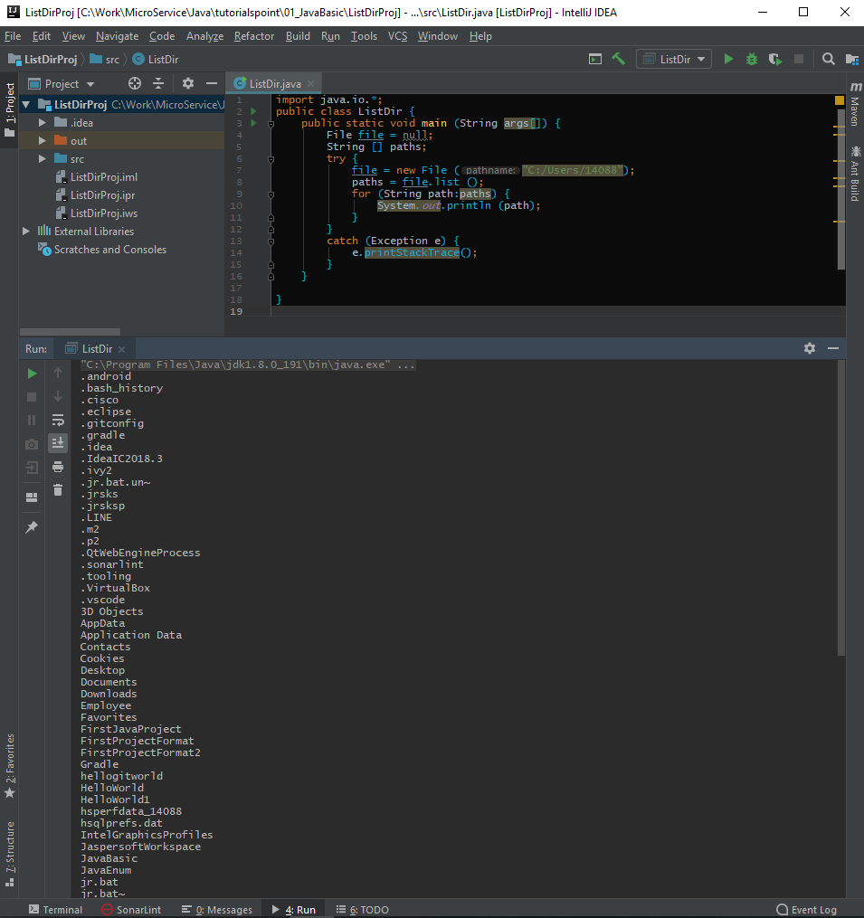
20.5 Directory
https://www.tutorialspoint.com/java/index.htm
Directories in Java (2)
Following example list “C:/Users/10488" directory

Slide 25
End of Chapter

