Slide 1

3 Setup Environment
Peter H. Chen

Slide 2
3 Setup Environment
https://www.tutorialspoint.com/java/index.htm
In this chapter, we will discuss on the different aspects of setting up a congenial environment for Java.
Local Environment Setup
If you are still willing to set up your environment for Java programming language, then this section guides you on how to download and set up Java on your machine. Following are the steps to set up the environment.
Java SE is freely available from the link Download Java. You can download a version based on your operating system.
Follow the instructions to download Java and run the .exe to install Java on your machine. Once you installed Java on your machine, you will need to set environment variables to point to correct installation directories −

Slide 3
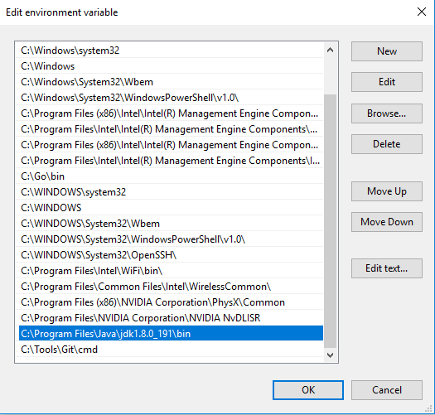
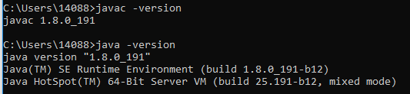
3 Setup Environment
https://www.tutorialspoint.com/java/index.htm
Setting Up the Path for Windows
Assuming you have installed Java in c:\Program Files\java\jdk directory −
Right-click on 'My Computer' and select 'Properties’.
Click the 'Environment variables' button under the 'Advanced' tab.
Setup PATH = ‘C:\Program Files\Java\jdkx.x.x_xxx\bin’,

Slide 4
3 Setup Environment
https://www.tutorialspoint.com/java/index.htm
Install IntelliJ or Ecllipse
Install IntelliJ
Use IDE to
Create Project
Create Class
Create File
Run Application

Slide 5
End of Chapter

