Slide 1
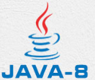
4 Basic Syntax
Peter H. Chen

Slide 2
4 Basic Syntax
https://www.tutorialspoint.com/java/index.htm
When we consider a Java program, it can be defined as a collection of objects that communicate via invoking each other's methods. Let us now briefly look into what do class, object, methods, and instance variables mean.
Object − Objects have states and behaviors. Example: A dog has states - color, name, breed as well as behavior such as wagging their tail, barking, eating. An object is an instance of a class.
Class − A class can be defined as a template/blueprint that describes the behavior/state that the object of its type supports.
Methods − A method is basically a behavior. A class can contain many methods. It is in methods where the logics are written, data is manipulated and all the actions are executed.
Instance Variables − Each object has its unique set of instance variables. An object's state is created by the values assigned to these instance variables.

Slide 3
4.1 Hello World

Slide 4
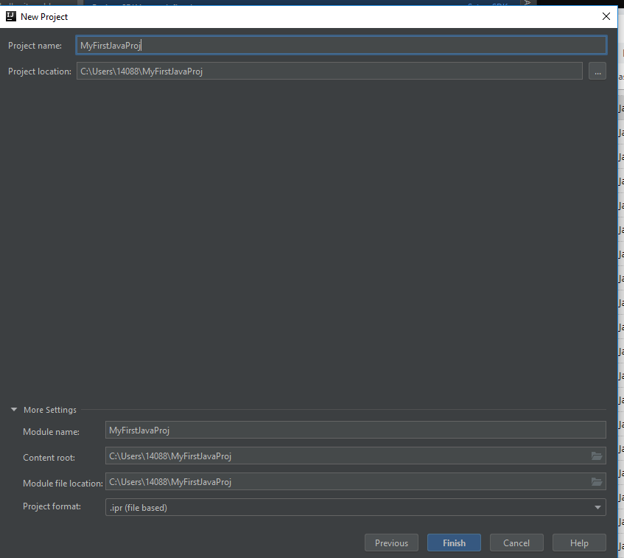
4.1 Hello World
https://www.tutorialspoint.com/java/index.htm
First Java Program (1)
Let us look at a simple code that will print the words Hello World.
Example
Start intelliJ:
New -> Project -> Java: Click Next, Next; Project Name: MyFirstJavaProj, Click Finish as below

Slide 5
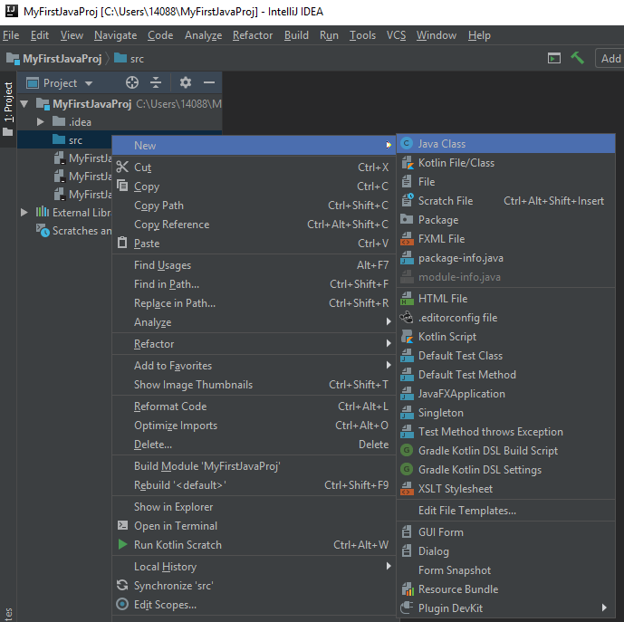
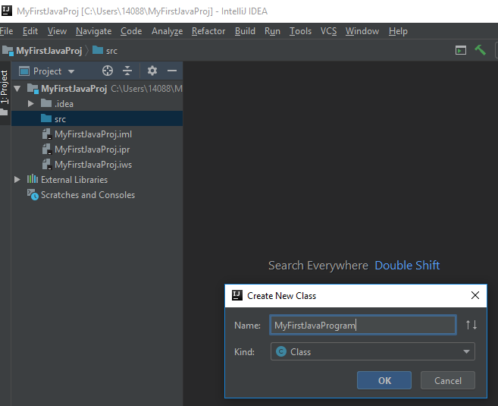
4.1 Hello World
https://www.tutorialspoint.com/java/index.htm
First Java Program (2)
Select Explore: click src folder; New -> Java Class as below.
Enter Class Name: “MyFirstJavaProgram” as below.

Slide 6
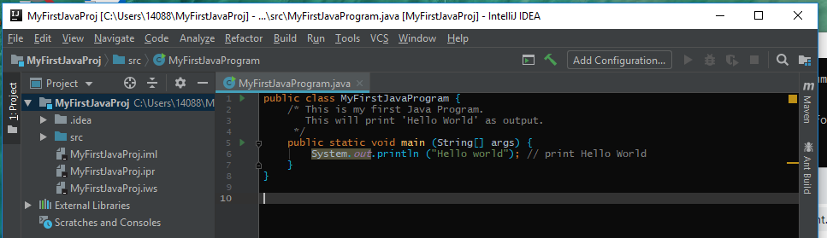
4.1 Hello World
https://www.tutorialspoint.com/java/index.htm
First Java Program (3)
Enter the Java code as below:

Slide 7
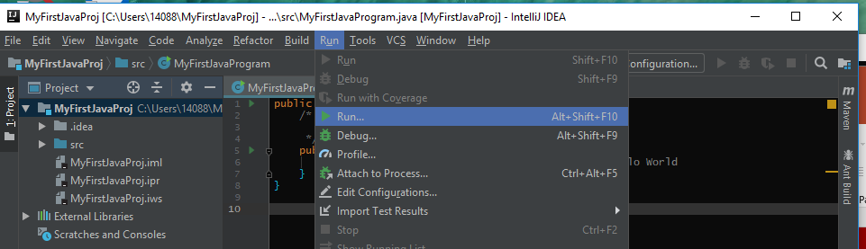
4.1 Hello World
https://www.tutorialspoint.com/java/index.htm
First Java Program (4)
> Run -> Run …

Slide 8
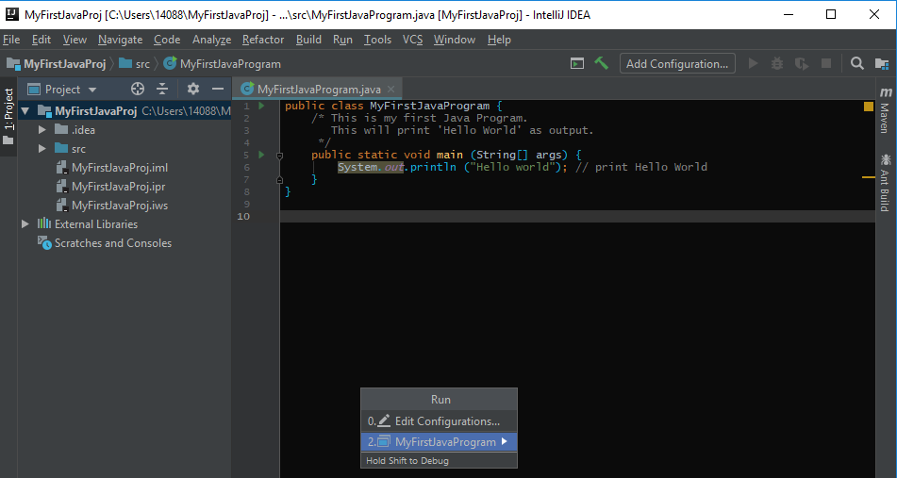
4.1 Hello World
https://www.tutorialspoint.com/java/index.htm
First Java Program (4)
Select “MyFirstProgram”

Slide 9
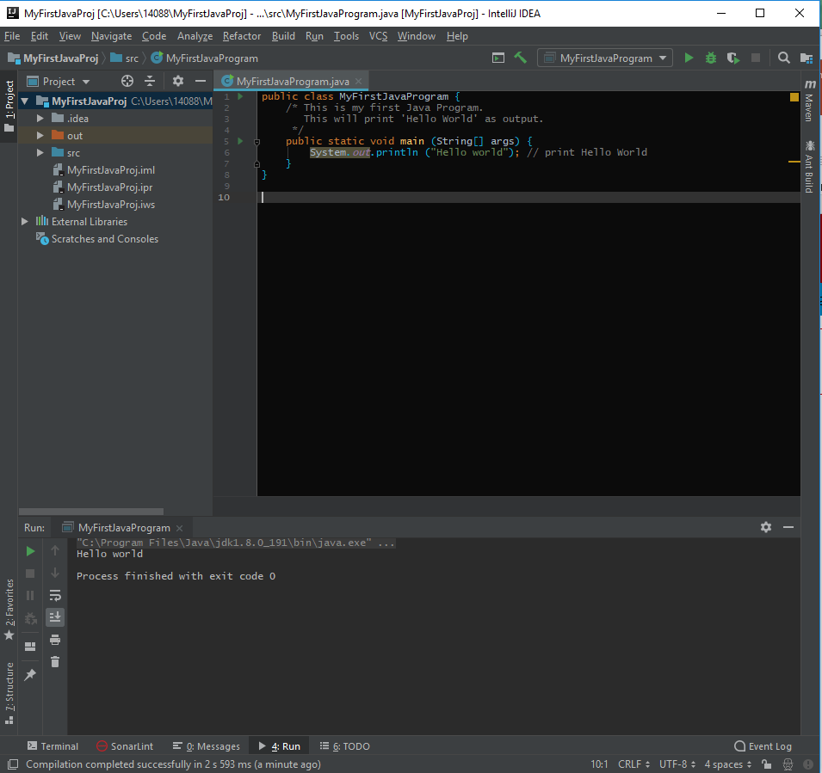
4.1 Hello World
https://www.tutorialspoint.com/java/index.htm
First Java Program (5)
Check output window “Hello World” is printed.

Slide 10
4.2 Enum

Slide 11
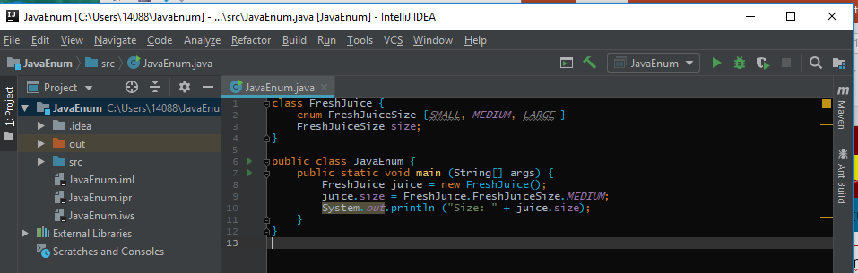
4.2 Enum
https://www.tutorialspoint.com/java/index.htm
Enum (1)
New -> File -> Project: JavaEnum
New -> Java Class: JavaEnum
Enter the Java code as follow:

Slide 12
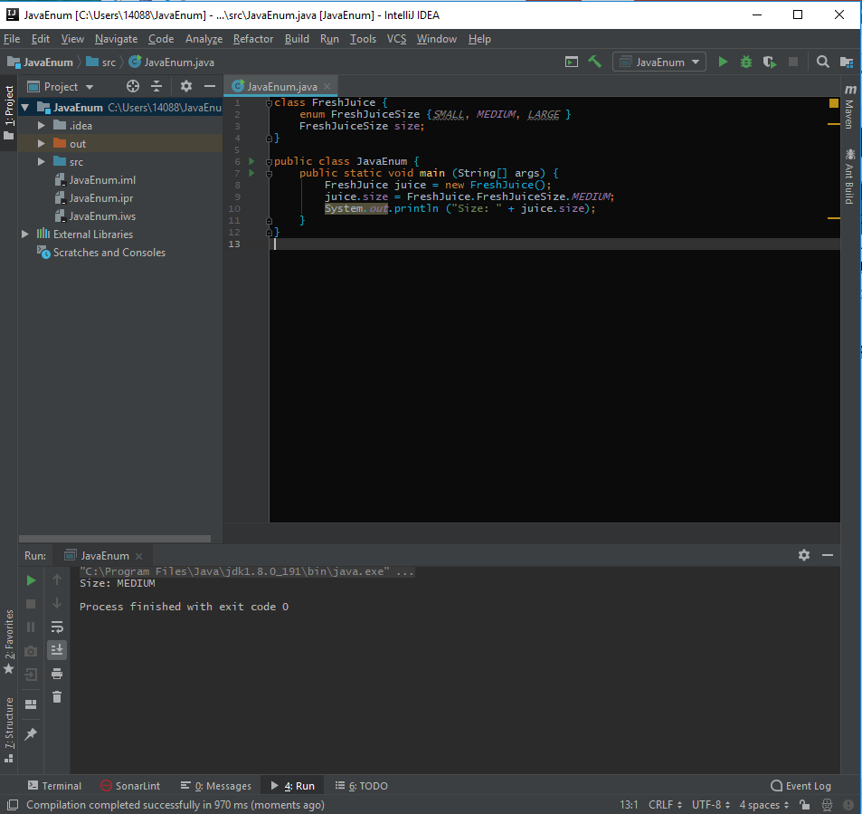
4.2 Enum
https://www.tutorialspoint.com/java/index.htm
Enum (1)
Run:
Select “JavaEnum”
Output: “Size: MEDIUM”

Slide 13
4.3 Inheritance and Interface

Slide 14
4.3 Inheritance and Interface
https://www.tutorialspoint.com/java/index.htm
Inheritance
In Java, classes can be derived from classes. Basically, if you need to create a new class and here is already a class that has some of the code you require, then it is possible to derive your new class from the already existing code.
This concept allows you to reuse the fields and methods of the existing class without having to rewrite the code in a new class. In this scenario, the existing class is called the superclass and the derived class is called the subclass.
Interfaces
In Java language, an interface can be defined as a contract between objects on how to communicate with each other. Interfaces play a vital role when it comes to the concept of inheritance.
An interface defines the methods, a deriving class (subclass) should use. But the implementation of the methods is totally up to the subclass.

Slide 15
End of Chapter

