Slide 1

5 Object and Class
Peter H. Chen

Slide 2
5 Object and Class
https://www.tutorialspoint.com/java/index.htm
Java is an Object-Oriented Language. As a language that has the Object-Oriented feature, Java supports the following fundamental concepts −
Polymorphism
Inheritance
Encapsulation
Abstraction
Classes
Objects
Instance
Method
Message Parsing
In this chapter, we will look into the concepts - Classes and Objects.
Object − Objects have states and behaviors. Example: A dog has states - color, name, breed as well as behaviors – wagging the tail, barking, eating. An object is an instance of a class.
Class − A class can be defined as a template/blueprint that describes the behavior/state that the object of its type support.

Slide 3
5 Object and Class
https://www.tutorialspoint.com/java/index.htm
Objects in Java
Let us now look deep into what are objects. If we consider the real-world, we can find many objects around us, cars, dogs, humans, etc. All these objects have a state and a behavior.
If we consider a dog, then its state is - name, breed, color, and the behavior is - barking, wagging the tail, running.
If you compare the software object with a real-world object, they have very similar characteristics.
Software objects also have a state and a behavior. A software object's state is stored in fields and behavior is shown via methods.
So in software development, methods operate on the internal state of an object and the object-to-object communication is done via methods.

Slide 4
5 Object and Class
https://www.tutorialspoint.com/java/index.htm
Classes in Java
A class is a blueprint from which individual objects are created.
Following is a sample of a class.
Example
public class Dog {
String breed;
int age;
String color;
void barking() {
}
void hungry() {
}
void sleeping() {
}
}

Slide 5
5 Object and Class
https://www.tutorialspoint.com/java/index.htm
A class can contain any of the following variable types.
Local variables − Variables defined inside methods, constructors or blocks are called local variables. The variable will be declared and initialized within the method and the variable will be destroyed when the method has completed.
Instance variables − Instance variables are variables within a class but outside any method. These variables are initialized when the class is instantiated. Instance variables can be accessed from inside any method, constructor or blocks of that particular class.
Class variables − Class variables are variables declared within a class, outside any method, with the static keyword.
A class can have any number of methods to access the value of various kinds of methods. In the above example, barking(), hungry() and sleeping() are methods.
Following are some of the important topics that need to be discussed when looking into classes of the Java Language.

Slide 6
5 Object and Class
https://www.tutorialspoint.com/java/index.htm
Constructors
When discussing about classes, one of the most important sub topic would be constructors. Every class has a constructor. If we do not explicitly write a constructor for a class, the Java compiler builds a default constructor for that class.
Each time a new object is created, at least one constructor will be invoked. The main rule of constructors is that they should have the same name as the class. A class can have more than one constructor.
Following is an example of a constructor −
Example
public class Puppy {
public Puppy() { }
public Puppy(String name) {
// This constructor has one parameter, name.
}
}

Slide 7
5 Object and Class
https://www.tutorialspoint.com/java/index.htm
Java also supports Singleton Classes where you would be able to create only one instance of a class.
Note − We have two different types of constructors. We are going to discuss constructors in detail in the subsequent chapters.

Slide 8
5.1 Singleton Class

Slide 9
5.1 Singleton Class
https://www.tutorialspoint.com/java/java_using_singleton.htm
Singleton Class
The Singleton's purpose is to control object creation, limiting the number of objects to only one.
Since there is only one Singleton instance, any instance fields of a Singleton will occur only once per class, just like static fields.
Singletons often control access to resources, such as database connections or sockets.
For example, if you have a license for only one connection for your database or your JDBC driver has trouble with multithreading, the Singleton makes sure that only one connection is made or that only one thread can access the connection at a time.

Slide 10
5.1 Singleton Class
https://www.tutorialspoint.com/java/java_using_singleton.htm
Example 1 (1):
The easiest implementation consists of
A private constructor
A field to hold intantiation, and
A public static accessor method with a name like getInstance().
The private field can be assigned from within a static initializer block or, more simply, using an initializer.
The getInstance( ) method (which must be public) then simply returns this instance.
// File Name: Singleton.java
public class Singleton {
/* a field to hold the instiatation */
private static Singleton singleton = new Singleton( );
/* A private Constructor */
private Singleton() { }
/* a public accessor */
public static Singleton getInstance( ) {
return singleton;
}
/* Other access methods */
protected static void demoMethod( ) {
System.out.println("demoMethod for singleton");
}
}

Slide 11
5.1 Singleton Class
https://www.tutorialspoint.com/java/java_using_singleton.htm
Example 1 (2):
Here is the main program file where we will
Create a singleton object: Instantiate single and hold in tmp.
Use other access method
// File Name: SingletonDemo.java
public class SingletonDemo {
public static void main(String[] args) {
// Create a single object
Singleton tmp = Singleton.getInstance( );
// Use access method
tmp.demoMethod( );
}
}

Slide 12
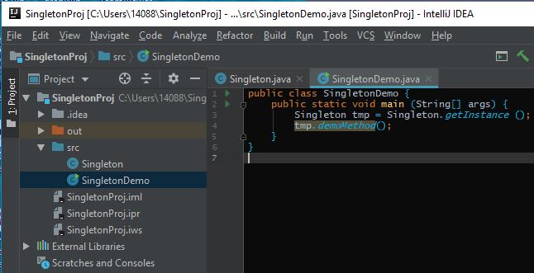
5.1 Singleton Class
https://www.tutorialspoint.com/java/java_using_singleton.htm
Implementing Singletons (1)
SingletonDemo.java

Slide 13
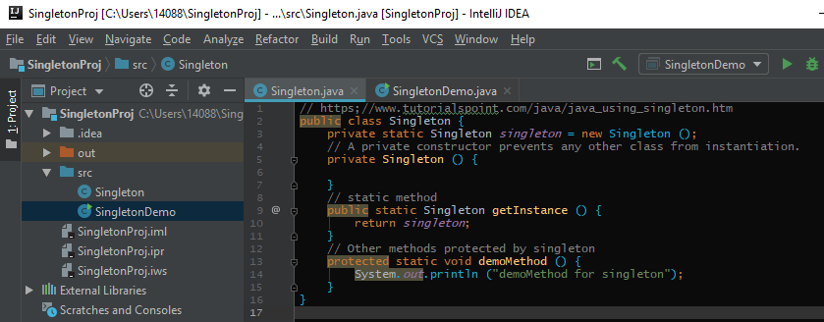
5.1 Singleton Class
https://www.tutorialspoint.com/java/java_using_singleton.htm
Implementing Singletons (2)
Singleton.java Example

Slide 14
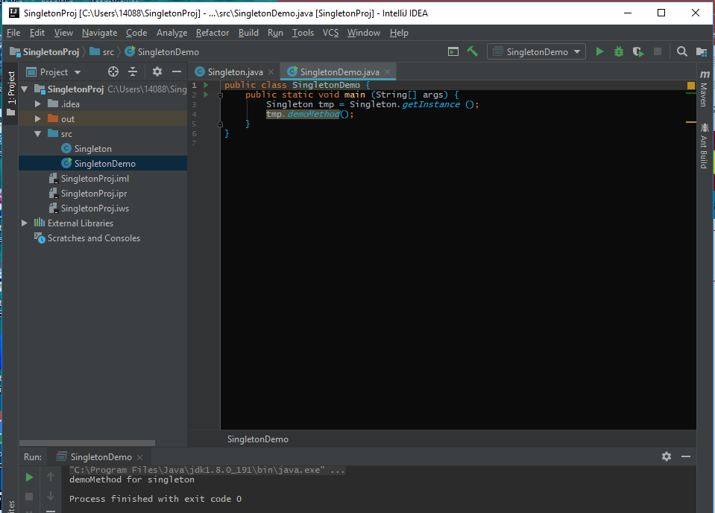
5.1 Singleton Class
https://www.tutorialspoint.com/java/java_using_singleton.htm
Implementing Singletons (3)
> run

Slide 15
5.2 Singleton Design Pattern

Slide 16
5.2 Singleton Design Pattern
https://www.tutorialspoint.com/java/java_using_singleton.htm
Example 2
Following implementation shows a classic Singleton design pattern
public class ClassicSingleton {
private static ClassicSingleton instance = null;
private ClassicSingleton() {
// Exists only to defeat instantiation.
}
public static ClassicSingleton getInstance() {
if (instance == null) {
instance = new ClassicSingleton();
}
return instance;
}
}

Slide 17
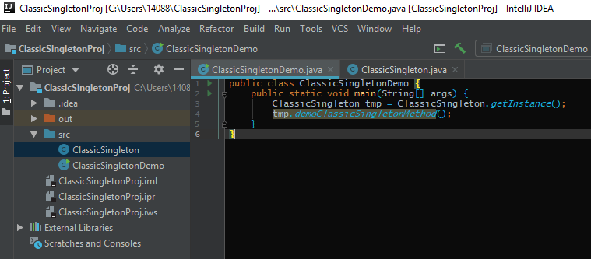
5.2 Singleton Design Pattern
https://www.tutorialspoint.com/java/java_using_singleton.htm
Prevent the duplicate Singleton (1)
Create ClassicSingletonDemo.java

Slide 18
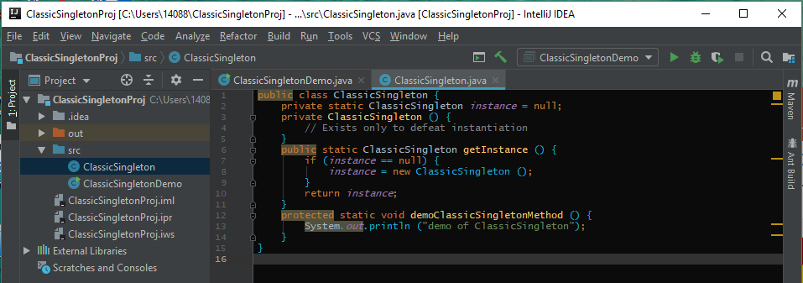
5.2 Singleton Design Pattern
https://www.tutorialspoint.com/java/java_using_singleton.htm
Prevent the duplicate Singleton (2)
Create ClassicSingleton.java

Slide 19
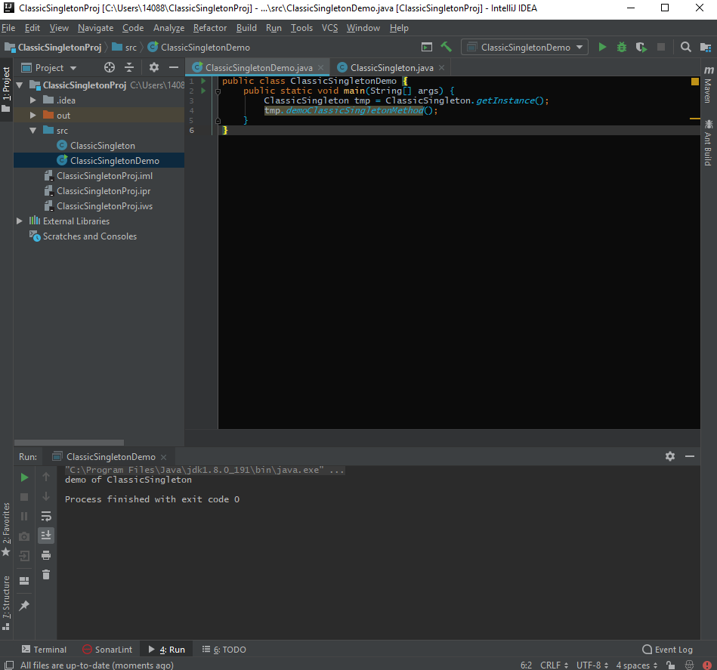
5.2 Singleton Design Pattern
https://www.tutorialspoint.com/java/java_using_singleton.htm
Prevent the duplicate Singleton (2)
> run

Slide 20
5.3 Create Object

Slide 21
5.3 Create Object
https://www.tutorialspoint.com/java/java_object_classes.htm
As mentioned previously, a class provides the blueprints for objects.
So basically, an object is created from a class.
In Java, the new keyword is used to create new objects.
There are three steps when creating an object from a class −
Declaration − A variable declaration with a variable name with an object type.
Instantiation − The 'new' keyword is used to create the object.
Initialization − The 'new' keyword is followed by a call to a constructor. This call initializes the new object.
Following is an example of creating an object −
Example

Slide 22
End of Chapter

