Slide 1

6 Constructor
Peter H. Chen

Slide 2
6 Constructor
https://www.tutorialspoint.com/java/index.htm
A constructor initializes an object when it is created. It has the same name as its class and is syntactically similar to a method. However, constructors have no explicit return type.
Typically, you will use a constructor to give initial values to the instance variables defined by the class, or to perform any other start-up procedures required to create a fully formed object.
All classes have constructors, whether you define one or not, because Java automatically provides a default constructor that initializes all member variables to zero. However, once you define your own constructor, the default constructor is no longer used.
Syntax
Following is the syntax of a constructor
class ClassName {
ClassName() {
}
}
Java allows two types of constructors namely −
No argument Constructors
Parameterized Constructors

Slide 3
6.1 Default Constructor

Slide 4
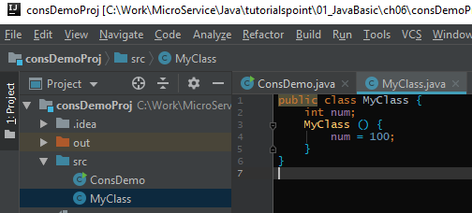
6.1 Default Constructor
https://www.tutorialspoint.com/java/index.htm
Default Constructors
As the name specifies the no argument constructors of Java does not accept any parameters instead, using these constructors the instance variables of a method will be initialized with fixed values for all objects.
Example:

Slide 5
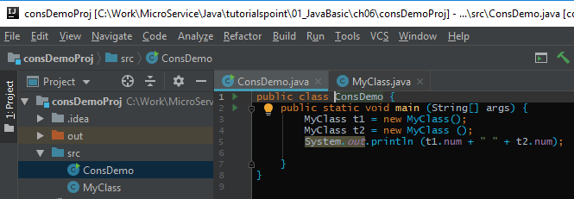
6.1 Default Constructor
https://www.tutorialspoint.com/java/index.htm
You would call constructor to initialize objects as follows

Slide 6
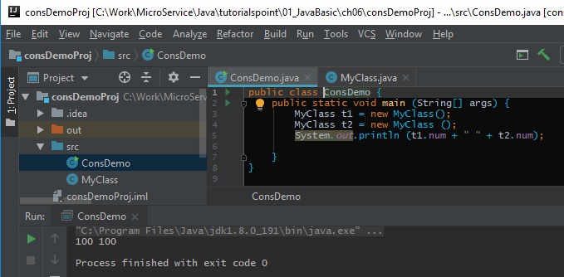
6.1 Default Constructor
https://www.tutorialspoint.com/java/index.htm
This would produce the following result

Slide 7
6.2 Parameterized Constructor

Slide 8
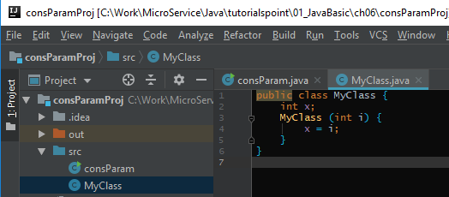
6.2 Parameterized Constructor
https://www.tutorialspoint.com/java/index.htm
Parameterized Constructors
Most often, you will need a constructor that accepts one or more parameters.
Parameters are added to a constructor in the same way that they are added to a method, just declare them inside the parentheses after the constructor's name.
Example
Here is a simple example that uses a constructor

Slide 9
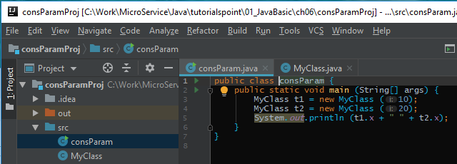
6.2 Parameterized Constructor
https://www.tutorialspoint.com/java/index.htm
You would call constructor to initialize objects as follows

Slide 10
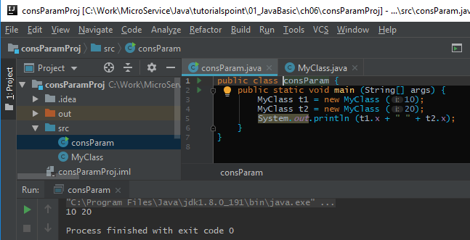
6.2 Parameterized Constructor
https://www.tutorialspoint.com/java/index.htm
> run

Slide 11
End of Chapter

