Slide 1

1 Queue
Peter H. Chen

Slide 2
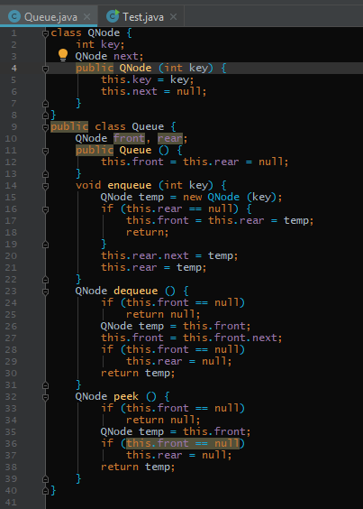
1 Queue
https://www.tutorialspoint.com/java/index.htm
Queue example: enqueue(), dequeue(), peek()

Slide 3
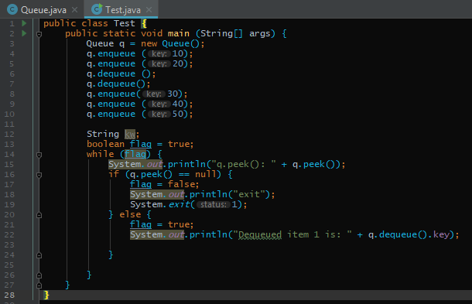
1 Queue
https://www.tutorialspoint.com/java/index.htm
Queue Test example:

Slide 4
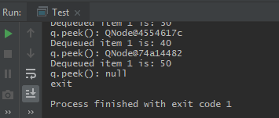
1 Queue
https://www.tutorialspoint.com/java/index.htm
Run Test Queue:

Slide 5
End of Chapter

