Slide 1

1 Kafka Workflow
Peter H. Chen

Slide 2
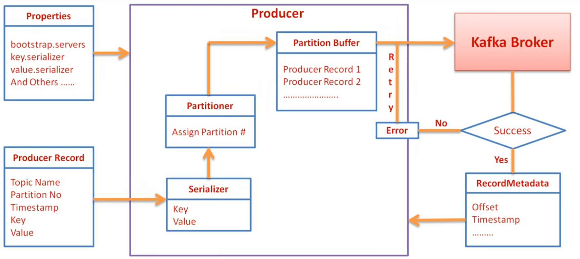
1 Kafka Workflow
https://www.youtube.com/watch?v=_RrgVDTd38M&index=11&list=PLkz1SCf5iB4enAR00Z46JwY9GGkaS2NON
Kafka Workflow:
Properties: Bootstrap server, key and value are serialized.
Producer Record parameter: Topic, partition number, timestamp, key, and value.

Slide 3
End of Chapter

