Slide 1

12 Kafka Callback
Peter H. Chen

Slide 2
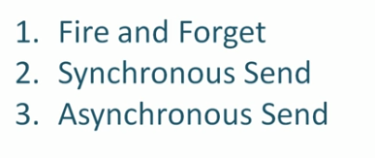
12 Kafka Callback
https://www.youtube.com/watch?v=vgSaZicdy1I&list=PLkz1SCf5iB4enAR00Z46JwY9GGkaS2NON&index=12
Kafka Callback:

Slide 3
12.2 Fire and Forgot

Slide 4
12.2 Synchronous Send

Slide 5
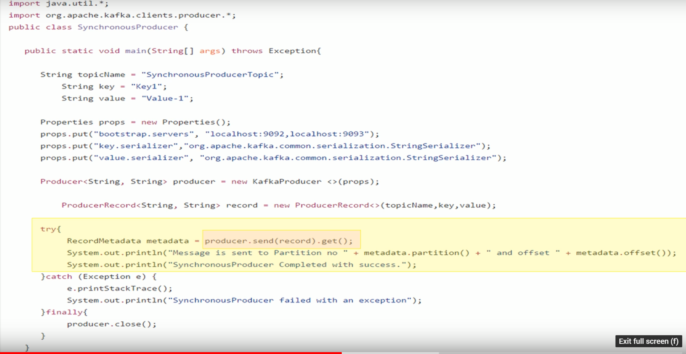
12.2 Synchronous Send
https://www.youtube.com/watch?v=vgSaZicdy1I&list=PLkz1SCf5iB4enAR00Z46JwY9GGkaS2NON&index=12
Kafka Callback: Synchronous Send
Step 1
Step 2
Step 3

Slide 6
12.3 Asynchronous Send

Slide 7
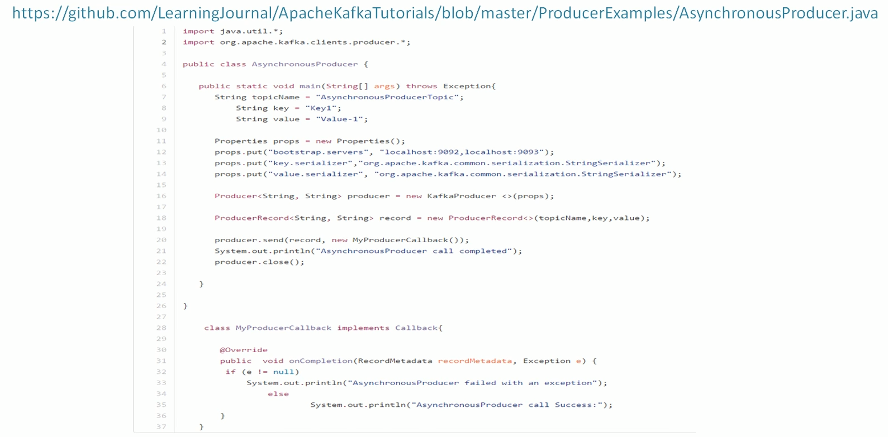
12.3 Asynchronous Send
https://www.youtube.com/watch?v=vgSaZicdy1I&list=PLkz1SCf5iB4enAR00Z46JwY9GGkaS2NON&index=12
Kafka Callback: Asynchronous Send

Slide 8
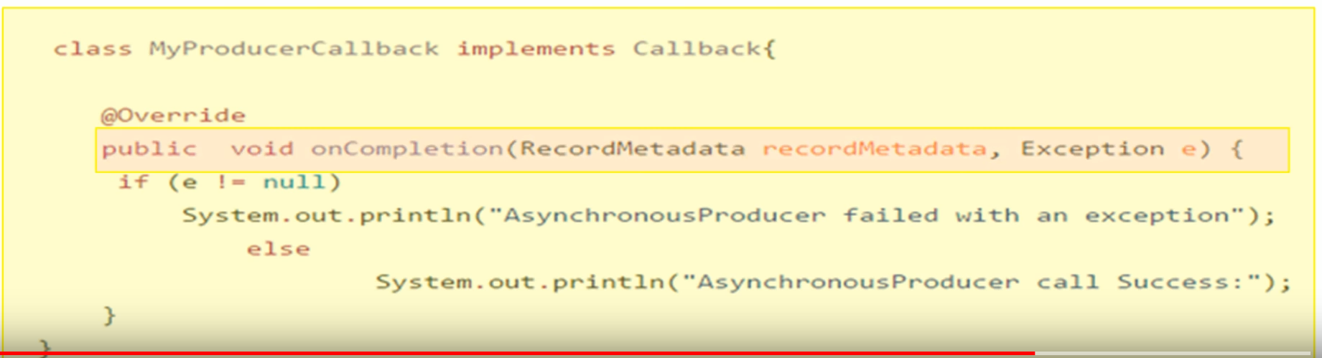
12.3 Asynchronous Send
https://www.youtube.com/watch?v=vgSaZicdy1I&list=PLkz1SCf5iB4enAR00Z46JwY9GGkaS2NON&index=12
Kafka Callback: Asynchronous Send Override Callback

Slide 9
End of Chapter

