Slide 1

13 Partitioner
Peter H. Chen

Slide 2
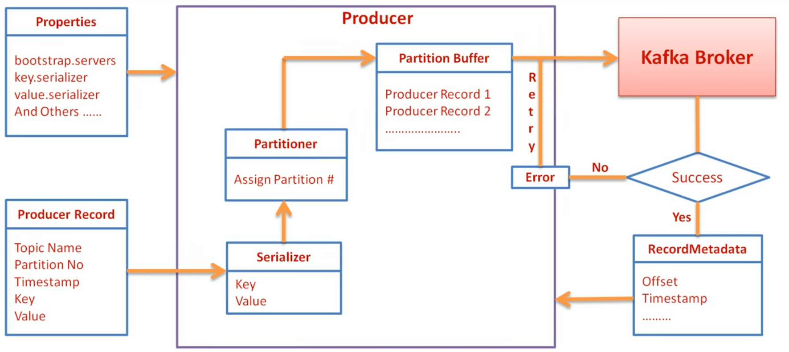
13 Partitioner
https://www.youtube.com/watch?v=pMDAcNRkWkE&index=13&list=PLkz1SCf5iB4enAR00Z46JwY9GGkaS2NON
Kafka Partitioner:

Slide 3
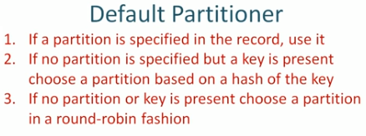
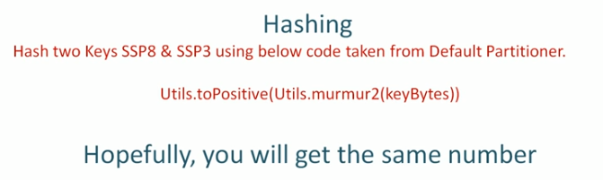
13 Default Partitioner
https://www.youtube.com/watch?v=pMDAcNRkWkE&index=13&list=PLkz1SCf5iB4enAR00Z46JwY9GGkaS2NON
Default Partitioner

Slide 4
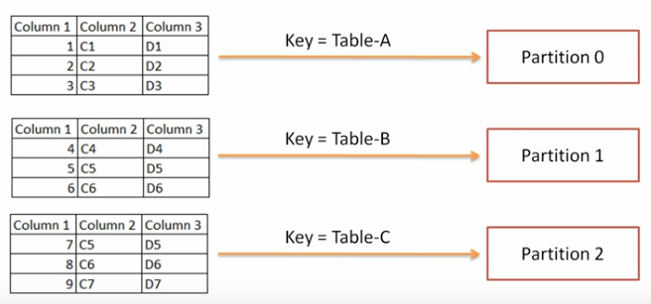
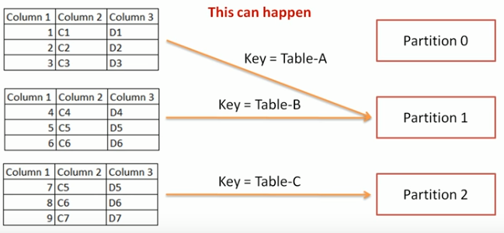
13 Default Partitioner
https://www.youtube.com/watch?v=pMDAcNRkWkE&index=13&list=PLkz1SCf5iB4enAR00Z46JwY9GGkaS2NON
Default Partitioner

Slide 5
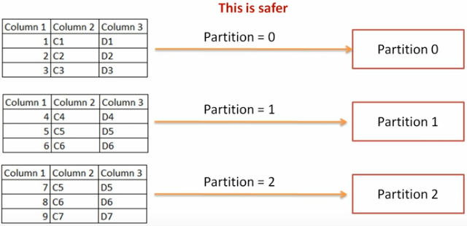
13 Default Partitioner
https://www.youtube.com/watch?v=pMDAcNRkWkE&index=13&list=PLkz1SCf5iB4enAR00Z46JwY9GGkaS2NON
Default Partitioner

Slide 6
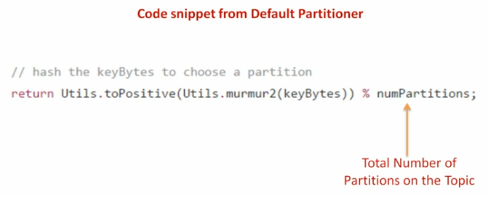
13 Default Partitioner
https://www.youtube.com/watch?v=pMDAcNRkWkE&index=13&list=PLkz1SCf5iB4enAR00Z46JwY9GGkaS2NON
Default Partitioner

Slide 7
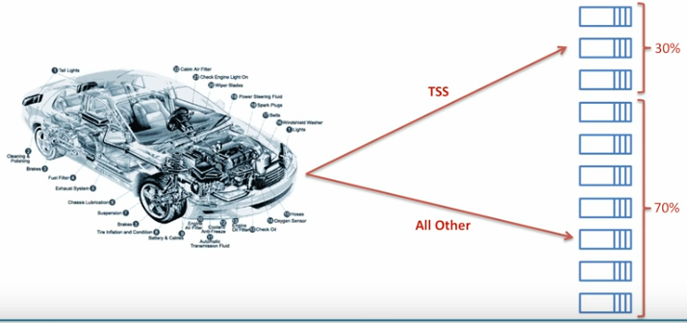
13 Default Partitioner
https://www.youtube.com/watch?v=pMDAcNRkWkE&index=13&list=PLkz1SCf5iB4enAR00Z46JwY9GGkaS2NON
Default Partitioner

Slide 8
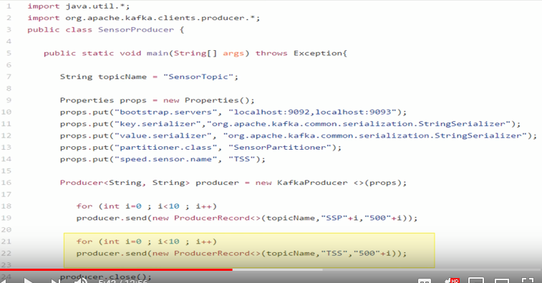
13 Default Partitioner
https://www.youtube.com/watch?v=pMDAcNRkWkE&index=13&list=PLkz1SCf5iB4enAR00Z46JwY9GGkaS2NON
Default Partitioner

Slide 9
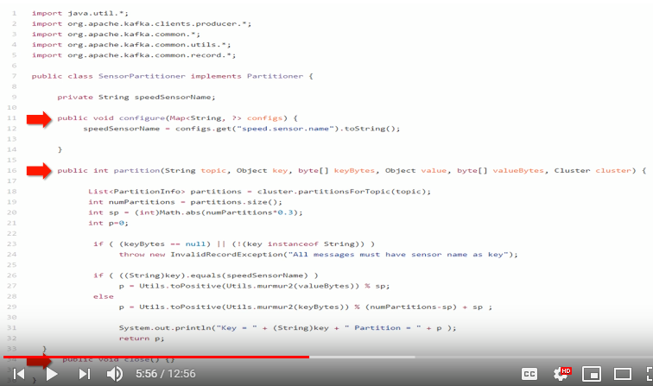
13 Default Partitioner
https://www.youtube.com/watch?v=pMDAcNRkWkE&index=13&list=PLkz1SCf5iB4enAR00Z46JwY9GGkaS2NON
Partitioner: Implement three methods in your class: Configure Method, Partition method, and close method.
Size = 10, sp = 0-3
TSS = 0-3
TSS = 3-9

Slide 10
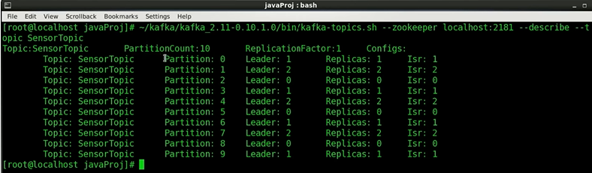
13 Default Partitioner
https://www.youtube.com/watch?v=pMDAcNRkWkE&index=13&list=PLkz1SCf5iB4enAR00Z46JwY9GGkaS2NON
Partitioner: We have 10 partitions in this topics (SensorTopic).

Slide 11
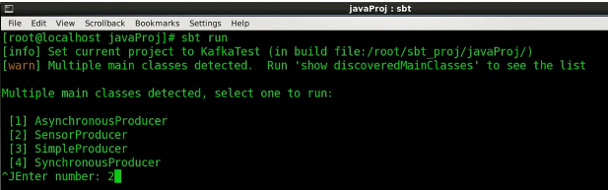
13 Default Partitioner
https://www.youtube.com/watch?v=pMDAcNRkWkE&index=13&list=PLkz1SCf5iB4enAR00Z46JwY9GGkaS2NON
Partitioner: We have 10 partitions in this topics (SensorTopic).

Slide 12
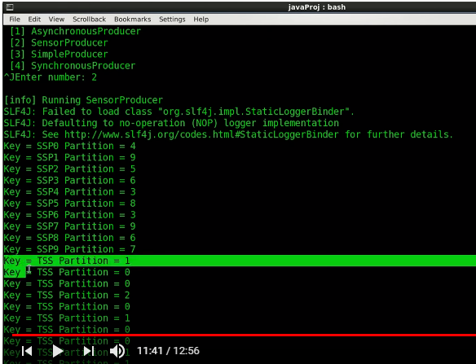
13 Default Partitioner
https://www.youtube.com/watch?v=pMDAcNRkWkE&index=13&list=PLkz1SCf5iB4enAR00Z46JwY9GGkaS2NON
Partitioner: We have 10 partitions in this topics (SensorTopic).
Hash guarantees same key will have same number.
But two different keys can have the same hash number.
You have to specify partition number for two different keys.
You cannot not reply on key for partitioning, be careful. It can mixes data for two different key values.

Slide 13
End of Chapter

