Slide 1

15 Producer Configs
Peter H. Chen

Slide 2
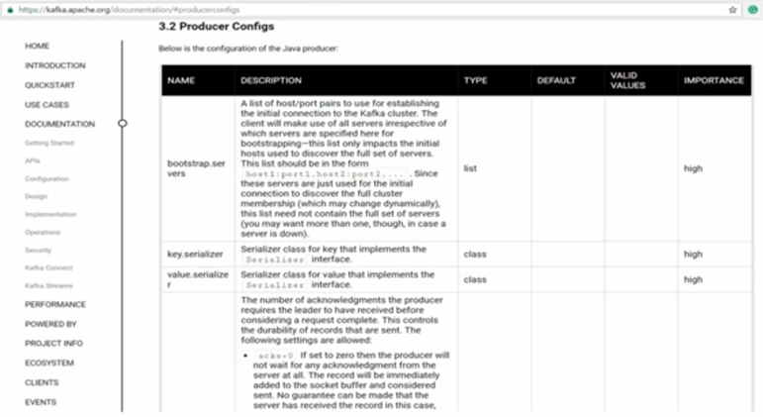
15 Producer Configs
https://www.youtube.com/watch?v=6X-cFwKqmUE&list=PLkz1SCf5iB4enAR00Z46JwY9GGkaS2NON&index=14
In Kafka, almost everything is controlled using configuration.

Slide 3
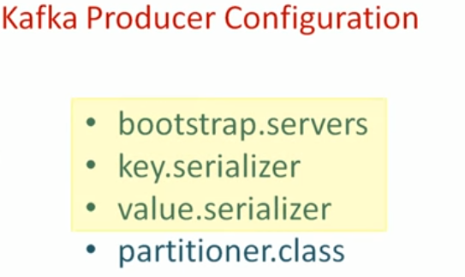
15 Producer Configs
https://www.youtube.com/watch?v=6X-cFwKqmUE&list=PLkz1SCf5iB4enAR00Z46JwY9GGkaS2NON&index=14
In earlier examples, we use three configuration parameters which are mandatory.
The fourth parameter “partitioner.class” is for custom partitioner.

Slide 4
15 Producer Configs
https://www.youtube.com/watch?v=6X-cFwKqmUE&list=PLkz1SCf5iB4enAR00Z46JwY9GGkaS2NON&index=14
Bootstrap.servers provide the url and etc are mdandatory.
key.serailzier for key
Value.serializer for value.
Partitioner.class: need to class name for parameter for custom modification.
Read the Kafka document for details.
We will only discuss three important parameter here: They impact the Kafka reliability and performance.

Slide 5
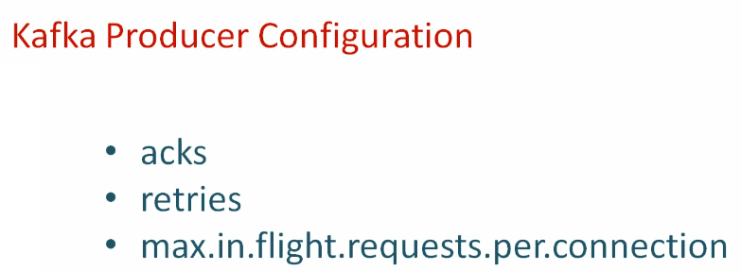
15 Producer Configs
https://www.youtube.com/watch?v=6X-cFwKqmUE&list=PLkz1SCf5iB4enAR00Z46JwY9GGkaS2NON&index=14
You can use bootstrap or Partitioner class to setup these properties.

Slide 6
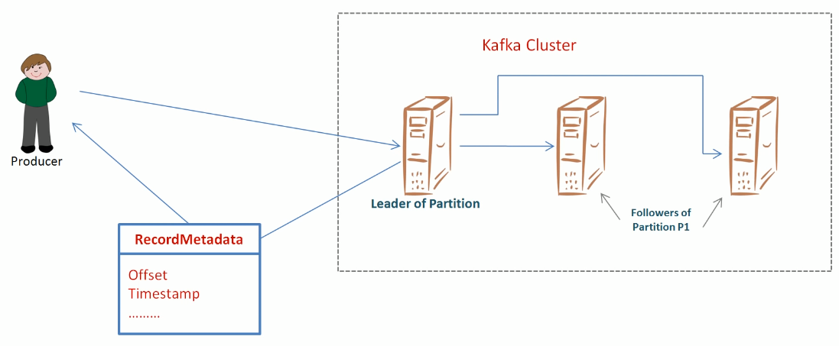
15 Producer Configs
https://www.youtube.com/watch?v=6X-cFwKqmUE&list=PLkz1SCf5iB4enAR00Z46JwY9GGkaS2NON&index=14
The acks parameter: The producer put the topic and Acknowledgement from Kafka broker.

Slide 7
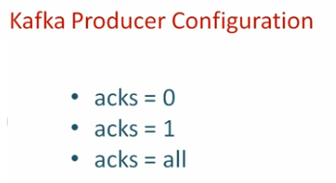
15 Producer Configs
https://www.youtube.com/watch?v=6X-cFwKqmUE&list=PLkz1SCf5iB4enAR00Z46JwY9GGkaS2NON&index=14
The acks parameter: 0, 1, all.

Slide 8
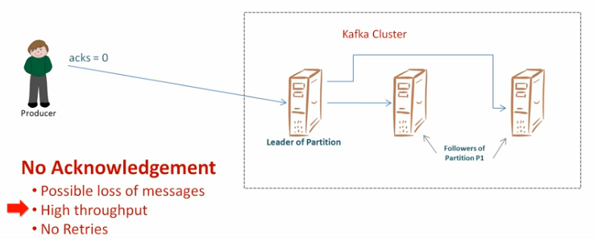
15 Producer Configs
https://www.youtube.com/watch?v=6X-cFwKqmUE&list=PLkz1SCf5iB4enAR00Z46JwY9GGkaS2NON&index=14
The acks parameter: 0

Slide 9
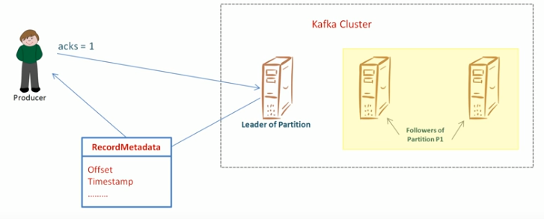
15 Producer Configs
https://www.youtube.com/watch?v=6X-cFwKqmUE&list=PLkz1SCf5iB4enAR00Z46JwY9GGkaS2NON&index=14
The acks parameter: 1 (only Leader response), replicate may be not copy and response.

Slide 10
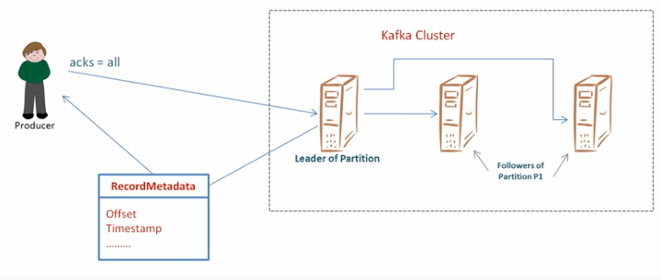
15 Producer Configs
https://www.youtube.com/watch?v=6X-cFwKqmUE&list=PLkz1SCf5iB4enAR00Z46JwY9GGkaS2NON&index=14
The acks parameter: all (waiting for all replicates)

Slide 11
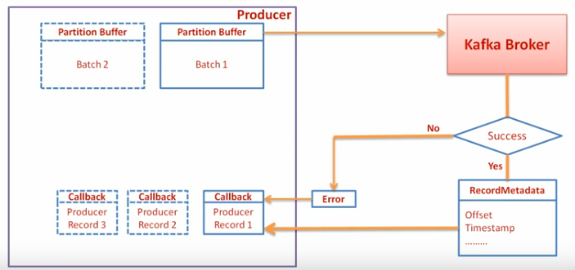
15 Producer Configs
https://www.youtube.com/watch?v=6X-cFwKqmUE&list=PLkz1SCf5iB4enAR00Z46JwY9GGkaS2NON&index=14
The max.in.flight.request parameter: How many asynchronous callback in flight request are response per connection. High values will have low throughput.

Slide 12
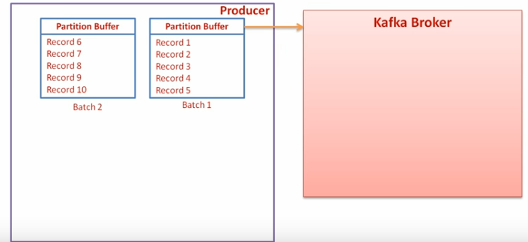
15 Producer Configs
https://www.youtube.com/watch?v=6X-cFwKqmUE&list=PLkz1SCf5iB4enAR00Z46JwY9GGkaS2NON&index=14
The max.in.flight.request parameter: Example

Slide 13
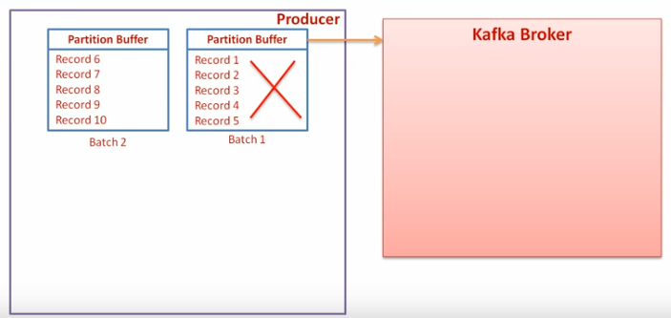
15 Producer Configs
https://www.youtube.com/watch?v=6X-cFwKqmUE&list=PLkz1SCf5iB4enAR00Z46JwY9GGkaS2NON&index=14
The max.in.flight.request parameter: First batch fail

Slide 14
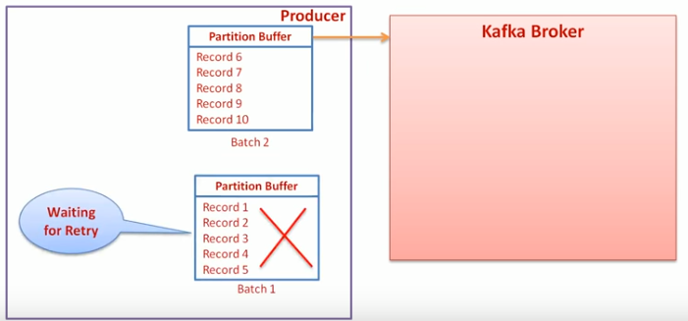
15 Producer Configs
https://www.youtube.com/watch?v=6X-cFwKqmUE&list=PLkz1SCf5iB4enAR00Z46JwY9GGkaS2NON&index=14
The max.in.flight.request parameter: remaining five are second batch are success.

Slide 15
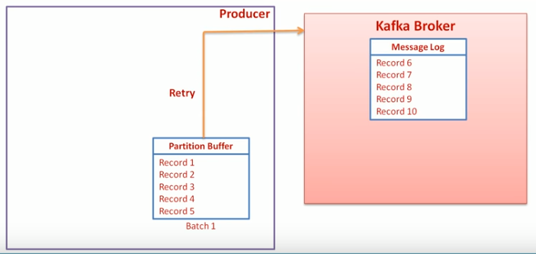
15 Producer Configs
https://www.youtube.com/watch?v=6X-cFwKqmUE&list=PLkz1SCf5iB4enAR00Z46JwY9GGkaS2NON&index=14
The max.in.flight.request parameter: If we have retry, the producer will resend.

Slide 16
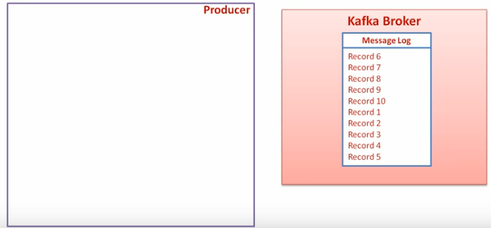
15 Producer Configs
https://www.youtube.com/watch?v=6X-cFwKqmUE&list=PLkz1SCf5iB4enAR00Z46JwY9GGkaS2NON&index=14
The max.in.flight.request parameter: If we have retry, the broker will have batch 1.

Slide 17
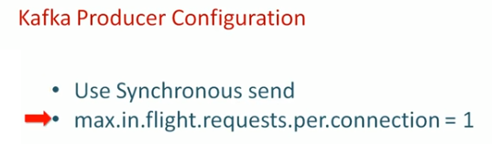
15 Producer Configs
https://www.youtube.com/watch?v=6X-cFwKqmUE&list=PLkz1SCf5iB4enAR00Z46JwY9GGkaS2NON&index=14
If you want to deliver the order, use the following: Use synchronous send or set max.in.flight.request.per.connection = 1

Slide 18
End of Chapter

