Slide 1

16 Consumer Groups
Peter H. Chen

Slide 2
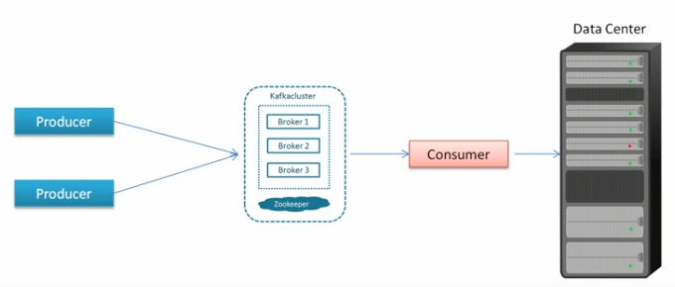
16 Consumer Groups
https://www.youtube.com/watch?v=6X-cFwKqmUE&list=PLkz1SCf5iB4enAR00Z46JwY9GGkaS2NON&index=14
Single consumer

Slide 3
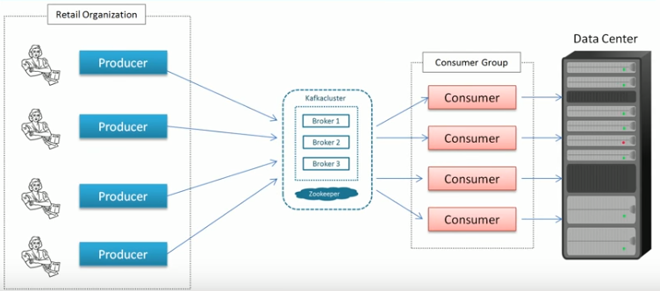
16 Consumer Groups
https://www.youtube.com/watch?v=6X-cFwKqmUE&list=PLkz1SCf5iB4enAR00Z46JwY9GGkaS2NON&index=14
Many applications have multiple producers and multiple consumers, Consumer groups, at the end.
In the producer side, there is individual applicaitons.
In the consumer side, the consumers can be grouped together as a single applicaiton.

Slide 4

16 Consumer Groups
https://www.youtube.com/watch?v=6X-cFwKqmUE&list=PLkz1SCf5iB4enAR00Z46JwY9GGkaS2NON&index=14
The question is how do we read in parallel?

Slide 5
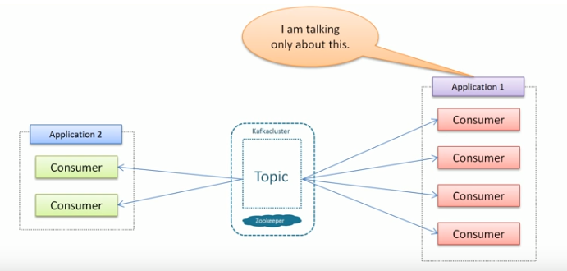
16 Consumer Groups
https://www.youtube.com/watch?v=6X-cFwKqmUE&list=PLkz1SCf5iB4enAR00Z46JwY9GGkaS2NON&index=14
When we talk about read in parallel, we mean a single application does the consumer reading in parallel.

Slide 6
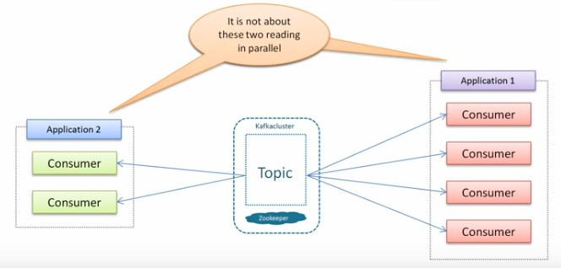
16 Consumer Groups
https://www.youtube.com/watch?v=6X-cFwKqmUE&list=PLkz1SCf5iB4enAR00Z46JwY9GGkaS2NON&index=14
It is not multiple applications reading in parallel.

Slide 7
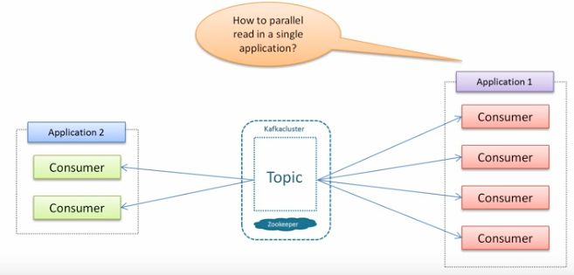
16 Consumer Groups
https://www.youtube.com/watch?v=6X-cFwKqmUE&list=PLkz1SCf5iB4enAR00Z46JwY9GGkaS2NON&index=14
How do we read in single application?

Slide 8
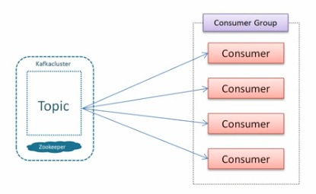
16 Consumer Groups
https://www.youtube.com/watch?v=6X-cFwKqmUE&list=PLkz1SCf5iB4enAR00Z46JwY9GGkaS2NON&index=14
We can read in a singe group..

Slide 9
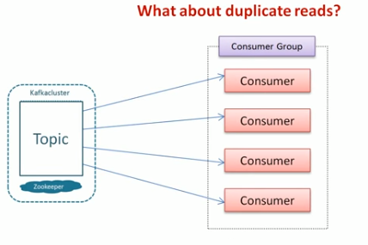
16 Consumer Groups
https://www.youtube.com/watch?v=6X-cFwKqmUE&list=PLkz1SCf5iB4enAR00Z46JwY9GGkaS2NON&index=14
However, there is a concern of duplicate read.

Slide 10
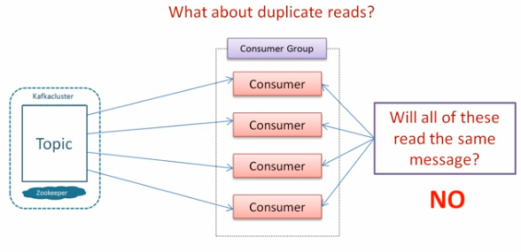
16 Consumer Groups
https://www.youtube.com/watch?v=6X-cFwKqmUE&list=PLkz1SCf5iB4enAR00Z46JwY9GGkaS2NON&index=14
Don’t you think there is a duplicate read? There answer is “NO”

Slide 11
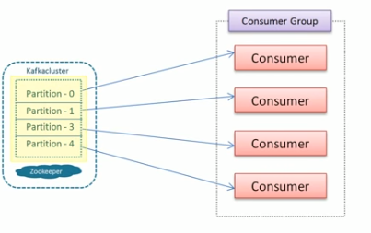
16 Consumer Groups
https://www.youtube.com/watch?v=6X-cFwKqmUE&list=PLkz1SCf5iB4enAR00Z46JwY9GGkaS2NON&index=14
Only one consumer own a particular partition at a particular time.

Slide 12
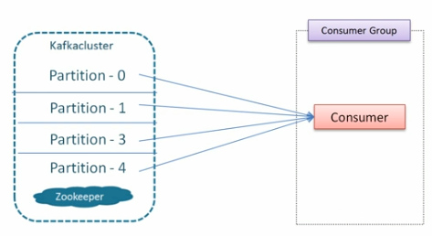
16 Consumer Groups
https://www.youtube.com/watch?v=6X-cFwKqmUE&list=PLkz1SCf5iB4enAR00Z46JwY9GGkaS2NON&index=14
If we have one consumer.

Slide 13
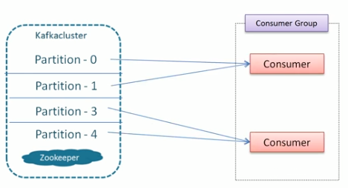
16 Consumer Groups
https://www.youtube.com/watch?v=6X-cFwKqmUE&list=PLkz1SCf5iB4enAR00Z46JwY9GGkaS2NON&index=14
If we have two consumers, each of them read two particular partition.

Slide 14
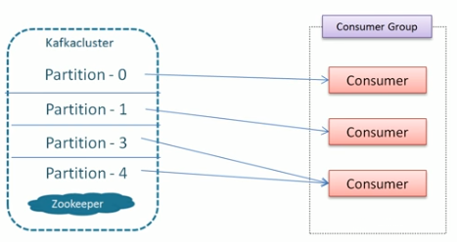
16 Consumer Groups
https://www.youtube.com/watch?v=6X-cFwKqmUE&list=PLkz1SCf5iB4enAR00Z46JwY9GGkaS2NON&index=14
If we have three consumers, the arrangement may looks like this.
The fundamental concept is the consumers do not share the partitions. There is no way we can read more than one partition.

Slide 15
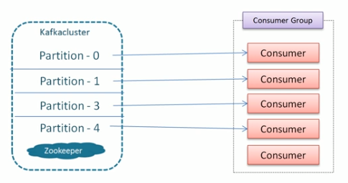
16 Consumer Groups
https://www.youtube.com/watch?v=6X-cFwKqmUE&list=PLkz1SCf5iB4enAR00Z46JwY9GGkaS2NON&index=14
There is a possibility that consumer has no partition to read. The fifth consumer has nothing to read.

Slide 16
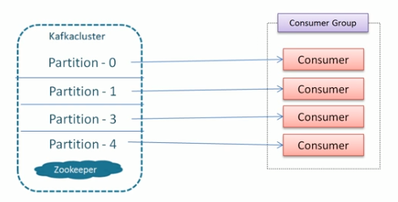
16 Consumer Groups
https://www.youtube.com/watch?v=6X-cFwKqmUE&list=PLkz1SCf5iB4enAR00Z46JwY9GGkaS2NON&index=14
I have four partitions and four consumers to read. All reading is parallel.
Each of consumer has no duplicate data.

Slide 17
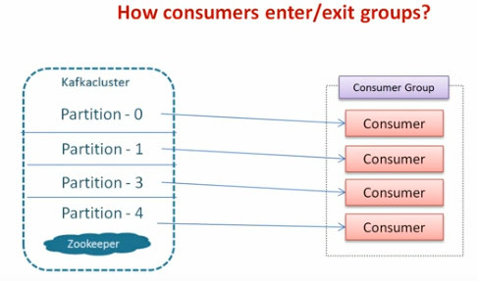
16 Consumer Groups
https://www.youtube.com/watch?v=6X-cFwKqmUE&list=PLkz1SCf5iB4enAR00Z46JwY9GGkaS2NON&index=14
Another question: How consumer enter or exit groups?
This question is obvious.

Slide 18
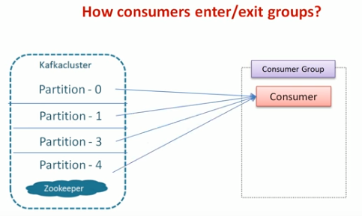
16 Consumer Groups
https://www.youtube.com/watch?v=6X-cFwKqmUE&list=PLkz1SCf5iB4enAR00Z46JwY9GGkaS2NON&index=14
Another question: How consumer enter or exit groups?
This question is obvious.

Slide 19
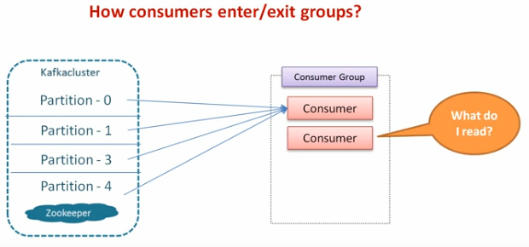
16 Consumer Groups
https://www.youtube.com/watch?v=6X-cFwKqmUE&list=PLkz1SCf5iB4enAR00Z46JwY9GGkaS2NON&index=14
We have one consumer reading four partition.
We add another consumer. What do I read?
Which partition should this consumer read?

Slide 20
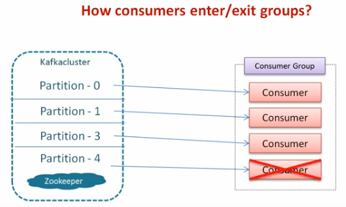
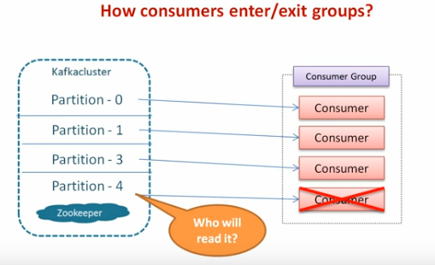
16 Consumer Groups
https://www.youtube.com/watch?v=6X-cFwKqmUE&list=PLkz1SCf5iB4enAR00Z46JwY9GGkaS2NON&index=14
This is a reassignment problem.
Assume we have four consumers but one of them exit.
What should happen to the partition 4?

Slide 21
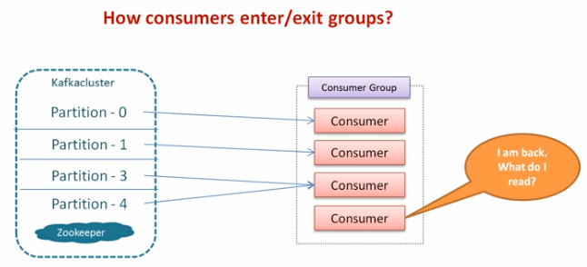
16 Consumer Groups
https://www.youtube.com/watch?v=6X-cFwKqmUE&list=PLkz1SCf5iB4enAR00Z46JwY9GGkaS2NON&index=14
After some time, the consumer is back. For consumer 4, What do I read? So the reassignment is happened again.
In the real application, we cannot control the consumer enter or exit.
My question is “How Kafka handle this?”
When consumer join this, how Kafka assign the partition to it?

Slide 22

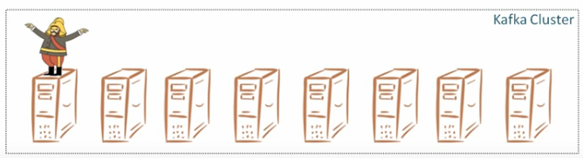
16 Consumer Groups
https://www.youtube.com/watch?v=6X-cFwKqmUE&list=PLkz1SCf5iB4enAR00Z46JwY9GGkaS2NON&index=14
Who manage all of this? The answer is simple “A group coordinator”
One of the Kafka broker is elected as the group coordinator.

Slide 23
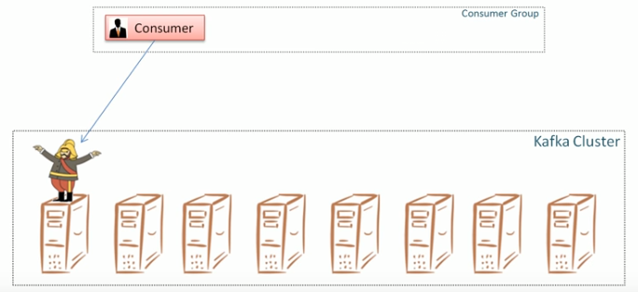
16 Consumer Groups
https://www.youtube.com/watch?v=6X-cFwKqmUE&list=PLkz1SCf5iB4enAR00Z46JwY9GGkaS2NON&index=14
When consumer want to join the group. The consumer requests the group coordinator.

Slide 24
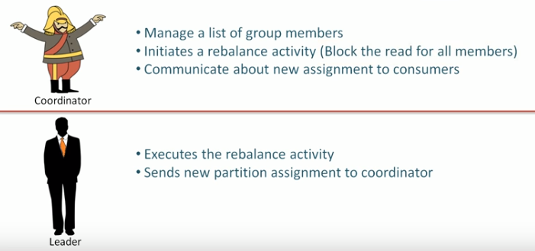
16 Consumer Groups
https://www.youtube.com/watch?v=6X-cFwKqmUE&list=PLkz1SCf5iB4enAR00Z46JwY9GGkaS2NON&index=14
The coordinator manager the list of group member, block the read of all members, and communicate the new assignment.
The group leader responsible for rebalance execution.

Slide 25
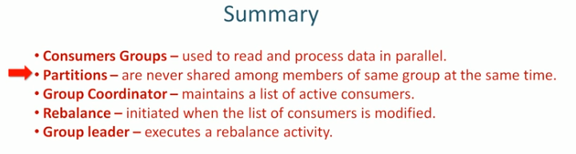
16 Consumer Groups
https://www.youtube.com/watch?v=6X-cFwKqmUE&list=PLkz1SCf5iB4enAR00Z46JwY9GGkaS2NON&index=14
Summary of consumer groups

Slide 26
End of Chapter

