Slide 1

17 Create Consumer
Peter H. Chen

Slide 2
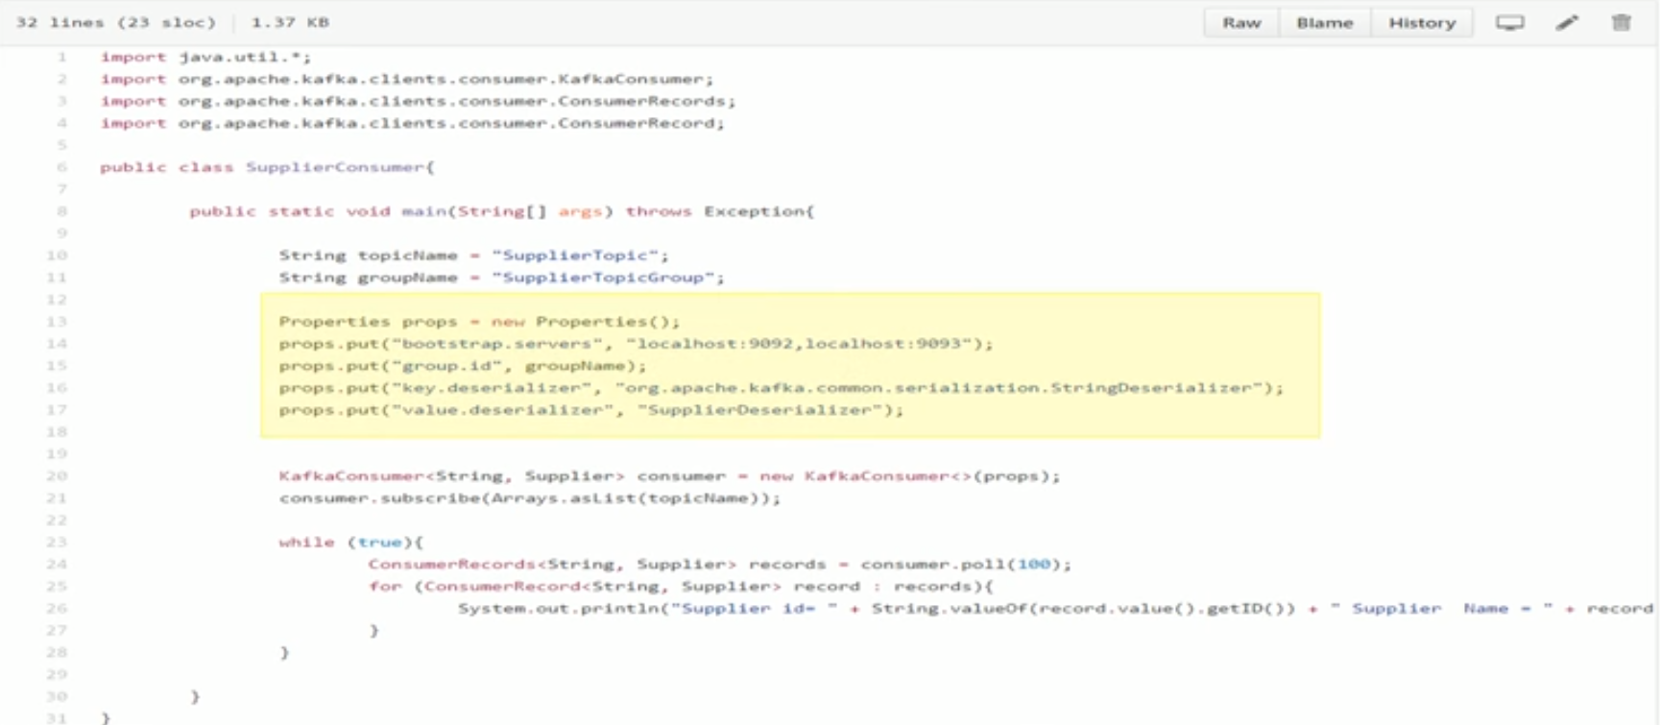
17 Create Consumer
https://www.youtube.com/watch?v=6X-cFwKqmUE&list=PLkz1SCf5iB4enAR00Z46JwY9GGkaS2NON&index=14
In this section, we write code for Kafka consumer.
Create consumer is simple to create producer. We create the properties of an object.
Create three mandatory properties: bootstrap Server, group id, key deserializer, and value deserializer.

Slide 3
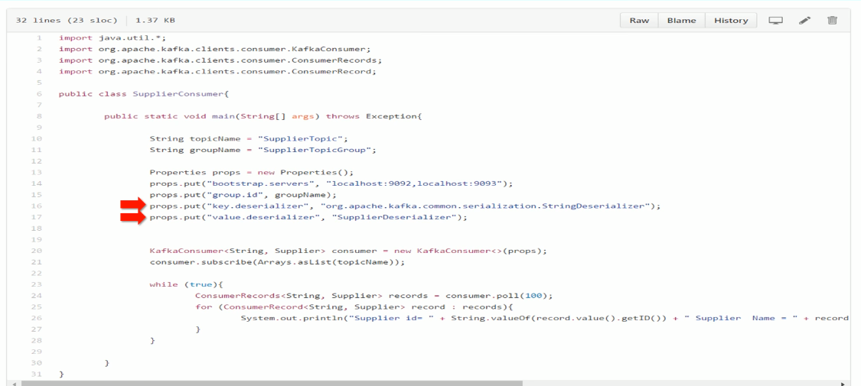
17 Create Consumer
https://www.youtube.com/watch?v=6X-cFwKqmUE&list=PLkz1SCf5iB4enAR00Z46JwY9GGkaS2NON&index=14
We already know the bootstrap server are Kafka broker.
In the producer, we use serializer. In consumer, we use key/value deserializer.

Slide 4
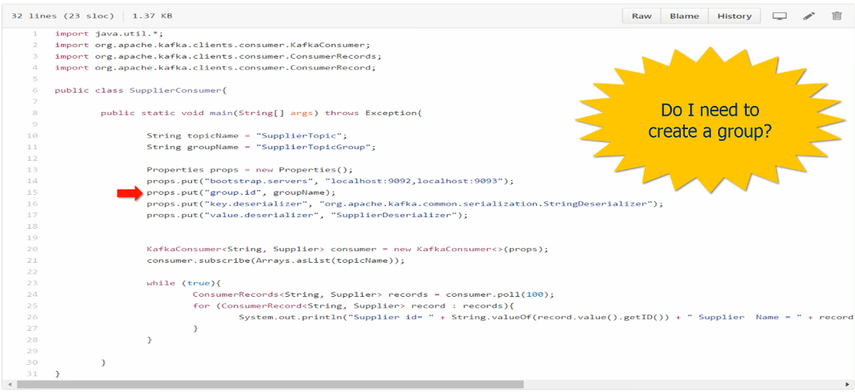
17 Create Consumer
https://www.youtube.com/watch?v=6X-cFwKqmUE&list=PLkz1SCf5iB4enAR00Z46JwY9GGkaS2NON&index=14
Yu may have question: “Do I need to create a group?”
No, you do not nee to worry about to create a group. Who is the group coordinator? And who is the group leader? AL these are taking care by API.
For us, it is as simple as to define a group name. The group name is a string. You can define any string name.

Slide 5
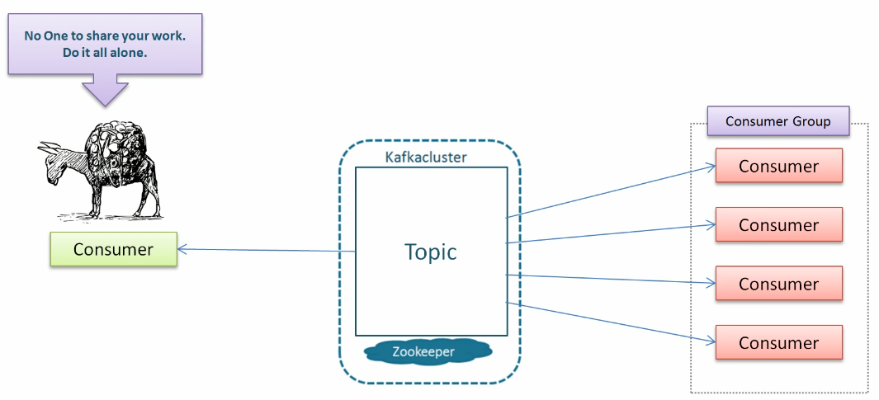
17 Create Consumer
https://www.youtube.com/watch?v=6X-cFwKqmUE&list=PLkz1SCf5iB4enAR00Z46JwY9GGkaS2NON&index=14
The group id is not mandatory, you can skip the group name. But you should know if you do not have group, then you are the independent consumer. Your code will read all the data of the topic.

Slide 6
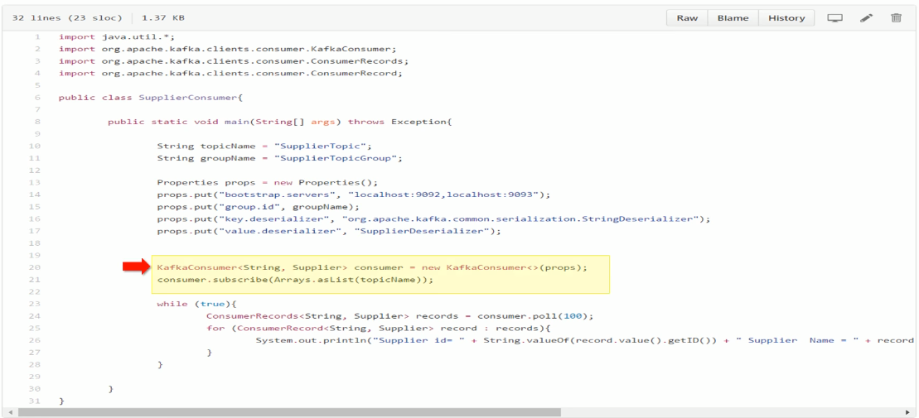
17 Create Consumer
https://www.youtube.com/watch?v=6X-cFwKqmUE&list=PLkz1SCf5iB4enAR00Z46JwY9GGkaS2NON&index=14
Once you create all the properties, the next step is to create Kafka consumer object and subscribe one or more topics. The subscribe method take a list of topics.
SO you can subscribe multiple topics at a time.
You can use regular expression or wide card to subscribe multiple topics.

Slide 7
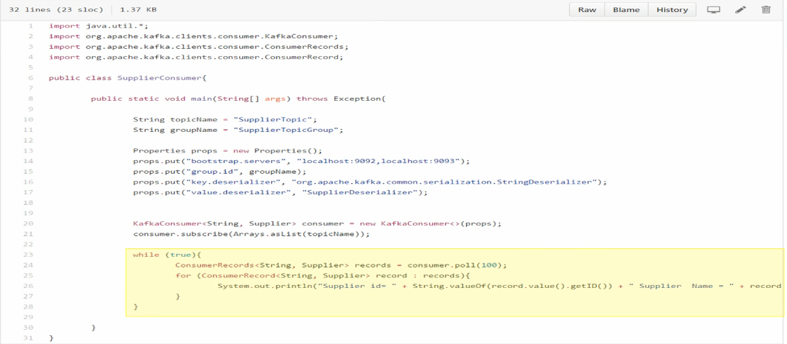
17 Create Consumer
https://www.youtube.com/watch?v=6X-cFwKqmUE&list=PLkz1SCf5iB4enAR00Z46JwY9GGkaS2NON&index=14
After create the consumer, you use this while loop to read all the records of the topics.
The poll method will return the poll message, process them, and then again to poll more message. 100 is the time out for 100msec. If there is no data to poll. Just wait for 100 msec before next poll.

Slide 8
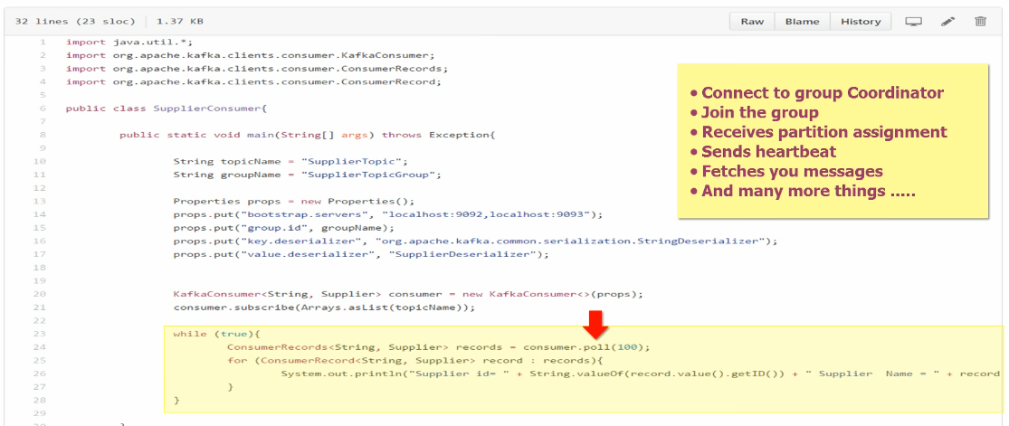
17 Create Consumer
https://www.youtube.com/watch?v=6X-cFwKqmUE&list=PLkz1SCf5iB4enAR00Z46JwY9GGkaS2NON&index=14
The poll method is very import. It handles connect to group coordinator, joint the group, receives partition assignment, sends heartbeat, fetches message, and etc.

Slide 9
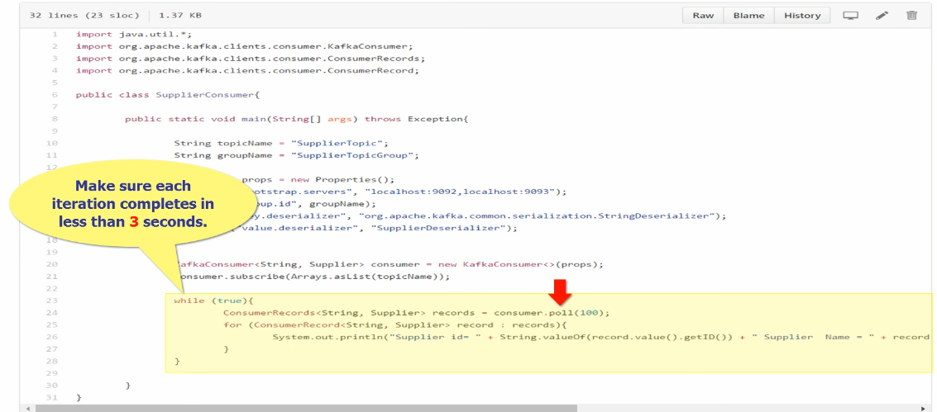
17 Create Consumer
https://www.youtube.com/watch?v=6X-cFwKqmUE&list=PLkz1SCf5iB4enAR00Z46JwY9GGkaS2NON&index=14
Make sure the while loop finished in 3 sec.

Slide 10
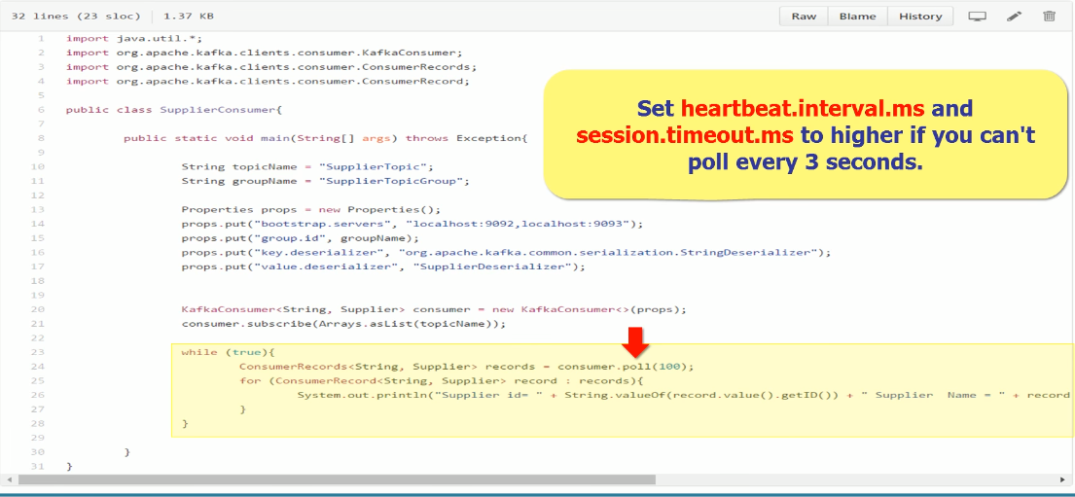
17 Create Consumer
https://www.youtube.com/watch?v=6X-cFwKqmUE&list=PLkz1SCf5iB4enAR00Z46JwY9GGkaS2NON&index=14
If you can not finished in 3 sec, the coordinator may assume you are dead.
If have to set the interval time higher to prevent the coordinator think you are dead.

Slide 11
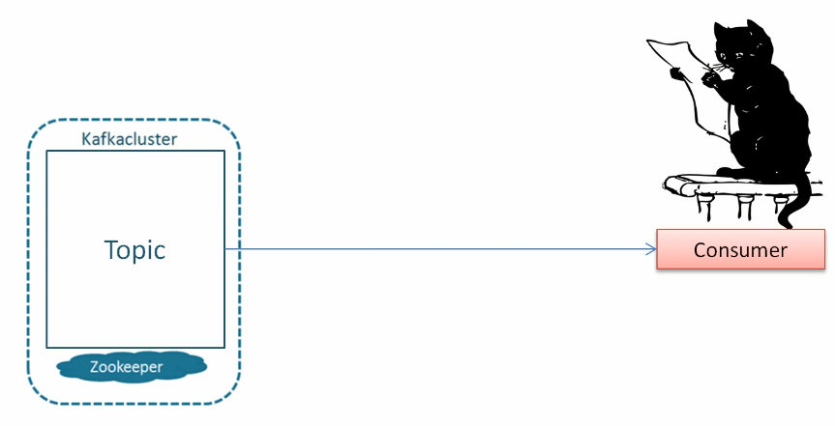
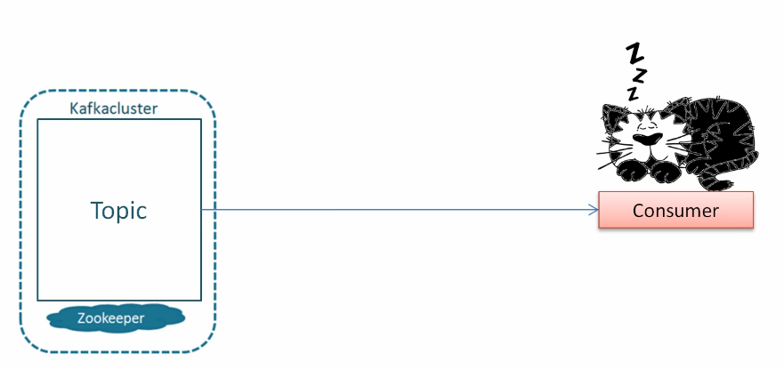
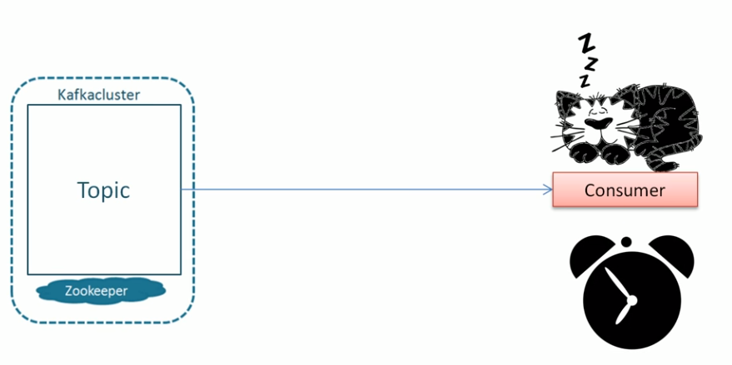
17 Create Consumer
https://www.youtube.com/watch?v=6X-cFwKqmUE&list=PLkz1SCf5iB4enAR00Z46JwY9GGkaS2NON&index=14
Wait up for few hour and sleep again for few hours.

Slide 12
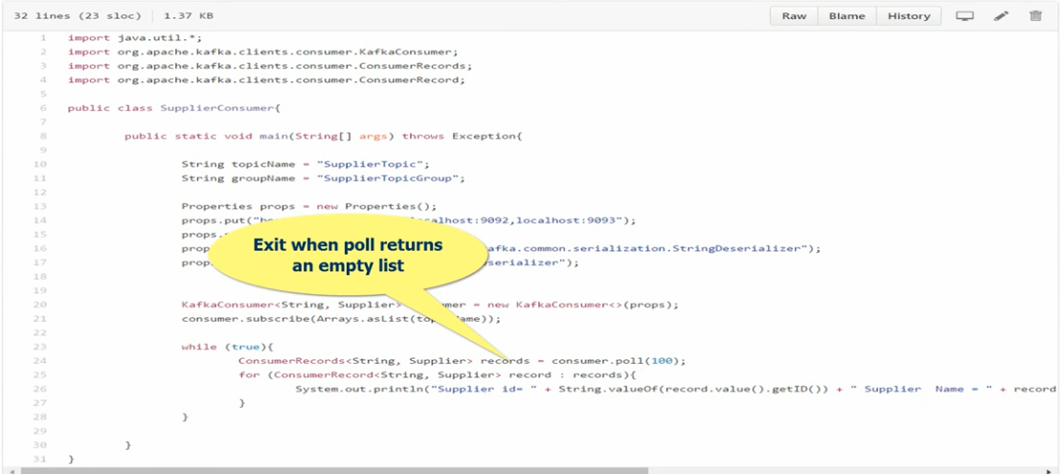
17 Create Consumer
https://www.youtube.com/watch?v=6X-cFwKqmUE&list=PLkz1SCf5iB4enAR00Z46JwY9GGkaS2NON&index=14
You can exit when poll return an empty list.

Slide 13
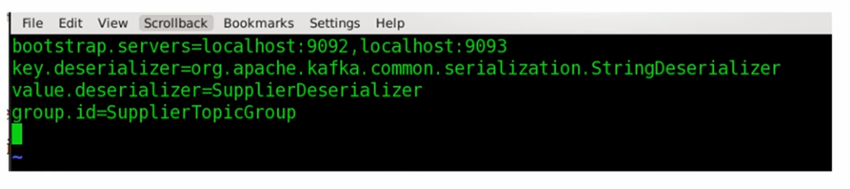
17 Create Consumer
https://www.youtube.com/watch?v=6X-cFwKqmUE&list=PLkz1SCf5iB4enAR00Z46JwY9GGkaS2NON&index=14
You can start the consumer creation.

Slide 14
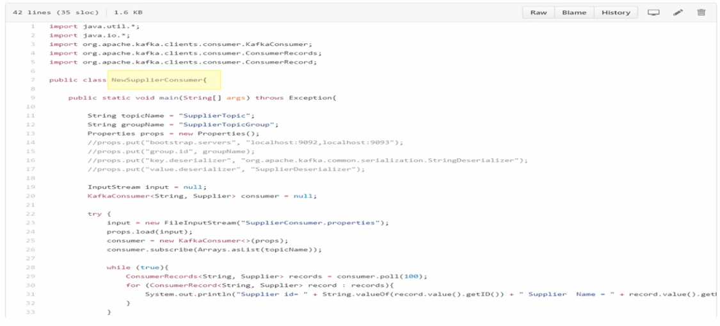
17 Create Consumer
https://www.youtube.com/watch?v=6X-cFwKqmUE&list=PLkz1SCf5iB4enAR00Z46JwY9GGkaS2NON&index=14
Change the code to new consumer defined in external files.

Slide 15
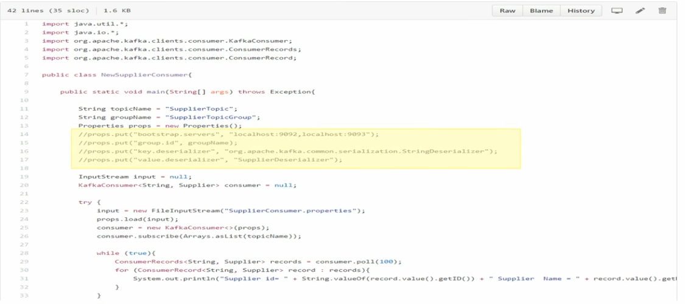
17 Create Consumer
https://www.youtube.com/watch?v=6X-cFwKqmUE&list=PLkz1SCf5iB4enAR00Z46JwY9GGkaS2NON&index=14
Comment out some codes. They are not required for the external files.

Slide 16
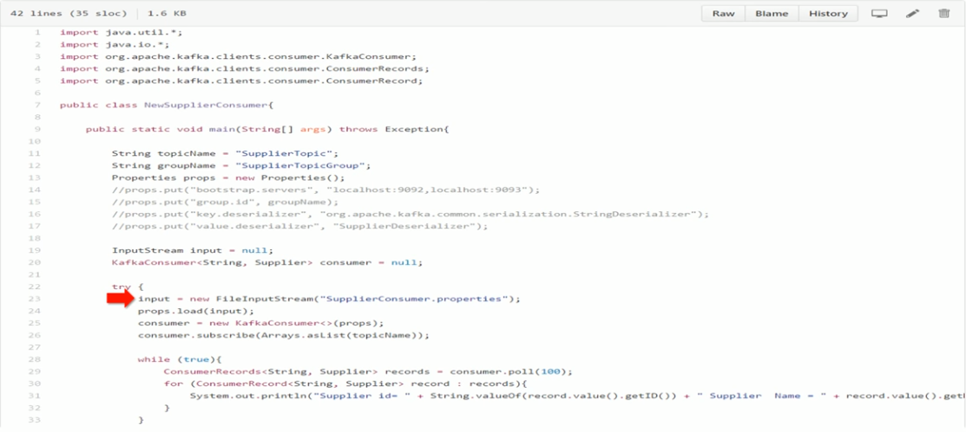
17 Create Consumer
https://www.youtube.com/watch?v=6X-cFwKqmUE&list=PLkz1SCf5iB4enAR00Z46JwY9GGkaS2NON&index=14
Read the property file.

Slide 17
End of Chapter

