Slide 1

19 Rebalance
Peter H. Chen

Slide 2
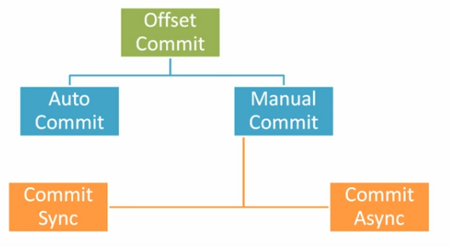
19 Rebalance
https://www.youtube.com/watch?v=XpaRknSTsB0&list=PLkz1SCf5iB4enAR00Z46JwY9GGkaS2NON&index=19
Previous section, we know the commit.

Slide 3
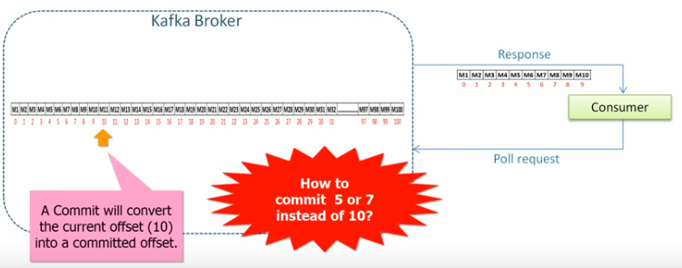
19 Rebalance
https://www.youtube.com/watch?v=XpaRknSTsB0&list=PLkz1SCf5iB4enAR00Z46JwY9GGkaS2NON&index=19
In this section we will study the particular offset (without commit) and rebalance.

Slide 4
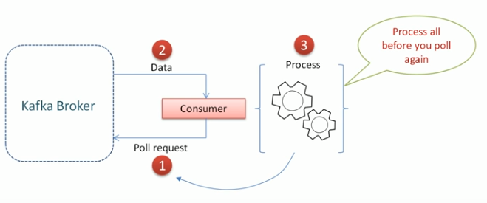
19 Rebalance
https://www.youtube.com/watch?v=XpaRknSTsB0&list=PLkz1SCf5iB4enAR00Z46JwY9GGkaS2NON&index=19
For example, we got a lot of data. We take times to process, before we complete, you poll again.

Slide 5

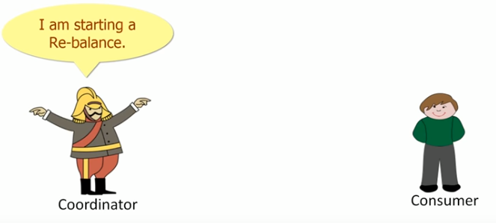
19 Rebalance
https://www.youtube.com/watch?v=XpaRknSTsB0&list=PLkz1SCf5iB4enAR00Z46JwY9GGkaS2NON&index=19
Delay may cause the broker think you are dead (actually you are busy in computing), broker may taking away you, and trigger the rebalance.

Slide 6
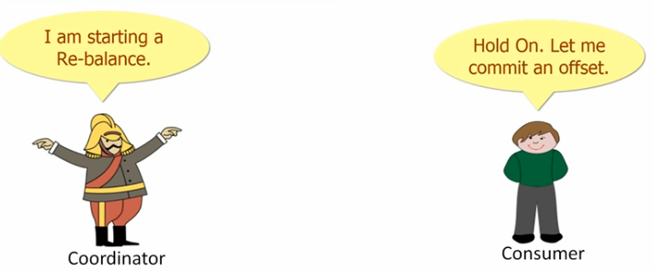

19 Rebalance
https://www.youtube.com/watch?v=XpaRknSTsB0&list=PLkz1SCf5iB4enAR00Z46JwY9GGkaS2NON&index=19
Consumer said hold on, let me commit an offset.

Slide 7
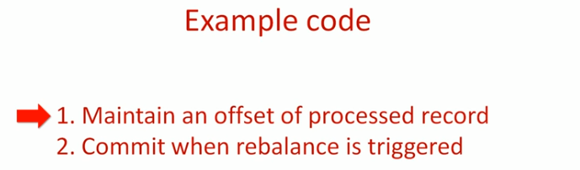
19 Rebalance
https://www.youtube.com/watch?v=XpaRknSTsB0&list=PLkz1SCf5iB4enAR00Z46JwY9GGkaS2NON&index=19
Example Code

Slide 8
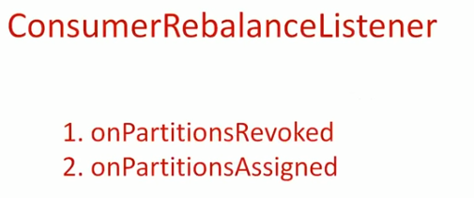
19 Rebalance
https://www.youtube.com/watch?v=XpaRknSTsB0&list=PLkz1SCf5iB4enAR00Z46JwY9GGkaS2NON&index=19
Class ConsumerRebalanceListener

Slide 9
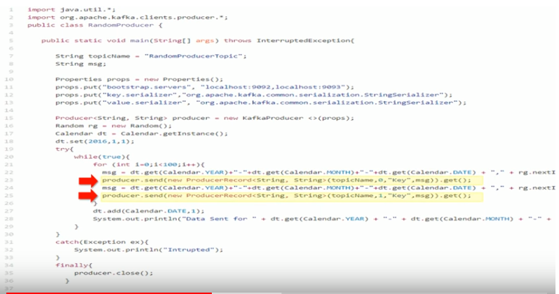
19 Rebalance
https://www.youtube.com/watch?v=XpaRknSTsB0&list=PLkz1SCf5iB4enAR00Z46JwY9GGkaS2NON&index=19
Add Listener: Commit before triggered.

Slide 10
End of Chapter

