Slide 1

18 Offset Management
Peter H. Chen

Slide 2
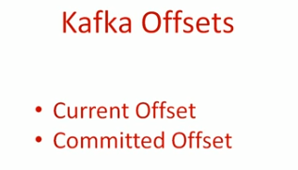
18 Offset Management
https://www.youtube.com/watch?v=6X-cFwKqmUE&list=PLkz1SCf5iB4enAR00Z46JwY9GGkaS2NON&index=14
Kafka maintains two kinds of offset.

Slide 3
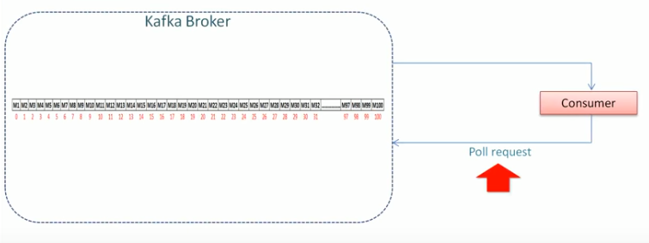
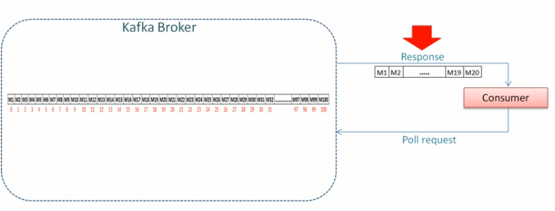
18 Offset Management
https://www.youtube.com/watch?v=6X-cFwKqmUE&list=PLkz1SCf5iB4enAR00Z46JwY9GGkaS2NON&index=14
When consumer call the poll request, Kafka send the response of messages.

Slide 4
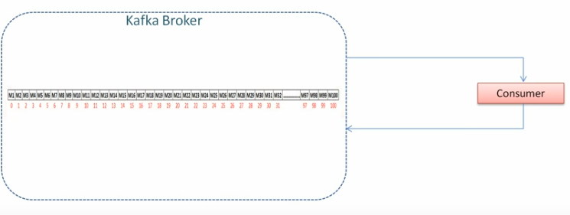
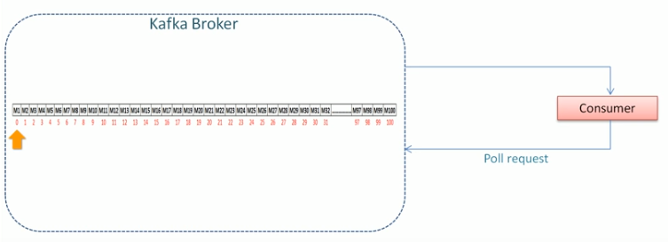
18 Offset Management
https://www.youtube.com/watch?v=6X-cFwKqmUE&list=PLkz1SCf5iB4enAR00Z46JwY9GGkaS2NON&index=14
Let assume you have 100 messages, initially.
Offset = 0.

Slide 5
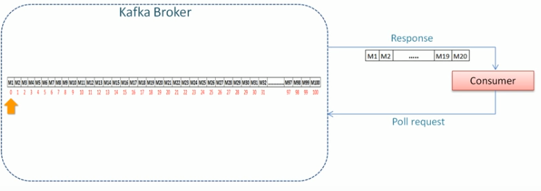
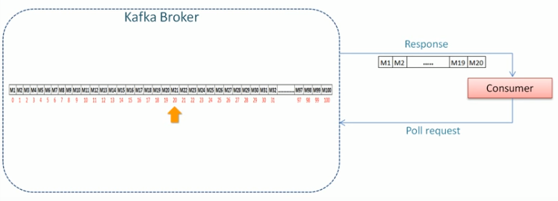
18 Offset Management
https://www.youtube.com/watch?v=6X-cFwKqmUE&list=PLkz1SCf5iB4enAR00Z46JwY9GGkaS2NON&index=14
Consumer make the call and receive 20 messages (M1-M20).
Now, Kafka will move the offset to 20.

Slide 6
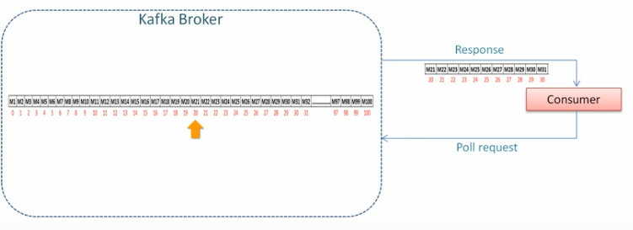
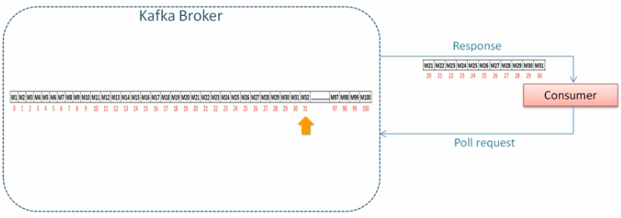
18 Offset Management
https://www.youtube.com/watch?v=6X-cFwKqmUE&list=PLkz1SCf5iB4enAR00Z46JwY9GGkaS2NON&index=14
Consumer make another request for 10 messages (M21-M31).
Again, the offset will move to 31.

Slide 7
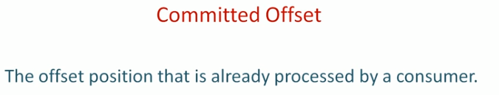
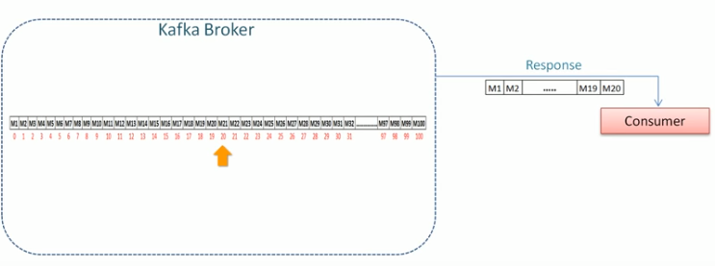
18 Offset Management
https://www.youtube.com/watch?v=6X-cFwKqmUE&list=PLkz1SCf5iB4enAR00Z46JwY9GGkaS2NON&index=14
Committed Offset.

Slide 8
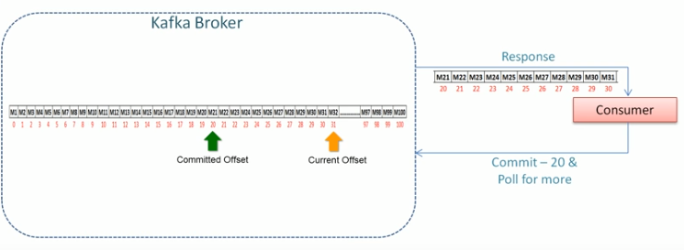
18 Offset Management
https://www.youtube.com/watch?v=6X-cFwKqmUE&list=PLkz1SCf5iB4enAR00Z46JwY9GGkaS2NON&index=14
Committed Offset: Offset of the last offset committed to database that consumer has successful processed.

Slide 9
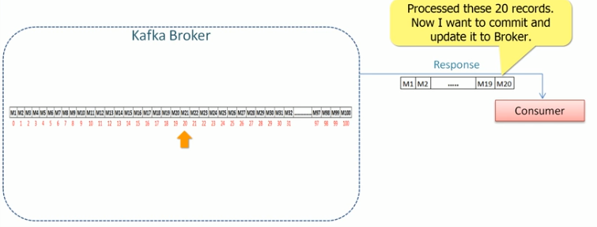
18 Offset Management
https://www.youtube.com/watch?v=6X-cFwKqmUE&list=PLkz1SCf5iB4enAR00Z46JwY9GGkaS2NON&index=14
Committed Offset.

Slide 10

18 Offset Management
https://www.youtube.com/watch?v=6X-cFwKqmUE&list=PLkz1SCf5iB4enAR00Z46JwY9GGkaS2NON&index=14
Summary of Offset

Slide 11
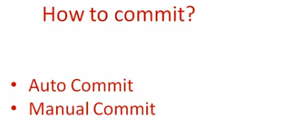
18 Offset Management
https://www.youtube.com/watch?v=6X-cFwKqmUE&list=PLkz1SCf5iB4enAR00Z46JwY9GGkaS2NON&index=14
Auto Commit

Slide 12
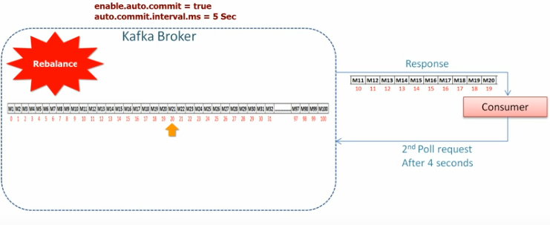
18 Offset Management
https://www.youtube.com/watch?v=6X-cFwKqmUE&list=PLkz1SCf5iB4enAR00Z46JwY9GGkaS2NON&index=14
Auto Commit

Slide 13
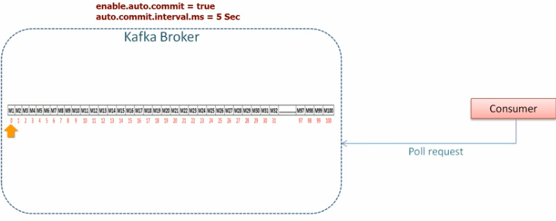
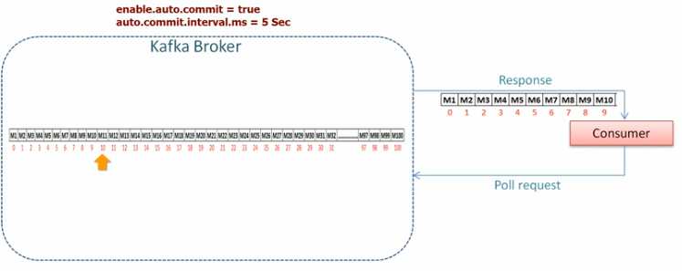
18 Offset Management
https://www.youtube.com/watch?v=6X-cFwKqmUE&list=PLkz1SCf5iB4enAR00Z46JwY9GGkaS2NON&index=14
Auto Commit

Slide 14
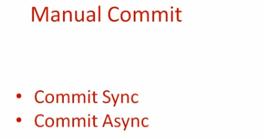
18 Offset Management
https://www.youtube.com/watch?v=6X-cFwKqmUE&list=PLkz1SCf5iB4enAR00Z46JwY9GGkaS2NON&index=14
Manual Commit

Slide 15
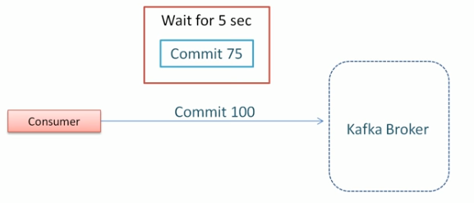
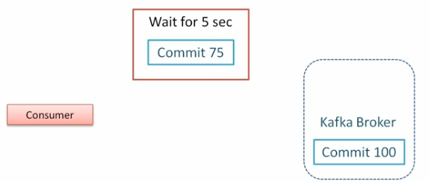
18 Offset Management
https://www.youtube.com/watch?v=6X-cFwKqmUE&list=PLkz1SCf5iB4enAR00Z46JwY9GGkaS2NON&index=14
Manual Commit

Slide 16
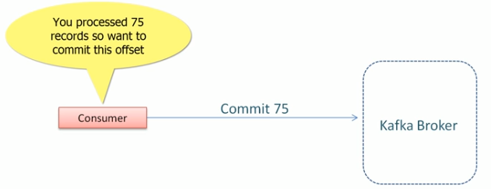
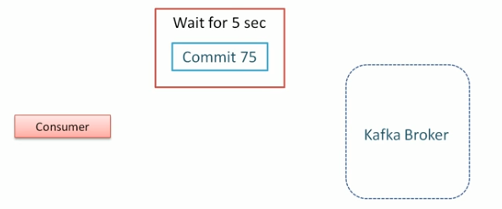
18 Offset Management
https://www.youtube.com/watch?v=6X-cFwKqmUE&list=PLkz1SCf5iB4enAR00Z46JwY9GGkaS2NON&index=14
Manual Commit

Slide 17
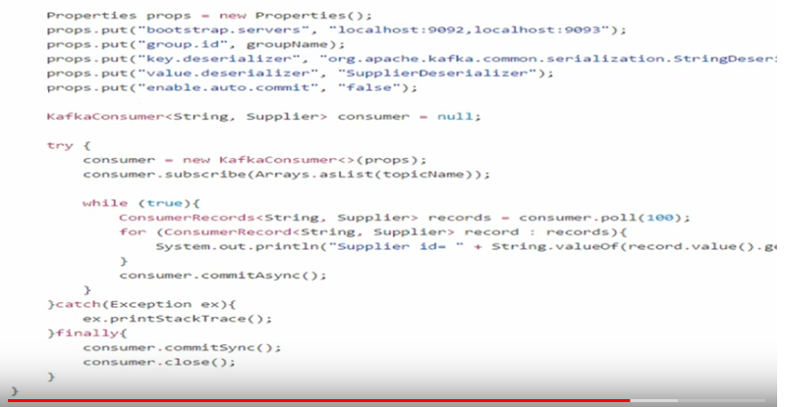
18 Offset Management
https://www.youtube.com/watch?v=6X-cFwKqmUE&list=PLkz1SCf5iB4enAR00Z46JwY9GGkaS2NON&index=14
Asynchronous Commit

Slide 18
End of Chapter

