Slide 1

20 Exact One Process
Peter H. Chen

Slide 2
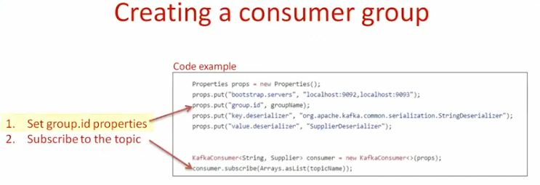
20 Exact One Process
https://www.youtube.com/watch?v=AshMNCxSp3c&index=20&list=PLkz1SCf5iB4enAR00Z46JwY9GGkaS2NON
Kafka consumer:

Slide 3
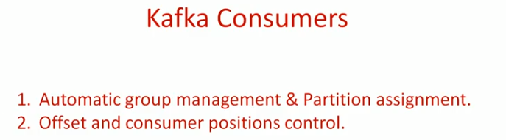
20 Exact One Process
https://www.youtube.com/watch?v=AshMNCxSp3c&index=20&list=PLkz1SCf5iB4enAR00Z46JwY9GGkaS2NON
Kafka consumer:

Slide 4
End of Chapter

