Slide 1

21 Schema Evolution: Part 1
Peter H. Chen

Slide 2
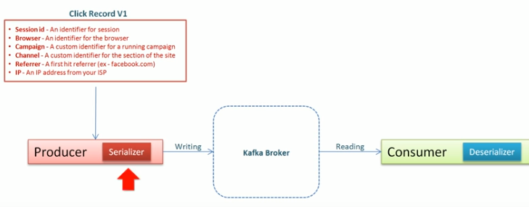
21 Schema Evolution: Part 1
https://www.youtube.com/watch?v=1OdsRuKXWbM&list=PLkz1SCf5iB4enAR00Z46JwY9GGkaS2NON&index=21
How to Handle schema change:

Slide 3
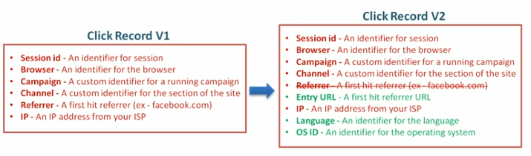
21 Schema Evolution: Part 1
https://www.youtube.com/watch?v=1OdsRuKXWbM&list=PLkz1SCf5iB4enAR00Z46JwY9GGkaS2NON&index=21
How to Handle schema change:

Slide 4
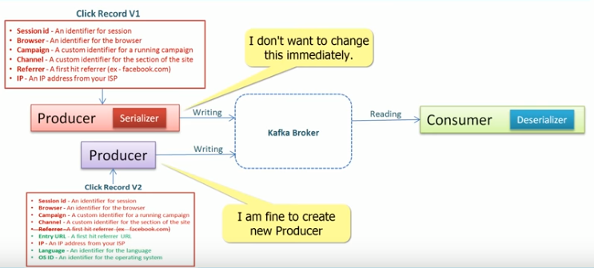
21 Schema Evolution: Part 1
https://www.youtube.com/watch?v=1OdsRuKXWbM&list=PLkz1SCf5iB4enAR00Z46JwY9GGkaS2NON&index=21
How to Handle schema change:

Slide 5
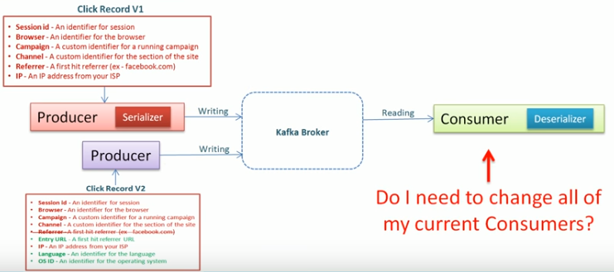
21 Schema Evolution: Part 1
https://www.youtube.com/watch?v=1OdsRuKXWbM&list=PLkz1SCf5iB4enAR00Z46JwY9GGkaS2NON&index=21
How to Handle schema change:

Slide 6
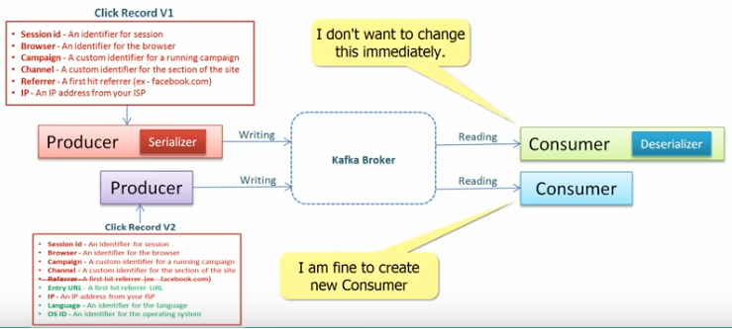
21 Schema Evolution: Part 1
https://www.youtube.com/watch?v=1OdsRuKXWbM&list=PLkz1SCf5iB4enAR00Z46JwY9GGkaS2NON&index=21
How to Handle schema change:

Slide 7
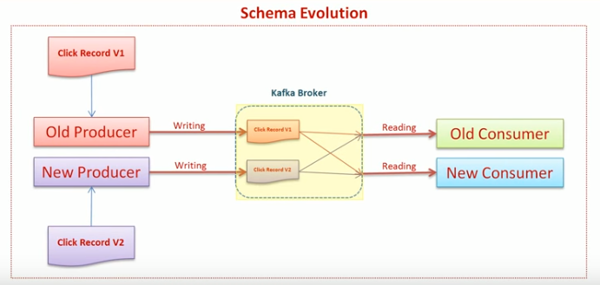
21 Schema Evolution: Part 1
https://www.youtube.com/watch?v=1OdsRuKXWbM&list=PLkz1SCf5iB4enAR00Z46JwY9GGkaS2NON&index=21
How to Handle schema change:

Slide 8
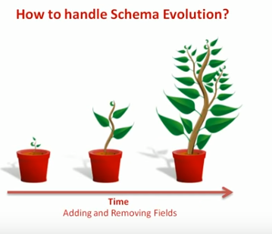
21 Schema Evolution: Part 1
https://www.youtube.com/watch?v=1OdsRuKXWbM&list=PLkz1SCf5iB4enAR00Z46JwY9GGkaS2NON&index=21
How to Handle schema change:

Slide 9
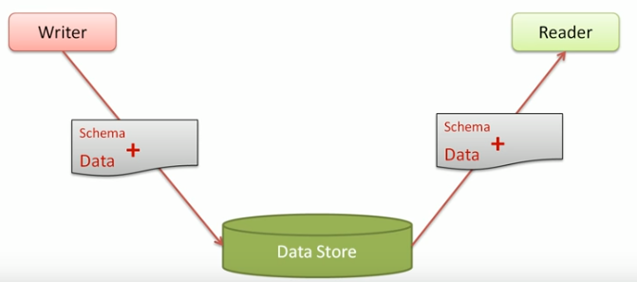
21 Schema Evolution: Part 1
https://www.youtube.com/watch?v=1OdsRuKXWbM&list=PLkz1SCf5iB4enAR00Z46JwY9GGkaS2NON&index=21
Supply both the schema and data. Some one want to read/write with schema and data.

Slide 10
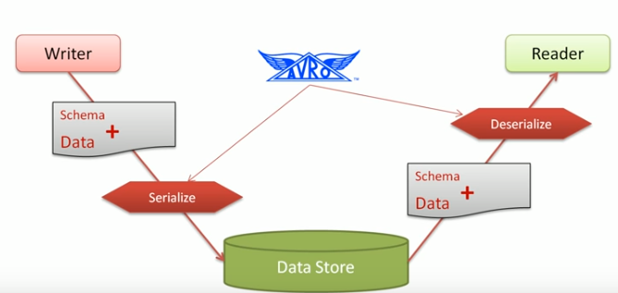
21 Schema Evolution: Part 1
https://www.youtube.com/watch?v=1OdsRuKXWbM&list=PLkz1SCf5iB4enAR00Z46JwY9GGkaS2NON&index=21
Supply both the schema and data. Some one want to read/write with schema and data.
Avro handles the schema evolution problem.

Slide 11
End of Chapter

