Slide 1

22 Schema Evolution: Part 2
Peter H. Chen

Slide 2
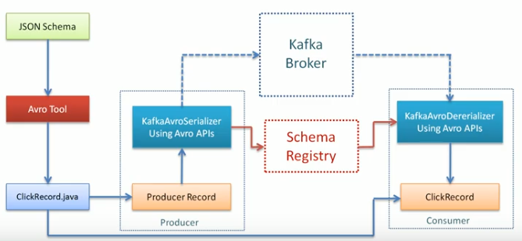
22 Schema Evolution: Part 2
https://www.youtube.com/watch?v=1OdsRuKXWbM&list=PLkz1SCf5iB4enAR00Z46JwY9GGkaS2NON&index=21
How to Handle schema change:

Slide 3
End of Chapter

