Slide 1

23 Kafka Final
Peter H. Chen

Slide 2
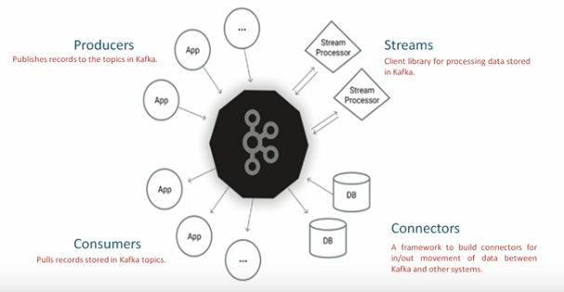
23 Kafka Final
https://www.youtube.com/watch?v=sZubfo1c0gQ&list=PLkz1SCf5iB4enAR00Z46JwY9GGkaS2NON&index=23
How Kafka work:

Slide 3
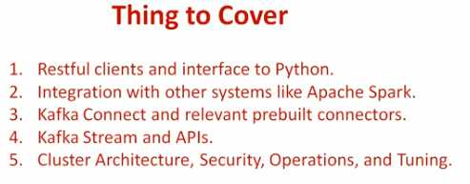
23 Kafka
https://www.youtube.com/watch?v=sZubfo1c0gQ&list=PLkz1SCf5iB4enAR00Z46JwY9GGkaS2NON&index=23
Build a solid foundation. Remaining are:

Slide 4
End of Chapter

