Slide 1
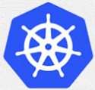
5 Docker Operation
Peter H. Chen

Slide 2
5 Docker Operation
https://www.tutorialspoint.com/kubernetes/index.htm
Docker run under Kubernetes.

Slide 3
5.1 Install Docker

Slide 4
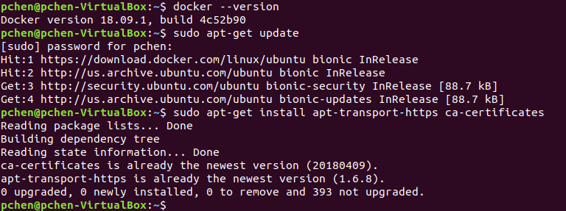
5.1 Install Docker
https://www.tutorialspoint.com/kubernetes/index.htm
Prerequisites (1)
Installing Docker − Docker is required on all the instances of Kubernetes. Following are the steps to install the Docker.
Step 1 − Log on to the machine with the root user account.
Step 2 − Update the package information. Make sure that the apt package is working.
Step 3 − Run the following commands.
$ sudo apt-get update
$ sudo apt-get install apt-transport-https ca-certificates

Slide 5
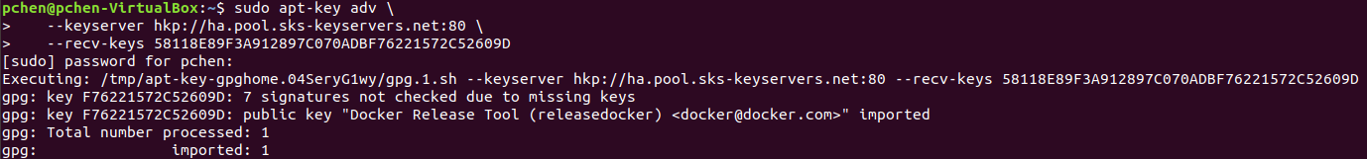
5.1 Install Docker
https://www.tutorialspoint.com/kubernetes/index.htm
Prerequisites (2)
Step 4 − Add the new GPG key.
$ sudo apt-key adv \ --keyserver hkp://ha.pool.sks-keyservers.net:80 \ --recv-keys 58118E89F3A912897C070ADBF76221572C52609D
$ echo "deb https://apt.dockerproject.org/repo ubuntu-trusty main" | sudo tee /etc/apt/sources.list.d/docker.list

Slide 6
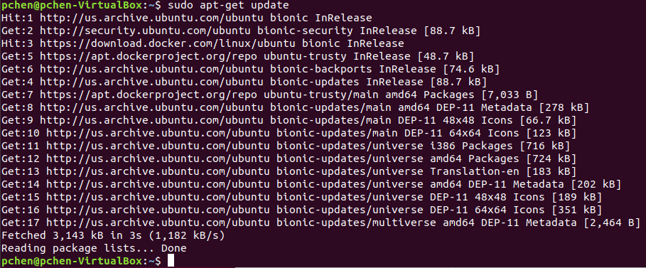
5.1 Install Docker
https://www.tutorialspoint.com/kubernetes/index.htm
Prerequisites (3)
Step 5 − Update the API package image.
$ sudo apt-get update
Once all the above tasks are complete, you can start with the actual installation of the Docker engine.
However, before this you need to verify that the kernel version you are using is correct.

Slide 7
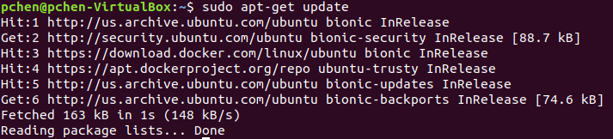
5.1 Install Docker
https://www.tutorialspoint.com/kubernetes/index.htm
Install Docker Engine (1)
Run the following commands to install the Docker engine.
Step 1 − Logon to the machine.
Step 2 − Update the package index.
$ sudo apt-get update

Slide 8
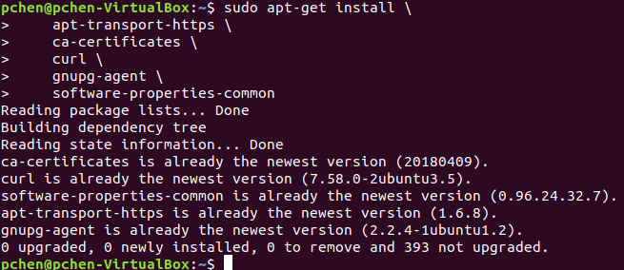
5.1 Install Docker
https://www.tutorialspoint.com/kubernetes/index.htm
Install Docker Engine (2)
Step 3 − InsInstall packages to allow apt to use a repository over HTTPS.
$ apt-get install \
apt-transport-https \
ca-certificates \
curl \
gnupg-agent \
software-properties-common

Slide 9
5.1 Install Docker
https://www.tutorialspoint.com/kubernetes/index.htm
Install Docker Engine (3)
Add Docker’s official GPG key:
$ curl -fsSL https://download.docker.com/linux/ubuntu/gpg | sudo apt-key add -

Slide 10
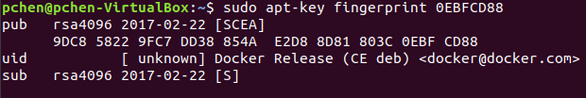
5.1 Install Docker
https://www.tutorialspoint.com/kubernetes/index.htm
Install Docker Engine (4)
Verify that you now have the key with the fingerprint9DC8 5822 9FC7 DD38 854A E2D8 8D81 803C 0EBF CD88, by searching for the last 8 characters of the fingerprint.
$ apt-key fingerprint 0EBFCD88
pub rsa4096 2017-02-22 [SCEA]
9DC8 5822 9FC7 DD38 854A E2D8 8D81 803C 0EBF CD88
uid [ unknown] Docker Release (CE deb) <docker@docker.com>
sub rsa4096 2017-02-22 [S]

Slide 11
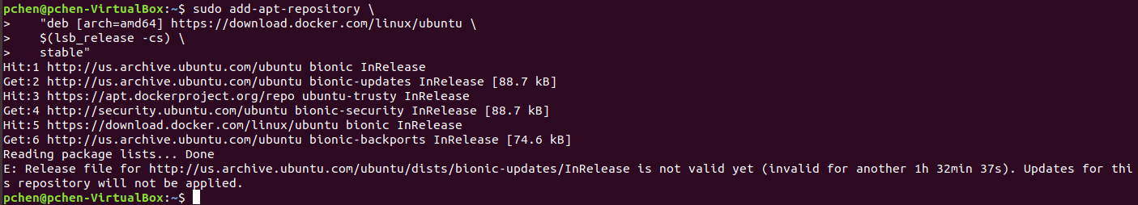
5.1 Install Docker
https://www.tutorialspoint.com/kubernetes/index.htm
Install Docker Engine (5)
Use the following command to set up the stable repository. To add the nightly or test repository, add the word nightly or test (or both) after the word stable in the commands below. Learn about nightly and test channels.
Note: The lsb_release -cs sub-command below returns the name of your Ubuntu distribution, such as xenial. Sometimes, in a distribution like Linux Mint, you might need to change $(lsb_release -cs) to your parent Ubuntu distribution. For example, if you are using Linux Mint Tessa, you could use bionic. Docker does not offer any guarantees on untested and unsupported Ubuntu distributions.
$ add-apt-repository \ "deb [arch=amd64] https://download.docker.com/linux/ubuntu \ $(lsb_release -cs) \ stable"

Slide 12
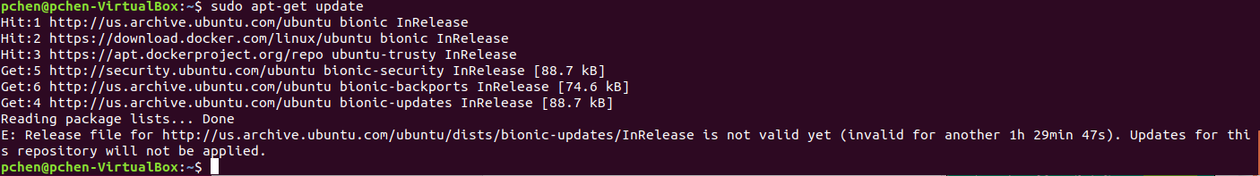
5.1 Install Docker
https://www.tutorialspoint.com/kubernetes/index.htm
Install Docker Engine (6)
INSTALL DOCKER CE
Update the apt package index.
$ apt-get update

Slide 13
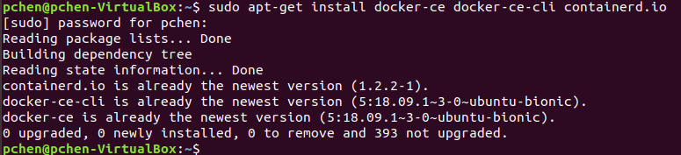
5.1 Install Docker
https://www.tutorialspoint.com/kubernetes/index.htm
Install Docker Engine (7)
Install the latest version of Docker CE and container, or go to the next step to install a specific version:
$ apt-get install docker-ce docker-ce-cli containerd.io
Got multiple Docker repositories?
If you have multiple Docker repositories enabled, installing or updating without specifying a version in the apt-get install or apt-get update command always installs the highest possible version, which may not be appropriate for your stability needs.

Slide 14
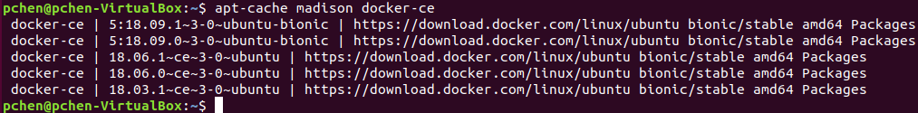
5.1 Install Docker
https://www.tutorialspoint.com/kubernetes/index.htm
Install Docker Engine (9)
To install a specific version of Docker CE, list the available versions in the repo, then select and install:
List the versions available in your repo:
$ apt-cache madison docker-ce
docker-ce | 5:18.09.1~3-0~ubuntu-xenial | https://download.docker.com/linux/ubuntu xenial/stable amd64 Packages
docker-ce | 5:18.09.0~3-0~ubuntu-xenial | https://download.docker.com/linux/ubuntu xenial/stable amd64 Packages
docker-ce | 18.06.1~ce~3-0~ubuntu | https://download.docker.com/linux/ubuntu xenial/stable amd64 Packages
docker-ce | 18.06.0~ce~3-0~ubuntu | https://download.docker.com/linux/ubuntu xenial/stable amd64 Packages
...

Slide 15
5.1 Install Docker
https://www.tutorialspoint.com/kubernetes/index.htm
Install Docker Engine (8)
Install a specific version using the version string from the second column, for example, 5:18.09.1~3-0~ubuntu-xenial.
$ apt-get install docker-ce=<VERSION_STRING> docker-ce-cli=<VERSION_STRING> containerd.io

Slide 16
5.2 Docker Operation

Slide 17
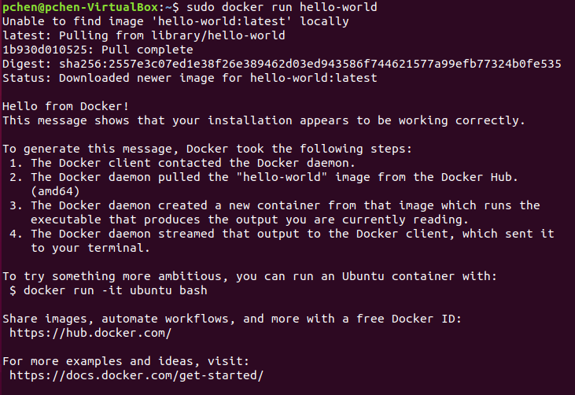
5.2 Docker Operation
https://www.tutorialspoint.com/kubernetes/index.htm
Docker Operation (1)
Verify that Docker CE is installed correctly by running the hello-world image.
$ docker run hello-world

Slide 18
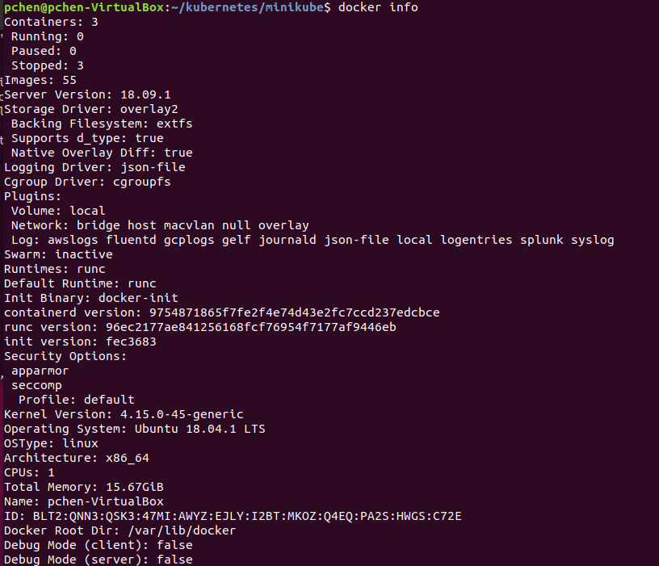
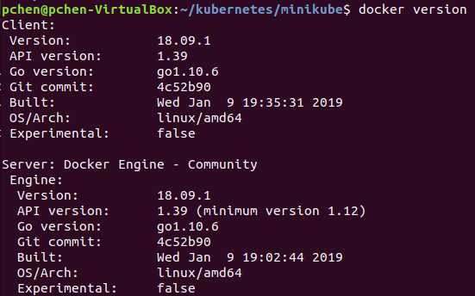
5.2 Docker Operation
https://www.tutorialspoint.com/kubernetes/index.htm
Docker Operation (2)
Now we are ready to build Kubernetes. We need to install Kubernetes on all the machines on the cluster.
$ docker version
$ docker info

Slide 19
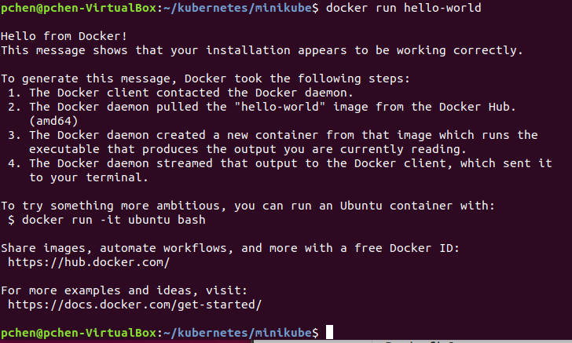
5.2 Docker Operation
https://www.tutorialspoint.com/kubernetes/index.htm
Docker Operation (3)
Check docker command ‘hello-world’
$ docker run hello-world

Slide 20
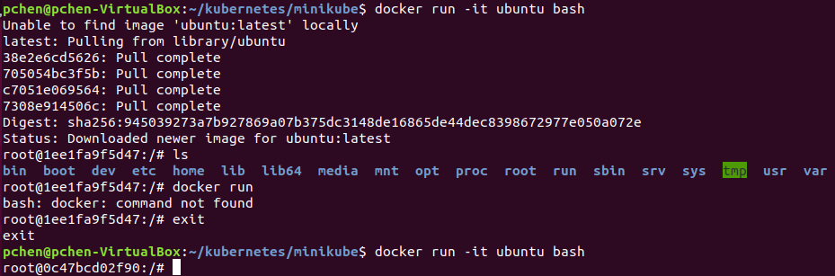
5.2 Docker Operation
https://www.tutorialspoint.com/kubernetes/index.htm
Docker Operation (4)
Pull out docker images. The –it is interactive.
$ docker run -it ubuntu bash

Slide 21
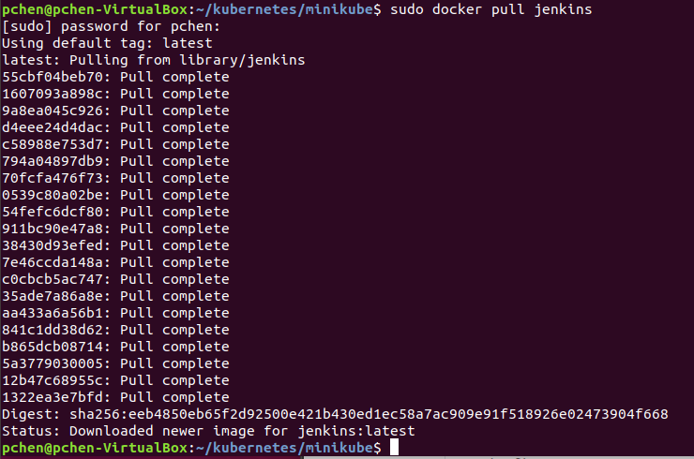
5.2 Docker Operation
https://www.tutorialspoint.com/kubernetes/index.htm
Docker Operation (5)
Pull out docker images. The –it is interactive.
$ sudo docker pull jenkins

Slide 22
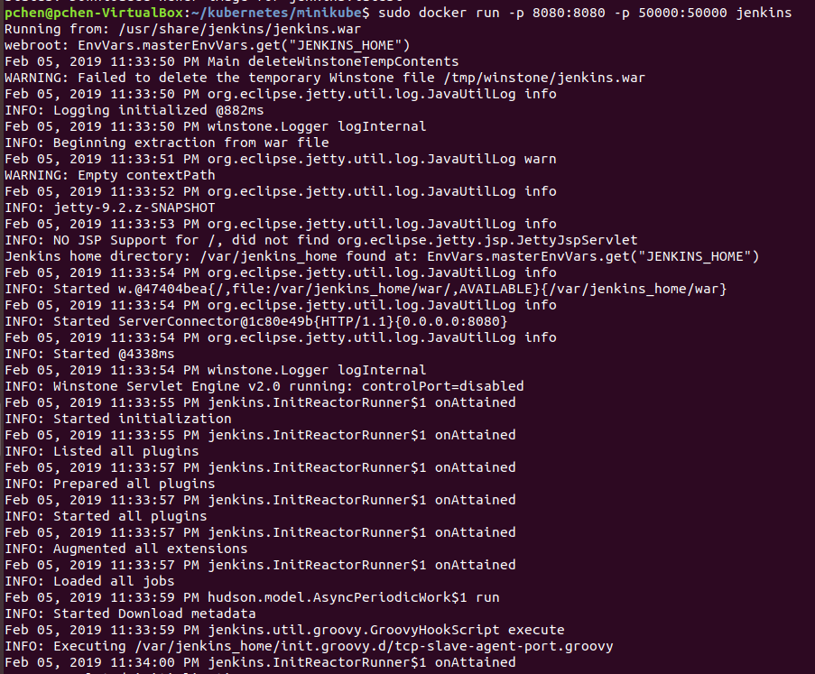
5.2 Docker Operation
https://www.tutorialspoint.com/kubernetes/index.htm
Docker Operation (6)
Pull out docker images. The –it is interactive.
$ sudo docker run -p 8080:8080 -p 50000:50000 jenkins

Slide 23
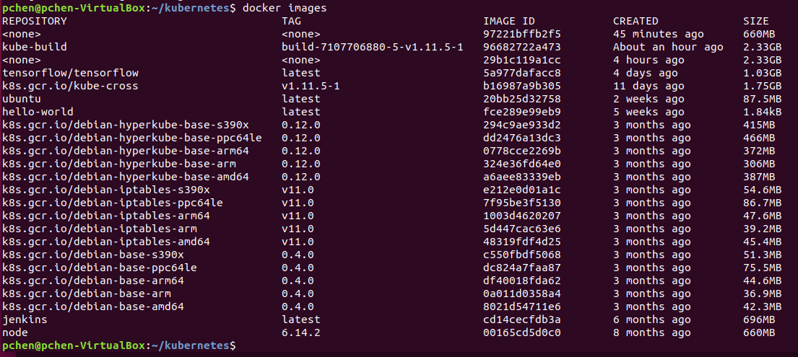
5.2 Docker Operation
https://www.tutorialspoint.com/kubernetes/index.htm
Docker Operation (7)
To see all the images in the system, use “docker images”.
$ docker images

Slide 24
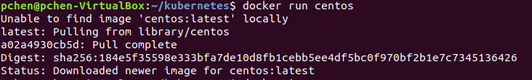
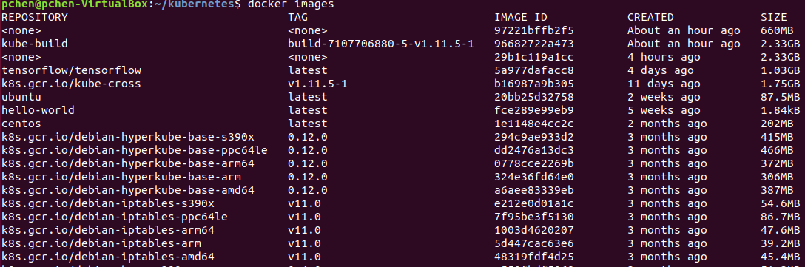
5.2 Docker Operation
https://www.tutorialspoint.com/kubernetes/index.htm
Docker Operation (8)
To see all the images in the system, use “docker images”.
$ docker run centos
$ docker images

Slide 25
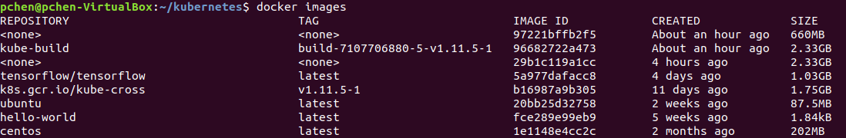
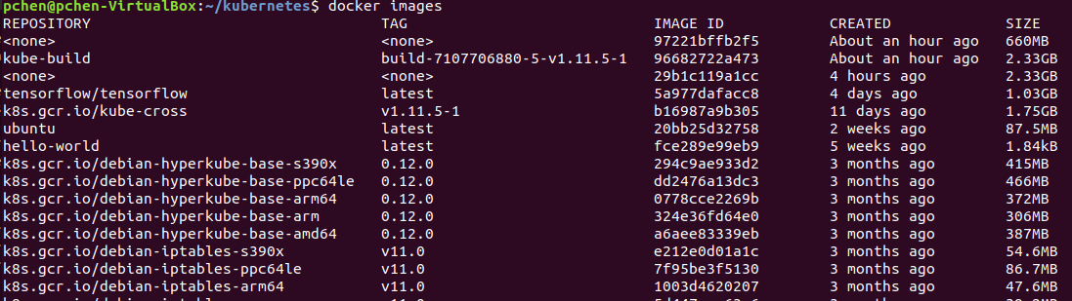
5.2 Docker Operation
https://www.tutorialspoint.com/kubernetes/index.htm
Docker Operation (9)
To see all the images in the system, use “docker images”.
$ docker images
$ docker rmi –f imageID
$ docker images

Slide 26
End of Chapter

