Slide 1

10 Buffer
Peter H. Chen

Slide 2
10 Buffer
https://www.tutorialspoint.com/nodejs/nodejs_npm.htm
Buffer
Pure JavaScript is Unicode friendly, but it is not so for binary data.
While dealing with TCP streams or the file system, it's necessary to handle octet streams.
Node provides Buffer class which provides instances to store raw data similar to an array of integers but corresponds to a raw memory allocation outside the V8 heap.
Buffer class is a global class that can be accessed in an application without importing the buffer module.

Slide 3
10 Buffer
https://www.tutorialspoint.com/nodejs/nodejs_npm.htm
Creating Buffers
Node Buffer can be constructed in a variety of ways.
Method 1
Following is the syntax to create an uninitiated Buffer of 10 octets
var buf = new Buffer(10);
Method 2
Following is the syntax to create a Buffer from a given array
var buf = new Buffer([10, 20, 30, 40, 50]);
Method 3
Following is the syntax to create a Buffer from a given string and optionally encoding type
var buf = new Buffer("Simply Easy Learning", "utf-8");
Though "utf8" is the default encoding, you can use any of the following encodings "ascii", "utf8", "utf16le", "ucs2", "base64" or "hex".

Slide 4
10 Buffer
https://www.tutorialspoint.com/nodejs/nodejs_npm.htm
Parameters
Here is the description of the parameters used −
string − This is the string data to be written to buffer.
offset − This is the index of the buffer to start writing at. Default value is 0.
length − This is the number of bytes to write. Defaults to buffer.length.
encoding − Encoding to use. 'utf8' is the default encoding.
Return Value
This method returns the number of octets written. If there is not enough space in the buffer to fit the entire string, it will write a part of the string.

Slide 5
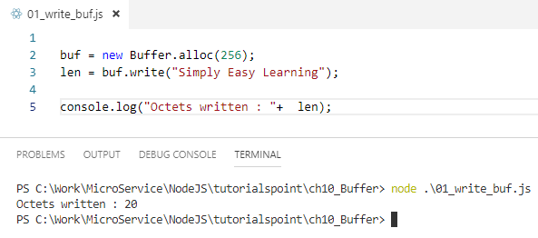
10 Buffer
https://www.tutorialspoint.com/nodejs/nodejs_npm.htm
Example

Slide 6
10 Buffer
https://www.tutorialspoint.com/nodejs/nodejs_npm.htm
Reading from Buffers
Syntax
Following is the syntax of the method to read data from a Node Buffer
buf.toString([encoding][, start][, end])
Parameters
Here is the description of the parameters used −
encoding − Encoding to use. 'utf8' is the default encoding.
start − Beginning index to start reading, defaults to 0.
end − End index to end reading, defaults is complete buffer.
Return Value
This method decodes and returns a string from buffer data encoded using the specified character set encoding.

Slide 7
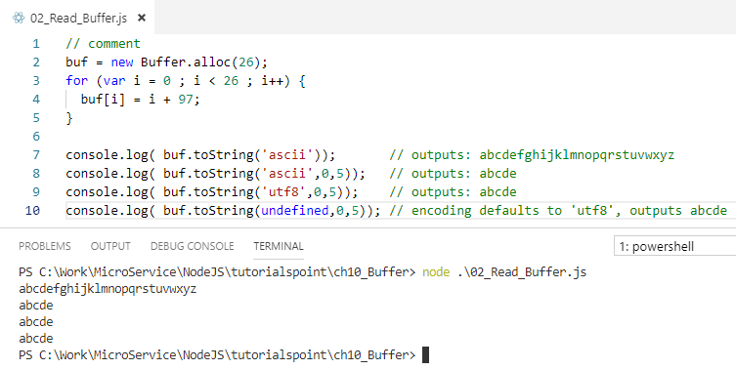

10 Buffer
https://www.tutorialspoint.com/nodejs/nodejs_npm.htm
Example

Slide 8
10 Buffer
https://www.tutorialspoint.com/nodejs/nodejs_npm.htm
Convert Buffer to JSON
Syntax
Following is the syntax of the method to convert a Node Buffer into JSON object −
buf.toJSON()
Return Value
This method returns a JSON-representation of the Buffer instance.

Slide 9
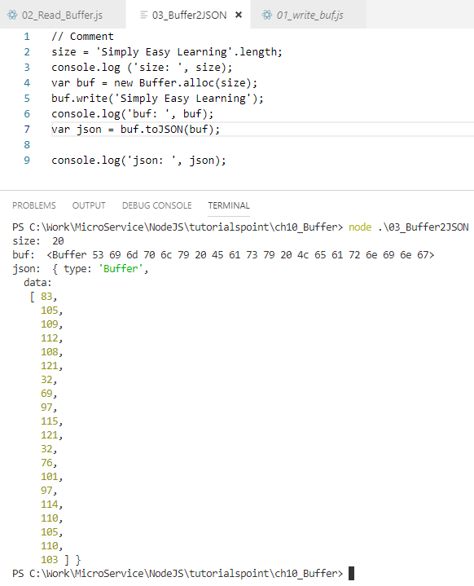
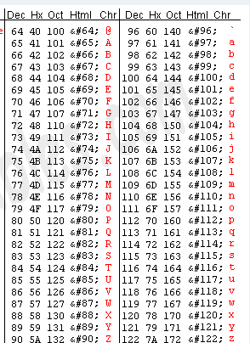
10 Buffer
https://www.tutorialspoint.com/nodejs/nodejs_npm.htm
Example

Slide 10
End of Chapter

