Slide 1

12 File
Peter H. Chen

Slide 2
12 File
https://www.tutorialspoint.com/nodejs/nodejs_streams.htm
File System
Node implements File I/O using simple wrappers around standard POSIX functions. The Node File System (fs) module can be imported using the following syntax −
var fs = require("fs“)

Slide 3
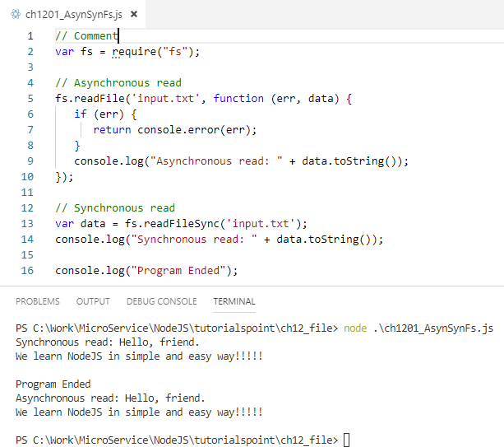
12 File
https://www.tutorialspoint.com/nodejs/nodejs_streams.htm
Synchronous vs Asynchronous
Every method in the fs module has synchronous as well as asynchronous forms. Asynchronous methods take the last parameter as the completion function callback and the first parameter of the callback function as error.
It is better to use an asynchronous method instead of a synchronous method, as the former never blocks a program during its execution, whereas the second one does.

Slide 4
12 File
https://www.tutorialspoint.com/nodejs/nodejs_streams.htm
Example

Slide 5
12 File
https://www.tutorialspoint.com/nodejs/nodejs_streams.htm
File
The following sections in this chapter provide a set of good examples on major File I/O methods.
Open a File
Syntax
Following is the syntax of the method to open a file in asynchronous mode
fs.open(path, flags[, mode], callback)
Parameters
Here is the description of the parameters used −
path − This is the string having file name including path.
flags − Flags indicate the behavior of the file to be opened. All possible values have been mentioned below.
mode − It sets the file mode (permission and sticky bits), but only if the file was created. It defaults to 0666, readable and writeable.
callback − This is the callback function which gets two arguments (err, fd).

Slide 6
12 File
https://www.tutorialspoint.com/nodejs/nodejs_streams.htm
Flags (1)
Flags for read/write operations are
No | Flag & Description
1 | r Open file for reading. An exception occurs if the file does not exist.
2 | r+ Open file for reading and writing. An exception occurs if the file does not exist.
3 | rs Open file for reading in synchronous mode.
4 | rs+ Open file for reading and writing, asking the OS to open it synchronously. See notes for 'rs' about using this with caution.
5 | w Open file for writing. The file is created (if it does not exist) or truncated (if it exists).
6 | wx Like 'w' but fails if the path exists.

Slide 7
12 File
https://www.tutorialspoint.com/nodejs/nodejs_streams.htm
Flags (2)
No | Flag & Description
7 | w+ Open file for reading and writing. The file is created (if it does not exist) or truncated (if it exists).
8 | wx+ Like 'w+' but fails if path exists.
9 | a Open file for appending. The file is created if it does not exist.
10 | ax Like 'a' but fails if the path exists.
11 | a+ Open file for reading and appending. The file is created if it does not exist.
12 | ax+ Like 'a+' but fails if the the path exists.

Slide 8
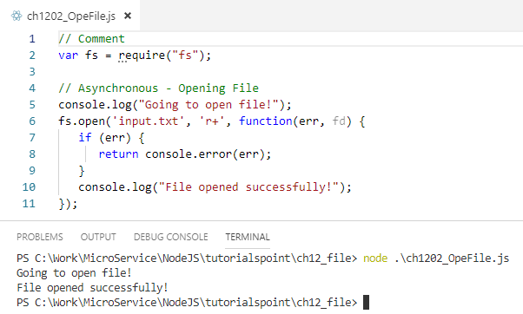
12 File
https://www.tutorialspoint.com/nodejs/nodejs_streams.htm
Example

Slide 9
12 File
https://www.tutorialspoint.com/nodejs/nodejs_streams.htm
Get File Information (1)
Syntax
Following is the syntax of the method to get the information about a file
fs.stat(path, callback)
Parameters
Here is the description of the parameters used −
path − This is the string having file name including path.
callback − This is the callback function which gets two arguments (err, stats) where stats is an object of fs.Stats type which is printed below in the example.
Apart from the important attributes which are printed below in the example, there are several useful methods available in fs.Stats class which can be used to check file type. These methods are given in the following table.

Slide 10
12 File
https://www.tutorialspoint.com/nodejs/nodejs_streams.htm
Get File Information (2)
No | Method & Description
1 | stats.isFile() Returns true if file type of a simple file.
2 | stats.isDirectory() Returns true if file type of a directory.
3 | stats.isBlockDevice() Returns true if file type of a block device.
4 | stats.isCharacterDevice() Returns true if file type of a character device.
5 | stats.isSymbolicLink() Returns true if file type of a symbolic link.
6 | stats.isFIFO() Returns true if file type of a FIFO.
7 | stats.isSocket() Returns true if file type of asocket.

Slide 11
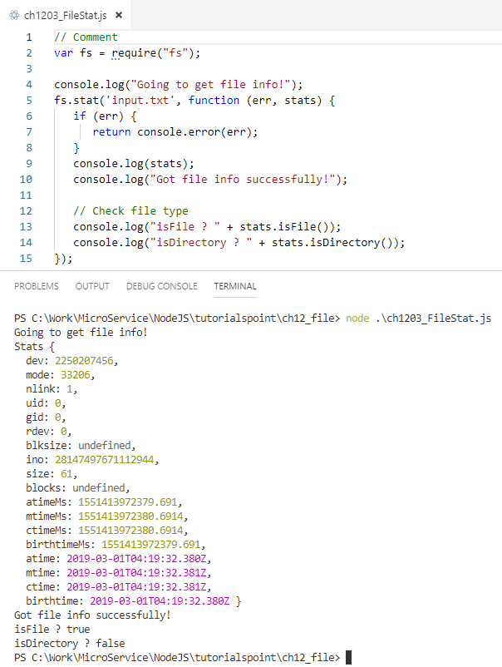
12 File
https://www.tutorialspoint.com/nodejs/nodejs_streams.htm
Example

Slide 12
12 File
https://www.tutorialspoint.com/nodejs/nodejs_streams.htm
Reading a File
Syntax
Following is the syntax of one of the methods to read from a file
fs.read(fd, buffer, offset, length, position, callback)
This method will use file descriptor to read the file. If you want to read the file directly using the file name, then you should use another method available.
Parameters
Here is the description of the parameters used −
fd − This is the file descriptor returned by fs.open().
buffer − This is the buffer that the data will be written to.
offset − This is the offset in the buffer to start writing at.
position − This is an integer specifying where to begin reading from in the file. If position is null, data will be read from the current file position.
callback − This is the callback function which gets the three arguments, (err, bytesRead, buffer).

Slide 13
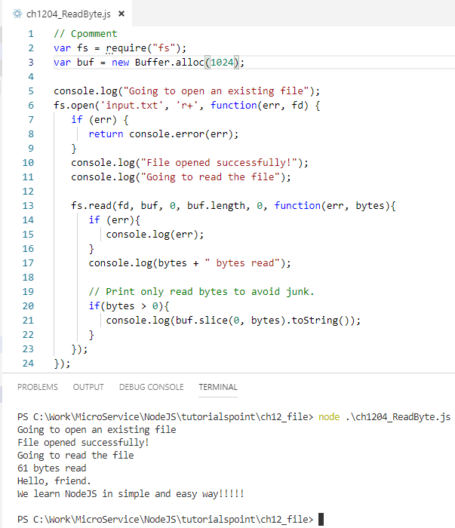
12 File
https://www.tutorialspoint.com/nodejs/nodejs_streams.htm
Example

Slide 14
12 File
https://www.tutorialspoint.com/nodejs/nodejs_streams.htm
Closing a File
Syntax
Following is the syntax to close an opened file
fs.close(fd, callback)
Parameters
Here is the description of the parameters used −
fd − This is the file descriptor returned by file fs.open() method.
callback − This is the callback function No arguments other than a possible exception are given to the completion callback.

Slide 15
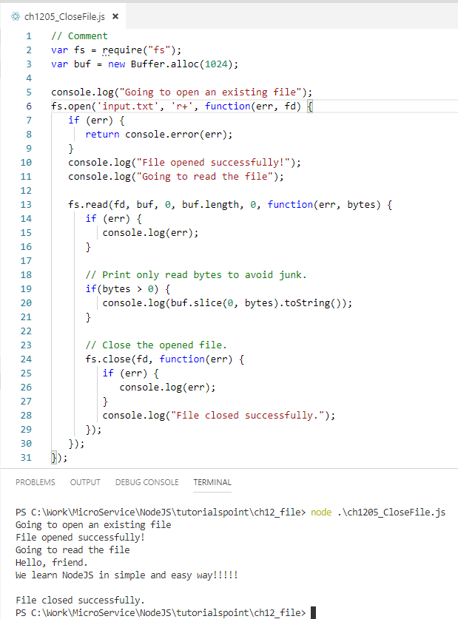
12 File
https://www.tutorialspoint.com/nodejs/nodejs_streams.htm
Example

Slide 16
12 File
https://www.tutorialspoint.com/nodejs/nodejs_streams.htm
Truncate a File
Syntax
Following is the syntax of the method to truncate an opened file
fs.ftruncate(fd, len, callback)
Parameters
Here is the description of the parameters used −
fd − This is the file descriptor returned by fs.open().
len − This is the length of the file after which the file will be truncated.
callback − This is the callback function No arguments other than a possible exception are given to the completion callback.

Slide 17
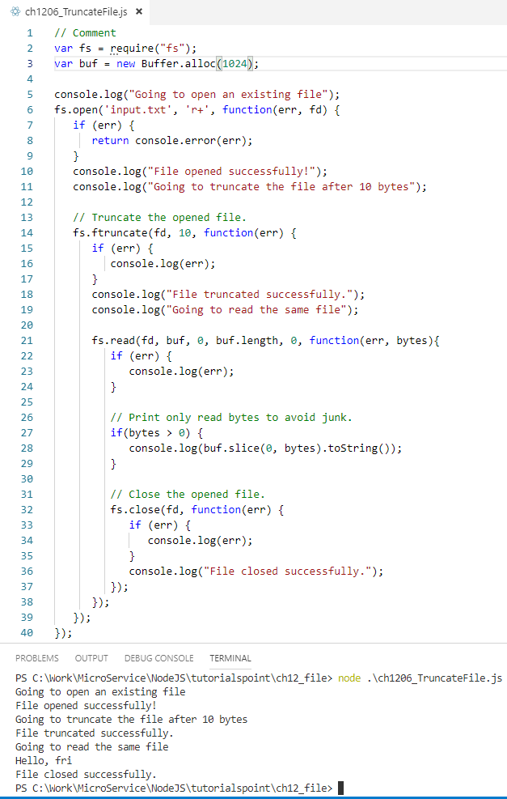
12 File
https://www.tutorialspoint.com/nodejs/nodejs_streams.htm
Example

Slide 18
12 File
https://www.tutorialspoint.com/nodejs/nodejs_streams.htm
Delete a File
Syntax
Following is the syntax of the method to delete a file
fs.unlink(path, callback)
Parameters
Here is the description of the parameters used −
path − This is the file name including path.
callback − This is the callback function No arguments other than a possible exception are given to the completion callback.

Slide 19
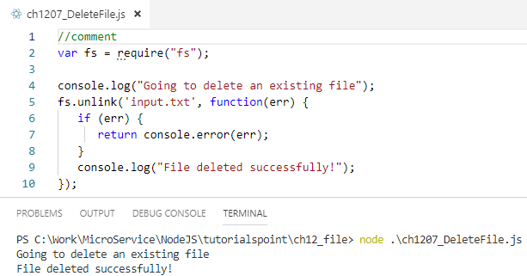
12 File
https://www.tutorialspoint.com/nodejs/nodejs_streams.htm
Example

Slide 20
12 File
https://www.tutorialspoint.com/nodejs/nodejs_streams.htm
Create a Directory
Syntax
Following is the syntax of the method to create a directory
fs.mkdir(path[, mode], callback)
Parameters
Here is the description of the parameters used −
path − This is the directory name including path.
mode − This is the directory permission to be set. Defaults to 0777.
callback − This is the callback function No arguments other than a possible exception are given to the completion callback.

Slide 21
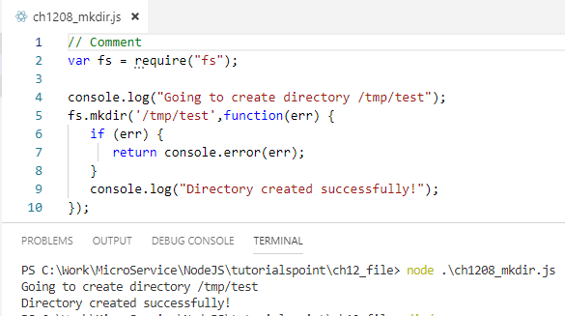
12 File
https://www.tutorialspoint.com/nodejs/nodejs_streams.htm
Example

Slide 22
12 File
https://www.tutorialspoint.com/nodejs/nodejs_streams.htm
Read a Directory
Syntax
Following is the syntax of the method to read a directory
fs.readdir(path, callback)
Parameters
Here is the description of the parameters used −
path − This is the directory name including path.
callback − This is the callback function which gets two arguments (err, files) where files is an array of the names of the files in the directory excluding '.' and '..'.

Slide 23
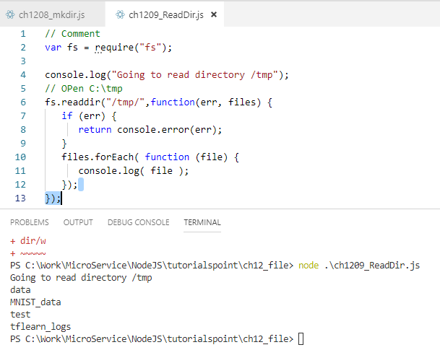
12 File
https://www.tutorialspoint.com/nodejs/nodejs_streams.htm
Example

Slide 24
12 File
https://www.tutorialspoint.com/nodejs/nodejs_streams.htm
Remove a Directory
Syntax
Following is the syntax of the method to remove a directory
fs.rmdir(path, callback)
Parameters
Here is the description of the parameters used −
path − This is the directory name including path.
callback − This is the callback function No arguments other than a possible exception are given to the completion callback.

Slide 25
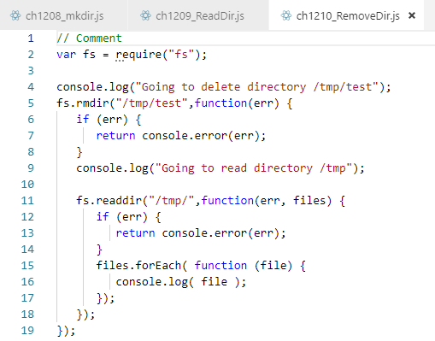
12 File
https://www.tutorialspoint.com/nodejs/nodejs_streams.htm
Example

Slide 26
End of Chapter

