Slide 1

Chapter 3: Visual Studio Editor
Peter H. Chen

Slide 2
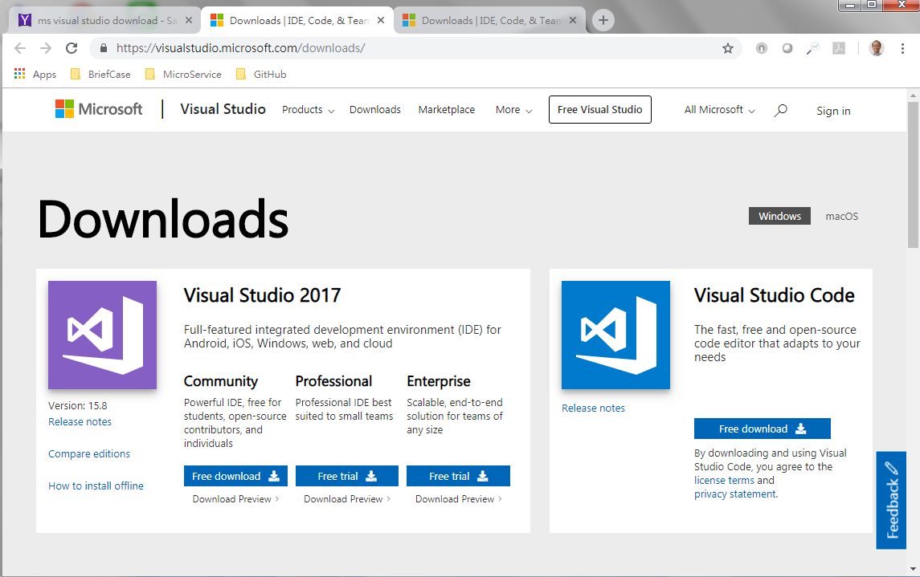
3 Visual Studio Editor
https://www.tutorialspoint.com/nodejs/nodejs_environment_setup.htm
We already have nodeJS setup already.
We need a text editor visual studio for program editing.
Download the Microsoft Visual Studio for editing. It is free.
https://visualstudio.microsoft.com/downloads/

Slide 3
End of Chapter

