Slide 1

Chapter 4: First Application
Peter H. Chen

Slide 2
4 First Application
https://www.tutorialspoint.com/nodejs/nodejs_first_application.htm
Before creating an actual "Hello, World!" application using Node.js, let us see the components of a Node.js application.
A Node.js application consists of the following three important components −
Import required modules − We use the require directive to load Node.js modules.
Create server − A server which will listen to client's requests similar to Apache HTTP Server.
Read request and return response − The server created in an earlier step will read the HTTP request made by the client which can be a browser or a console and return the response.

Slide 3
4.1 Create NodeJS Application

Slide 4
4.1 Create NodeJS Application
https://www.tutorialspoint.com/nodejs/nodejs_first_application.htm
Step 1 - Import Required Module
We use the require directive to load the http module and store the returned HTTP instance into an http variable as follows
var http = require("http");

Slide 5
4.1 Create NodeJS Application
https://www.tutorialspoint.com/nodejs/nodejs_first_application.htm
Step 2 - Create Server
We use the created http instance and call http.createServer() method to create a server instance and then we bind it at port 8081 using the listen method associated with the server instance.
Pass it a function with parameters request and response. Write the sample implementation to always return "Hello World"
http.createServer(function (request, response) {
// Send the HTTP header
// HTTP Status: 200 : OK
// Content Type: text/plain
response.writeHead(200, {'Content-Type': 'text/plain'});
// Send the response body as "Hello World"
response.end('Hello World\n');
}).listen(8081);
// Console will print the message
console.log('Server running at http://127.0.0.1:8081/');
The above code is enough to create an HTTP server which listens, i.e., waits for a request over 8081 port on the local machine.

Slide 6
4.1 Create NodeJS Application
https://www.tutorialspoint.com/nodejs/nodejs_first_application.htm
Step 3 - Testing Request & Response
Let's put step 1 and 2 together in a file called main.js and start our HTTP server as shown below
var http = require("http");
http.createServer(function (request, response) {
// Send the HTTP header
// HTTP Status: 200 : OK
// Content Type: text/plain
response.writeHead(200, {'Content-Type': 'text/plain'});
// Send the response body as "Hello World"
response.end('Hello World\n');
}).listen(8081);
// Console will print the message
console.log('Server running at http://127.0.0.1:8081/');
The above code is enough to create an HTTP server which listens, i.e., waits for a request over 8081 port on the local machine.

Slide 7
4.1 Create NodeJS Application
https://www.tutorialspoint.com/nodejs/nodejs_first_application.htm
Now execute the main.js to start the server as follows
$ node main.js
Verify the Output. Server has started.
Server running at http://127.0.0.1:8081/

Slide 8
4.2 Chrome Display

Slide 9
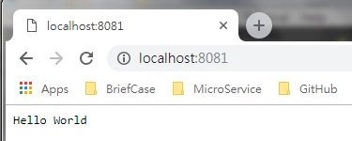
4.2 Chrome Display
https://www.tutorialspoint.com/nodejs/nodejs_first_application.htm
Open Chrome browser
Type: localhost:8081
You will get “Hello World”

Slide 10
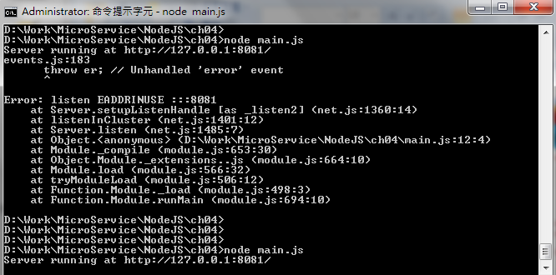
4.2 Chrome Display
https://www.tutorialspoint.com/nodejs/nodejs_first_application.htm
If you have multiple node execution on 8081 error as follow.
Use command “netstat -a -n -o” to see all the processes executed.
You can use “cntrol+

Slide 11
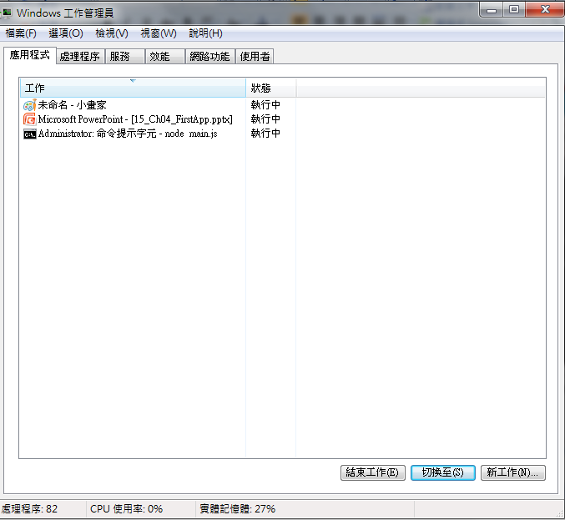
4.2 Chrome Display
https://www.tutorialspoint.com/nodejs/nodejs_first_application.htm
Use command “netstat -a -n -o” to see all the processes executed.
You can use “cntrol+alt+delete” to bring up the process manager as below.
Stop all the processes using port “8081” and restart “node main.js”

Slide 12
End of Chapter

