Slide 1

Chapter 6: npm
Peter H. Chen

Slide 2

6 npm
https://www.tutorialspoint.com/nodejs/nodejs_npm.htm
Node Package Manager (NPM) provides two main functionalities −
Online repositories for node.js packages/modules which are searchable on search.nodejs.org
Command line utility to install Node.js packages, do version management and dependency management of Node.js packages.
NPM comes bundled with Node.js installable after v0.6.3 version. To verify the same, open console and type the following command and see the result
$ npm --version
4.2.0

Slide 3
6.2 Global vs. Local Installation

Slide 4
6.1 Global vs. Local Installation
https://www.tutorialspoint.com/nodejs/nodejs_npm.htm
By default, NPM installs any dependency in the local mode. Here local mode refers to the package installation in node_modules directory lying in the folder where Node application is present.
Locally deployed packages are accessible via require() method. For example, when we installed express module, it created node_modules directory in the current directory where it installed the express module.
$ ls -l
total 0
drwxr-xr-x 3 root root 20 Mar 17 02:23 node_modules

Slide 5
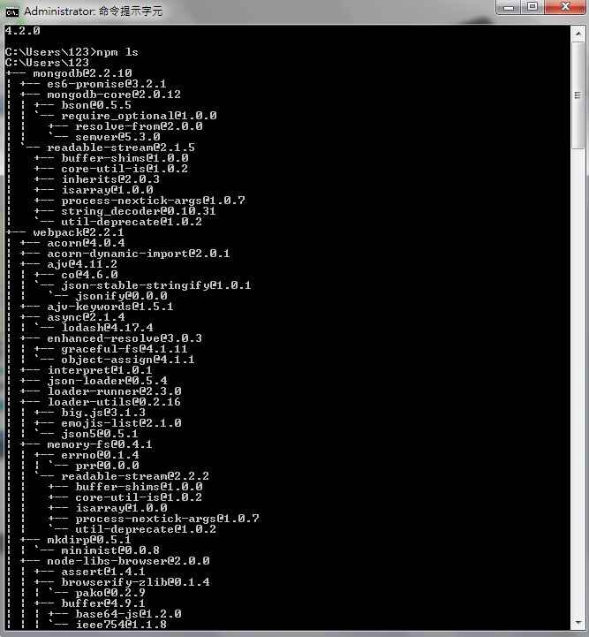
6.1 Global vs. Local Installation
https://www.tutorialspoint.com/nodejs/nodejs_npm.htm
Alternatively, you can use npm ls command to list down all the locally installed modules.

Slide 6
6.1 Global vs. Local Installation
https://www.tutorialspoint.com/nodejs/nodejs_npm.htm
Globally installed packages/dependencies are stored in system directory.
Such dependencies can be used in CLI (Command Line Interface) function of any node.js but cannot be imported using require() in Node application directly.
Now let's try installing the express module using global installation.
$ ls -l
total 0
drwxr-xr-x 3 root root 20 Mar 17 02:23 node_modules

Slide 7
End of Chapter

