Slide 1

11 Stream
Peter H. Chen

Slide 2
11 Stream
https://www.tutorialspoint.com/nodejs/nodejs_streams.htm
What are Streams?
Streams are objects that let you read data from a source or write data to a destination in continuous fashion. In Node.js, there are four types of streams −
Readable − Stream which is used for read operation.
Writable − Stream which is used for write operation.
Duplex − Stream which can be used for both read and write operation.
Transform − A type of duplex stream where the output is computed based on input.

Slide 3
11 Stream
https://www.tutorialspoint.com/nodejs/nodejs_streams.htm
Each type of Stream is an EventEmitter instance and throws several events at different instance of times.
For example, some of the commonly used events are −
data − This event is fired when there is data is available to read.
end − This event is fired when there is no more data to read.
error − This event is fired when there is any error receiving or writing data.
finish − This event is fired when all the data has been flushed to underlying system.
This document provides a basic understanding of the commonly used operations on Streams.

Slide 4
11.2 Reading from a Stream

Slide 5
11.2 Reading from a Stream
https://www.tutorialspoint.com/nodejs/nodejs_streams.htm
Create a text file named input.txt having the following content.
Tutorials Point is giving self learning content
to teach the world in simple and easy way!!!!!
Create a js file named main.js with the following code:

Slide 6
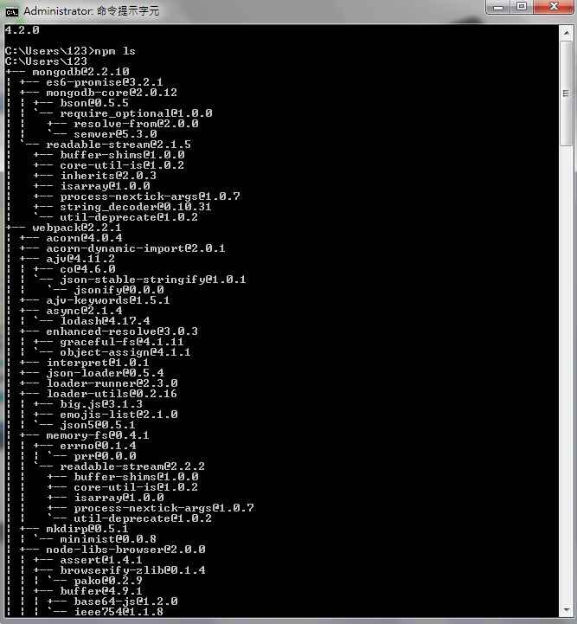
6.2 Global vs. Local Installation
https://www.tutorialspoint.com/nodejs/nodejs_npm.htm
Alternatively, you can use npm ls command to list down all the locally installed modules.

Slide 7
6.2 Global vs. Local Installation
https://www.tutorialspoint.com/nodejs/nodejs_npm.htm
Globally installed packages/dependencies are stored in system directory.
Such dependencies can be used in CLI (Command Line Interface) function of any node.js but cannot be imported using require() in Node application directly.
Now let's try installing the express module using global installation.
$ ls -l
total 0
drwxr-xr-x 3 root root 20 Mar 17 02:23 node_modules

Slide 8
End of Chapter

