Slide 1

8 Event Loop
Peter H. Chen

Slide 2
8 Event Loop
https://www.tutorialspoint.com/nodejs/nodejs_npm.htm
Event Loop
Node.js is a single-threaded application, but it can support concurrency via the concept of event and callbacks.
Every API of Node.js is asynchronous and being single-threaded, they use async function calls to maintain concurrency.
Node uses observer pattern. Node thread keeps an event loop and whenever a task gets completed, it fires the corresponding event which signals the event-listener function to execute.

Slide 3
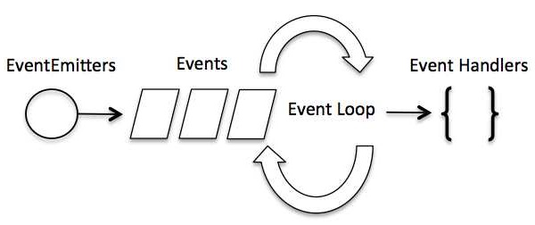
8 Event Loop
https://www.tutorialspoint.com/nodejs/nodejs_npm.htm
Event-Driven Programming (1)
Node.js uses events heavily and it is also one of the reasons why Node.js is pretty fast compared to other similar technologies.
As soon as Node starts its server, it simply initiates its variables, declares functions and then simply waits for the event to occur.
In an event-driven application, there is generally a main loop that listens for events, and then triggers a callback function when one of those events is detected.

Slide 4
8 Event Loop
https://www.tutorialspoint.com/nodejs/nodejs_npm.htm
Event-Driven Programming (2)
Although events look quite similar to callbacks, the difference lies in the fact that callback functions are called when an asynchronous function returns its result, whereas event handling works on the observer pattern.
The functions that listen to events act as Observers. Whenever an event gets fired, its listener function starts executing.
Node.js has multiple in-built events available through events module and EventEmitter class which are used to bind events and event-listeners as follows

Slide 5
8 Event Loop
https://www.tutorialspoint.com/nodejs/nodejs_npm.htm
Event-Driven Programming (2)
Although events look quite similar to callbacks, the difference lies in the fact that callback functions are called when an asynchronous function returns its result, whereas event handling works on the observer pattern.
The functions that listen to events act as Observers. Whenever an event gets fired, its listener function starts executing.
Node.js has multiple in-built events available through events module and EventEmitter class which are used to bind events and event-listeners as follows
// Import events module
var events = require('events’);
// Create an eventEmitter object
var eventEmitter = new events.EventEmitter();

Slide 6
8 Event Loop
https://www.tutorialspoint.com/nodejs/nodejs_npm.htm
Event-Driven Programming (3)
Following is the syntax to bind an event handler with an event
// Bind event and event handler as follows eventEmitter.on('eventName', eventHandler);
We can fire an event programmatically as follows:
// Fire an event
eventEmitter.emit('eventName');

Slide 7
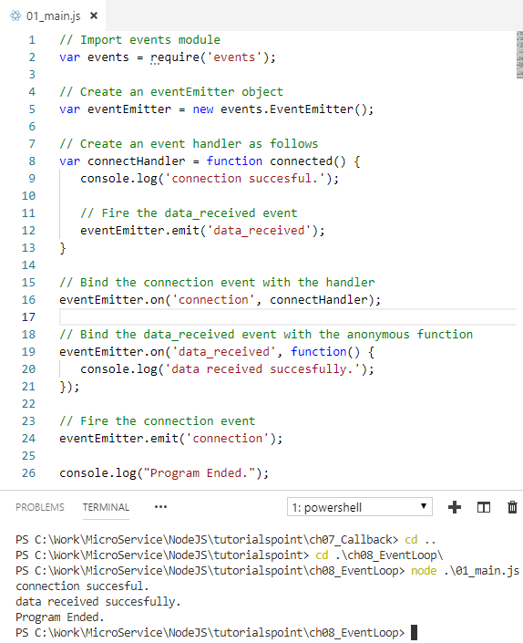
8 Event Loop
https://www.tutorialspoint.com/nodejs/nodejs_npm.htm
Event-Driven Programming (4)
Event emit example
Emit/Fire connection
Emit/Fire data received.

Slide 8
End of Chapter

