Slide 1

13 Global Object
Peter H. Chen

Slide 2
13 Global Object
https://www.tutorialspoint.com/nodejs/nodejs_streams.htm
Node.js global objects are global in nature and they are available in all modules.
We do not need to include these objects in our application, rather we can use them directly.
These objects are modules, functions, strings, and object itself as explained below.

Slide 3
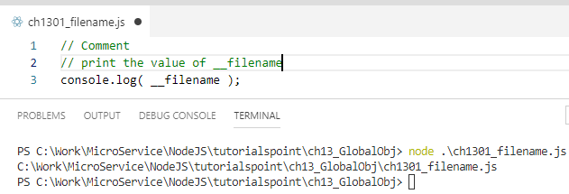
13 Global Object
https://www.tutorialspoint.com/nodejs/nodejs_streams.htm
__filename
The __filename represents the filename of the code being executed.
This is the resolved absolute path of this code file.
For a main program, this is not necessarily the same filename used in the command line.
The value inside a module is the path to that module file.
Example

Slide 4
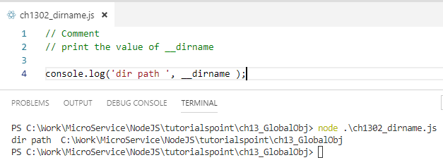
13 Global Object
https://www.tutorialspoint.com/nodejs/nodejs_streams.htm
__dirname
The __dirname represents the name of the directory that the currently executing script resides in.
Example

Slide 5
End of Chapter

