Slide 1

7 Code Structure
Peter H. Chen

Slide 2
7 Code Structure
https://www.tutorialspoint.com/spring_boot/spring_boot_code_structure.htm
Spring Boot does not have any code layout to work with.
However, there are some best practices that will help us.
This chapter talks about them in detail.

Slide 3
6.1 Default Package

Slide 4
6.1 Default Package
https://www.tutorialspoint.com/spring_boot/spring_boot_code_structure.htm
A class that does not have any package declaration is considered as a default package.
Note that generally a default package declaration is not recommended.
Spring Boot will cause issues such as malfunctioning of Auto Configuration or Component Scan, when you use default package.
Note − Java's recommended naming convention for package declaration is reversed domain name.
For example − com.tutorialspoint.myproject

Slide 5
6.2 Typical Layout

Slide 6
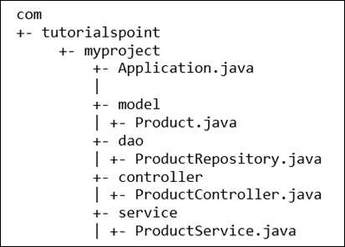
6.2 Typical Layout
https://www.tutorialspoint.com/spring_boot/spring_boot_code_structure.htm
The typical layout of Spring Boot application is shown in the image given below

Slide 7
6.2 Typical Layout
https://www.tutorialspoint.com/spring_boot/spring_boot_code_structure.htm
The Application.java file should declare the main method along with @SpringBootApplication.
Observe the code given below for a better understanding
package com.tutorialspoint.myproject;
import org.springframework.boot.SpringApplication;
import org.springframework.boot.autoconfigure.SpringBootApplication;
@SpringBootApplication
public class Application {
public static void main(String[] args) {
SpringApplication.run(Application.class, args);
}
}

Slide 8
End of Chapter

