Slide 1

3 Quick Start
Peter H. Chen

Slide 2

3 Introduction
https://www.tutorialspoint.com/spring_boot/spring_boot_quick_start.htm
This chapter will teach you how to create a Spring Boot application using Maven and Gradle.
Download spring-boot-cli from : https://docs.spring.io/spring-boot/docs/current/reference/html/getting-started-installing-spring-boot.html#getting-started-installing-the-cli
Unzip and put into “C:\Sping\spring-boot-cli-2.0.5”
Setup Environment variable: PSRING_BOOT_HOME= “C:\Spring\Spring-boot-cli-2.0.5”
Setup Environment variable: PATH = %PRING_BOOT_HOME\bin”; …
Start command window and type: spring --version

Slide 3
3.1 Setup Spring Boot
Peter H. Chen

Slide 4

3.1 Setup Spring
https://www.tutorialspoint.com/spring_boot/spring_boot_quick_start.htm
Download spring-boot-cli from : https://docs.spring.io/spring-boot/docs/current/reference/html/getting-started-installing-spring-boot.html#getting-started-installing-the-cli
SPRING_BOOT_HOME= “C:\Spring\spring-boot-cli-2.0.5
PATH = %SPRING_BOO_HOME%\bin;…
C:\> spring --version

Slide 5
3.2 Setup Maven
Peter H. Chen

Slide 6
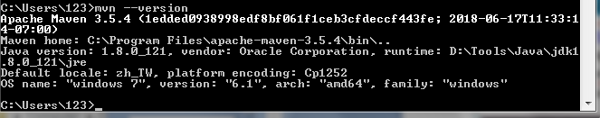
3.2 Setup Maven
https://www.tutorialspoint.com/spring_boot/spring_boot_quick_start.htm
Download Maven from : https://www-us.apache.org/dist/maven/
Unzip and put under C:\Program Files\Apache\maven
Set M2_HOME = “C:\Program Files\Apache\maven”
Set PATH =%M2_HOME%\bin;

Slide 7
3.3 Setup Gradle
Peter H. Chen

Slide 8
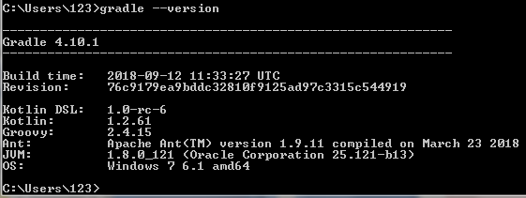
3.3 Setup Gradle
https://www.tutorialspoint.com/spring_boot/spring_boot_quick_start.htm
Download Gradle from : https://gradle.org/releases/
Unzip and put under C:\Spring\Gradle
Set GRADLE_HOME = “C:\Spring\Gradle”
Set PATH =%GRADLE_HOME%\bin;

Slide 9
3.4 Edit Hello.groovy
Peter H. Chen

Slide 10
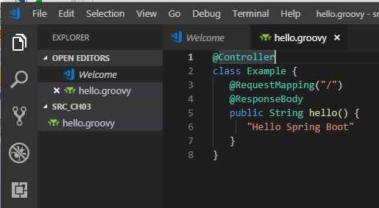
3.4 Edit Hello.groovy
https://www.tutorialspoint.com/spring_boot/spring_boot_quick_start.htm
Code: Hello.groovy

Slide 11
3.5 Run Hello.groovy
Peter H. Chen

Slide 12
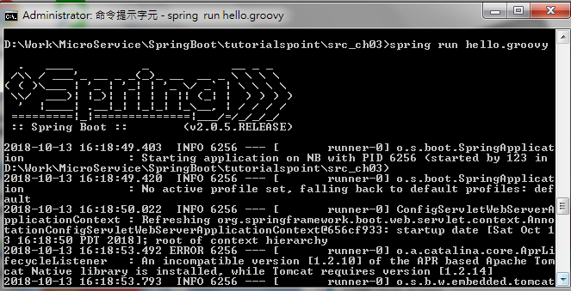
3.5 Run Hello.groovy
https://www.tutorialspoint.com/spring_boot/spring_boot_quick_start.htm
Change directory to “Hello.groovy” locaiton
Type : spring run hello.groovy

Slide 13
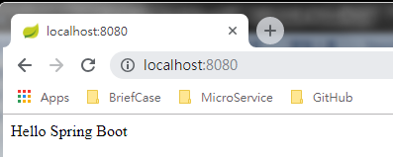
3.5 Run Hello.groovy
https://www.tutorialspoint.com/spring_boot/spring_boot_quick_start.htm
Open chrome
Type: “localhost:8080”
Chrome display “Hello Spring Boot” by the code “hello.groovy”

Slide 14
End of Chapter

