Slide 1

4 Bootstrapping
Peter H. Chen

Slide 2
4 Bootstrapping
https://www.tutorialspoint.com/spring_boot/spring_boot_bootstrapping.htm
This chapter will explain you how to perform bootstrapping on a Spring Boot application.

Slide 3
4.1 Spring Initializer

Slide 4
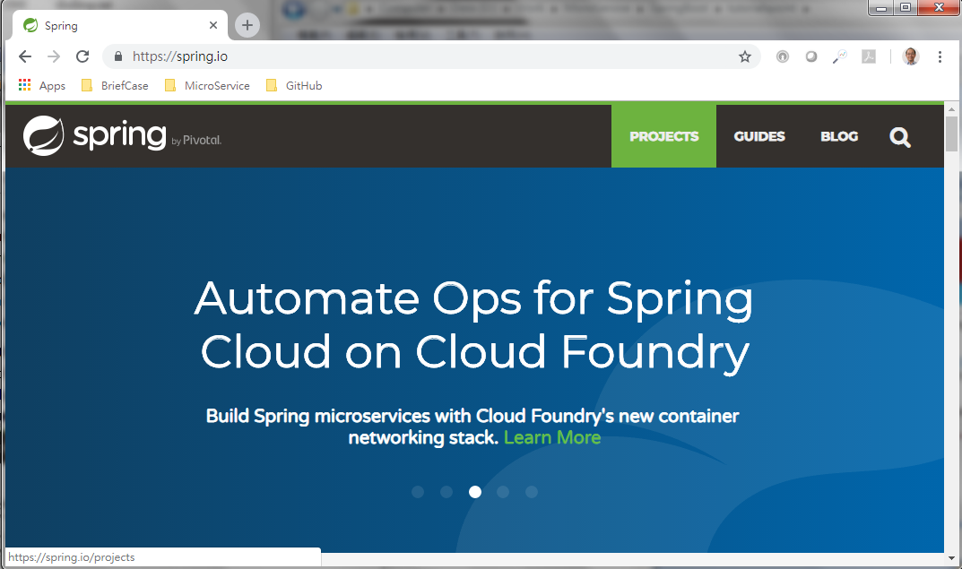
4.1 Spring Initializer
https://www.tutorialspoint.com/spring_boot/spring_boot_bootstrapping.htm
One of the ways to Bootstrapping a Spring Boot application is by using Spring Initializer.
Go to https.spring.io
Select Projects

Slide 5
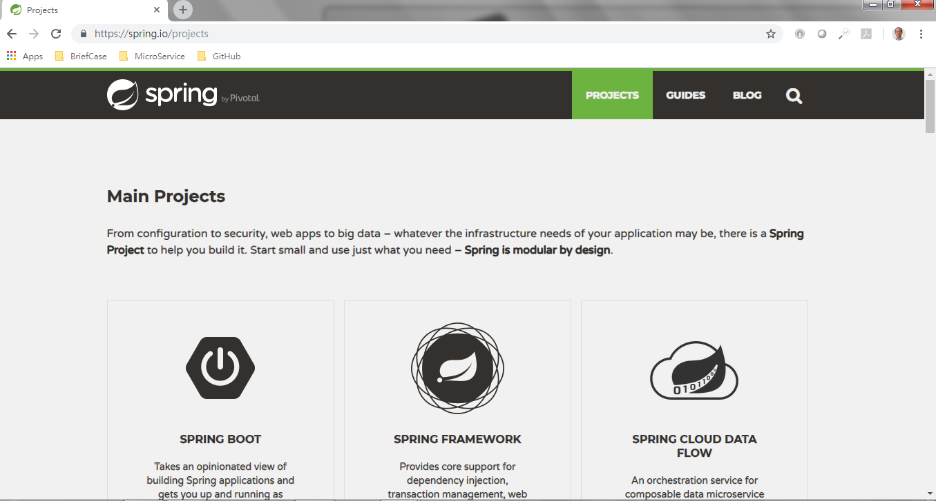
4.1 Spring Initializer
https://www.tutorialspoint.com/spring_boot/spring_boot_bootstrapping.htm
Select Spring Boot

Slide 6
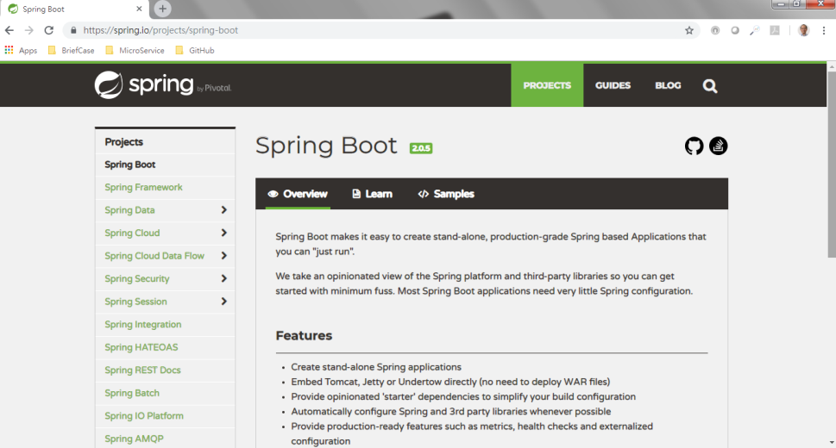
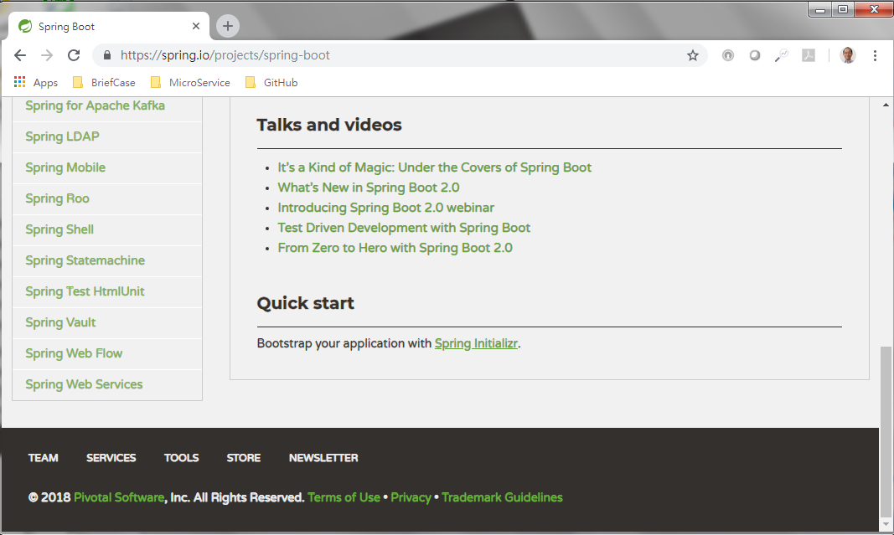
4.1 Spring Initializer
https://www.tutorialspoint.com/spring_boot/spring_boot_bootstrapping.htm
Select Spring Boot
Scroll down to bottom of Spring Boot window.
Select Quick Start Spring Initializr.

Slide 7
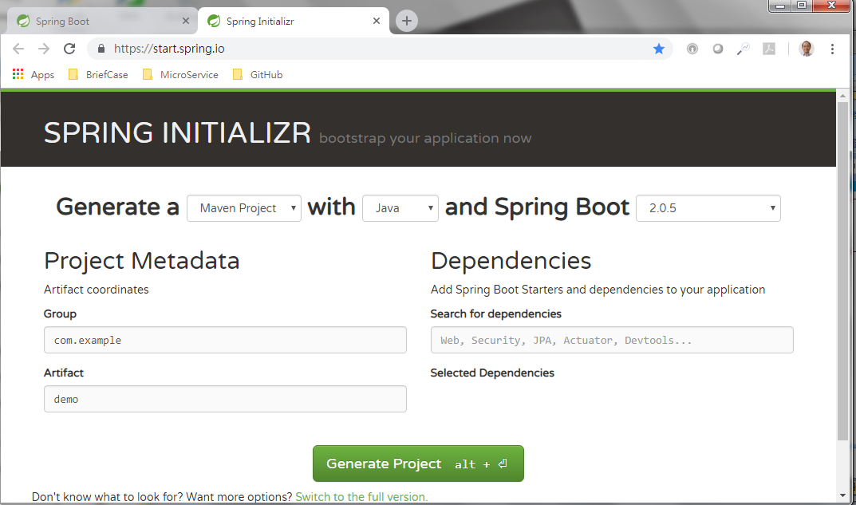
4.1 Spring Initializer
https://www.tutorialspoint.com/spring_boot/spring_boot_bootstrapping.htm
Spring Initializr Window.

Slide 8
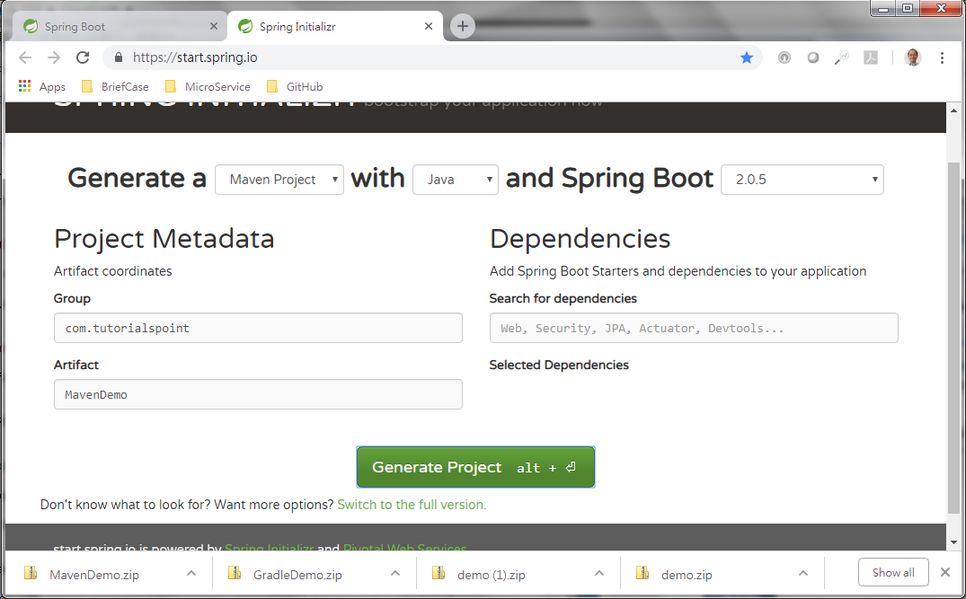
4.1 Spring Initializer
https://www.tutorialspoint.com/spring_boot/spring_boot_bootstrapping.htm
Generate MavenDemo.zip: Specify Artifact: MavenDemo
MavenDemo
Generate MavenDemo.zip

Slide 9
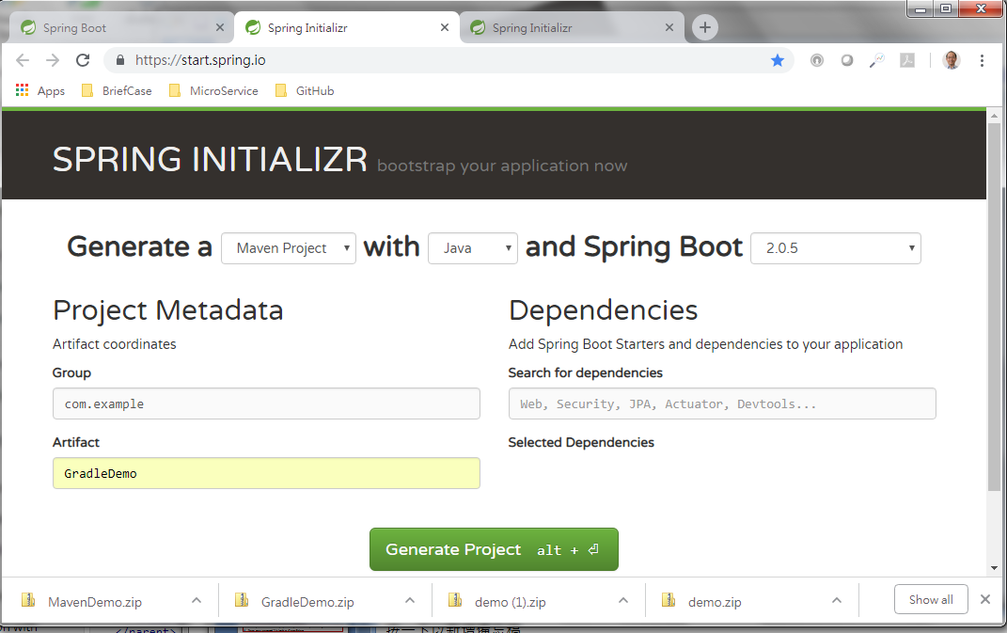
4.1 Spring Initializer
https://www.tutorialspoint.com/spring_boot/spring_boot_bootstrapping.htm
Generate GradelDemo.zip: Specify Artifact: GradleDemo
GradleDemo
Generate GradleDemo.zip

Slide 10
4.2 Maven

Slide 11
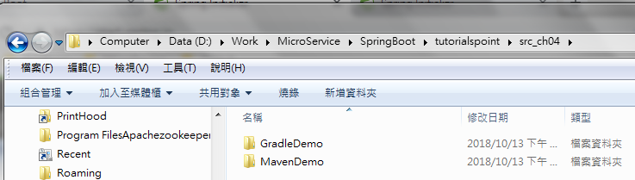
4.2 Maven
https://www.tutorialspoint.com/spring_boot/spring_boot_bootstrapping.htm
Unzip GradelDemo.zip and MavenDemo.zip as follow:

Slide 12
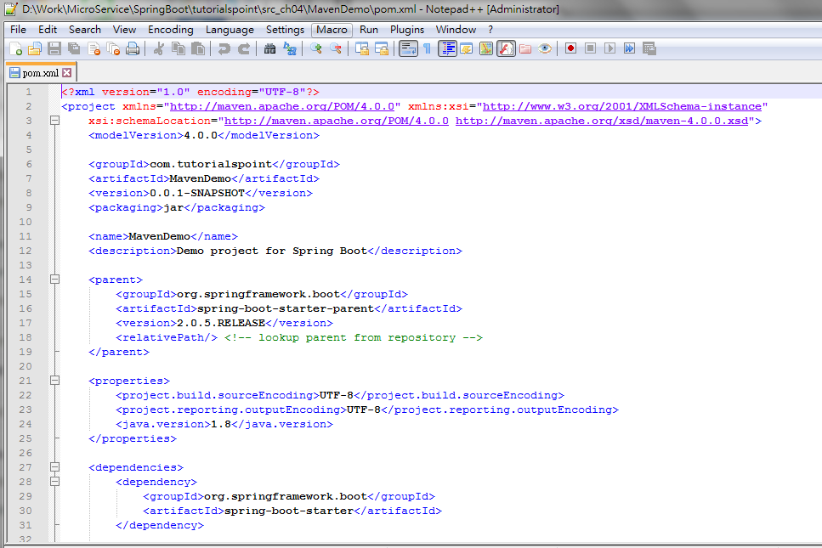
4.2 Maven
https://www.tutorialspoint.com/spring_boot/spring_boot_bootstrapping.htm
Open MavenDemo directory.
The pom.xml file looks as shown below

Slide 13
4.3 Gradle

Slide 14
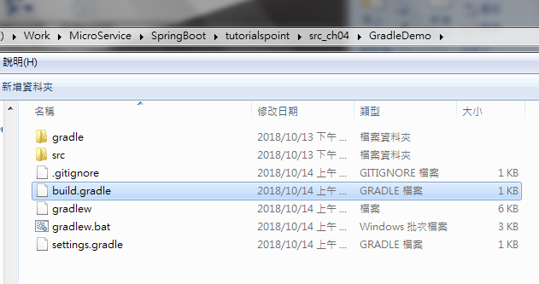
4.3 Gradle
https://www.tutorialspoint.com/spring_boot/spring_boot_bootstrapping.htm
Open the GradleDemo folder.
There is file build.gradle.

Slide 15
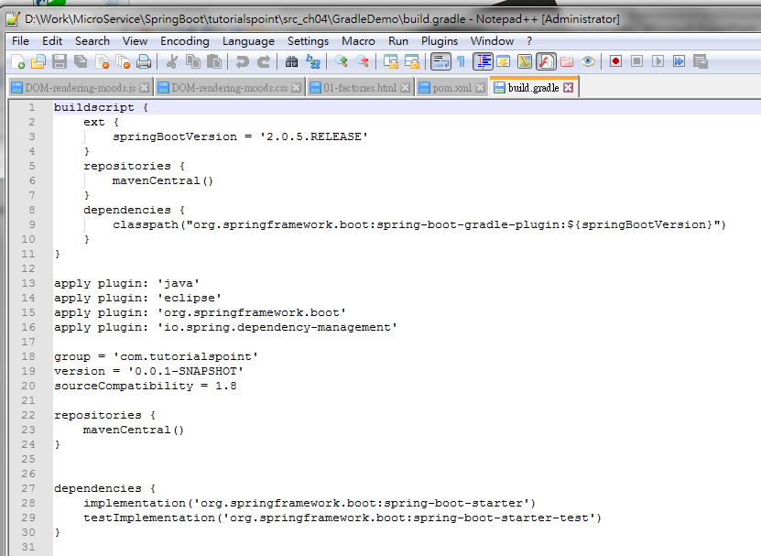
4.3 Gradle
https://www.tutorialspoint.com/spring_boot/spring_boot_bootstrapping.htm
The build.gradle is as follow:

Slide 16
4.4 Class Path Dependencies

Slide 17
4.4 Class Path Dependencies
https://www.tutorialspoint.com/spring_boot/spring_boot_bootstrapping.htm
Spring Boot provides a number of Starters to add the jars in our class path.
For example, for writing a Rest Endpoint, we need to add the spring-boot-starter-web dependency in our class path.
Observe the codes shown below for a better understanding

Slide 18
4.4 Class Path Dependencies
https://www.tutorialspoint.com/spring_boot/spring_boot_bootstrapping.htm
Maven dependency
<dependencies>
<dependency>
<groupId>org.springframework.boot</groupId>
<artifactId>spring-boot-starter</artifactId>
</dependency>
<dependency>
<groupId>org.springframework.boot</groupId>
<artifactId>spring-boot-starter-test</artifactId>
<scope>test</scope>
</dependency>
</dependencies>
<dependencies>
<dependency>
<groupId>org.springframework.boot</groupId>
<artifactId>spring-boot-starter-web</artifactId>
</dependency>
<dependency>
<groupId>org.springframework.boot</groupId>
<artifactId>spring-boot-starter-test</artifactId>
<scope>test</scope>
</dependency>
</dependencies>

Slide 19
4.4 Class Path Dependencies
https://www.tutorialspoint.com/spring_boot/spring_boot_bootstrapping.htm
Gradle dependency
dependencies {
implementation('org.springframework.boot:spring-boot-starter')
testImplementation('org.springframework.boot:spring-boot-starter-test')
}
dependencies {
implementation('org.springframework.boot:spring-boot-starter-web')
testImplementation('org.springframework.boot:spring-boot-starter-test')
}

Slide 20
4.5 Java Main Method

Slide 21
4.5 Java Main Method
https://www.tutorialspoint.com/spring_boot/spring_boot_bootstrapping.htm
The main method should be writing the Spring Boot Application class. This class should be annotated with @SpringBootApplication.
This is the entry point of the spring boot application to start. You can find the main class file under src/java/main directories with the default package.
In this example, the main class file is located at the src/java/main directories with the default package com.tutorialspoint.demo.

Slide 22
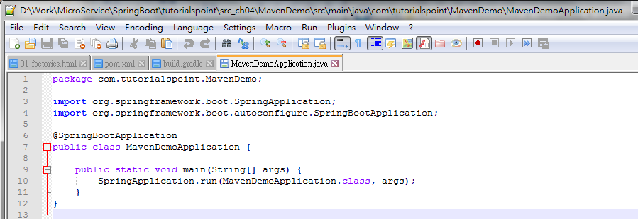
4.5 Java Main Method
https://www.tutorialspoint.com/spring_boot/spring_boot_bootstrapping.htm
Observe the code shown here for a better understanding
package com.tutorialspoint.MavenDemo;
import org.springframework.boot.SpringApplication;
import org.springframework.boot.autoconfigure.SpringBootApplication;
@SpringBootApplication
public class MavenDemoApplication {
public static void main(String[] args) {
SpringApplication.run(MavenDemoApplication.class, args);
}
}

Slide 23
4.5 Java Main Method
https://www.tutorialspoint.com/spring_boot/spring_boot_bootstrapping.htm
Write a Rest Endpoint
To write a simple Hello World Rest Endpoint in the Spring Boot Application main class file itself, follow the steps shown below −
Firstly, add the @RestController annotation at the top of the class.
Now, write a Request URI method with @RequestMapping annotation.
Then, the Request URI method should return the Hello World string.
Now, your main Spring Boot Application class file will look like as shown in the code given below

Slide 24
4.5 Java Main Method
https://www.tutorialspoint.com/spring_boot/spring_boot_bootstrapping.htm
Code modify as follow:
package com.tutorialspoint.MavenDemo;import org.springframework.boot.SpringApplication;import org.springframework.boot.autoconfigure.SpringBootApplication;
// Add RestControllerimport org.springframework.web.bind.annotation.RequestMapping;import org.springframework.web.bind.annotation.RestController;@SpringBootApplication
// Add Rest Controller
@RestControllerpublic class MavenDemoApplication {
public static void main(String[] args) {
SpringApplication.run(MavenDemoApplication.class, args);
}
@RequestMapping(value = "/")
public String hello() {
return "Hello World";
}
}

Slide 25
4.6 Create an Executable JAR

Slide 26
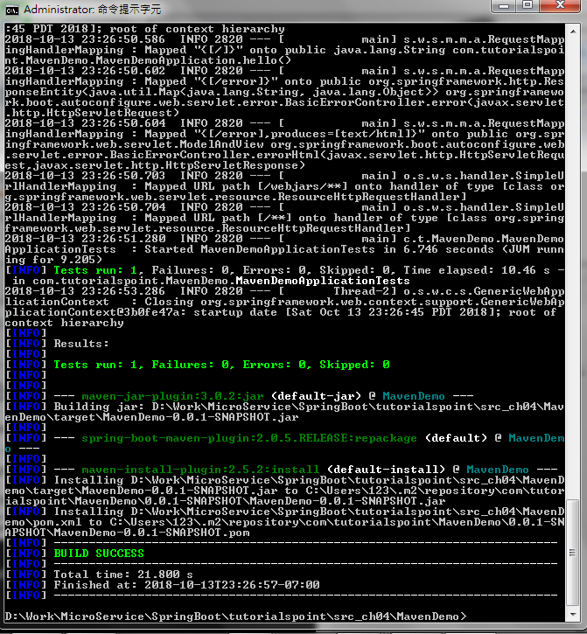
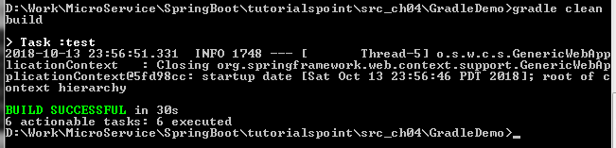
4.6 Create an Executable JAR
https://www.tutorialspoint.com/spring_boot/spring_boot_bootstrapping.htm
Create an Executable JAR:
C:\> MavenDemo> mvb clean install
Create an Executable JAR:
C:\> GradleDemo> gradle clean build

Slide 27
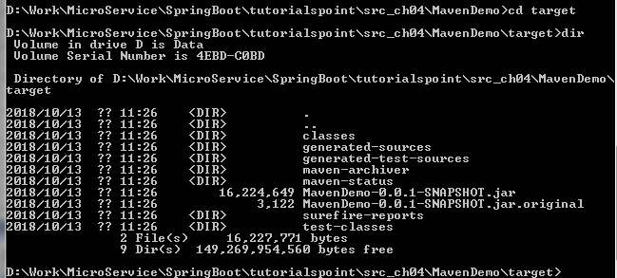
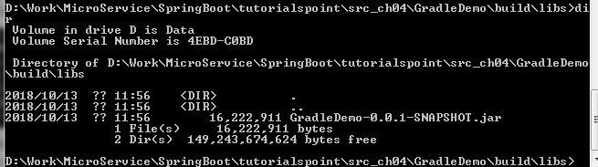
4.6 Create an Executable JAR
https://www.tutorialspoint.com/spring_boot/spring_boot_bootstrapping.htm
For Maven:
C:\> cd target
C:\> dir
For Gradle:
C:\> cd build\libs
C:\> dir

Slide 28
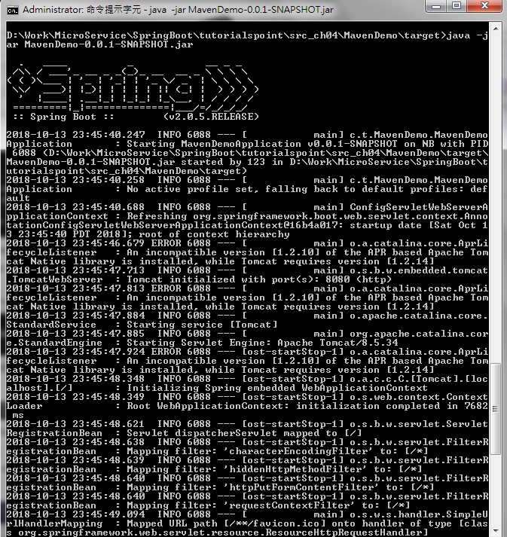
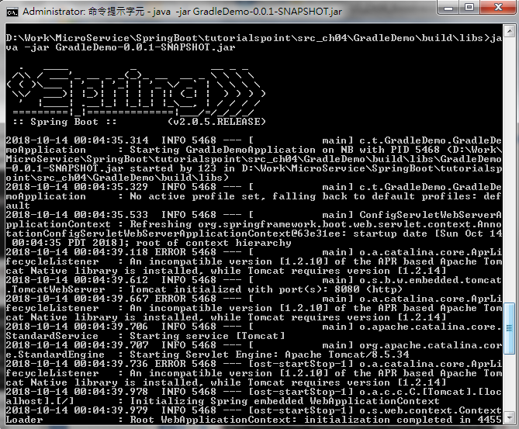
4.6 Create an Executable JAR
https://www.tutorialspoint.com/spring_boot/spring_boot_bootstrapping.htm
For Maven:
C:\> cd >target
C:\>java –jar MavenDemo-0.0.1-SNAPSHOT.jar
For Gradle:
C:\> cd build\libs
C:\>java –jar MavenDemo-0.0.1-SNAPSHOT.jar

Slide 29
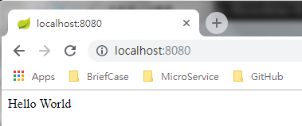
4.6 Create an Executable JAR
https://www.tutorialspoint.com/spring_boot/spring_boot_bootstrapping.htm
For Maven:
Open Chrome and Enter: “localhost:8080”
For Gradle:
Open Chrome and Enter: “localhost:8080”

Slide 30
End of Chapter

