Slide 1

5 Tomcat Deployment
Peter H. Chen

Slide 2
5 Tomcat Deployment
https://www.tutorialspoint.com/spring_boot/spring_boot_tomcat_deployment.htm
By using Spring Boot application, we can create a war file to deploy into the web server.
In this chapter, you are going to learn how to create a WAR file and deploy the Spring Boot application in Tomcat web server

Slide 3
5 Tomcat Deployment
https://www.tutorialspoint.com/spring_boot/spring_boot_tomcat_deployment.htm
Go to spring.io to specify artifact for “TomcatMavenDemo” and “TomcatGradleDemo”.
Unip them into your working directory.

Slide 4
5.1 pom.xml

Slide 5
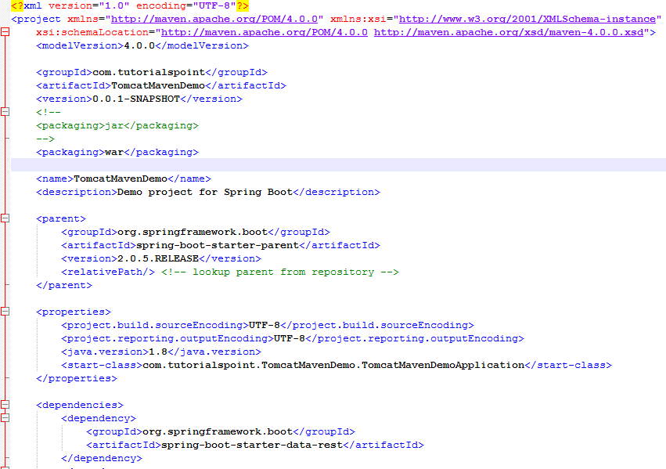
5.1 pom.xml
https://www.tutorialspoint.com/spring_boot/spring_boot_tomcat_deployment.htm
Pom.xml: Change <packaging>war</packaging>

Slide 6
5.2 Java Code

Slide 7
5.2 Java Code
https://www.tutorialspoint.com/spring_boot/spring_boot_tomcat_deployment.htm
The traditional way of deployment is making the Spring Boot Application @SpringBootApplication class extend the SpringBootServletInitializer class.
Spring Boot Servlet Initializer class file allows you to configure the application when it is launched by using Servlet Container.

Slide 8
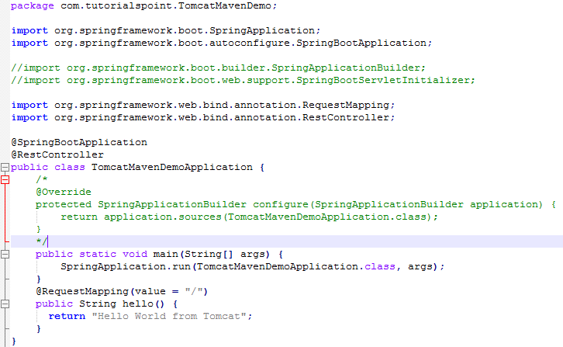
5.2 Java Code
https://www.tutorialspoint.com/spring_boot/spring_boot_tomcat_deployment.htm
The code for Spring Boot Application class file for JAR file deployment is given below:

Slide 9
5.3 mvn packaging

Slide 10
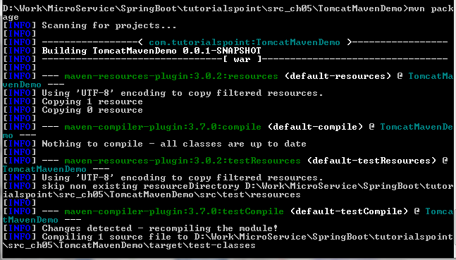
5.3 mvn packaging
https://www.tutorialspoint.com/spring_boot/spring_boot_tomcat_deployment.htm
Build war: mvn packaging

Slide 11
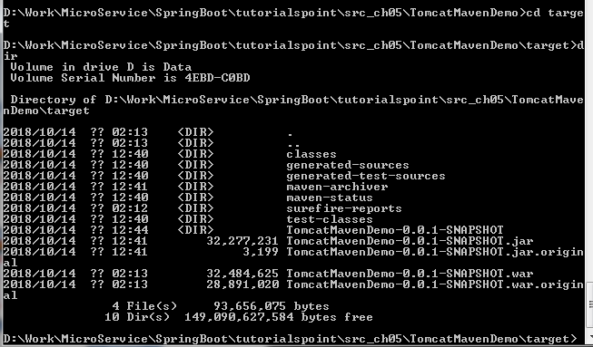
5.3 mvn packaging
https://www.tutorialspoint.com/spring_boot/spring_boot_tomcat_deployment.htm
D:\> cd target
D:\> dir

Slide 12
5.4 Deploy into Tomcat

Slide 13
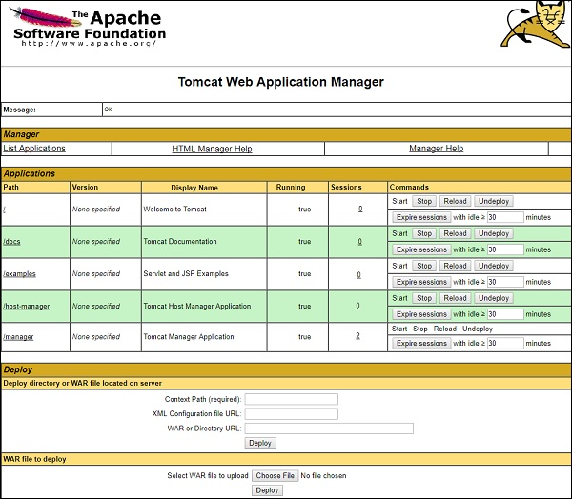
5.4 Deploy into Tomcat
https://www.tutorialspoint.com/spring_boot/spring_boot_tomcat_deployment.htm
Run Apache server: copy war file to webapps directory
Start apach tomcat

Slide 14
5.5 Display on Browser

Slide 15
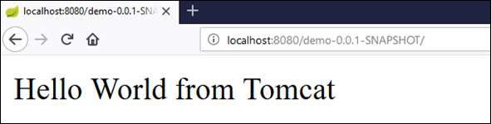
5.5 Deploy on Browser
https://www.tutorialspoint.com/spring_boot/spring_boot_tomcat_deployment.htm
Open Browser
Enter “http://localhost:8080/demo-0.0.1-SNAPSHOT/”

Slide 16
End of Chapter

