Slide 1

25 Customize Spring Boot
Peter H. Chen

Slide 2
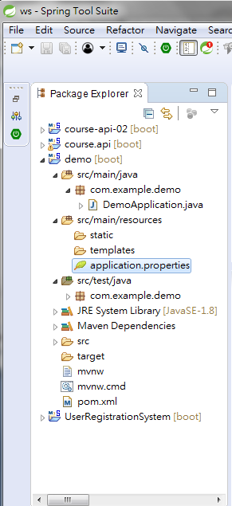

25 Customize Spring Boot IDE
https://www.youtube.com/watch?v=E7_a-kB46LU&list=PLqq-6Pq4lTTbx8p2oCgcAQGQyqN8XeA1x&index=9
80% you don’t need to customize.
There is properties file in resource folder.

Slide 3
End of Chapter

